Slide 1
IT MANAGEMENT PROCESSES R 250918
Architecture Planning
Portfolio Management
Resources Planning
Project Management
Operations Planning
Demand Management

Slide 2
FOREWORD: IT FOR COMPETITIVE ADVANTAGE From: Porter & Millar “How Information gives you competitive advantage” (1985)
Information content of the product
IT management reflects the business role of IT
With a high information intensity in product and process, IT is a competitive advantage
In that case IT planning largely coincides with business planning
Retail
Automative
Aerospace
Banking
Online education
Telecom
News
Entertainment
H
Information intensity of the process
Tobacco
Mining
Iron & Steel
Chemicals
L
L
H

Slide 3
IT MANAGEMENT: OVERVIEW
Architecture Planning
Resources Planning
Enterprise Strategy
Technology Opportunities
Business Architecture
Digital Architecture
Initiative Proposals
Portfolio Management and Project Launch
Human Resources Planning
Infrastr. Resources Planning
Financial Palanning (Budget)
Top-down requests
Project Management
Operations planning
Demand Management
Bottom-up requests

Slide 4
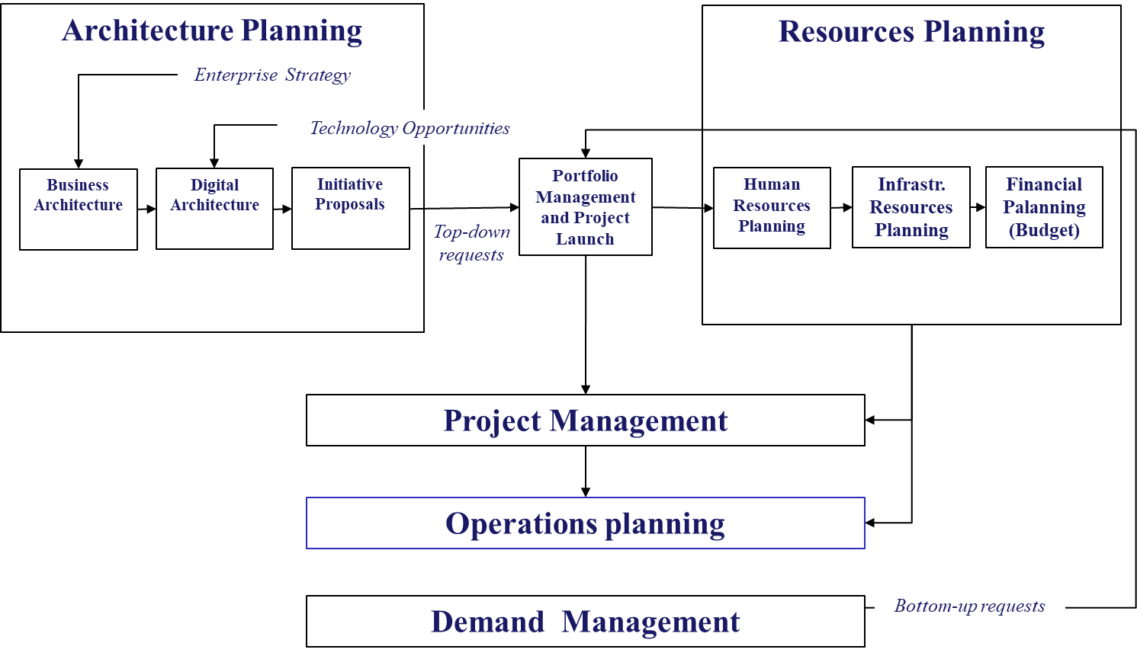
IT MANAGEMENT: OVERVIEW
IT management is made of various processes which involve the IT corporate department, corporate managers, demand managers, and project managers.
Corporate managers lead corporate functions and divisions (E.G. Sales, Production, Finance, etc.) and make decisions on IT projects
Demand Managers assist corporate functions and divisions (E.G. Sales, Production, Finance. etc.) by collecting their requirements and supporting projects
Project managers lead ongoing projects

Slide 5
IT MANAGEMENT: OVERVIEW
Architecture Planning
Resources Planning
Enterprise Strategy
Technology Opportunities
Business Architecture
Digital Architecture
Initiative Proposals
Portfolio Management and Project Launch
Human Resources Planning
Infrastr. Resources Planning
Financial Palanning (Budget)
Top-down requests
Project Management
Operations planning
Demand Management
Bottom-up requests

Slide 6
IT MANAGEMENT: ARCHITECTURE PLANNING
Enterprise Strategy
Technology Opportunities
Business Architecture
Digital Architecture
Initiative Proposals
Business processes
Map of Business Processes and Products
Innovation and changes
Corporate structure
Innovation and changes
Market and business
Breakthrough and changes
Systems
Systems Map as is / to be
Data
Data Map as is /to be
Data Base & Data Lake Map as is /to be
Infrastructure
Data Center Maps as is /to be
Network Map as is /to be
Bottom-up Initiatives from Demand Managers
Strategic initiatives
Regulation compliance

Slide 7
IT MANAGEMENT: ARCHITECTURE PLANNING
Large organizations typically maintain a map of their digital architecture to ensure its consistency and its alignment with business and technology innovations
This task is carried out by a dedicated staff in the IT department which cooperates with demand managers and with the assistance of strategy consultants
Various methodologies were conceived for strategic planning
TOGAF-ADM, a guide for the architcture planning process
SCOR, a reference model of business processes in manufacturing
ETOM, a reference model of information architecture in telecommunications
Etc.

Slide 8
IT MANAGEMENT: PORTFOLIO MANAGEMENT
Architecture Planning
Resources Planning
Enterprise Strategy
Technology Opportunities
Business Architecture
Digital Architecture
Initiatives Proposals
Portfolio Management and Project Launch
Human Resources Planning
Infrastr. Resources Planning
Financial Palanning (Budget)
Top-down requests
Project Management
Operations planning
Demand Management
Bottom-up requests

Slide 9
IT MANAGEMENT: PORTFOLIO MANAGEMENT
The portfolio includes project proposals originated from strategic planning or bottom-up requests from Demand Managers or other sources
Top-down proposals reflect big budget initiatives that innovate the core of the corporate digital architecture, e.g., Lakewarehouse in Healthcare
Bottom-up requests address existing apps or infrastructures, and reflect improvements, additions, regulation compliance; generally, their budget is smaller
Portfolio management is intended to balance strategic innovation with the maintenance of existing applications within available resources
Portfolio management typically is a high-level management process, run by a committee at Vice-President level, e.g., Chief Information Officer, Chief Technology Officer, Chief Operations Officer, Chief Financial Officer
This committee, often called Systems or IT Committee, decides priorities - projects to launch, postpone or discard.

Slide 10
IT MANAGEMENT: PORTFOLIO MANAGEMENT
Initiatives
The Project Portfolio is created in a series of steps
Consolidation of gathered initiative proposals
Assessment of proposals
Selection of proposals
Consolidation is an ad hoc process
Assessment usually include the evaluation of:
Cost/Benefit (Business Return);
Risk (usually by score)
IT/Business Alignment (usually by score)
Selection is iterative: approved initiatives make the Project Portfolio
Consolidation
Consolidated Initiatives
Assessment
Assessed Initiatives
(Status: to approve)
Selection
Discarded
(Status: Rejected)
Approved Initiatives
(Status: approved)

Slide 11
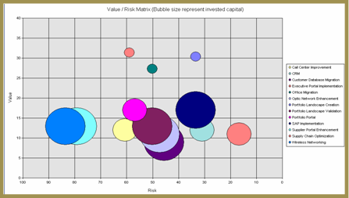
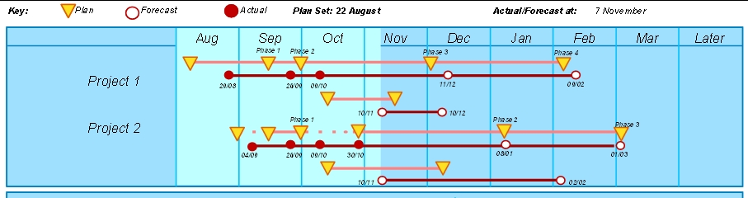
IT MANAGEMENT: PORTFOLIO MANAGEMENT
Risk-Value Map
Selection Grid
Cost-Benefit Ratio
2
Consider
Go for it
Must
Do!
1
Wait
Evaluate
Gantt-Diagram
0
Non-strategic
Strategic
Mandatory
Project selection can rely on a variety of visual tools:
In Risk –Value Maps estimated risks are balanced against potential benefits: best projects are in the top right corner of the matrix
In Selection Grid potential projects are positioned according to their return and alignment; preferential projects are the mandatory projects (they may be bottom – up request) and the strategic projects with high return
In Gantt diagrams the estimated duration of the projects and on ongoing projects are shown
Notes:
Punteggio finale = f (allineamento(interno, esterno); rischio)

Slide 12
IT MANAGEMENT: RESOURCES PLANNING
Architecture Planning
Resources Planning
Enterprise Strategy
Technology Opportunities
Business Architecture
Digital Architecture
Initiative Proposals
Portfolio Management and Project Launch
Human Resources Planning
Infrastr. Resources Planning
Financial Palanning (Budget)
Top-down requests
Project Management
Operations planning
App Maintenance & Operations
Bottom-up requests

Slide 13
IT MANAGEMENT: RESOURCES PLANNING
Resource allocation is intended to size resources consistently with the strategy and the resource availability.
Resource allocation includes general planning processes typical to large corporations
In Human Resources Planning, the corporation defines recruitment, training and allocation of the IT staff based on the requirements emerging from the strategy for IT infrastructure, systems and technology (E.G. datalakehouse, AI projects, new computer network, etc.) and regulation compliance (security, certification, etc.)
In Infrastructure Planning, the corporation plans capacity, e.g. of data centers, cloud provision, and network, and the related schedule
In Financial Planning the corporation defines the IT budget and its allocation among corporate functions, divisions and strategic projects
Some processes are often run by other departments e.g.:
HR planning: HR department
Financial Planning: Financial Department

Slide 14
IT MANAGEMENT: PROJECT MANAGEMENT
Architecture Planning
Resources Planning
Enterprise Strategy
Technology Opportunities
Business Architecture
Digital Architecture
Initiative Proposals
Portfolio Management and Project Launch
Human Resources Planning
Infrastr. Resources Planning
Financial Palanning (Budget)
Top-down requests
Project Management
Operations planning
App Maintenance & Operations
Bottom-up requests

Slide 15
IT MANAGEMENT: PROJECT MANAGEMENT
Project management addresses the projects during their life cycle
A corporation typically runs several projects at the same time:
(A few) strategic projects are generally sponsored by the top management, because they impact the whole business of the corporation e.g., AI driven intelligence in FBI
Divisional and functional projects typically address requirements of
an individual division: e.g., spare parts management of an engine factory within an automotive company
an individual function: e,g., AI-driven recruiting system for the HR department
Large maintenance projects, such as migration from on-premise data center to public cloud, often managed by the IT department itself
The progress of each project is reported to its respective Project Steering Committee
A typical project management methodology is PMI by Project Management Institute (illustrated it in a separate lecture)

Slide 16
IT MANAGEMENT: OPERATIONS PLANNING
Architecture Planning
Resources Planning
Enterprise Strategy
Technology Opportunities
Business Architecture
Digital Architecture
Initiative Proposals
Portfolio Management and Project Launch
Human Resources Planning
Infrastr. Resources Planning
Financial Palanning (Budget)
Top-down requests
Project Management
Operations planning
Demand Management
Bottom-up requests

Slide 17
IT MANAGEMENT: OPERATIONS PLANNING
Operations planning addresses
Data centers,
Networks,
End user computing (local networks and related systems).
Customer Care / Help Desk: support users
Disaster Recovery
It schedules tasks, and defines staff and shifts, for:
Routine operations
Transition and deployment of new software at the end of projects
Configuration changes
Security
Etc.

Slide 18
IT MANAGEMENT: DEMAND MANAGEMENT
Architecture Planning
Resources Allocation
Enterprise Strategy
Technology Opportunities
Business Architecture
Digital Architecture
Initiative Proposals
Portfolio Management and Project Launch
Human Resources Planning
Infrastr. Resources Planning
Financial Palanning (Budget)
Top-down requests
Project Management
Operations planning
Demand Management
Bottom-up requests

Slide 19
IT MANAGEMENT: DEMAND MANAGEMENT
Demand Management is a decentralized process that addresses IT issues within the organization units of an enterprise, such as a Division (e.g., the Sales Division of an automotive corporation) or a Department (e.g., Human Resources)
Demand Management includes
Identification of information needs of user departments which shall generate bottom-up requests for
New applications
Additions to or modifications of existing applications
Support to requirements definition
User project management

