Slide 1
Radiology Case Study Policlinico San Matteo, Pavia Testimonial: Dr. Ing. Loredana Gazzaniga R 251031
Privacy
Security
Infrastructure
Process

Slide 2
Privacy
Privacy
Security
Infrastructure
Process
Rules:
https://commission.europa.eu/law/law-topic/data-protection_en
https://commission.europa.eu/law/law-topic/data-protection/data-protection-explained_en
Italy implementation:
Generally, Italian Regulations are very strict on privacy especially in the critical contexts of Healthcare and Government
Personal profile must not be extracted by integrating data on:
Health
Residence
School education
Lifestyle
Sensitive data should not move from their original authorized storage
Accordingly, EPR is only a table of contents, where referrals, discharges, vaccines are all stored in their original databases and are accessed through a link by legitimate users

Slide 3
Privacy
Privacy
Security
Infrastructure
Process
Data privacy includes
Integrity
Availability
Privacy
Any infringement of the above parameters implies:
Log and notify to Privacy Authority the infringements that may occur due to a system error or wrong operation
Little: not relevant and immediately solved
Medium: small violation affecting several individuals
Large: significant privacy breach affecting many individuals
In the worst case: notification to the individuals affected and publishing on the news

Slide 4
Privacy
Privacy
Security
Infrastructure
Process
For the sake of privacy, data must be stored in the physical location where they were originally recorded and must not be moved around
E.g.:
A patient goes to the emergency of a hospital A and makes some exams e.g., blood and glycemia
After that first care, the patient goes to a larger hospital B for finalizing her/his care
Only hospital A may allow the hospital B to receive the referrals on blood and glycemia

Slide 5
Privacy
Privacy
Security
Infrastructure
Process
Implications on healthcare projects:
Rule: GDPR rule article 25: Privacy by design
All project documents should be checked to ensure that only legitimate users are allowed to access patient data
Legitimate users include the General Practitioner (who can access data of her/his patient only), the patient, healthcare services, only when treating the patient
The legitimate users should access patient data only by a specific secured procedure
Even patients can access their own data by a secured procedure such as SPID https://www.spid.gov.it/en/
Only selected functions can access sensitive data

Slide 6
Security
Privacy
Security
Infrastructure
Process
Scope: to ensure data integrity and block illegitimate access
Rule: NIS2 (Network and Information Security Directive 2) https://digital-strategy.ec.europa.eu/en/policies/nis2-directive
In fact, security is cross-related with privacy requirements
Implications on projects: check data integrity by solving data overlaps, ambiguity and uncontrolled redundancy
Continuity / Downgrading
In case of computer service denial, the healthcare service chain, from General Practitioners down to labs and hospitals, can rely on paper documents e.g.:
Paper prescriptions by GPs
Paper visit referrals by labs
Paper labels for lab exams
Etc.

Slide 7
Infrastructure history
Privacy
Security
Infrastructure
Process
Infrastructure grew bottom-up with each hospital and lab using its own software for check-in, labs, and hospital operations.
Labs and hospitals have their own database with reservations (CUP), referrals, radiographies, exams, medical records, discharges.
The regional database store EPR and other overall information such as GP master data, exemptions, service master data, etc.
The regional database can be accessed by every service point - hospital, General Practitioner, clinic, lab, pharmacies
This access relies on Extranet (as explained in the Radiology Case Background)

Slide 8
Infrastructure: project by Lombardy Region
Privacy
Security
Infrastructure
Process
As-is
To-be
Each hospital check-in is connected to its own labs.
Each hospital may have its own coding of services that can include multiple levels.
Check-in software is centralized, and labs are connected to check-in through a shared middleware.
Code of services is unified.

Slide 9
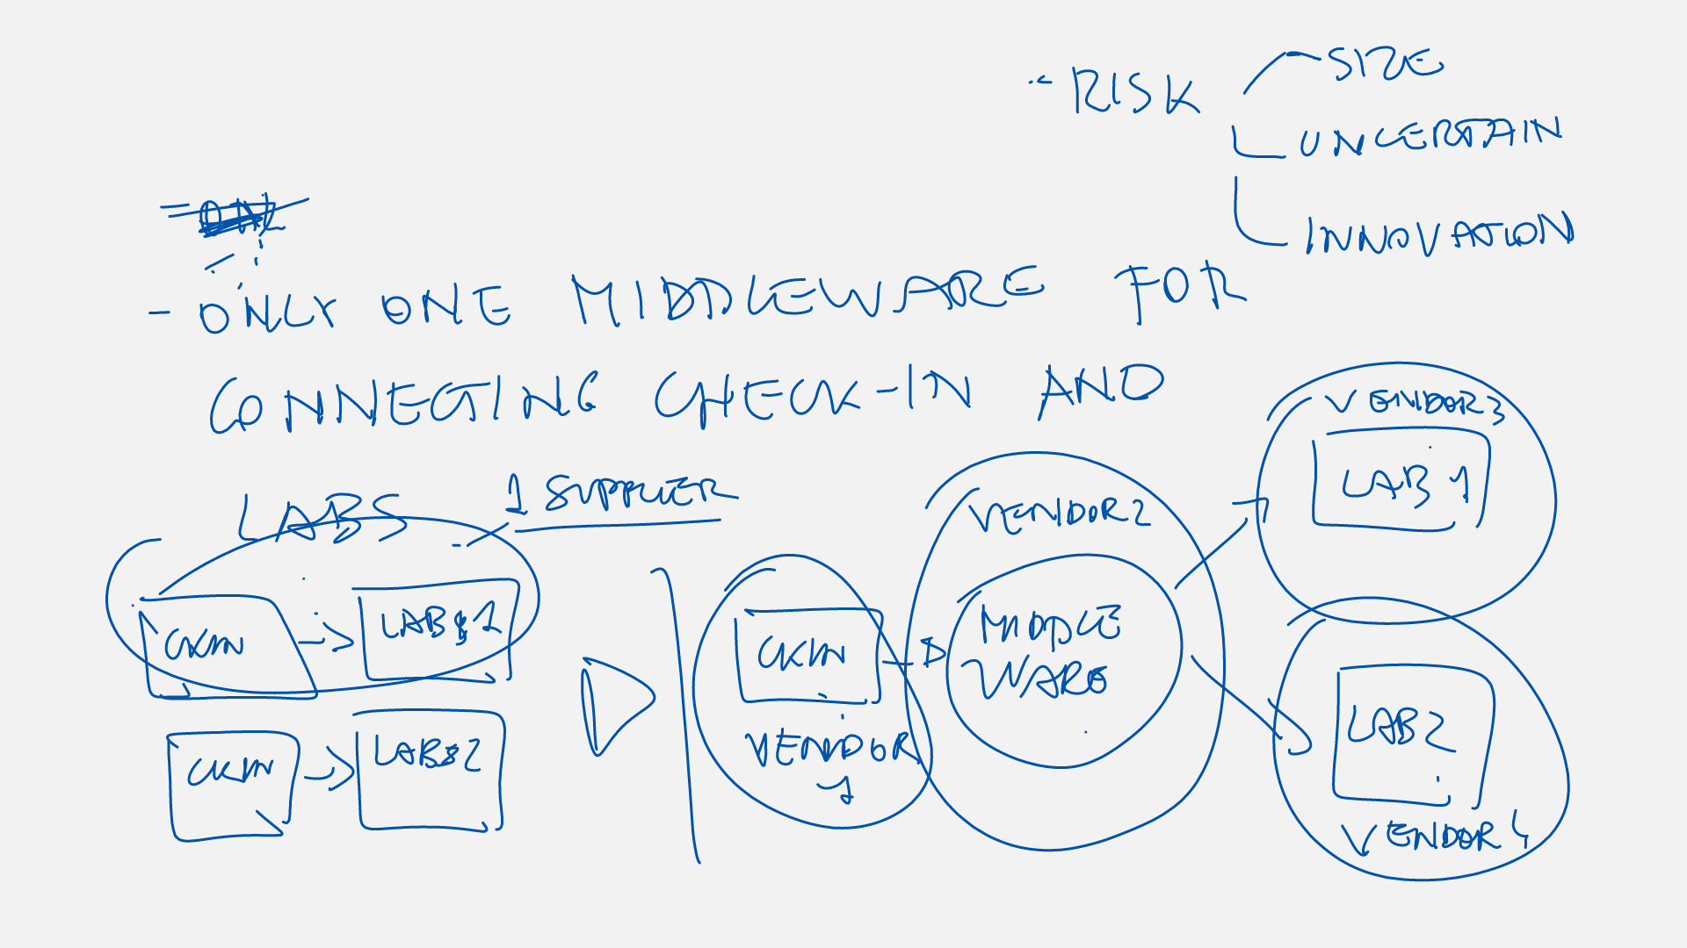
Infrastructure: model as-is /to-be
Privacy
Security
Infrastructure
Process

Slide 10
Check-in cases: recall
Privacy
Security
Infrastructure
Process
Emergency
Standard check-in
Emergency code: Black, Red, Yellow, Green
Patient identification cases
Patient with Health card
Patient without Health Card
Patient without ID
Foreign patient with or without ID
Exam management functions
Follow-up functions
Patient identification
The document for registering is prescription, which is identified by a unique number
Prescription, on paper or digital. specifies exams, visits, operations of the patients
Health card or ID is complementary identification
Patient data are downloaded from the regional database
Exam management
Based on the registration, the the series of services (exams, visits, operations) the patient should receive
Date management: the system can group dates of checks for the sake of the patient
Exam grouping
Follow-up

