Slide 1
VIRTUAL SHOPPING A DRAFT
Case-study R 250022

Slide 2
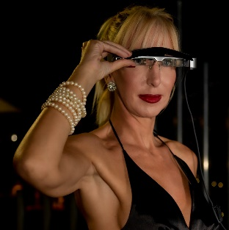
Virtual shopping (VS)
Framework
Tourism
Enterprise
Factory
VS will be a virtual shopping system, a service in which a salesperson illustrates the shop and its items to a remote consumer (connected to the Internet)
Remote shopping increases the chance of selling to remote consumers; actually
Only 30% of luxury shop visitors buy
Luxury sales are online but only1-2% of online visitors buy
With virtual shopping 30% of remote consumers may buy

Slide 3
Remote Shopping
Scope
Project Outline
Architecture
Functions
Remote customers buy by phone and are supported by a personal shopper
Many customers also navigate on social networks
Virtual shopping adds
Selection of shops and items
Realtime watching of items and interaction with the shop salesperson
Payment
Brand | Instagram | Facebook | Twitter
Louis Vuitton | 22.4 | 20.7 | 7.3
Gucci | 22.3 | 16.7 | 5.5
Dior | 18.8 | 16.1 | 8.3
D&G | 16.2 | 11.1 | 5.3
Prada | 14.9 | 6.3 | 1.0
Calvin Klein | 11.9 | 12.2 | 3.6
Versace | 11.7 | 5.0 | 4.5
Burberry | 11.2 | 17.0 | 8.6
Ralph Lauren | 7.6 | 8.9 | 2.3

Slide 4
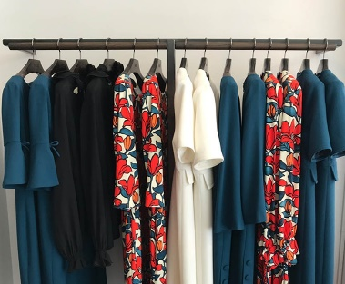

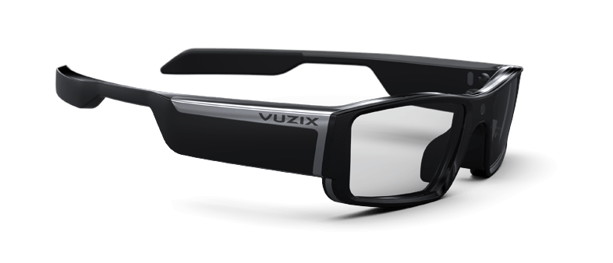
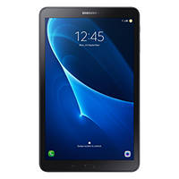

Virtual Shopping: Digital transformation areas
Stakeholders
Process
Technology
Framework
Tourism
Enterprise
Factory
Consumer Management
Cloud services
Shops / Brands
Shop Browsing
Virtual Visit
Smart Glass
Consumers
Shop Management
Payment & Logistics
Shoppers
Smart Phone

Slide 5
Virtual visit process
Scope
Project Outline
Architecture
Functions
1: Registration: the customer
Downloads the app form the website
Enters personal data
2.a Selection of the shopper from the shopper list
2.b: Shop selection: the customer
Opens the app
Selects the shop / location
Books the time of the virtual visit and receives confirmation
3: Virtual visit: the consumer
Connects to the booked shop
Interacts with the shopper and/or the shop salesperson
Watches the items through the Smart Glass of the salesperson
Selects items
4: Cart & payment:
The salesperson finalizes the customer’s order
The customer confirms and pays
5: Assessment :
The customer rates his/her experience

Slide 6

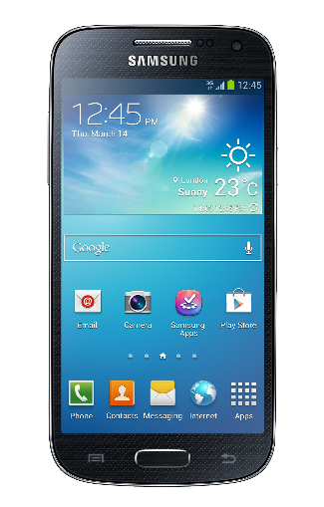


Streaming
Smartphone
Scope
Project
Architecture
Functions
WiFi
eth
Smartphone
Database
Internet
WiFi o eth
Bluetooth
WiFi
Customer
Smart glass

Slide 7
Smart Glass
Scope
Project
Architecture
Functions
Wearable computer glasses
add information alongside or to what the wearer sees.
change their optical properties at runtime
Information is seen by the customer

Slide 8
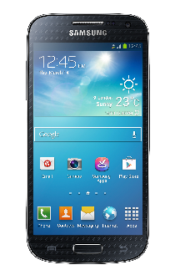


Streaming: flow DB/smartphone salesperson
Scope
Project
Architecture
Functions
Database
Internet
The smartphone of the salesperson reservations reads on the system database

Slide 9

Streaming: call to the shopper
Scope
Project
Architecture
Functions
Customer starts acall that that is forwarded to the smart glass and smart phone
The salesperson replies by the smart phone app
Internet
Customer
Smart glass

Slide 10
Streaming: visione
Scope
Project
Architecture
Functions
Smart glasses forward streaming to the server to which the customer is connected
DB
Internet
Customer

Slide 11
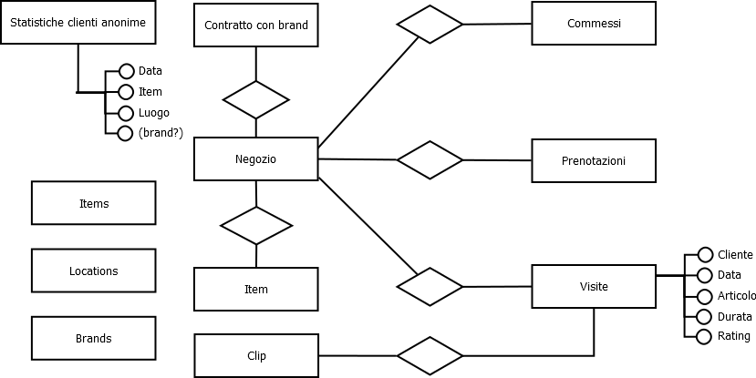
Database Conceptual Schema
Scope
Project
Architecture
Functions

Slide 12
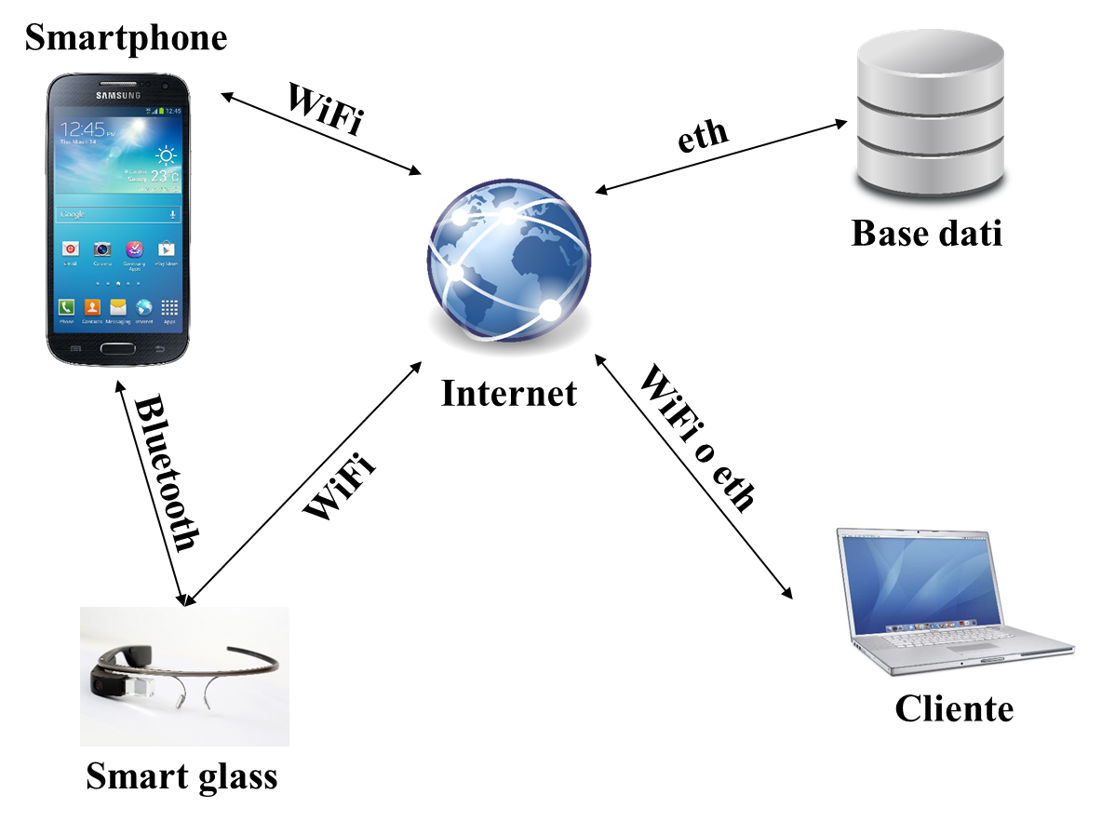
Database Conceptual Schema
Scope
Project
Architecture
Functions
Database includes:
Tables (merchandise, location, brand) for searching the
Number of visits to each associated shop (for each brand)
Demo clips on visits

Slide 13


App download
Scope
Project
Architecture
Functions
The shop will receive a link to download the app though Google / Apple

Slide 14
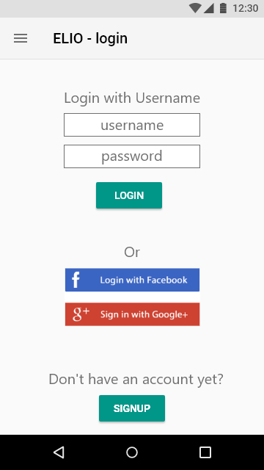
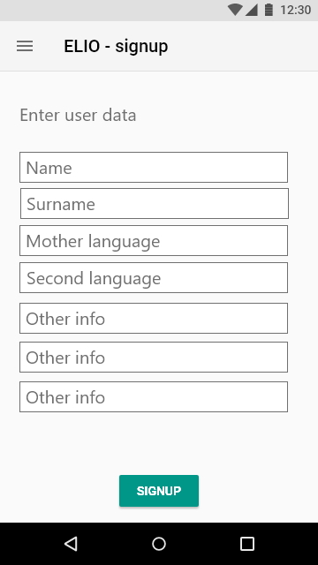
Remote consumer
Scope
Project
Architecture
Functions

Slide 15
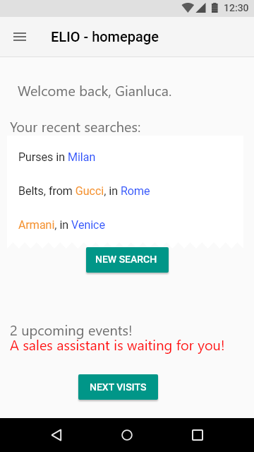
Remote consumer
Scope
Project
Architecture
Functions
Homepage:
Recent searches
New search
Shopper ready notification
List of booked visits
Logout

Slide 16
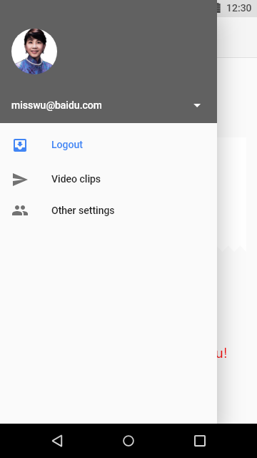
Remote consumer
Project Scope
Project
Architecture
Functions
From the home page the consumer can access to her/his setting, logout, and retrieve the clips she/he wanted to record

Slide 17
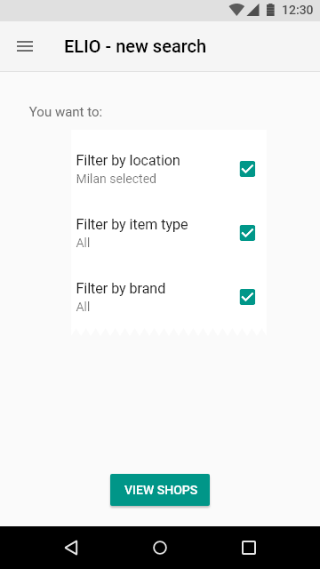
Remote consumer
Scope
Project
Architecture
Functions
New search:
Filter by brand (default: all)
Filter by merchandise (default: all)
Choose location (One only, mandatory)

Slide 18
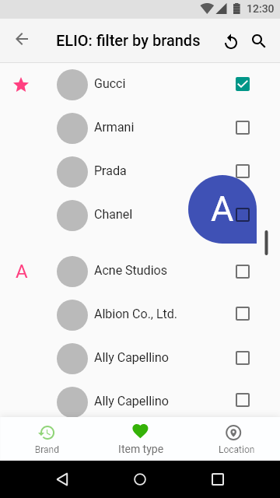
Remote consumer
Scope
Project
Architecture
Functions
Filter by brand:
Sorted brand list
The consumer can select more brands
Th consumer can also switch to other filters (bottom screen)

Slide 19
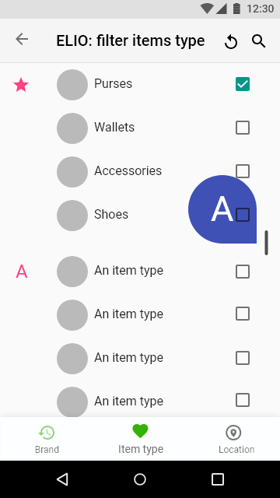

Remote Consumer
Scope
Project
Architecture
Functions

Slide 20
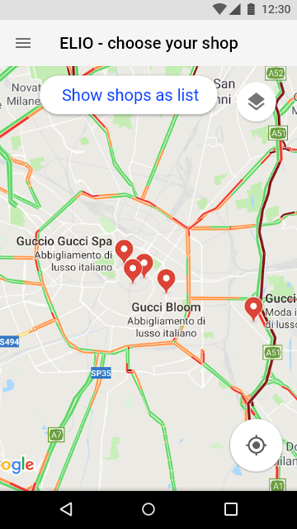
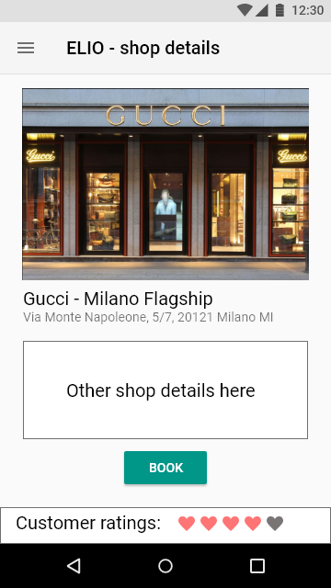
Remote consumer
Scope
Project
Architecture
Functions
The selected shop is shown in the map (info is extracted from Google)

Slide 21
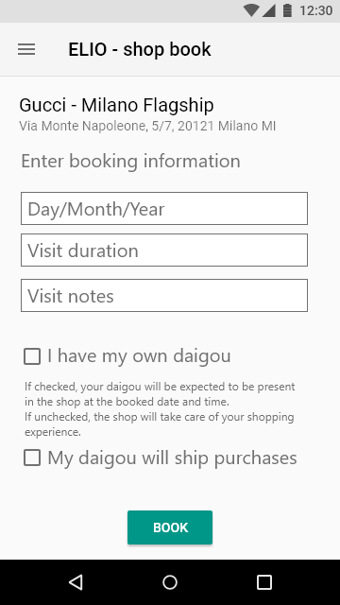
Remote consumer
Scope
Project
Architecture
Functions
After selecting the shop, the consumer can book
The consumer can also choose her/his own shopper (daigou) who will show up in the shop at the booked time
One the reservation is finished the user will be back at the reservation list waiting for the shop’s confirmation

Slide 22
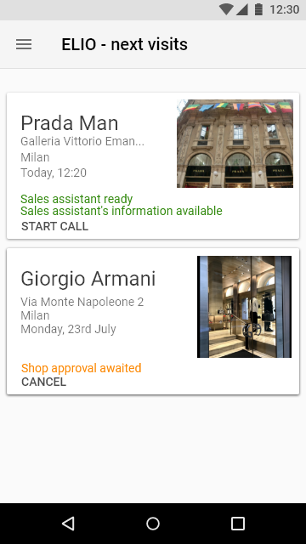
Remote consumer
Scope
Project
Architecture
Functions
The consumer always can see her/his reservations and check their status
can

Slide 23
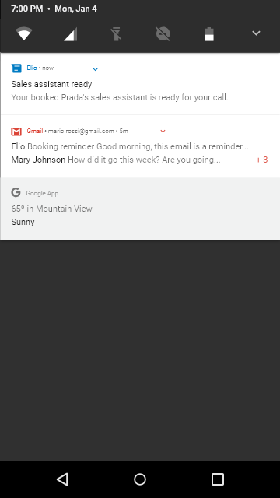
Remote consumer
Scope
Project
Architecture
Functions
One day before, the consumer receives notifications (email o WeChat)
When the shop salesperson is ready, the consumer receives a further alert and starts the streaming session

Slide 24
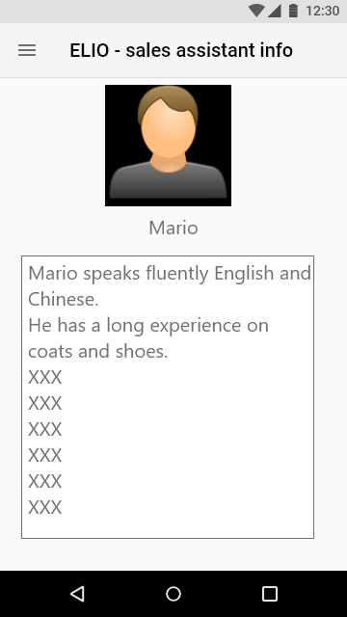
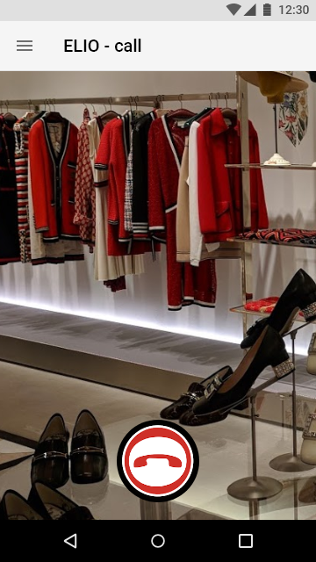
Remote consumer
Scope
Project
Architecture
Functions
The customer can read the info on the salesperson

Slide 25
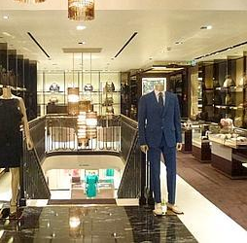


Remote consumer
Scope
Project
Architecture
Functions
Negozio
Internet
Ms.Wu
Mario
Ms. Wu calls the shopper Mario
Ms. Wu speaks in Chinese with Mario, asks to see some items
Mario takes and shows the items
Smart glasses transmit the video that Ms. Wu watches on her smartphone or laptop
At the end, Ms. Wu selects the items for her cart
The subsequent functions for payment and shipping are illustrated in another presentation

Slide 26
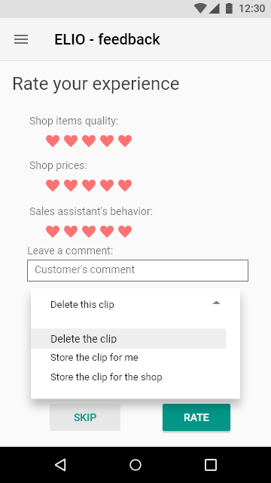
Remote consumer
Scope
Project
Architecture
Functions
The consumer can rate her/his experience
The consumer can record the videoclip
Recorded videoclips can be seen on the home page

Slide 27
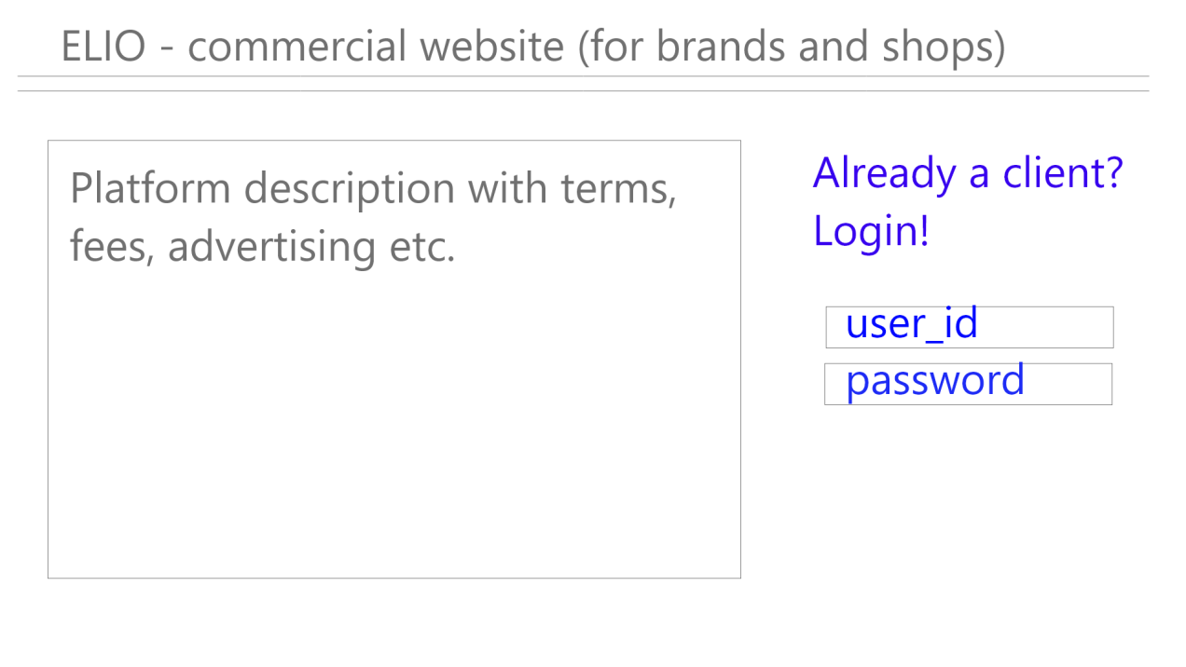
Shop
Homepage - login for brand or shop
Project Scope
Project
Architecture
Functions
Secured Website
Credentials after the contract
Credentials for brand or shop are in 2 different pages (a brand can manage all its shops)

Slide 28
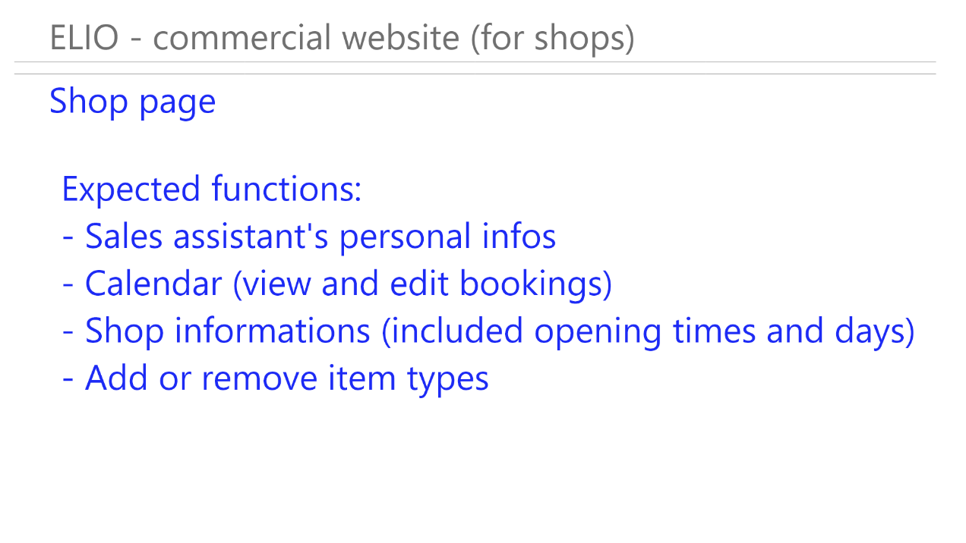
Shop
Scope
Project
Architecture
Functions
The shop can enter, change, and delete the master data of its salespersons

Slide 29
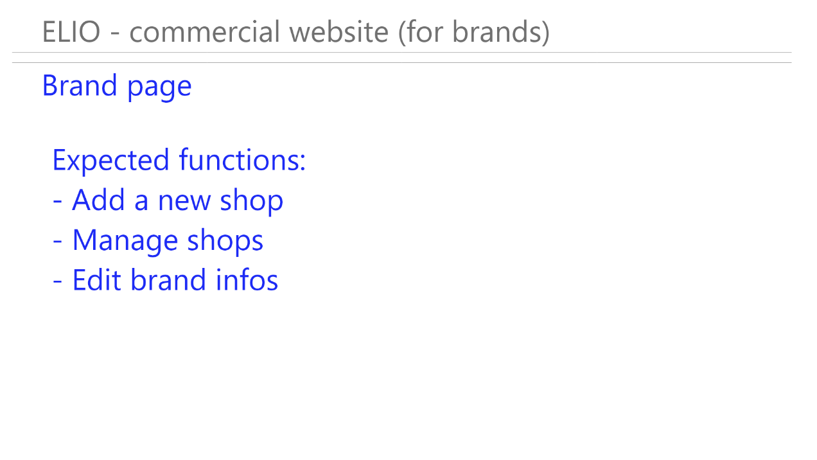
Shop
Project Scope
Project
Architecture
Functions
A brand can add or delete its shops
Each shop has its own login
A brand can see and change data of its shops
A brand can change its own data

Slide 30
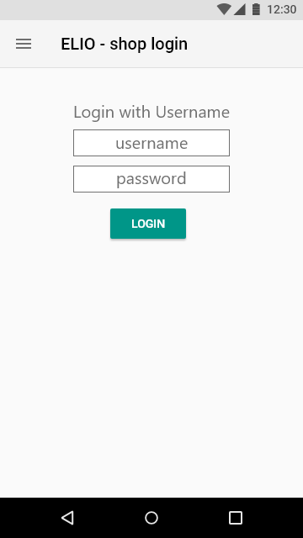
Shop
Project Scope
Project
Architecture
Functions
The shop login relies on credentials

Slide 31
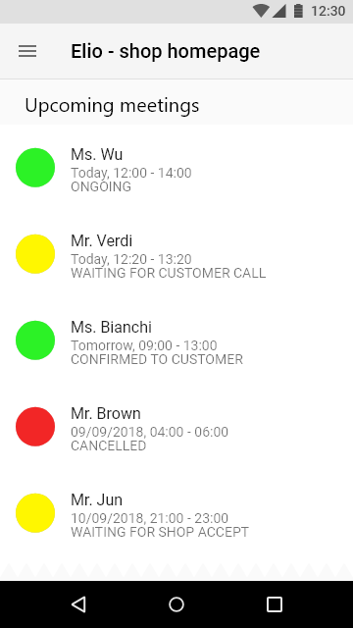
Shop
Scope
Project
Architecture
Functions
Homepage negozio:
Lista prenotazioni visite ordinate per data e orario
Per ogni prenotazione, dati importanti:
Con chi
Quando
Stato della prenotazione

Slide 32
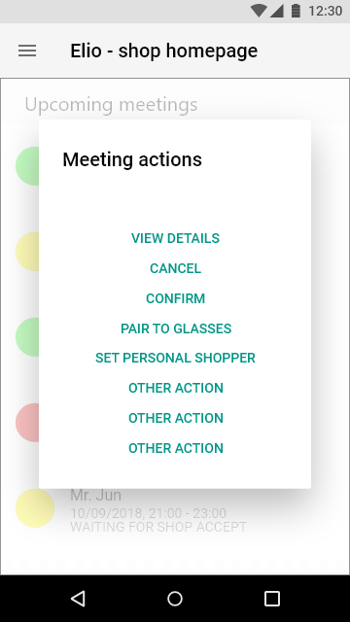
Shop : visit management
Scope
Project
Architecture
Functions
Shop app: can confirm or delete events
Smart phone connected to the smart glass: can only notify data and status of the salesperson and answer the customer’s call

Slide 33
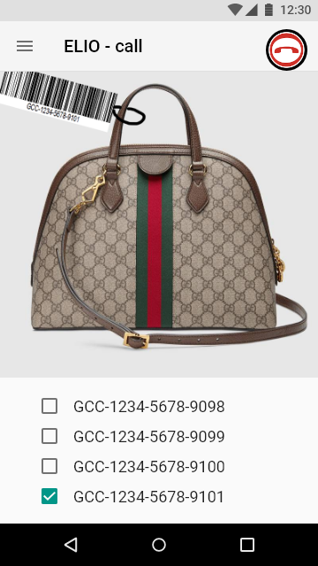
Shop : cart
The salesperson composes the cart
Framing the item
Framing the associated barcode
Saving a pic of the item
The session is interactive
The salesperson can add or delete items in any moment
NB Item pricelist is not open to Elio
Project Scope
Project
Architecture
Functions

Slide 34
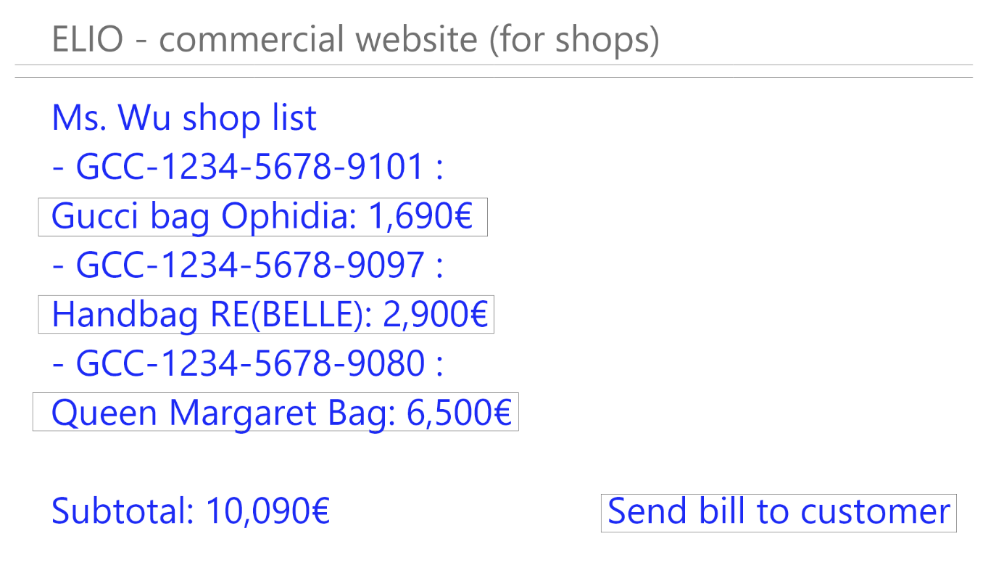
Shop : prices: option 1 manual entry
Project Scope
Project
Architecture
Functions
The salesperson adds item process manually
Otherwise, prices are downloaded from the shop pricelist

Slide 35
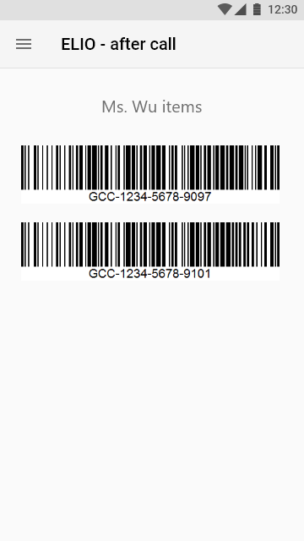
Shop : prices: option 2 barcode
The salesperson gets on the smartphone the barcodes of the cart items
The salesperson loads the prices of the items e.g. from the cash barcodes
Scope
Project
Architecture
Functions

Slide 36
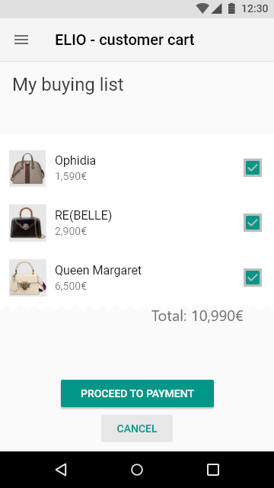
Shop : item list for the customer
The customer receives the priced item list with associated pics
The customer confirms, changes, or delete the items in the cart
Scope
Progetto
Architettura
Funzionalità utente

Slide 37
Shop : paying options
Scope
Project
Architecture
Functions
EXX receives the payment
EXX charges its fees and transfers the payment to the shop
The customer can save the cart and decide later what to buy

Slide 38
OBS (Organization Breakdown Structure)
Scope
Project
Architecture
Functions
Project manager
www
Web & Operation
xx
Streaming
vvv
Steering Committee
ppp
Communications
zzz

Slide 39
Work Packages
Scope
Project
Architecture
Functions
WP3
Personal Shopper
WP1
Project Management
WP4
Remote Consumer
WP 9 Test / Pilot Deployment
WP2 Communication
WP5
Payment Management
WP6
Shop Management
WP7
Visit /Shop Analysis

Slide 40
WP1 – IT Project management (Project Office)
Scope
Project
Architecture
Functions
Duration: M1 to M12
Objective: Control the relevant issues of the IT project
Tasks:
Time and Cost Management
Project planning
Monthly Progress Report
Monthly Plan Review
Cost
Project Risk
Compliance Planning and Control
Software Quality
Privacy (GDPR)
Project Change Management
Documentation and communications support
Effort: 10% of development resources
Leader: TBD
Remarks: Monthly cycle

Slide 41
WP2 – Communications
Scope
Project
Architecture
Functions
Duration: M1 to Mf
Objective: Make the project visible to consumers and shops and assure GDPR (privacy)
WBE:
Plan and manage communication with brands
Identify influencers
Create and disseminate clip
Organize events
Publish on social networks
Advertise consumers
Define GDPR profile
Effort : TBD
Leader: TBD
Participants:
Steering Committee
Chinese Partner
Italian Chamber of Commerce
Brand Partners
Deliverable
Clip Italian / English/ Chinese
Contract with Influencers
Events
Newspapers article for brands

Slide 42
WP3 - Personal Shopper
Scope
Project
Architecture
Functions
Duration: M1 to M4
Objective: Minimum Viable Product (website, personal shopper app, personal shopper payment)
WBE:
Streaming integration
Website
Creation of test environment
Payment system
System test
Field test with a multi-brand shop
Test with a branded shop
Release to personal shoppers
Effort: TBD
Leader: xxxx
Participants:
AA (streaming)
Personal Shopper (test)
Remote consumer (test)
Deliverable
Downloadable Android App for Consumers and Operators
Directions and demo
Remarks:
Only English or Italian

Slide 43
WP4 – International consumer
Scope
Project
Architecture
Functions
Duration: M4 to M8
Objective: finalize the software for visit management
WBE:
Shop Selection
Visit Reservation
Scoring /back-end
Test preparation
Consumer test
Effort: TBD
Leader: xxxx
Participants:
bbbb (streaming)
Chinese Consumers (test)
Partner Shops
Deliverable
IOS/Safari streaming
Multilingual downloadable App for Consumers and Operators
Multilingual directions and demo

Slide 44
WP5 – Payment Management
Scope
Project
Architecture
Functions
Duration: TBD
Objective: finalize the payment system for international consumers
WBE:
Define payment systems
Check with payment institutions
Develop payment procedure
Test preparation
Consumer test
Effort: TBD
Leader: xxxxx
Participants:
Partner Shops
Deliverable
Add-on to App

Slide 45
WP6 – Shop Management
Scope
Project
Architecture
Functions
Duration: M1 to M5
Objective: develop the software by which the shop manages visits
WBE:
Interface definition
Spec sprint (Product Backlog definition)
Sprint for Reservation Management
Sprint for Salespersons Management
Sprint for Customer Scoring
Leader: TBD
Effort: TBD
Remarks:
Agile approach

Slide 46
WP7 – Shop Analysis
Scope
Project
Architecture
Functions
Duration: TBD
Objective: develop the software to analyze visits by shop/location/item/customer region and alike
WBE:
Service Architecture definition
Spec sprint (Product Backlog definition)
Sprint for Customer Profiling
Sprint for Customer’s Dashboard
Sprint for Shop’s Dashboard
Effort :
Leader: TBD
Remarks:
Agile approach
BI application

Slide 47
WP7 – Shop Analysis
Scope
Project
Architecture
Functions
Duration: TBD
Objective: develop the software to analyze visits by shop/location/item/customer region and alike
WBE:
Service Architecture definition
Spec sprint (Product Backlog definition)
Sprint for Customer Profiling
Sprint for Customer’s Dashboard
Sprint for Shop’s Dashboard
Effort :
Leader: TBD
Remarks:
Agile approach

Slide 48
REVIEW QUESTIONS: PROJECT CHARTER
Scope
Project
Architecture
Functions
A feasibility study should be at least a project charter, i.e., a document that is complete and robust enough to launch a project
Use Project Integration of PMBOK 6 as a reference guide
With this objective, review each chapter of this feasibility draft in terms of
Completeness: are significant points addressed?
Robustness and detail
Prepare a table with your comments and suggestions
Area | Comments | Suggestions
Scope
Architecture
Functions
Project

Slide 49
REVIEW QUESTIONS; PROJECT MNGT KNOWLEDGE AREAS
Scope
Project
Architecture
Functions
According to PMBOK a project charter should address 9 knowledge areas by subsidiary plans
Please review each chapter of this feasibility draft in terms of
Completeness: are significant points addressed?
Robustness and detail
Prepare a table with your comments and suggestions
 | Comments | Suggestions
Integration
Scope
Time
Cost
Quality
HR
Communi-cations
Risk
Procurement
Stakeholder

