Slide 1



chapter 3
the interaction
extras … more about widgets

Slide 2
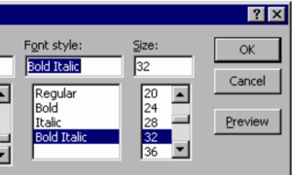
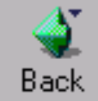
understanding and choosing widgets
widgets - bits that make the GUI
what do they do
what are they good for

Slide 3
one-by-one – WIMP elements
widgets - bits that make the GUI
what do they do
what are they good for

Slide 4
widgets?
individual items on a GUI screen ...
checkboxes, menus, toolbars, buttons etc.
three aspects:
appearance - what they look like
interaction - how they behave
semantics - what they mean

Slide 5
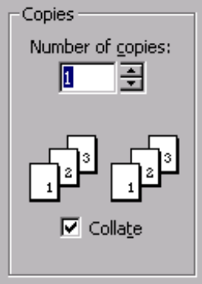
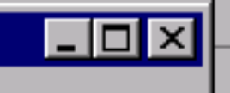

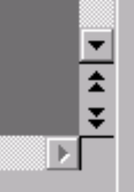


appearance

Slide 6
appearance includes words
verbs - action words
quit, exit, embolden, italicise
adjectives - description/state words
bold, italic
nouns - usually as a form of description
Times New Roman, US Letter
beware of mixes …
embolden + italic !!?!

Slide 7



behaviour
Move mouse over button – highlights
Move mouse off target with button still down – highlight removed
Release mouse – nothing happens

Slide 8
behaviour … ctd.
some bits the toolkit does for you
but is it right?
some you control
e.g. drawing, interactions between widgets
beware timing issues
e.g. large selections under Windows apps.

Slide 9
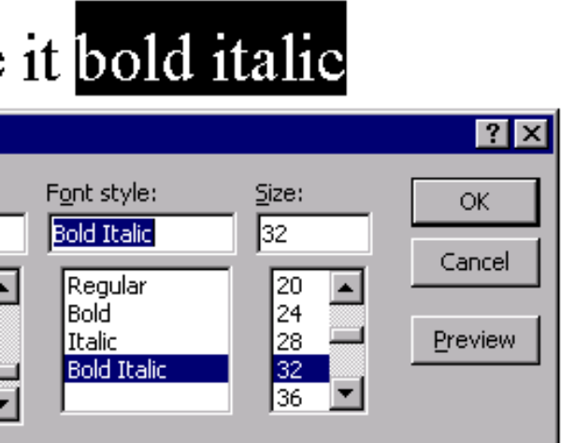
semantics
menus, buttons, …, etc.
do things …
… lets make it bold italic

Slide 10
YOU say what it means
semantics usually up to you
although widgets may link direct to database
even then, you say what links
think separately:
meaning first - what you want it to do
then appearance - how you do it
choose the widget for the job

Slide 11
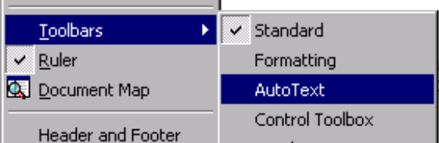
what do you want?
actions
usually menu, buttons, or toolbar
setting state/options
usually checkbox, radio button, combi-box
but …
menus can be used to set state etc. ...

Slide 12

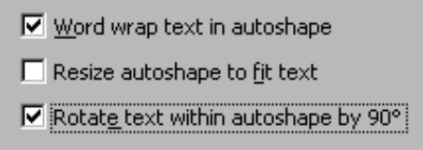
how many?
one of several options
radio buttons, selection menu
zero, one or more options
checkbox, multi-choice menu
free choice
offer recent/typical shortcuts
one line text boxes often terrible!

Slide 13
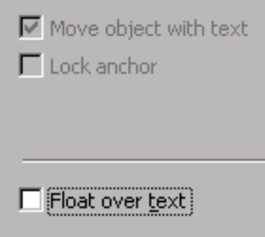
and more ...
number
fixed e.g. bold, italic, underline
variable e.g. font list
scolling through telephone list …
liveness
grey out inactive options
dynamic interactions
some choices dependent on others

