Slide 1



chapter 4
Paradigms
(additional materials)

Slide 2
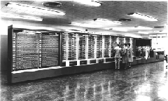
Beginnings – Computing in 1945
Harvard Mark I
Picture from http://piano.dsi.uminho.pt/museuv/indexmark.htm
55 feet long, 8 feet high, 5 tons
Notes:
Picture from http://piano.dsi.uminho.pt/museuv/indexmark.htm

Slide 3
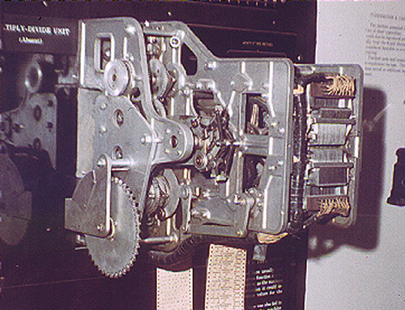
Context - Computing in 1945
Ballistics calculations
Physical switches (before microprocessor)
Paper tape
Simple arithmetic & fixed calculations (before programs)
3 seconds to multiply
Picture from http://www.gmcc.ab.ca/~supy/
Notes:
Picture from http://www.gmcc.ab.ca/~supy/

Slide 4
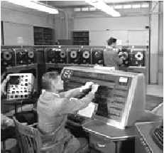
Batch Processing
Computer had one task, performed sequentially
No “interaction” between operator and computer after starting the run
Punch cards, tapes for input
Serial operations

Slide 5
People
Who are the people associated with various interactive paradigm shifts?

Slide 6

Other Resources
Howard Rheingold – Tools for Thought
History of interactive breakthroughs
On-line at http://www.rheingold.com/texts/tft/

Slide 7
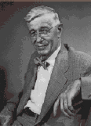
Innovator: Vannevar Bush
“As We May Think” - 1945 Atlantic Monthly
“…publication has been extended far beyond our
present ability to make real use of the record.”
Postulated Memex device
Stores all records/articles/communications
Items retrieved by indexing, keywords, cross
references (now called hyperlinks)
(Envisioned as microfilm, not computer)
Interactive and nonlinear components are key
http://www.theatlantic.com/unbound/flashbks/computer/bushf.htm

Slide 8
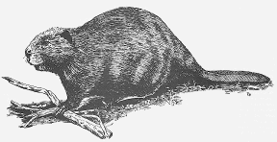
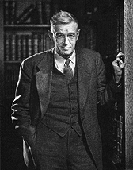
More About Vannevar Bush
Name rhymes with "Beaver"
Faculty member MIT
Coordinated WWII effort with 6000 US scientists
Social contract for science
federal government funds universities
universities do basic research
research helps economy & national defense
Notes:
Picture of Bush from http://www-eecs.mit.edu/AY95-96/events/bush/

Slide 9
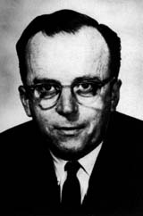
Innovator: J. R. Licklider
1960 - Postulated “man-computer symbiosis”
Couple human brains and computing machines tightly to revolutionize information handling

Slide 10
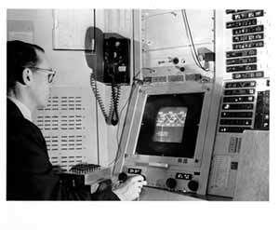
Innovator: Ivan Sutherland
SketchPad - 1963 PhD thesis at MIT
Hierarchy - pictures & subpictures
Master picture with instances (ie, OOP)
Constraints
Icons
Copying
Light pen input device
Recursive operations

Slide 11
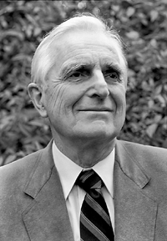
Innovator: Douglas Englebart
Landmark system/demo:
hierarchical hypertext, multimedia, mouse, high-res display, windows, shared files, electronic messaging, CSCW, teleconferencing, ...
Inventor
of mouse

Slide 12

About Doug Engelbart
Graduate of Berkeley (EE '55)
"bi-stable gaseous plasma digital devices"
Stanford Research Institute (SRI)
Augmentation Research Center
1962 Paper "Conceptual Model for Augmenting Human Intellect"
Complexity of problems increasing
Need better ways of solving problems
Picture of Engelbart from bootstrap.org
Notes:
Picture of Engelbart from bootstrap.org

Slide 13
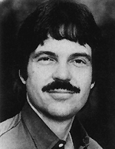
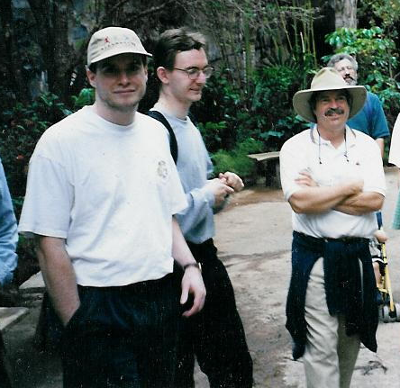
Innovator: Alan Kay
Dynabook - Notebook sized computer loaded with multimedia and can store everything
@PARC
Personal
computing
Desktop
interface
Overlapping
windows

Slide 14
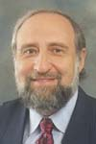
Innovator: Ben Shneiderman
Coins and explores notion of direct manipulation of interface
Long-time Director of HCI Lab at Maryland

Slide 15
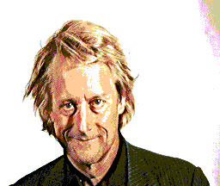
Innovator: Ted Nelson
Computers can help people, not just business
Coined term “hypertext”

Slide 16
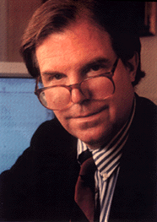
Innovator: Nicholas Negroponte
MIT Architecture Machine Group
’69-’80s - prior to Media Lab
Ideas
wall-sized displays, video disks, AI in interfaces (agents), speech recognition, multimedia with hypertext
Put That There (Video)

Slide 17
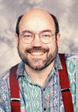
Innovator: Mark Weiser
Introduced notion of Ubiquitous Computing and Calm Technology
It’s everywhere, but recedes quietly into background
CTO of Xerox PARC

