Slide 1



chapter 14
communication and collaboration models

Slide 2
CSCW Issues and Theory
All computer systems have group impact
not just groupware
Ignoring this leads to the failure of systems
Look at several levels – minutiae to large scale context:
face-to-face communication
conversation
text based communication
group working

Slide 3
Face-to-face communication
Most primitive and most subtle form of communication
Often seen as the paradigm for computer mediated communication?

Slide 4
Transfer effects
carry expectations into electronic media … … sometimes with disastrous results
may interpret failure as rudeness of colleague
e.g. personal space
video may destroy mutual impression of distance
happily the `glass wall' effect helps

Slide 5
Eye contact
to convey interest and establish social presence
video may spoil direct eye contact (see video tunnel, chap 19)
but poor quality video better than audio only

Slide 6
Gestures and body language
much of our communication is through our bodies
gesture (and eye gaze) used for deictic reference
head and shoulders video loses this
So … close focus for eye contact …
… or wide focus for body language?

Slide 7
Back channels
Alison: Do you fancy that film … err¹ …
`The Green' um² …
it starts at eight.
Brian: Great!
Not just the words!
Back channel responses from Brian at 1 and 2
quizzical at 1
affirmative at 2

Slide 8
Back channels (ctd)
Back channels include:
nods and grimaces
shrugs of the shoulders
grunts and raised eyebrows
Utterance begins vague … … then sharpens up just enough

Slide 9
Back channels -media effects
Restricting media restricts back channels
video – loss of body language
audio – loss of facial expression
half duplex – lose most voice back-channel responses
text based – nothing left!

Slide 10
Back channels and turn-taking
in a meeting …
speaker offers the floor (fraction of a second gap)
listener requests the floor (facial expression, small noise)
Grunts, ‘um’s and ‘ah’s, can be used by the:
listener to claim the floor
speaker to hold the floor
… but often too quiet for half-duplex channels
e.g. Trans-continental conferences – special problem
lag can exceed the turn taking gap … leads to a monologue!

Slide 11
Basic conversational structure
Alison: Do you fancy that film
Brian: the uh (500 ms) with the black cat
‘The Green whatsit’
Alison: yeah, go at uh …
(looks at watch – 1.2 s) … 20 to?
Brian: sure
Smallest unit is the utterance
Turn taking ⇒ utterances usually alternate …

Slide 12
Adjacency pairs
Simplest structure – adjacency pair
Adjacency pairs may nest:
Brian: Do you want some gateau?
Alison: is it very fattening?
Brian: yes, very
Alison: and lots of chocolate?
Brian: masses
Alison: I'll have a big slice then.
Structure is: B-x, A-y, B-y, A-z, B-z, A-x
inner pairs often for clarification
… but, try analysing the first transcript in detail!

Slide 13
Context in conversation
Utterances are highly ambiguous
We use context to disambiguate:
Brian: (points) that post is leaning a bit
Alison: that's the one you put in
Two types of context:
external context – reference to the environment
e.g., Brian's ‘that’ – the thing pointed to
internal context – reference to previous conversation
e.g., Alison's ‘that’ – the last thing spoken of
deictic reference

Slide 14
Referring to things – deixis
Often contextual utterances involve indexicals:
that, this, he, she, it
these may be used for internal or external context
Also descriptive phrases may be used:
external: ‘the corner post is leaning a bit’
internal: ‘the post you mentioned’
In face-to-face conversation can point

Slide 15
Common Ground
Resolving context depends on meaning ⇒ participants must share meaning
so must have shared knowledge
Conversation constantly negotiates meaning … a process called grounding:
Alison: So, you turn right beside the river.
Brian: past the pub.
Alison: yeah …
Each utterance is assumed to be:
relevant – furthers the current topic
helpful – comprehensible to listener

Slide 16
Focus and topic
Context resolved relative to current dialogue focus
Alison: Oh, look at your roses : : :
Brian: mmm, but I've had trouble with greenfly.
Alison: they're the symbol of the English summer.
Brian: greenfly?
Alison: no roses silly!
Tracing topics is one way to analyse conversation.
Alison begins – topic is roses
Brian shifts topic to greenfly
Alison misses shift in focus … breakdown

Slide 17
Breakdown
Breakdown happens at all levels: topic, indexicals, gesture
Breakdowns are frequent, but
redundancy makes detection easy (Brian cannot interpret ‘they're … summer’)
people very good at repair (Brain and Alison quickly restore shared focus)
Electronic media may lose some redundancy
⇒ breakdown more severe

Slide 18
Speech act theory
A specific form of conversational analysis
Utterances characterised by what they do … … they are acts
e.g. ‘I'm hungry’
propositional meaning – hunger
intended effect – ‘get me some food’
Basic conversational act the illocutionary point:
promises, requests, declarations, …
Speech acts need not be spoken
e.g. silence often interpreted as acceptance …

Slide 19
Patterns of acts & Coordinator
Generic patterns of acts can be identified
Conversation for action (CfA) regarded as central
Basis for groupware tool Coordinator
structured email system
users must fit within CfA structure
not liked by users!

Slide 20
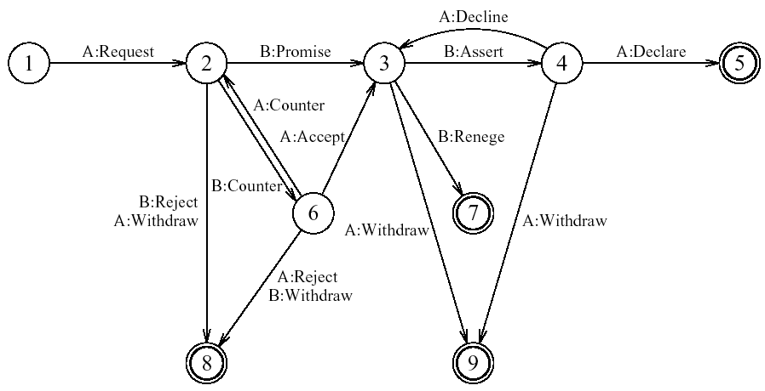
Conversations for action (CfA)
Circles represent ‘states’ in the conversation
Arcs represent utterances (speech acts)

Slide 21

CfA in action
Simplest route 1–5:
Alison: have you got the market survey on chocolate mousse? request
Brian: sure promise
Brian: there you are assert
Alison: thanks declare
More complex routes possible, e.g., 1–2–6–3 …
Alison: have you got … request
Brian: I've only got the summary figures counter
Alison: that'll do accept

Slide 22
Text-based communication
Most common media for asynchronous groupware exceptions: voice mail, answer-phones
Familiar medium, similar to paper letters but, electronic text may act as speech substitute!
Types of electronic text:
discrete directed messages, no structure
linear messages added (in temporal order)
non-linear hypertext linkages
spatial two dimensional arrangement
In addition, linkages may exist to other artefacts

Slide 23
Problems with text
No facial expression or body language
⇒ weak back channels
So, difficult to convey:
affective state – happy, sad, …
illocutionary force – urgent, important, …
Participants compensate: ‘flaming’ and smilies
;-) :-( :-)

Slide 24
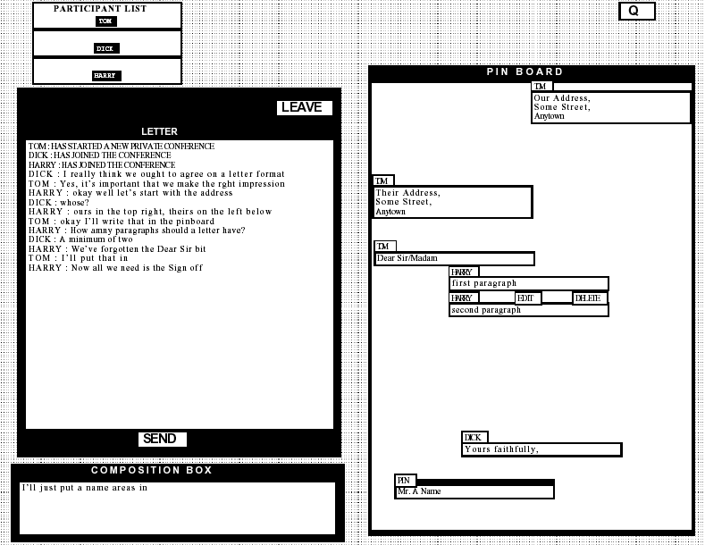
example – ‘Conferencer’
linear conversation area – LHS RHS – spatial simulated pinboard

Slide 25
Conferencer (ctd)
Note separate ‘composition box’ – transcript only updated when contribution ‘sent’ – granularity is the contribution
Pin board has similar granularity
‘cards’ only appear on other participants’ screens when edit/creation is confirmed
Note separate ‘composition box’ – transcript only updated when contribution ‘sent’ – granularity is the contribution
Pin board has similar granularity
‘cards’ only appear on other participants’ screens when edit/creation is confirmed

Slide 26
Grounding constraints
Establishing common ground depends on grounding constraints
cotemporality – instant feedthrough
simultaneity – speaking together
sequence – utterances ordered
Often weaker in text based communication
e.g., loss of sequence in linear text

Slide 27
loss of sequence
Network delays or coarse granularity ⇒ overlap
1. Bethan: how many should be in the group?
2. Rowena: maybe this could be one of the 4 strongest reasons
3. Rowena: please clarify what you mean
4. Bethan: I agree
5. Rowena: hang on
6. Rowena: Bethan what did you mean?
Message pairs 1&2 and 3&4 composed simultaneously – lack of common experience
Rowena: 2 1 3 4 5 6
Bethan: 1 2 4 3 5 6
N.B. breakdown of turn-taking due to poor back channels

Slide 28
Maintaining context
Recall context was essential for disambiguation
Text loses external context, hence deixis
(but, linking to shared objects can help)
1. Alison: Brian's got some lovely roses
2. Brian: I'm afraid they're covered in greenfly
3. Clarise: I've seen them, they're beautiful
Both (2) and (3) respond to (1)
… but transcript suggests greenfly are beautiful!

Slide 29
Non-linear conversation
1. Alison:
Brian’s got some
lovely roses
2. Brian:
I’m afraid they’re
covered in greenfly
3. Clarise:
I’ve seen them
they’re beautiful
4. Clarise:
have you tried
companion planting?
hypertext-based or
threaded-message systems
maintain ‘parallel’ conversations

Slide 30
Pace and granularity
Pace of conversation – the rate of turn taking
face-to-face – every few seconds
telephone – half a minute
email – hours or days
face-to-face conversation is highly interactive
initial utterance is vague
feedback gives cues for comprehension
lower pace ⇒ less feedback ⇒ less interactive

Slide 31
Coping strategies
People are very clever!
they create coping strategies when things are difficult
Coping strategies for slow communication
attempt to increase granularity:
eagerness – looking ahead in the conversation game
Brian: Like a cup of tea? Milk or lemon?
multiplexing – several topics in one utterance
Alison: No thanks. I love your roses.

Slide 32
The Conversation Game
Conversation is like a game
Linear text follows one path through it
Participants choose the path by their utterances
Hypertext can follow several paths at once

Slide 33
… like a game
participants choose the path by their utterances
Alison:
nice weather for
the time of year
Alison:
Oh, look at your
roses
Alison’s turn
Brian:
the red ones are
my favourite
Brian:
mmm, but I’ve had
trouble with greenfly
Brian’s turn
Alison’s turn
Alison:
they’re the symbol of
the English summer
Alison:
they’re the universal
sign of love
Alison:
have you tried
companion planting?
Brian:
talking of love
. . .
Brian’s turn
Brian:
thanks, I’ll try
that next year

Slide 34
Group dynamics
Work groups constantly change:
– in structure – in size
Several groupware systems have explicit rôles
But rôles depend on context and time
e.g., M.D. down mine under authority of foreman
and may not reflect duties
e.g., subject of biography, author, but now writer
Social structure may change: democratic, autocratic, … and group may fragment into sub-groups
Groupware systems rarely achieve this flexibility
Groups also change in composition
⇒ new members must be able to `catch up'

Slide 35
Physical environment
Face-to-face working radically affected by layout of workplace
e.g. meeting rooms:
recessed terminals reduce visual impact
inward facing to encourage eye contact
different power positions

Slide 36


power positions traditional meeting room
white
board
power positions
at front in reach
of white board

Slide 37

power positions augmented meeting room
shared
screen
power positions
at back – screen
accessed by
keyboard

Slide 38
Distributed cognition
Traditional cognitive psychology in the head
Distributed cognition suggests look to the world
Thinking takes place in interaction
with other people
with the physical environment
Implications for group work:
importance of mediating representations
group knowledge greater than sum of parts
design focus on external representation

