Slide 1



chapter 15
task models

Slide 2
What is Task Analysis?
Methods to analyse people's jobs:
what people do
what things they work with
what they must know

Slide 3
An Example
in order to clean the house
get the vacuum cleaner out
fix the appropriate attachments
clean the rooms
when the dust bag gets full, empty it
put the vacuum cleaner and tools away
must know about:
vacuum cleaners, their attachments, dust bags, cupboards, rooms etc.

Slide 4
Approaches to task analysis
Task decomposition
splitting task into (ordered) subtasks
Knowledge based techniques
what the user knows about the task and how it is organised
Entity/object based analysis
relationships between objects, actions and the people who perform them
lots of different notations/techniques

Slide 5
general method
observe
collect unstructured lists of words and actions
organize using notation or diagrams

Slide 6
Differences from other techniques
Systems analysis vs. Task analysis
system design - focus - the user
Cognitive models vs. Task analysis
internal mental state - focus - external actions
practiced `unit' task - focus - whole job

Slide 7
Task Decomposition
Aims: describe the actions people do structure them within task subtask hierarchy describe order of subtasks
Variants: Hierarchical Task Analysis (HTA) most common CTT (CNUCE, Pisa) uses LOTOS temporal operators

Slide 8
Textual HTA description
Hierarchy description ...
0. in order to clean the house
1. get the vacuum cleaner out
2. get the appropriate attachment
3. clean the rooms
3.1. clean the hall
3.2. clean the living rooms
3.3. clean the bedrooms
4. empty the dust bag
5. put vacuum cleaner and attachments away
... and plans
Plan 0: do 1 - 2 - 3 - 5 in that order. when the dust bag gets full do 4
Plan 3: do any of 3.1, 3.2 or 3.3 in any order depending on which rooms need cleaning
N.B. only the plans denote order

Slide 9
Generating the hierarchy
1 get list of tasks
2 group tasks into higher level tasks
3 decompose lowest level tasks further
Stopping rules How do we know when to stop? Is “empty the dust bag” simple enough? Purpose: expand only relevant tasks Motor actions: lowest sensible level

Slide 10
Tasks as explanation
imagine asking the user the question: what are you doing now?
for the same action the answer may be: typing ctrl-B making a word bold emphasising a word editing a document writing a letter preparing a legal case

Slide 11
HTA as grammar
can parse sentence into letters, nouns, noun phrase, etc.
noun phrase
syntax
det
noun
. . .
letter
. . .
. . .
. . .
lexical
The cat sat on the mat.
Notes:
N.B. not dealt with in this edition of the book, will add additional info to web site

Slide 12
parse scenario using HTA
get out cleaner
fix carpet head
clean dinning room
clean main bedroom
empty dustbag
clean sitting room
put cleaner away
1.
2.
3.2.
3.
0.
3.3.
4.
3.2.
5.
0. in order to clean the house
1. get the vacuum cleaner out
2. get the appropriate attachment
3. clean the rooms
3.1. clean the hall
3.2. clean the living rooms
3.3. clean the bedrooms
4. empty the dust bag
5. put vacuum cleaner and attachments away

Slide 13
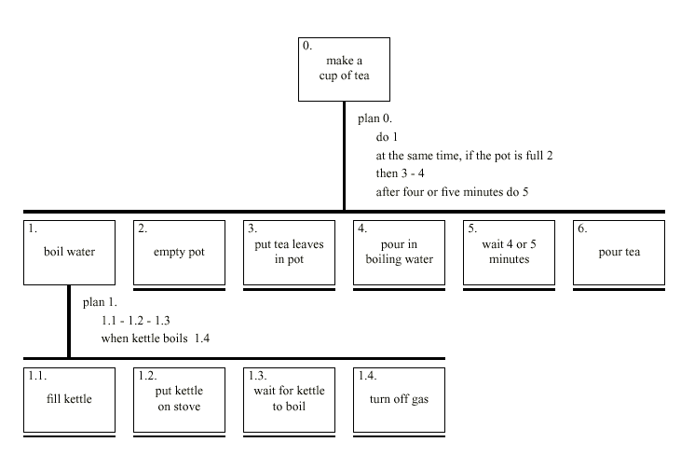
Diagrammatic HTA

Slide 14
Refining the description
Given initial HTA (textual or diagram)
How to check / improve it?
Some heuristics:
paired actions e.g., where is `turn on gas'
restructure e.g., generate task `make pot'
balance e.g., is `pour tea' simpler than making pot?
generalise e.g., make one cup ….. or more

Slide 15
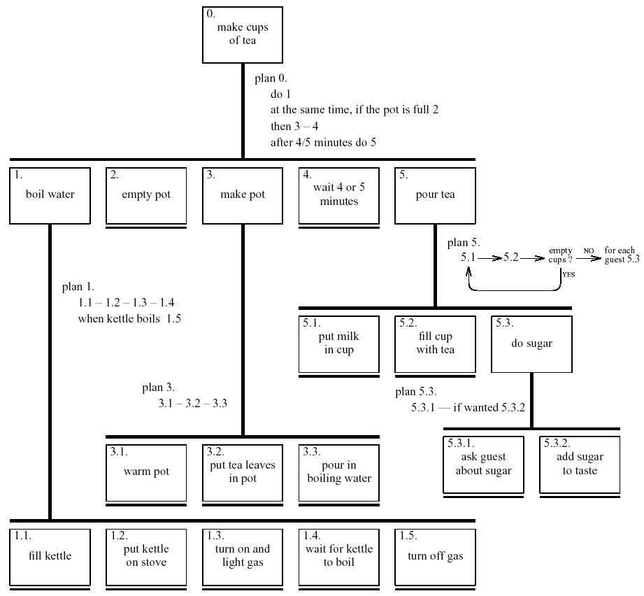
Refined HTA for making tea

Slide 16
Types of plan
fixed sequence - 1.1 then 1.2 then 1.3
optional tasks - if the pot is full 2
wait for events - when kettle boils 1.4
cycles - do 5.1 5.2 while there are still empty cups
time-sharing - do 1; at the same time ...
discretionary - do any of 3.1, 3.2 or 3.3 in any order
mixtures - most plans involve several of the above

Slide 17

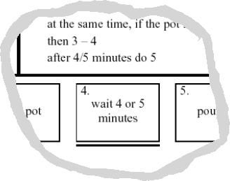
waiting …
is waiting part of a plan? … or a task?
generally
task – if ‘busy’ wait
you are actively waiting
plan – if end of delay is the event
e.g. “when alarm rings”, “when reply arrives”
in this example …
perhaps a little redundant …
TA not an exact science
see chapter 19 for more on delays!

Slide 18
Knowledge Based Analyses
Focus on:
Objects – used in task
Actions – performed
+ Taxonomies – represent levels of abstraction

Slide 19
Knowledge–Based Example …
motor controls
steering steering wheel, indicators
engine/speed
direct ignition, accelerator, foot brake
gearing clutch, gear stick
lights
external headlights, hazard lights
internal courtesy light
wash/wipe
wipers front wipers, rear wipers
washers front washers, rear washers
heating temperature control, air direction, fan, rear screen heater
parking hand brake, door lock
radio numerous!

Slide 20
Task Description Hierarchy
Three types of branch point in taxonomy:
XOR – normal taxonomy object in one and only one branch
AND – object must be in both multiple classifications
OR – weakest case can be in one, many or none
wash/wipe AND
function XOR
wipe front wipers, rear wipers
wash front washers, rear washers
position XOR
front front wipers, front washers
rear rear wipers, rear washers

Slide 21
Larger TDH example
kitchen item AND
/____shape XOR
/ |____dished mixing bowl, casserole, saucepan,
/ | soup bowl, glass
/ |____flat plate, chopping board, frying pan
/____function OR
{____preparation mixing bowl, plate, chopping board
{____cooking frying pan, casserole, saucepan
{____dining XOR
|____for food plate, soup bowl, casserole
|____for drink glass
N.B. ‘/|{’ used for branch types.

Slide 22
More on TDH
Uniqueness rule:
can the diagram distinguish all objects?
e.g., plate is:
kitchen item/shape(flat)/function{preparation,dining(for food)}/
nothing else fits this description
Actions have taxonomy too:
kitchen job OR
|____ preparation beating, mixing
|____ cooking frying, boiling, baking
|____ dining pouring, eating, drinking

Slide 23
Abstraction and cuts
After producing detailed taxonomy ‘cut’ to yield abstract view
That is, ignore lower level nodes e.g. cutting above shape and below dining, plate becomes: kitchen item/function{preparation,dining}/
This is a term in Knowledge Representation Grammar (KRG)
These can be more complex:
e.g. ‘beating in a mixing bowl’ becomes:
kitchen job(preparation) using a kitchen item/function{preparation}/

Slide 24
Entity-Relationship Techniques
Focus on objects, actions and their relationships
Similar to OO analysis, but …
includes non-computer entities
emphasises domain understanding not implementation
Running example
‘Vera's Veggies’ – a market gardening firm
owner/manager: Vera Bradshaw
employees: Sam Gummage and Tony Peagreen
various tools including a tractor `Fergie‘
two fields and a glasshouse
new computer controlled irrigation system

Slide 25
Objects
Start with list of objects and classify them:
Concrete objects:
simple things: spade, plough, glasshouse
Actors:
human actors: Vera, Sam, Tony, the customers
what about the irrigation controller?
Composite objects:
sets: the team = Vera, Sam, Tony
tuples: tractor may be < Fergie, plough >

Slide 26
Attributes
To the objects add attributes:
Object Pump3 simple – irrigation pump
Attributes:
status: on/off/faulty
capacity: 100 litres/minute
N.B. need not be computationally complete

Slide 27
Actions
List actions and associate with each:
agent – who performs the actions
patient – which is changed by the action
instrument – used to perform action
examples:
Sam (agent) planted (action) the leeks (patient)
Tony dug the field with the spade (instrument)

Slide 28
Actions (ctd)
implicit agents – read behind the words
`the field was ploughed' – by whom?
indirect agency – the real agent?
`Vera programmed the controller to irrigate the field'
messages – a special sort of action
`Vera told Sam to ... '
rôles – an agent acts in several rôles
Vera as worker or as manager

Slide 29
example – objects and actions
Object Sam human actor
Actions:
S1: drive tractor
S2: dig the carrots
Object Vera human actor – the proprietor
Actions: as worker
V1: plant marrow seed
V2: program irrigation controller
Actions: as manager
V3: tell Sam to dig the carrots
Object the men composite
Comprises: Sam, Tony
Object glasshouse simple
Attribute:
humidity: 0-100%
Object Irrigation Controller non-human actor
Actions:
IC1: turn on Pump1
IC2: turn on Pump2
IC3: turn on Pump3
Object Marrow simple
Actions:
M1: germinate
M2: grow

Slide 30
Events
… when something happens
performance of action
‘Sam dug the carrots’
spontaneous events
‘the marrow seed germinated’
‘the humidity drops below 25%’
timed events
‘at midnight the controller turns on’

Slide 31
Relationships
object-object
social - Sam is subordinate to Vera
spatial - pump 3 is in the glasshouse
action-object
agent (listed with object)
patient and instrument
actions and events
temporal and causal ‘Sam digs the carrots because Vera told him’
temporal relations
use HTA or dialogue notations.
show task sequence (normal HTA)
show object lifecycle

Slide 32
example – events and relations
Events:
Ev1: humidity drops below 25%
Ev2: midnight
Relations: object-object
location ( Pump3, glasshouse )
location ( Pump1, Parker’s Patch )
Relations: action-object
patient ( V3, Sam )
– Vera tells Sam to dig
patient ( S2, the carrots )
– Sam digs the carrots ...
instrument ( S2, spade )
– ... with the spade
Relations: action-event
before ( V1, M1) – the marrow must be sown before it can germinate
triggers ( Ev1, IC3 ) – when humidity drops below 25%, the controller turns on pump 3
causes ( V2, IC1 )
– the controller turns on the pump because Vera programmed it

Slide 33
Sources of Information
Documentation
N.B. manuals say what is supposed to happen but, good for key words and prompting interviews
Observation
formal/informal, laboratory/field (see Chapter 9)
Interviews
the expert: manager or worker? (ask both!)

Slide 34
Early analysis
Extraction from transcripts
list nouns (objects) and verbs (actions)
beware technical language and context: `the rain poured’ vs. `I poured the tea’
Sorting and classifying
grouping or arranging words on cards
ranking objects/actions for task relevance (see ch. 9)
use commercial outliner
Iterative process:
data sources  analysis
but costly, so use cheap sources where available

Slide 35
Uses – manuals & documentation
Conceptual Manual
from knowledge or entity–relations based analysis
good for open ended tasks
Procedural ‘How to do it’ Manual
from HTA description
good for novices
assumes all tasks known
To make cups of tea
Make pot of tea
once water has boiled
boil water –– see page 2
empty pot
make pot –– see page 3
wait 4 or 5 minutes
pour tea –– see page 4
warm pot
put tea leaves in pot
pour in boiling water
–– page 1 ––
–– page 3 ––

Slide 36
Uses – requirements & design
Requirements capture and systems design
lifts focus from system to use
suggests candidates for automation
uncovers user's conceptual model
Detailed interface design
taxonomies suggest menu layout
object/action lists suggest interface objects
task frequency guides default choices
existing task sequences guide dialogue design
NOTE. task analysis is never complete
rigid task based design ⇒ inflexible system

