Slide 1



chapter 17
models of the system

Slide 2
Models of the System
Standard Formalisms
software engineering notations used to specify the required behaviour of specific interactive systems
Interaction Models
special purpose mathematical models of interactive systems used to describe usability properties at a generic level
Continuous Behaviour
activity between the events, objects with continuous motion, models of time

Slide 3
types of system model
dialogue – main modes
full state definition
abstract interaction model
specific
system
generic
issues

Slide 4
Relationship with dialogue
Dialogue modelling is linked to semantics
System semantics affects the dialogue structure
But the bias is different
Rather than dictate what actions are legal, these formalisms tell what each action does to the system.

Slide 5
Irony
Computers are inherently mathematical machines
Humans are not
Formal techniques are well accepted for cognitive models of the user and the dialogue (what the user should do)
Formal techniques are not yet well accepted for dictating what the system should do for the user!

Slide 6
standard formalisms
general computing notations
to specify a particular system

Slide 7
standard formalisms
Standard software engineering formalisms can be used to specify an interactive system.
Referred to as formal methods
Model based – describe system states and operations
Z, VDM
Algebraic – describe effects of sequences of actions
OBJ, Larch, ACT-ONE
Extended logics – describe when things happen and who is responsible
temporal and deontic logics

Slide 8
Uses of SE formal notations
For communication
common language
remove ambiguity (possibly)
succinct and precise
For analysis
internal consistency
external consistency
with eventual program
with respect to requirements (safety, security, HCI)
specific versus generic

Slide 9
model-based methods
use general mathematics:
numbers, sets, functions
use them to define
state
operations on state

Slide 10

model-based methods
describe state using variables
types of variables:
basic type: x: Nat – non-negative integer {0,1,2,...}
or in the Z font:
individual item from set: shape_type: {line, ellipse, rectangle}
subset of bigger set: selection: set Nat – set of integers
or in the Z font:
function (often finite): objects: Nat → Shape_Type

Slide 11
Mathematics and programs
Mathematical counterparts to common programming constructs
Programming Mathematics
types sets
basic types basic sets
constructed types constructed sets
records unordered tuples
lists sequences
functions functions
procedures relations

Slide 12
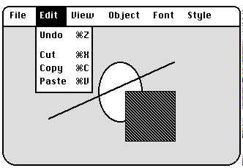
running example …
a simple graphics drawing package
supports several types of shape

Slide 13
define your own types
an x,y location is defined by two numbers
Point == Nat × Nat
a graphic object is defined by its shape, size, and centre
Shape ==
shape: {line, ellipse, rectangle}
x, y: Point – position of centre
wid: Nat
ht: Nat – size of shape

Slide 14
… yet another type definition
A collection of graphic objects can be identified by a ‘lookup dictionary’
[Id]
Shape_Dict == Id → Shape
Id is an introduced set
some sort of unique identifier for each object
Shap_Dict is a function
for any Id within its domain (the valid shapes) it gives you a corresponding shapthis means for any

Slide 15
use them to define state
shapes: Shape_Dict
selection: set Id – selected objects

Slide 16
invariants and initial state
invariants – conditions that are always be true
– must be preserved by every operation
selection ⊆ dom shapes
– selection must consist of valid objects
initial state – how the system starts!
dom shapes = {} – no objects
selection = {} – selection is empty

Slide 17
Defining operations
State change is represented as two copies of the state
before – State
after – State’
The Unselect operation deselects any selected objects
unselect:
selection' = {} – new selection is empty
shapes' = shapes – but nothing else changes

Slide 18
… another operation
delete:
dom shapes' = dom shapes – selection
– remove selected objects
∀ id ∈ dom shapes'
shapes' (id) = shapes(id)
– remaining objects unchanged
selection' = {} – new selection is empty
 note again use of primed variables for ‘new’ state

Slide 19
display/presentation
details usually very complex (pixels etc.) … but can define what is visible
Visible_Shape_Type =
Shape_Type
highlight: Bool
display:
vis_objects: set Visible_Shape_Type
vis_objects =
{ ( objects(id), sel(id) ) | id ∈ dom objects }
where sel(id ) = id ∈ selection

Slide 20
Interface issues
Framing problem
everything else stays the same
can be complicated with state invariants
Internal consistency
do operations define any legal transition?
External consistency
must be formulated as theorems to prove
clear for refinement, not so for requirements
Separation
distinction between system functionality and presentation is not explicit

Slide 21
Algebraic notations
Model based notations
emphasise constructing an explicit representations of the system state.
Algebraic notations
provide only implicit information about the system state.
Model based operations
defined in terms of their effect on system components.
Algebraic operations
defined in terms of their relationship with the other operations.

Slide 22
Return to graphics example
types
State, Pt
operations
init : → State
make ellipse : Pt × State → State
move : Pt × State → State
unselect : State → State
delete : State → State
axioms
for all st ∈ State, p ∈ Pt •
1. delete(make ellipse(st)) = unselect(st)
2. unselect(unselect(st)) = unselect(st)
3. move(p; unselect(st)) = unselect(st)

Slide 23
Issues for algebraic notations
Ease of use
a different way of thinking than traditional programming
Internal consistency
are there any axioms which contradict others?
External consistency
with respect to executable system less clear
External consistency
with respect to requirements is made explicit and automation possible
Completeness
is every operation completely defined?

Slide 24
Extended logics
Model based and algebraic notations make extended use of propositional and predicate logic.
Propositions
expressions made up of atomic terms: p, q, r, …
composed with logical operations: ∧ ∨ ¬ ⇒ …
Predicates
propositions with variables, e.g., p(x)
and quantified expressions: ∀ ∃
Not convenient for expressing time, responsibility and freedom, notions sometimes needed for HCI requirements.

Slide 25
Temporal logics
Time considered as succession of events
Basic operators:
– always (G funnier than A)
– eventually (G understands A)
– never (rains in So. Cal.)
Other bounded operators:
p until q – weaker than
p before q – stronger than
¬
¬

Slide 26
Explicit time
These temporal logics do not explicitly mention time, so some requirements cannot be expressed
Active research area, but not so much with HCI
Gradual degradation more important than time-criticality
Myth of the infinitely fast machine …

Slide 27
Deontic logics
For expressing responsibility, obligation between agents (e.g., the human, the organisation, the computer)
permission per
obligation obl
For example:
owns( Jane’ file `fred' ) ) ⇒
per( Jane, request( ‘print fred’ ))
performs( Jane, request( ‘print fred’ )) ) ⇒
obl( lp3, print(file ‘fred’))

Slide 28
Issues for extended logics
Safety properties
stipulating that bad things do not happen
Liveness properties
stipulating that good things do happen
Executability versus expressiveness
easy to specify impossible situations
difficult to express executable requirements
settle for eventual executable
Group issues and deontics
obligations for single-user systems have personal impact
for groupware … consider implications for other users.

Slide 29
interaction models
PIE model
defining properties
undo

Slide 30
Interaction models
General computational models were not designed with the user in mind
We need models that sit between the software engineering formalism and our understanding of HCI
formal
the PIE model for expressing general interactive properties to support usability
informal
interactive architectures (MVC, PAC, ALV) to motivate separation and modularisation of functionality and presentation (chap 8)
semi-formal
status-event analysis for viewing a slice of an interactive system that spans several layers (chap 18)

Slide 31
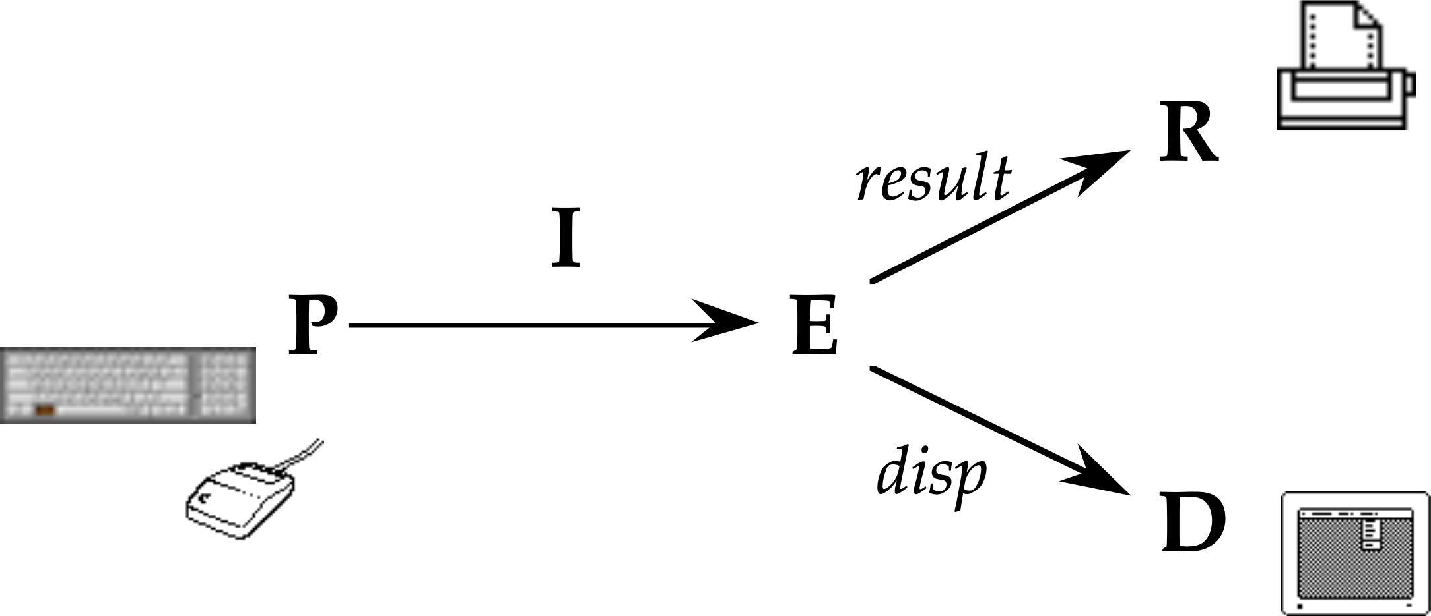
the PIE model
‘minimal’ black-box model of interactive system
focused on external observable aspects of interaction

Slide 32
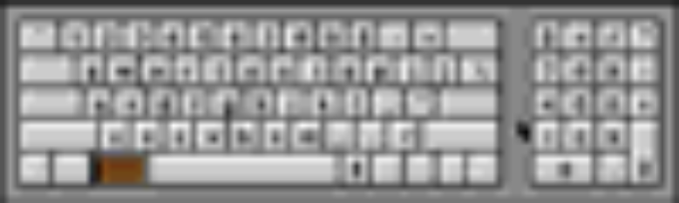

PIE model – user input
sequence of commands
commands include:
keyboard, mouse movement, mouse click
call the set of commands C
call the sequence P P = seq C

Slide 33
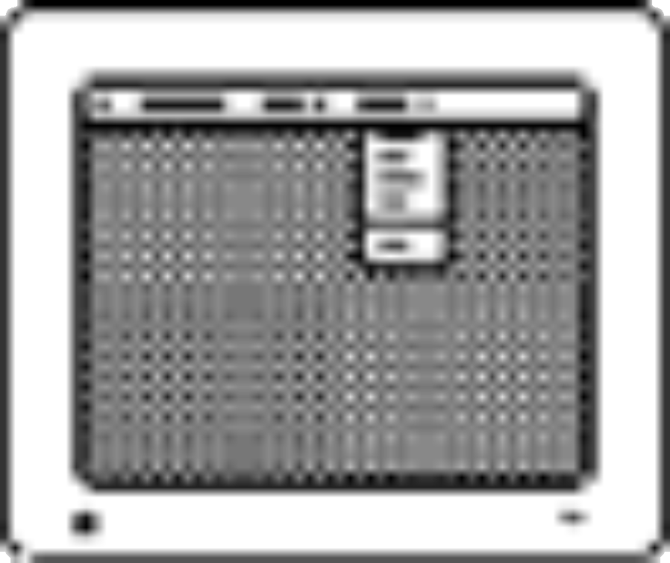

PIE model – system response
the ‘effect’
effect composed of: ephemeral display the final result
(e..g printout, changed file)
call the set of effects E

Slide 34
PIE model – the connection
given any history of commands (P)
there is some current effect
call the mapping the interpretation (I) I: P → E

Slide 35
More formally
[C;E;D;R]
P == seq C
I : P → E
display : E → D
result : E → R
Alternatively, we can derive a state transition function from the PIE.
doit : E × P → E
doit( I(p), q) = I(p q)
doit( doit(e, p). q) = doit(e, p q)

Slide 36
Expressing properties
WYSIWYG (what you see is what you get)
What does this really mean, and how can we test product X to see if it satisfies a claim that it is WYSIWYG?
Limited scope general properties which support WYSIWYG
Observability
what you can tell about the current state of the system from the display
Predictability
what you can tell about the future behaviour

Slide 37
Observability & predictability
Two possible interpretations of WYSIWYG:
What you see is what you:
will get at the printer
have got in the system
Predictability is a special case of observability

Slide 38
what you get at the printer
predict ∈ ( D → R ) s.t. predict o display = result
but really not quite the full meaning
R
result
I
P
E
predict
display
D

Slide 39
stronger – what is in the state
predict_{E} ∈ ( D → R ) s.t. predict_{E} o display = id_{E}
but too strong – only allows trivial systems where everything is always visible
R
result
I
P
E
predict
E
display
identity
on E
D

Slide 40
Relaxing the property
R
result
I
P
E
f
g
observe
O
D
O – the things you can indirectly observe in the system through scrolling etc.
predict the result
∃ f ∈ ( O → R ) s.t. f _{o} observe = result
or the effect
∃ g ∈ ( O → R ) s.t. g _{o} observe = id_{E}

Slide 41
Reachability and undo
Reachability – getting from one state to another.
∀ e, e’ ∈ E • ∃ p ∈ P • doit(e, p) = e’
Too weak
Undo – reachability applied between current state and last state.
∀ c ∈ C • doit(e, c undo) = e
Impossible except for very simple system with at most two states!
Better models of undo treat it as a special command to avoid this problem

Slide 42
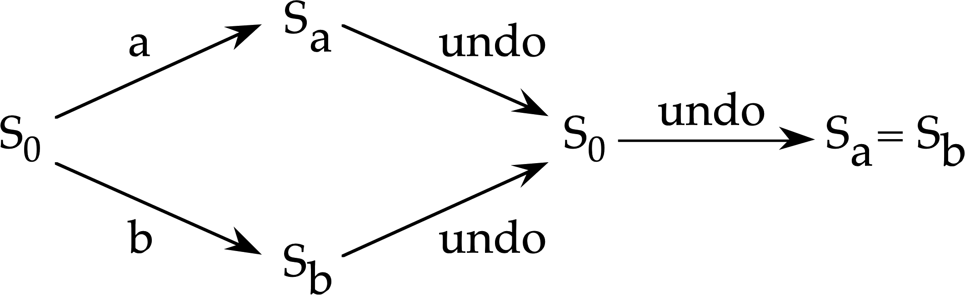
proving things – undo
∀ c : c undo ~ null ?
only for c ≠ undo

Slide 43
lesson
undo is no ordinary command!
other meta-commands:
back/forward in browsers
history window

Slide 44
Issues for PIE properties
Insufficient
define necessary but not sufficient properties for usability.
Generic
can be applied to any system
Proof obligations
for system defined in SE formalism
Scale
how to prove many properties of a large system
Scope
limiting applicability of certain properties
Insight
gained from abstraction is reusable

Slide 45
continuous behaviour
mouse movement
status–event & hybrid models
granularity and gestalt

Slide 46
dealing with the mouse
Mouse always has a location
not just a sequence of events
a status value
update depends on current mouse location
doit: E × C × M → E
captures trajectory independent behaviour
also display depends on mouse location
display: E × M → D
e.g.dragging window

Slide 47
formal aspects of status–event
events
at specific moments of time
keystrokes, beeps, stroke of midnight in Cinderella
status
values of a period of time
current computer display, location of mouse, internal state of computer, the weather

Slide 48
interstitial behaviour
discrete models
what happens at events
status–event analysis
also what happens between events
centrality …
in GUI – the feel
dragging, scrolling, etc.
in rich media – the main purpose

Slide 49
formalised …
current /
history of
action:
user-event x input-status x state -> response-event x (new) state
interstitial behaviour:
user-event x input-status x state -> response-event x (new) state
note: current input-status => trajectory independent history of input-status allows freehand drawing etc.

Slide 50
status–change events
events can change status
some changes of status are events
when bank balance < $100 need to do more work!
not all changes!
every second is a change in time
but only some times critical
when time = 12:30 – eat lunch
implementation issues
system design – sensors, polling behaviour
meaningful events
more on status-event analysis in chapter 18

Slide 51
making everything continuous
physics & engineering
everything is continuous
time, location, velocity, acceleration, force, mass
can model everything as pure continuous
state_{t} = ϕ ( t, t₀, state_{t0}, inputs during [t₀,t) )
output_{t} = η ( state_{t})
like interstitial behaviour
but clumsy for events – in practice need both
dx
dt
dv
dt
= v
= –g
x = vt –¹/₂gt²

Slide 52
hybrid models
computing “hybrid systems” models
physical world as differential equations
computer systems as discrete events
for industrial control, fly-by-wire aircraft
adopted by some
e.g. TACIT project Hybrid Petri Nets and continuous interactors
status–change
events
discrete
computation
continuous
input
discrete
input
threshold
object
state
enable/disable
status–status
mappings
continuous
output
discrete
output
depend on
discrete state

Slide 53
common features
actions
at events, discrete changes in state
interstitial behaviour
between events, continuous change

Slide 54
granularity and Gestalt
granularity issues
do it today
next 24 hours, before 5pm, before midnight?
two timing
‘infinitely’ fast times
computer calculation c.f. interaction time
temporal gestalt
words, gestures
where do they start, the whole matters

