Slide 1



chapter 18
modelling rich interaction

Slide 2
Modelling Rich Interaction
status–event analysis
rich environments in task analysis
sensor-based systems

Slide 3
status–event analysis
events – things that happen
e.g. alarm bell, beeps, keystrokes
status – things that are
e.g. screen display, watch face, mouse position
unifying framework – system (formal analysis) – user (psychology & heuristics)
time behaviour – detect delays, select feedback
transferable phenomena e.g. polling – active agent discovers status change

Slide 4
rich set of phenomena
events status
input keypress mouse position
output beep display
internal interrupt document state
external time temperature
Most notations only deal with subset of these
e.g. STNs: event-in/event-out
⇒ may need awkward work-arounds

Slide 5
rich set of behaviour
❶ actions:
state change at (user initiated) event
❷ status change events:
e.g. stock drops below re-order level
❸ interstitial behaviour:
between actions – e.g. dragging an icon
standard notations: ❶ usually, ❷ sometimes, ❸ never!

Slide 6
Properties of events
status change event
the passing of a time
actual and perceived events
usually some gap
polling
glance at watch face
status change becomes perceived event
granularity
birthday – days
appointment – minutes

Slide 7
Design implications
actual/perceived lag… matches application timescale?
too slow
response to event too late e.g., power plant emergency
too fast
interrupt more immediate task e.g., stock level low

Slide 8
Naïve psychology
Predict where the user is looking
mouse – when positioning
insertion point – intermittently when typing
screen – if you're lucky
Immediate events
audible bell – when in room (and hearing)
peripheral vision – movement or large change
Closure
lose attention (inc. mouse)
concurrent activity

Slide 9
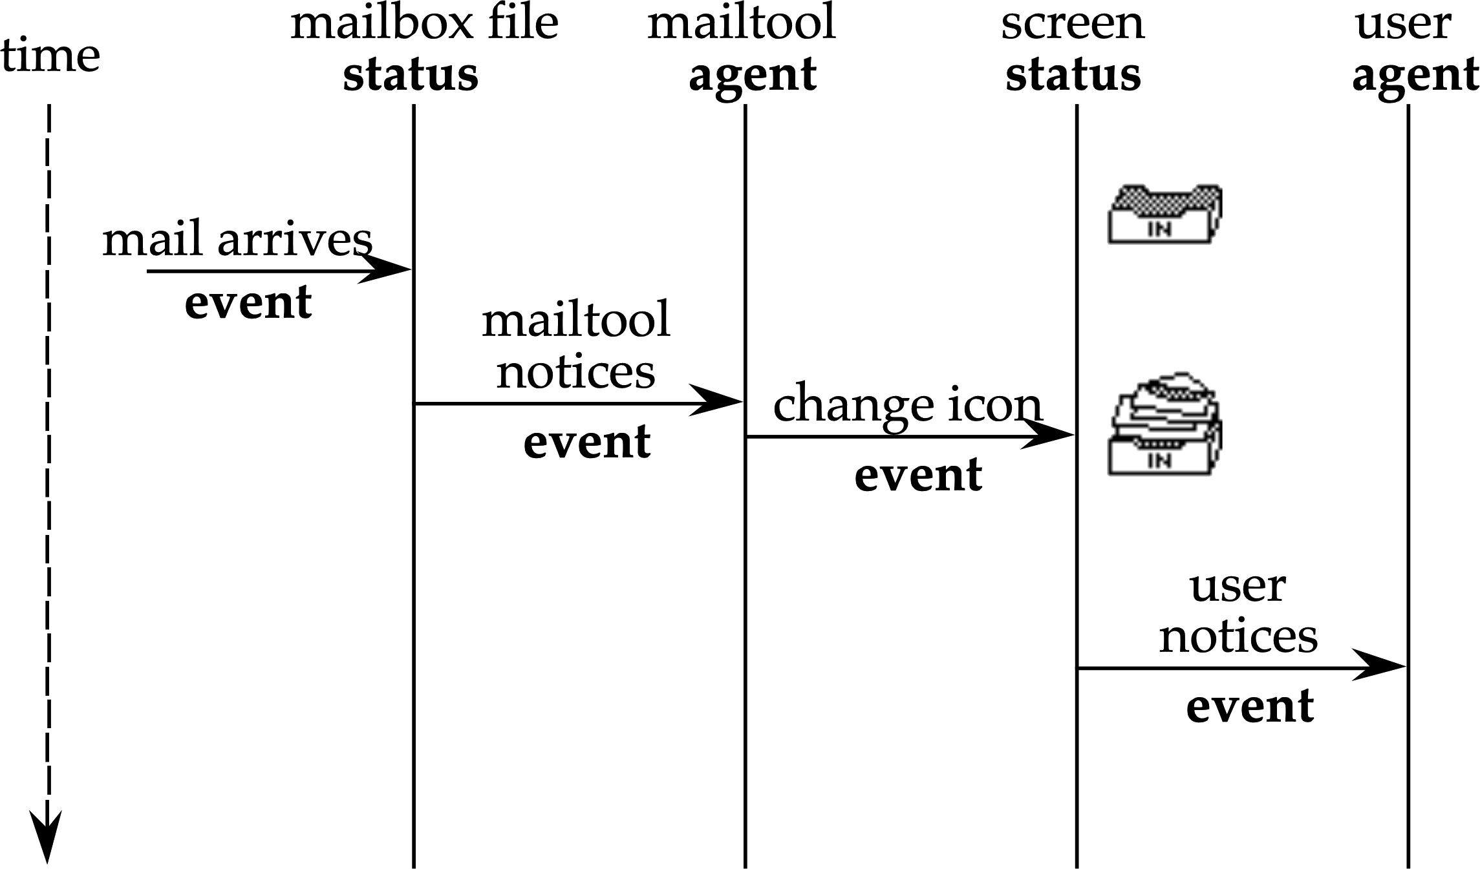
email delivery

Slide 10
email delivery (ctd)
mail has arrived!
timeline at each level
Perceived event in minutes – not guaranteed
alternative timescale
explicit examination – hours/days
audible bell – seconds
but want minutes – guaranteed

Slide 11
screen button widget
Delete
Delete
Delete
Delete
screen button often missed, … but, error not noticed
a common widget, a common error: Why?
Closure
mistake likely – concurrent action
not noticed – semantic feedback missed
Solution
widget feedback for application event
a perceived event for the user
N.B. an expert slip – testing doesn't help
the quick brown
the quick brown
the quick brown
the quick brown
quick
quick
quick
quick

Slide 12
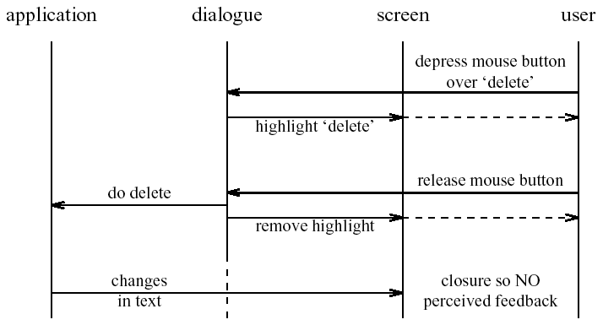
Screen-button – HIT
Delete
Delete
Delete
Delete
the quick brown
the quick brown
the quick brown
the brown fox
quick
quick
quick

Slide 13
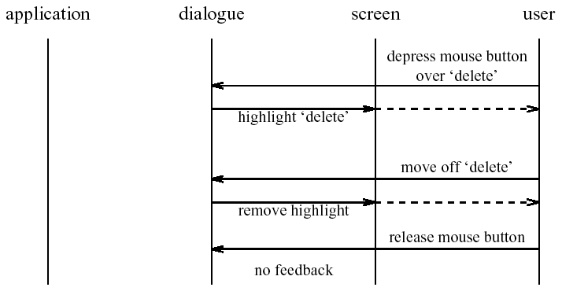
Screen button – MISS
Delete
Delete
Delete
Delete
the quick brown
the quick brown
the quick brown
the quick brown
quick
quick
quick
quick

Slide 14
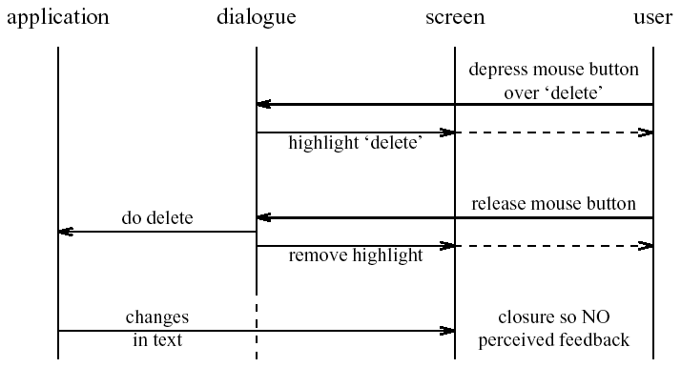

HIT or a MISS?
HIT
CLICK
identical screen feedback
semantic feedback only closure ⇒ eye moves elsewhere
one solution add simulated click
MISS

Slide 15
rich contexts

Slide 16
the problem
task models
formal description
situatedness
unique contexts
ethnography
rich ecologies
bringing
them together?

Slide 17
collaboration
already in several notations
e.g. CTT, GTA
add artefacts too ?

Slide 18
ConcurTaskTrees (CTT) Paterno et al. CNUCE, Pisa
book holiday
abstract task
user task
>>
holiday idea
make booking
computer task
user and computer
>>
||
>>
cooperative task
email advert
decide destination
( customer :)
book flights
( travel agent:)
choose hotel
( customer :)
book hotel
( travel agent:)

Slide 19
Groupware Task Analysis
GTA
conceptual framework, tools, elicitation techniques
rich model of task world
rich ontology
human roles for collaboration
physical and electronic objects
Used_by
Object
Contains
Role
Subrole
Is
Responsible
Event
Triggers
Uses
Plays
Performed_by
Performed_by
Agent
Task
Has
Goal
Subtask
Triggers
Subgoal

Slide 20
information
pre-planned cognitive model
goal  action
situated action
environment  action

Slide 21
control
open loop control
no feedback
fragile
control system
environment
actions

Slide 22
control
open loop control
no feedback
fragile
closed loop control
uses feedback
robust
feedback
control system
environment
actions

Slide 23
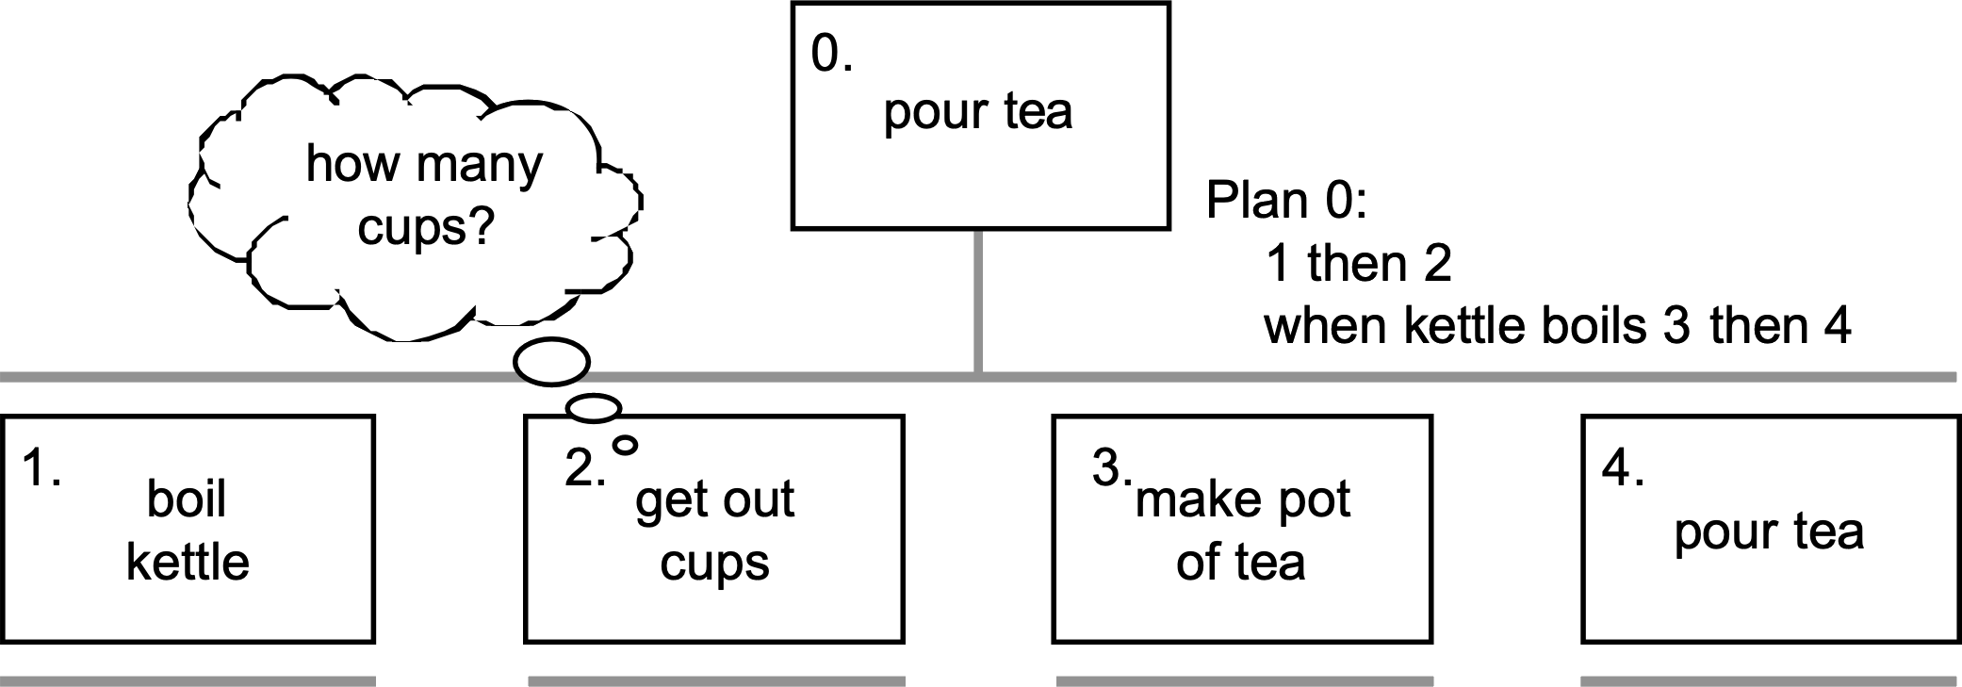
adding information

Slide 24
adding information (ctd)
information required when
subtask involves input (or output)
some kind of choice (how to know what to do)
subtask repeated (but iterations unspecified)
sources of information
part of existing task (e.g. phone number entered)
user remembers it (e.g. recall number after directory enquiry)
on device display (e.g. PDA address book, then dial)
in the environment
pre-existing (e.g. phone directory)
created in task (e.g. write number down on paper)
GUI easy (lots of space) mobile/PDA need to think

Slide 25
triggers
process – what happens and order
get post from pigeon hole
bring post to desk
open post

Slide 26
triggers
process – what happens and order
triggers – when and why
first thing in the
morning
holding post
at coffee time
get post from pigeon hole
bring post to desk
open post

Slide 27
common triggers
immediate
straight after previous task
temporal
at a particular time
sporadic
when someone thinks of it!
external event
when something happens, e.g. phone call
environmental cue
something prompts action … artefacts

Slide 28
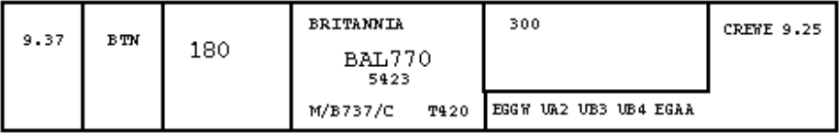
artefacts
ethnographic studies
as shared representation
as focus of activity
act as triggers, information sources, etc.

Slide 29
placeholders
knowing where you are in a process
like a program counter
coding:
memory
explicit (e.g. to do list)
in artefacts

Slide 30
where are you?

Slide 31
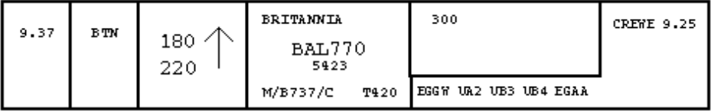
step 1. choose new flight level

Slide 32
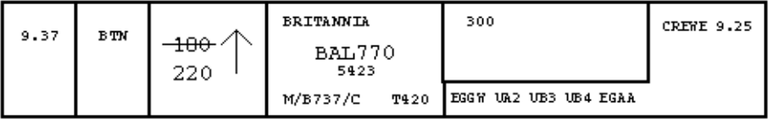
step 3. flight level confirmed

Slide 33
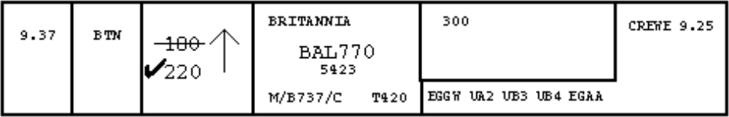
step 5. new flight level acheived

Slide 34
tracing placeholders
a form of information, may be …
in people’s heads
remembering what to do next
explicitly in the environment
to-do lists, planning charts, flight strips, workflow
implicitly in the environment
location and disposition of artefacts
electronic environments …
fewer affordances for artefacts
danger for careless design!
papers tidy or skewed
letter open or closed

Slide 35
low intention and sensor-based interaction

Slide 36

car courtesy lights
turn on
when doors unlocked/open
turned off
after time period
when engine turned on
driver's purpose is to get into the car
incidentally the lights come on

Slide 37

Pepys
Xerox Cambridge (RIP)
active badges
automatic diaries
Allan's purpose to visit Paul’s office
incidentally diary entry created

Slide 38
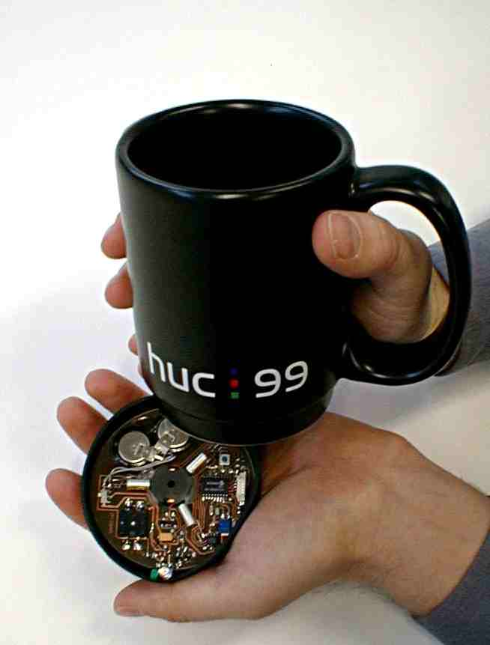
MediaCup
cup has sensors
heat, movement, pressure
broadcasts state (IR)
used for awareness
user is moving, drinking, …
Han's purpose to drink coffee
incidentally colleagues are aware

Slide 39
shopping cart
goods in shopping cart analysed
e.g. Amazon books
used to build knowledge about books
people who like X also like Y
used to give you suggestions
“you might like to look at …”, “special offer …”
my purpose to buy a book
incidentally shown related titles

Slide 40

onCue
‘intelligent’ toolbar
appropriate intelligence
make it good when it works
don’t make it hard of it doesn’t
analyses clipboard contents
suggests things to do with it
user's purpose to copy text elsewhere
incidentally alternative things to do

Slide 41
the intentional spectrum
intentional
press light switch
expected
walk into room expecting lights to switch on
incidental
walk into room … unbeknown to you
… air conditioning increases

Slide 42
fluidity
intentional
co-option
users explicitly use behaviour e.g. open door for lights
expected
comprehension
users notice, form model
then rely on behaviour
incidental

Slide 43
interaction models
intentional cycle
Norman execution/evaluation loop
some exceptions
multiple goals, displays, opportunistic
guidelines
feedback, transparency
intention
goal
execution
evaluation
system

Slide 44
cognition
physical things (inanimate)
directness of effect
locality of effect
visibility of state
computational things (also animate)
complex effects
non locality of effect
distance – networks; time – delays, memory
large hidden state

Slide 45
cognition
understanding
innate intelligences
physical, natural/animal, social, physiological
rational thought
imagination
interfaces
GUI, VR, AR, tangible
recruit physical/tangible intelligence
ubicomp, ambient, incidental
? ? ?
homunculi, haunted houses

Slide 46
designing incidental interaction
need richer representations
of the world, of devices, of artefacts
wider ecological concerns
two tasks
purposeful task – for interpretation
supported task – for actions

Slide 47
issues and process
no accepted methods but … general pattern
uncertainty
traditional system due to errors
sensor-based intrinsic to design
uncertain readings, uncertain inference
usually control non-critical aspects of environment
process … identify
input – what is going to be sensed
output – what is going to be controlled
scenarios – desired output and available input

Slide 48

designing a car courtesy light
safe? light advertises presence
available input
door open, car engine
desired output
light!
identify scenario
label steps
0 don’t care
+, ++, … want light
–, ––, … don’t want it
legal requirements
light off whilst driving
safety
approaching car??
deactivate alarm 0
walk up to car 
key in door –
open door & take key +
get in ++
close door 0
adjust seat +
find road map ++
look up route +++
find right key +
key in ignition –
start car 0
seat belt light flashes 0
fasten seat belt +
drive off –––––
illegal to drive with
interior light on

Slide 49
implementation
sensors not used for original purpose
open architectures, self-discovering, self-configuring
privacy
internet–enables kettle broadcasts to the world!
context
inferring activity from sensor readings – status not event
data filtering and fusion
using several sensors to build context
inference
hand-coded or machine-learning
must be used
control something (lights) or modify user actions (TV on)

Slide 50
architectures for sensor-based systems?
inference
control
data
fusion
context
model
raw
sensors
data
reduction
user
actions

