Slide 1
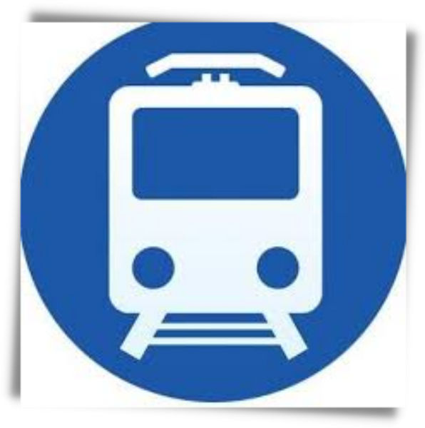

RAILWAY ENQUIRY SYSTEM
1602-19-737-128 Bheeshma Udumula
1602-19-737-145 Nikitha Maramraju
1602-19-737-164 Santosh Kumar Soma

Slide 2

01
Problem Statement
02
Abstract
03
Actors
Table of
Contents
04
Use cases
05
Overall Architecture
06
Existing Use-Case Diagram
07
Additional Use-Case Diagram
08
Sequence Diagrams
09
Class Diagram
10
DB Schema
11
Tech Stack

Slide 3



Indian Railways are the backbone to the transportation system. Approximately 30 million people travel daily in India using railways. It continues to grow and the solution proposed should have the flexibility to scale proportionality.
Service quality is the most important factor for the passenger’s satisfaction. India has biggest railway network across the country and in the whole world. The purpose of this project is to enhance the service quality of Railway Enquiry System and to attain the passenger's satisfaction.
In this project we provide users with the details of a train and various functions related to it.
Problem Statement

Slide 4
The Railway Enquiry System facilitates the passengers to enquire about the trains available on the basis of source and destination, Spot the trains and railway stations , PNR status, Locating the live station of the train, User Query Section(allows people to clarify their doubts), Get directions from your location to your nearest railway station, Chatbot.
The aim of this project is to design and develop a web application for the users incorporated with these features.
Abstract

Slide 5


Actors
People who use or interact with our application
USER
SYSTEM
RAILWAY ENQUIRY SYSTEM

Slide 6



Use-Cases #1
Spot your train
Live station
Train schedule
Find Station
PNR Status
RAILWAY ENQUIRY SYSTEM

Slide 7



Use-Cases #2
Find trains b/w Source and Destination
Get directions to Nearest Railway Station
Chatbot
User Query Sections
Find Train Fares

Slide 8





Request
Collect Data
Response
What the user sees and interacts with
Contains app logic
Python, JS
HTML, CSS, Bootstrap
Display Result
Frontend
Web Server
Django
Framework
Database
SQLite
Backend

Slide 9
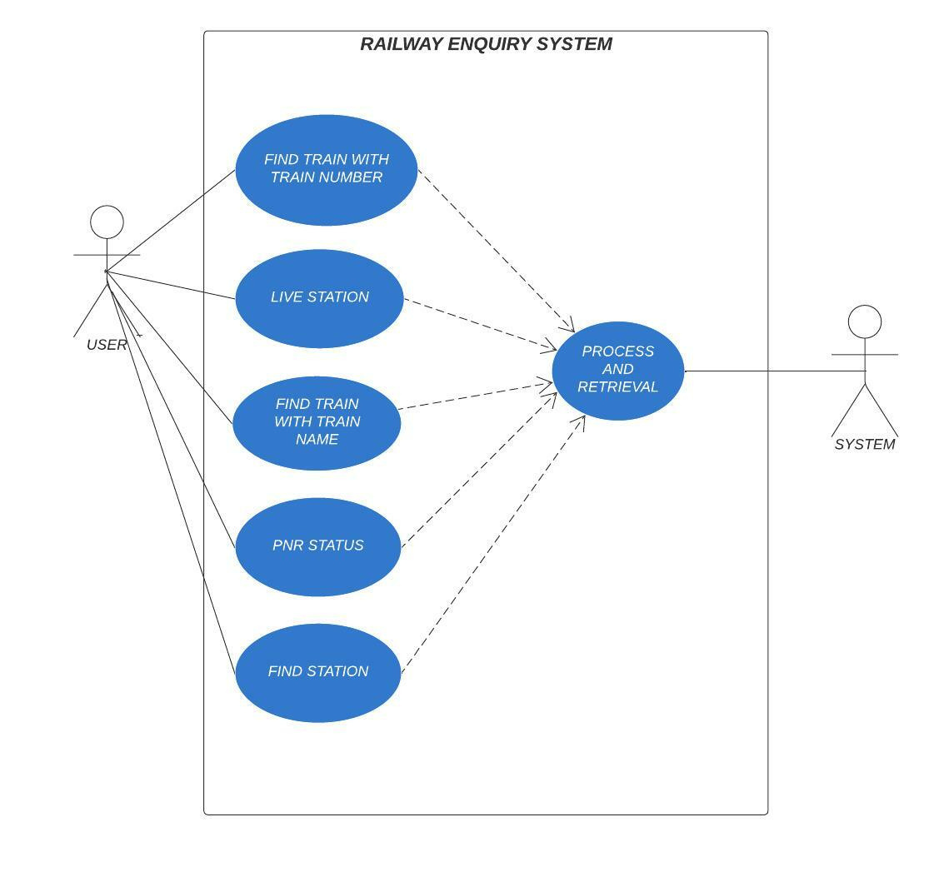
Existing
Use-Case
Diagram

Slide 10
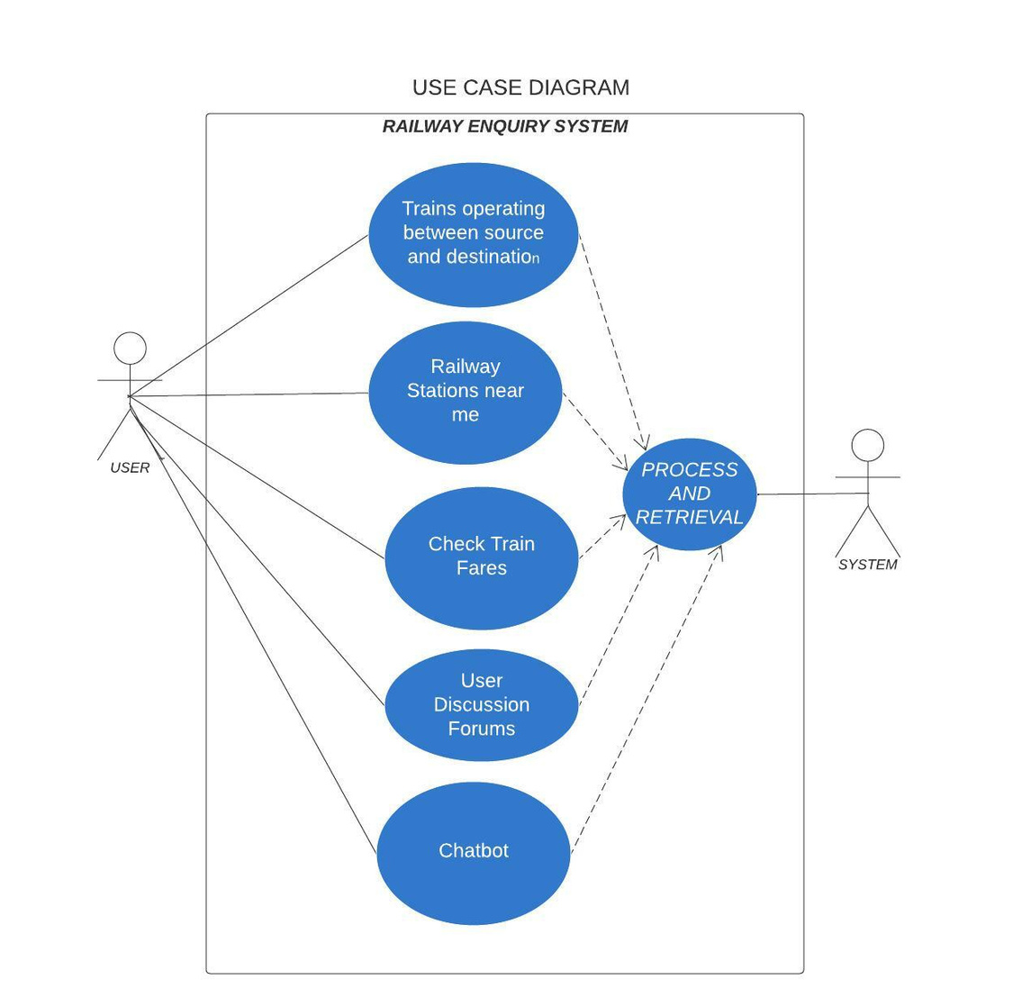
Additional
Use-Case
Diagram

Slide 11
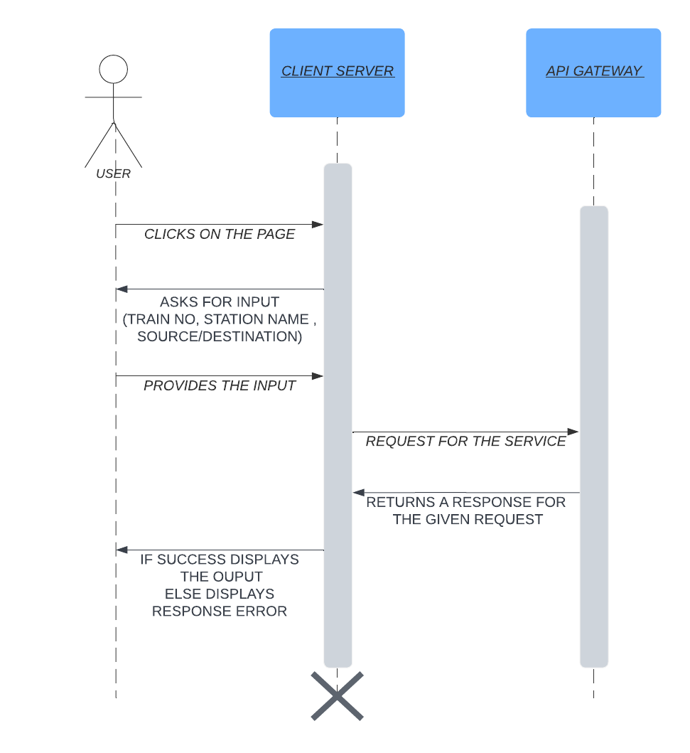
Sequence
Diagram-1

Slide 12
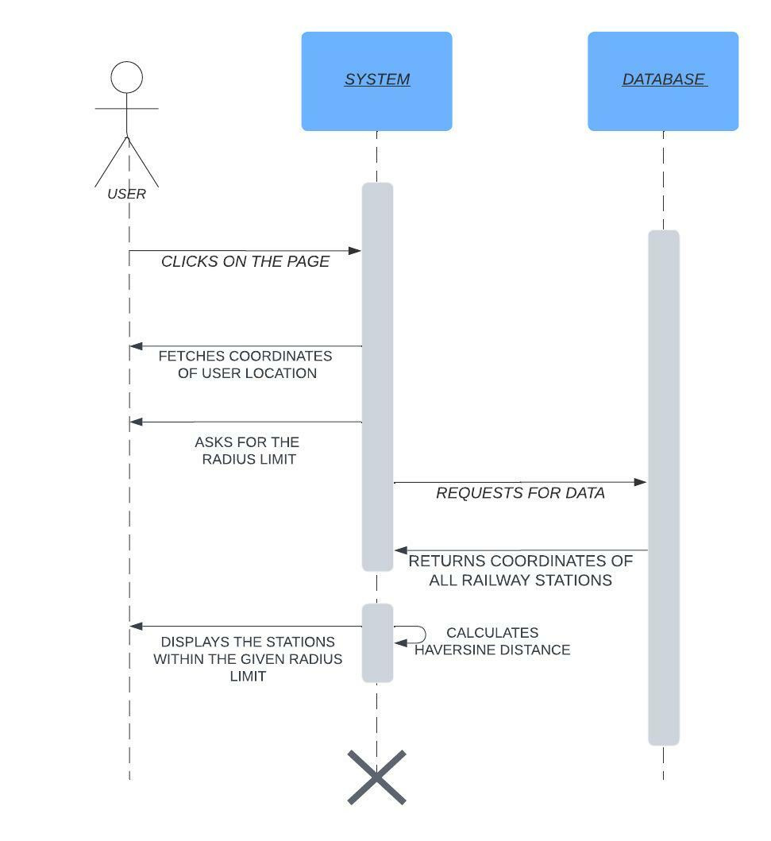
Sequence
Diagram-2

Slide 13
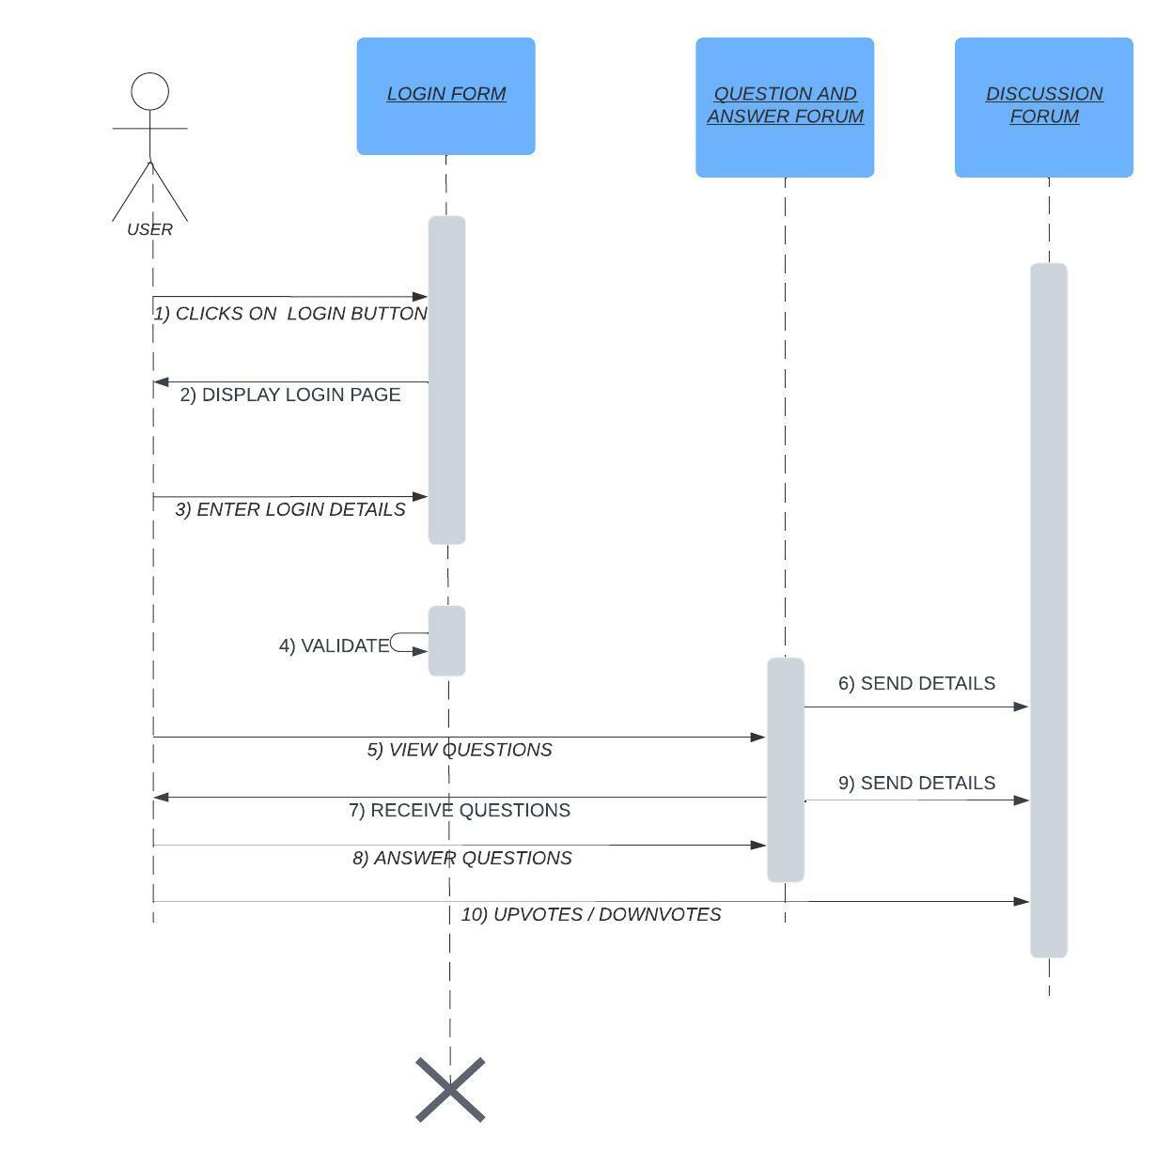
Sequence
Diagram-3

Slide 14
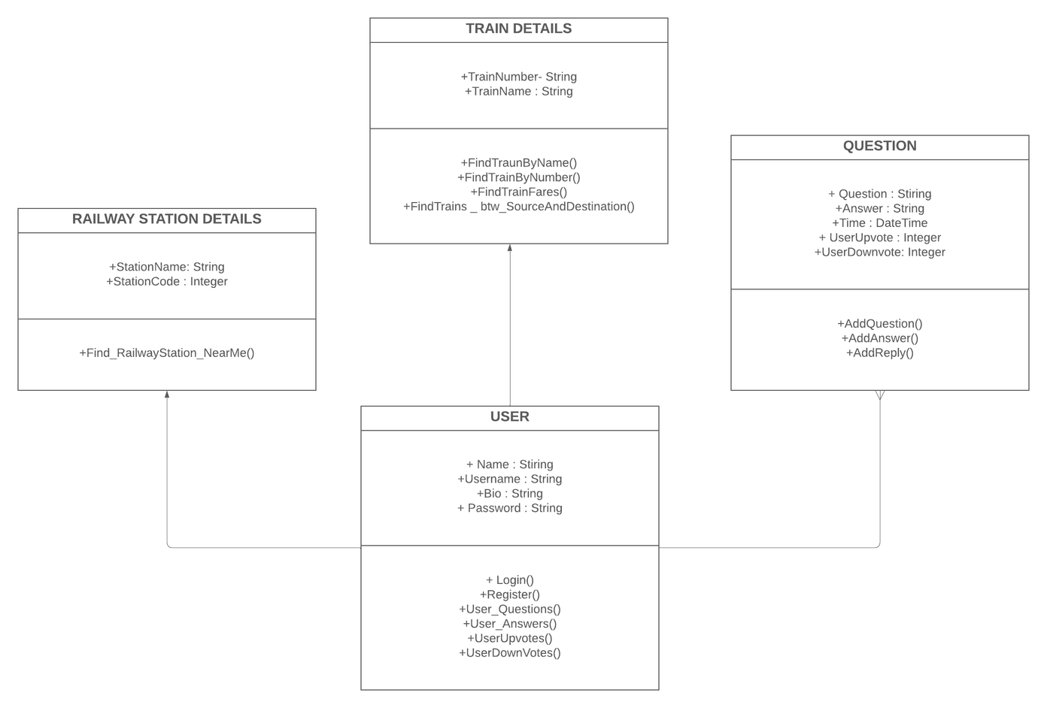
Class
Diagram

Slide 15
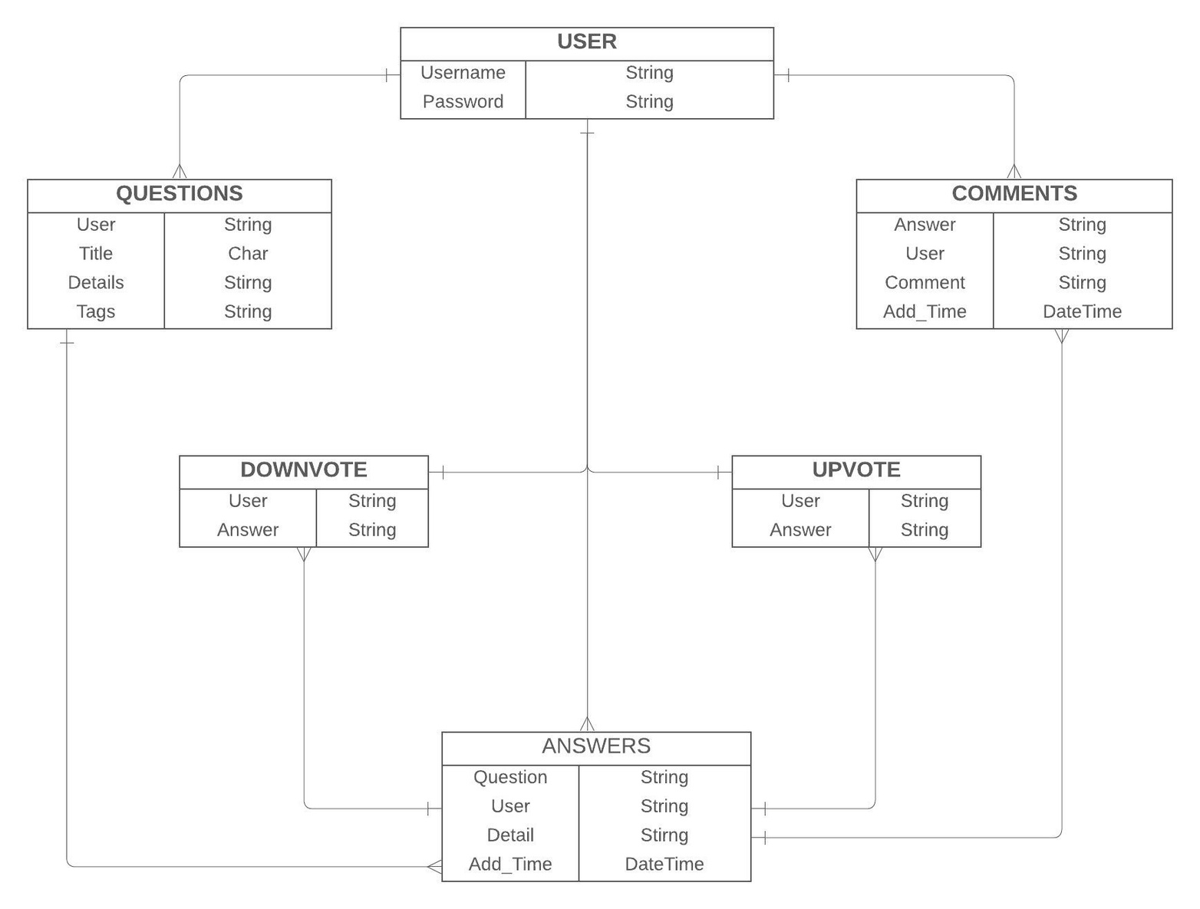
DB
Schema

Slide 16



Framework
Django
Tech Stack
Frontend
HTML CSS Bootstrap JS
Backend
Python SQLite3-DB
RAILWAY ENQUIRY SYSTEM

