Slide 1


Bank of Baroda Hackathon - 2022
Technology Partner
Team Name : Protomators
Your team bio : “A group becomes teammates when each member is sure enough of himself and his contribution to praise…”
Date : 10-09-2022

Slide 2
Problem Statement:
Bank handles large volumes of cheques in the clearing process. The process involves many technical verifications including signature verification. Some of these steps are manual and require human intervention to complete the process. The current process requires the high human capital deployment and longer processing time.
Automated Cheque Processing (ACP) is another component of the ACH that allows for faster cheque clearing. Paper cheques used to be processed manually, a process that took up to seven days to clear. With ACP, deposited cheques are cleared by the end of the next day if deposited by 2:00p.m.
So for the automation of the cheque processing we have chosen this problem statement to solve by using our knowledge in this hackathon.

Slide 3
User Segment & Pain Points
For any bank, Cheque clearing is a very important and highly resource intensive process. On any normal day, a leading bank can recive anywhere between 3-6 lakhs of cheques for Clearance. Being an intricate process, it involves multiple levels of screening and vigilance to ensure reulatory guidelines are met. For all these reasons, major parts of this process are manual in nature till date. Guidelines involve verifying account information and some technical details present in the cheques.
Difficulties:
1. Form Recognition (Model training):
In form recognition it is complex to train the OCR model for analysing the labels.
2. Signature Verification (Pattern analysis):
In Signature verification it is comples to analyse it through the Patte analysis.

Slide 4
Use Case:
Processing time while also making the process less rone to errors and possible frauds due to collusion.
Extract all the handwritten information on the cheque extract the signature present in the cheques
Validate the information against the business ruels deemed by the organization.
Verify the signature present in cheque with that of in the Organisation’s database

Slide 5
Azure tools or resources:
Azure Computer Vision (OCR): Azure's Computer Vision service gives you access to advanced algorithms that process images and return information based on the visual features you're interested in. Service. Description. Optical Character Recognition (OCR) The Optical Character Recognition (OCR) service extracts text from images. Azure Cloud: Running virtual machines or containers in the cloud is one of the most popular uses for Microsoft Azure. These compute resources can host infrastructure components, such as domain name system (DNS) servers; Windows Server services -- such as Internet Information Services (IIS); or third-party applications. Azure Container Registry: Azure Container Registry is a private registry service for building, storing, and managing container images and related artifacts. In this quickstart, you create an Azure container registry instance with the Azure portal

Slide 6
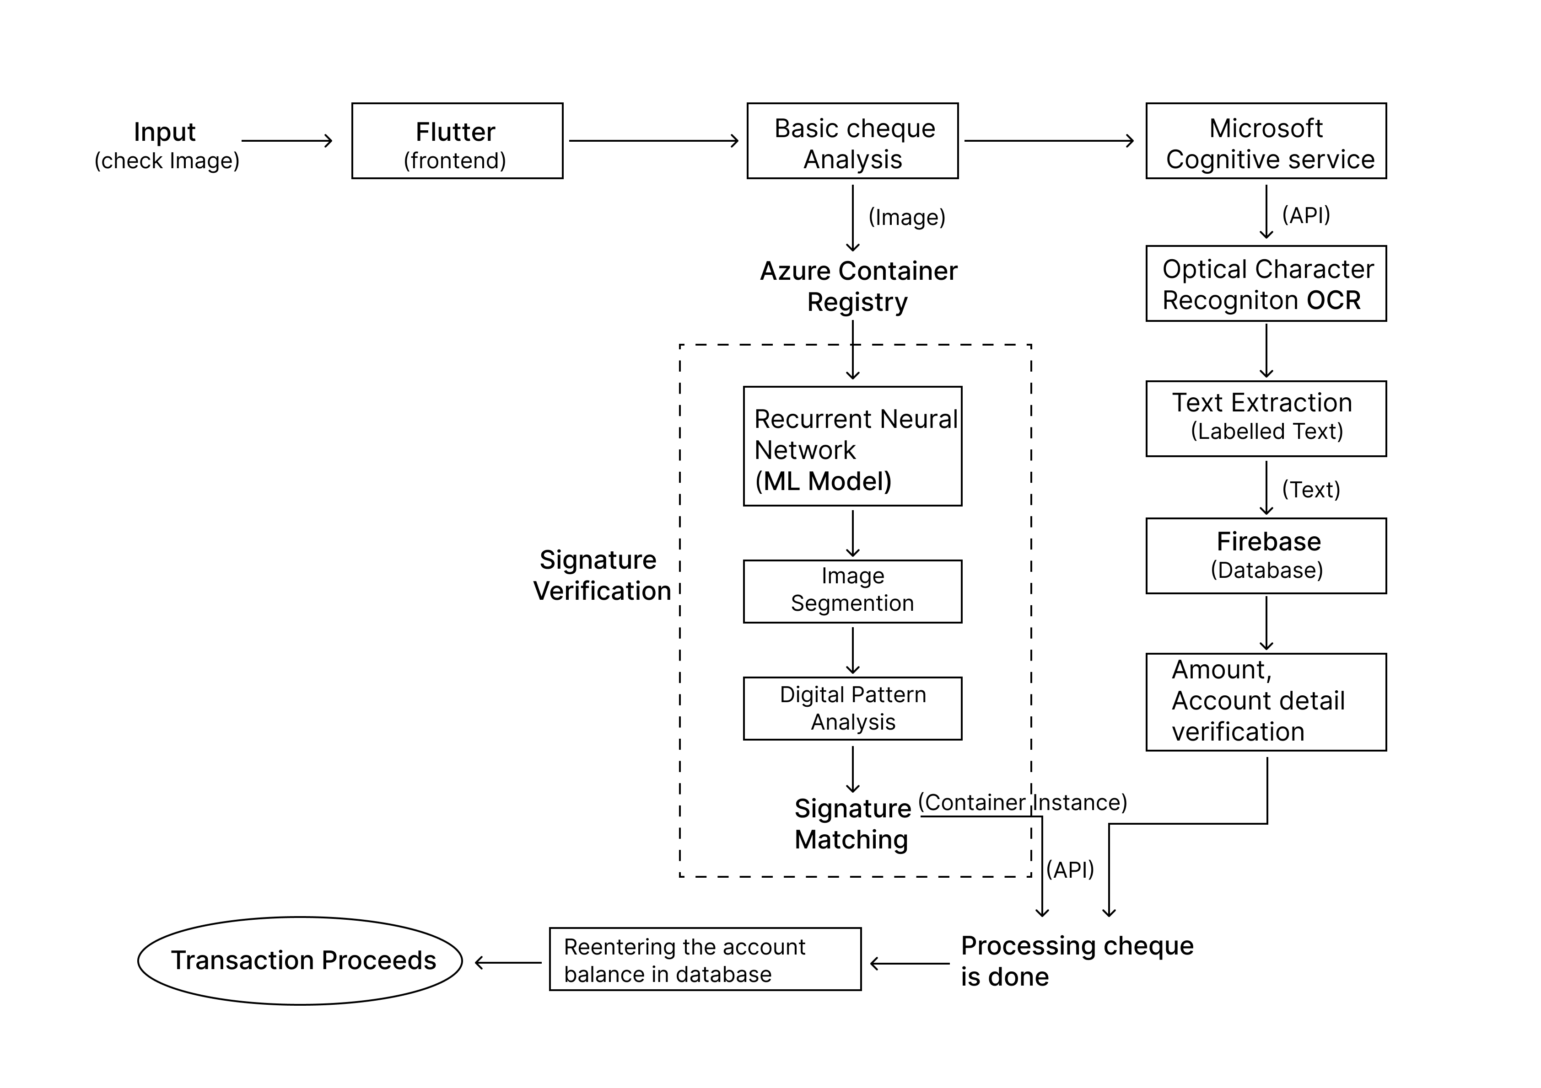
Process Flow:

Slide 7
Key Differentiators & Adoption Plan:
Reduced processing and quality assurance checking times.
Annually, manual labour is reduced by 75%.
Service Levels hae improved significantly.
Reduced operational costs by a considerable amount.
Process standardization increases
Customer experience improved.

Slide 8
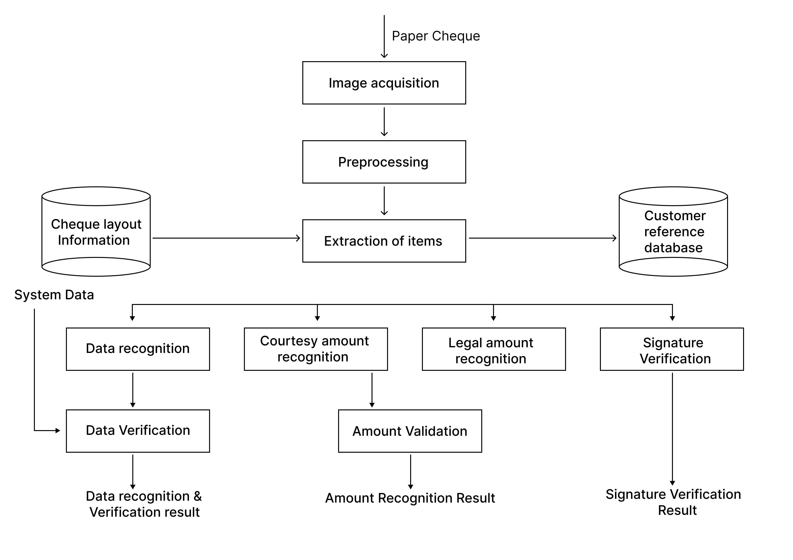
GitHub Repository Link & supporting diagrams, screenshots, if any
Repository Link: https://github.com/santosh-5/Automated_Cheque_Processing.git

Slide 9

Thank You
Team members names:
Santosh T
Sheik Ahamed S D
Ganapathy P
Lalith kanth D

