Slide 1
Heart Attack Prediction using ML Approach
By
Santosh Thiagarajan

Slide 2
Contents
Problem statement – HA dataset from UCI/Kaggle
Subject – What is heart attack?
  How to interpret heart attack biologically? Symptoms of heart attack.
Let’s know the Dataset - Understanding features/variables
Pipeline – what are we planning to do?
Preprocessing- Missing values, Unique values, Variable categories
EDA – Univariate Analysis, Bivariate Analysis
Modelling preparation
Machine Learning Inference analysis

Slide 3
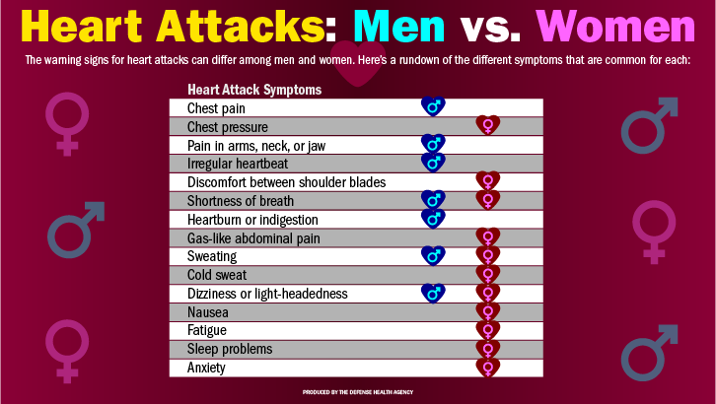
Domain – Subject
Symptoms of heart attack
What is heart attack?
  Medical Emergency
  Chest pain
  Shortness of breath
  Unstoppable cold sweatness
Interpret heart attack biologically
  Blockage in coronary artery
  Blood clot in Coronary Artery
  Narrowing of Coronary Artery
Image Source : https://health.mil/News/Articles/2022/02/11/Womens-Heart-Attacks-Symptoms-Can-Differ-from-Mens-Know-the-Signs?type=Photos

Slide 4
Dataset - Understanding features/variables

Slide 5
Dataset - Understanding features/variables

Slide 6
Machine Learning Pipeline
Data Analysis
Data loading
Data Preprocessing
Removing features with low correlation
Machine learning Modelling & Inference analysis
Split train and test dataset
Converting data to parquet format for large dataset
Univariate Data visualization
Bivariate Data visualization
Removing rows with null or nan values
Treating numerical features statistically
Scaling numerical variables
Categorical variables – one hot encoding
Import ML libraries for various Classifier Algorithms
Calculate accuracy
Calculate reliability
Calculate performance

Slide 7
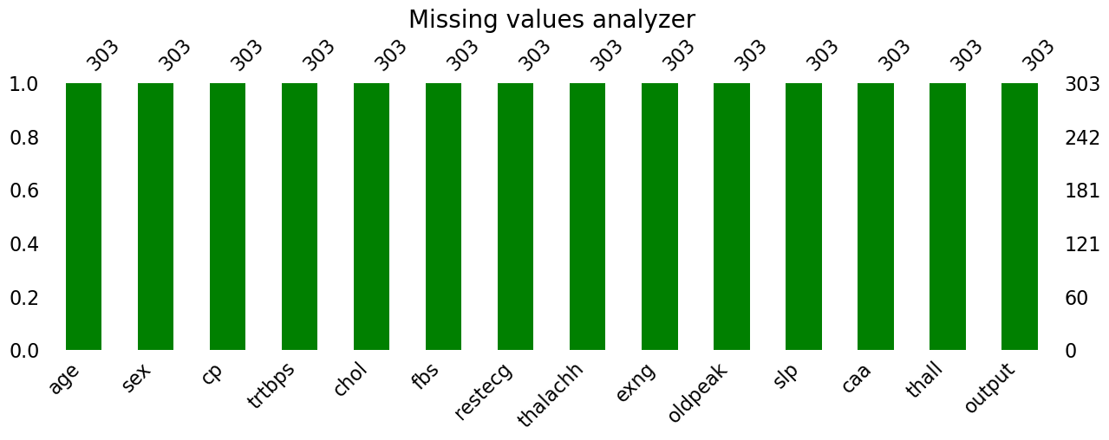
Preprocessing- Missing values – missingno package

Slide 8
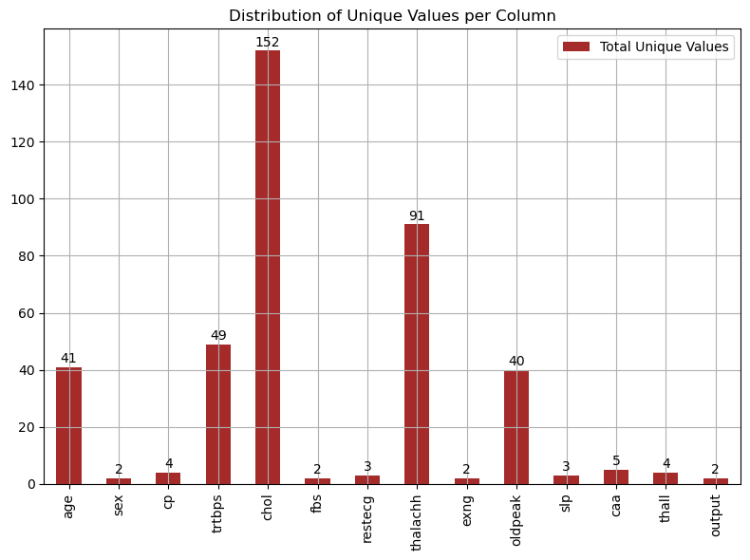
Preprocessing- Unique values

Slide 9
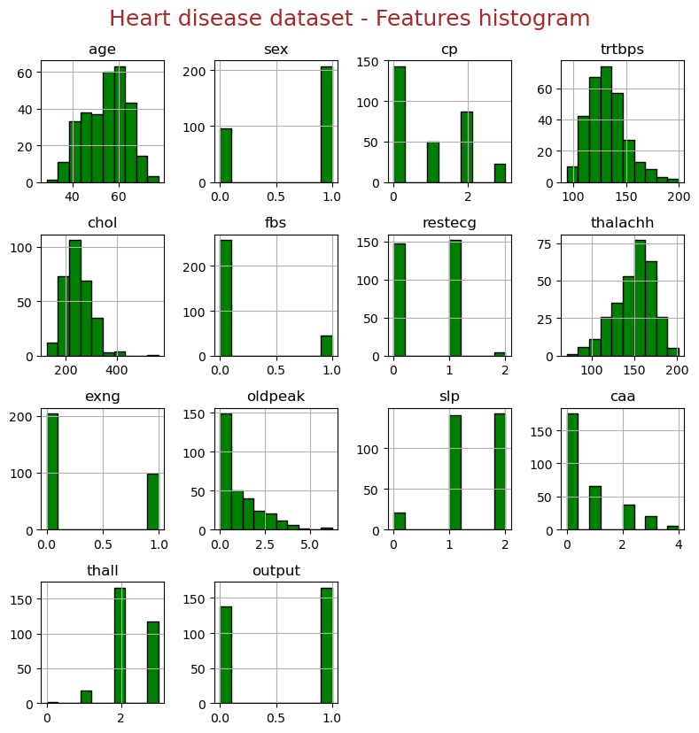
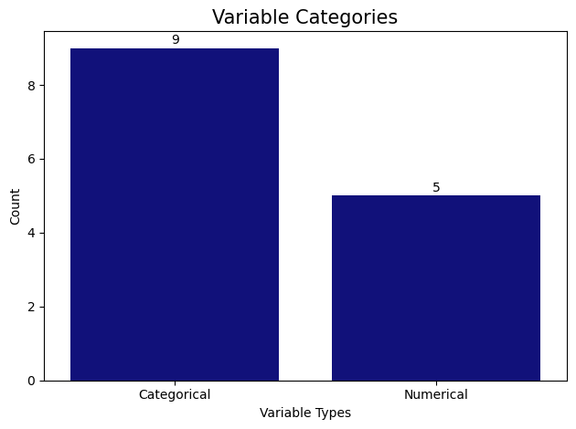
Preprocessing- variable categories

Slide 10
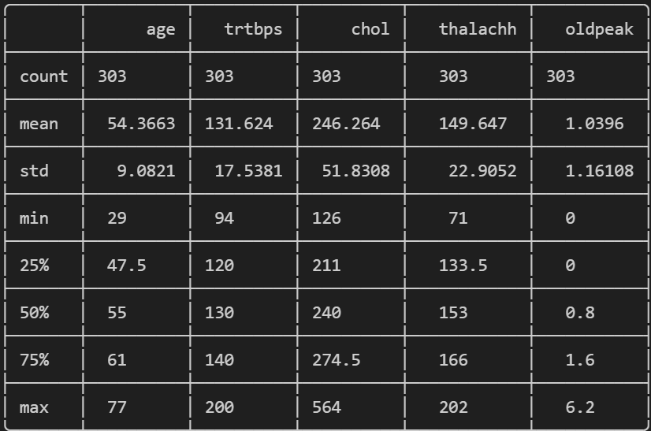
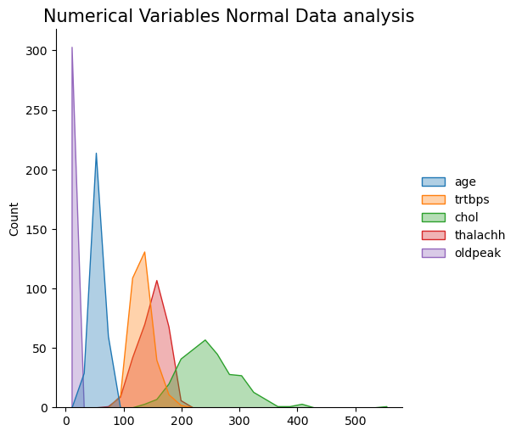
Preprocessing- Examining Statistics of Numerical variables

Slide 11
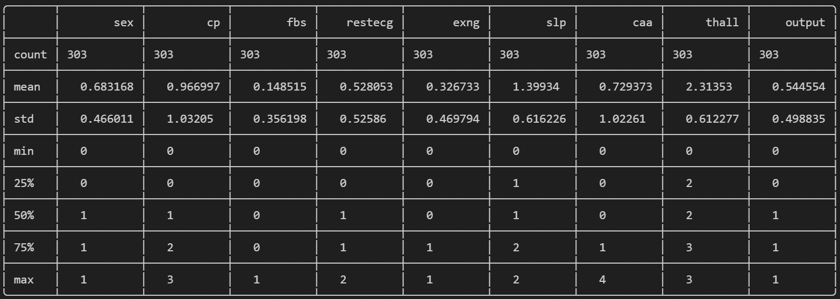
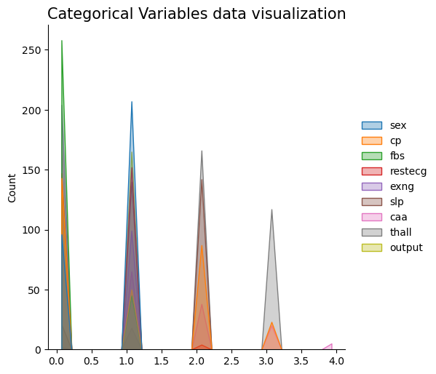
Preprocessing- Examining Statistics of Categorical variables

Slide 12
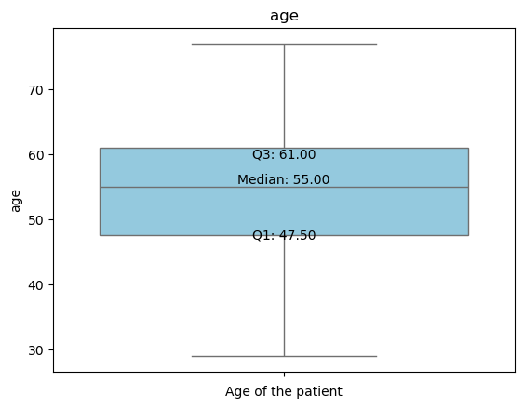
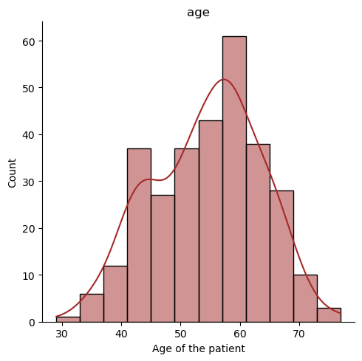
EDA – Univariate Analysis – Boxplot and Histplot - Age
Analysis – No significant observation. Normal age expectancy

Slide 13
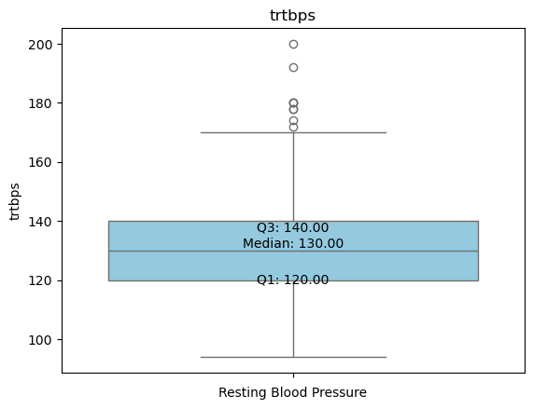
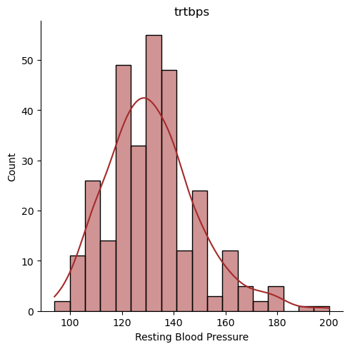
EDA – Univariate Analysis – Boxplot and Histplot - BP
Analysis – outlier exists.
Normal range – 80-120mmHg
Outlier
Outlier

Slide 14
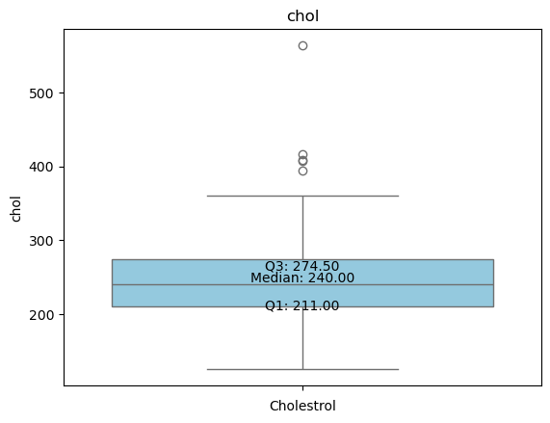
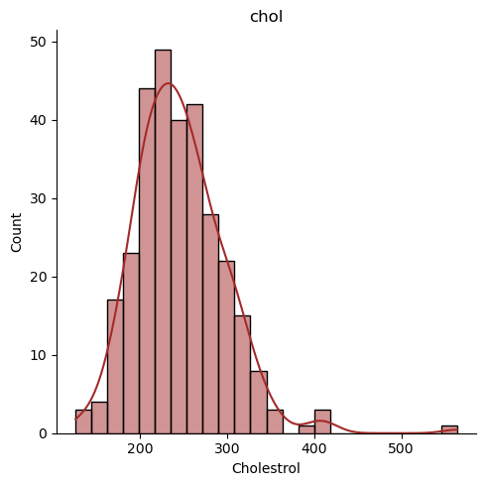
EDA – Univariate Analysis – Boxplot and Histplot - Cholesterol
Analysis – outlier exists.
Normal range – less than 200
Outlier
Outlier

Slide 15
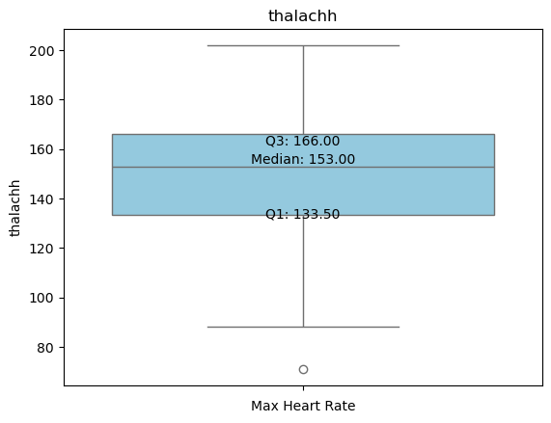
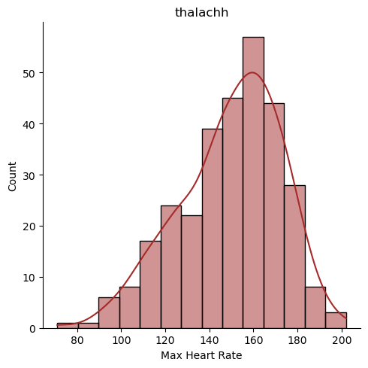
EDA – Univariate Analysis – Boxplot and Histplot – Thalach - HR
Analysis – outlier exists.
Normal range 60 to 100 beats per minute
Outlier
Outlier

Slide 16
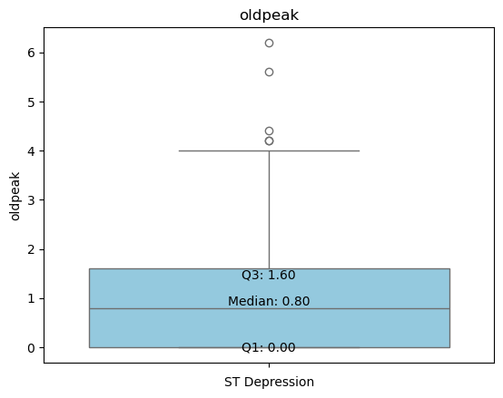
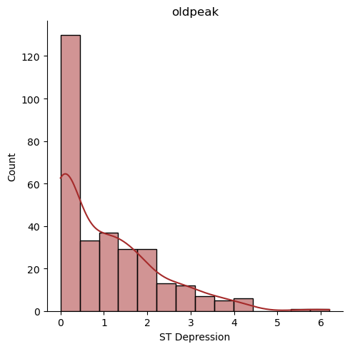
EDA – Univariate Analysis – Boxplot and Histplot – ST Depression
Outlier
Analysis – outlier exists.
Normal range less than 1 mm
Outlier

Slide 17
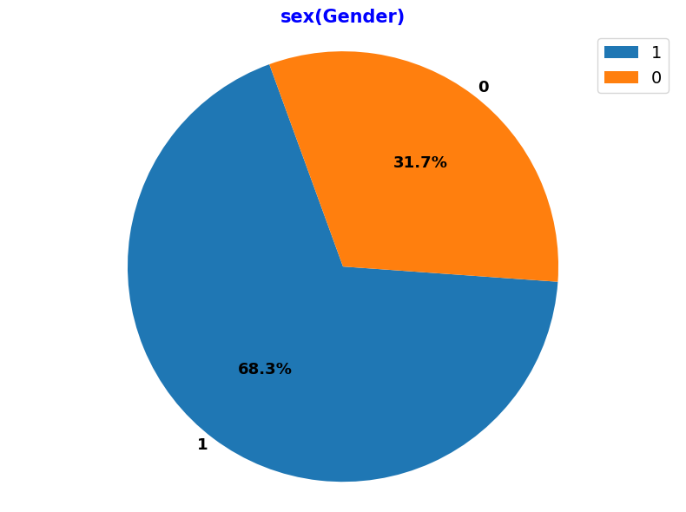
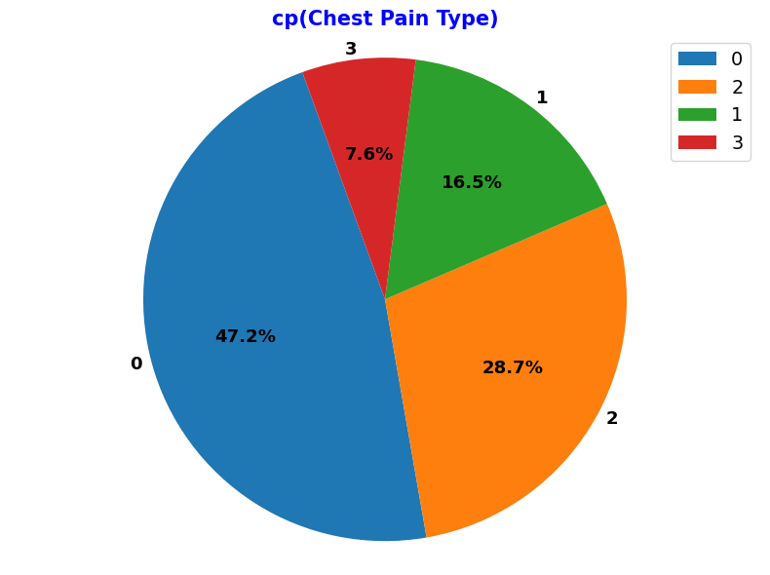
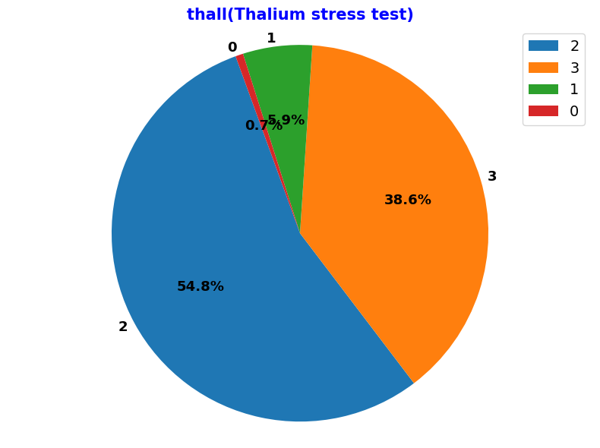
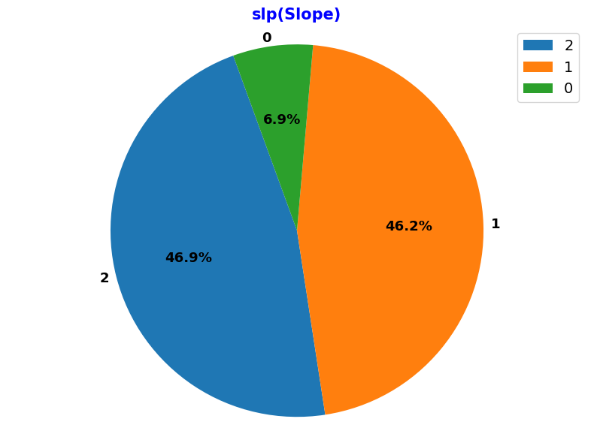
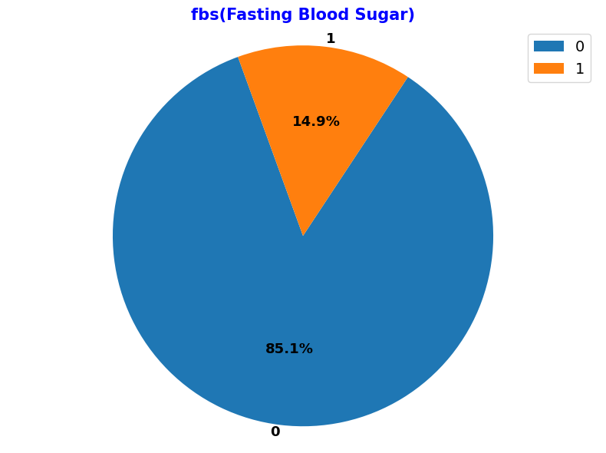
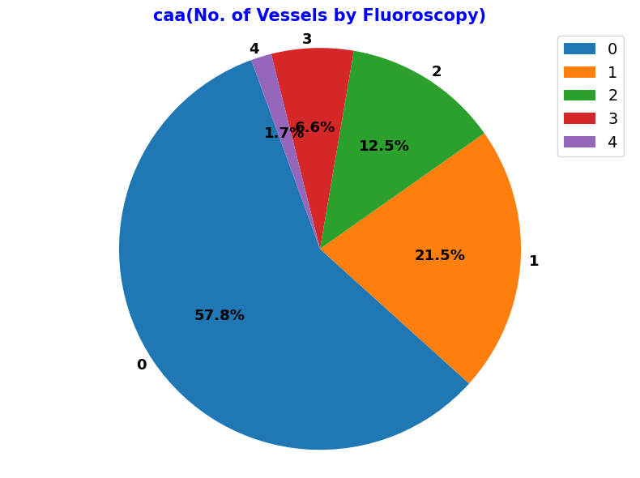
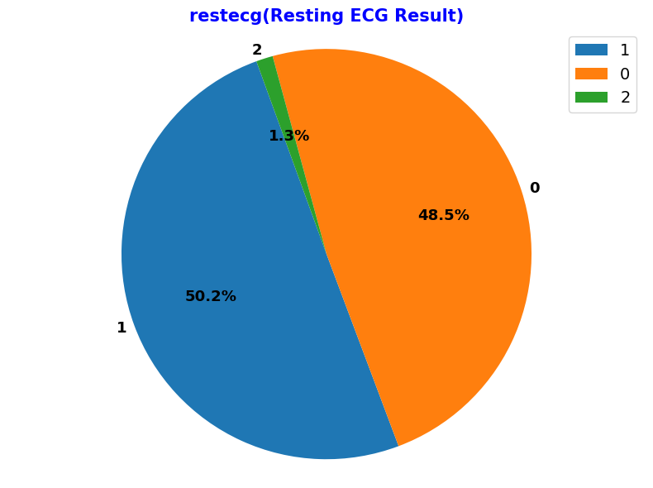
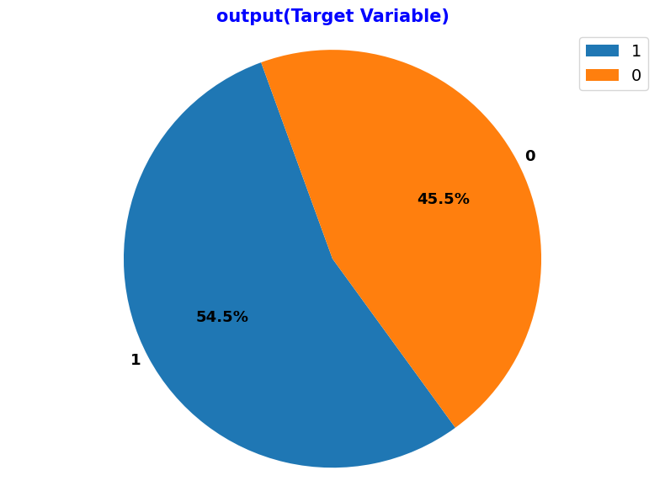
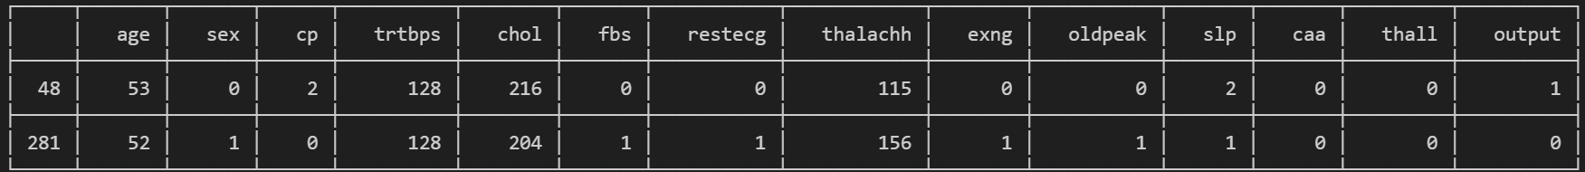
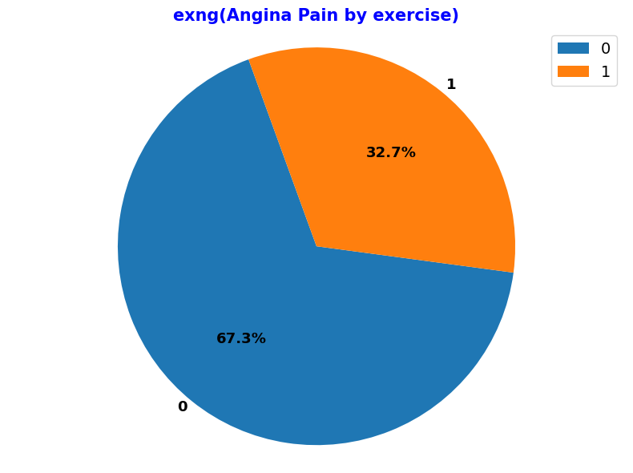
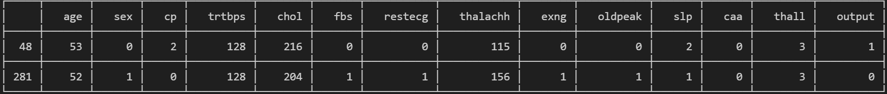
EDA – Univariate Analysis – pie chart for categorical features
Analysis – outlier exists.
Thal – Thalium stress test has value 0 for 3
0 is Outler and is replaced with mas of the column.
Replacing 0 with max of thal

Slide 18
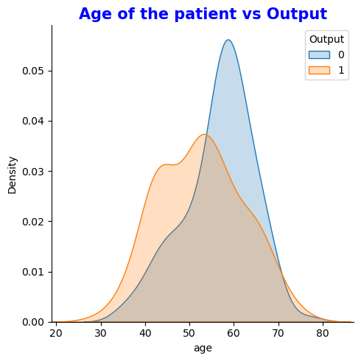
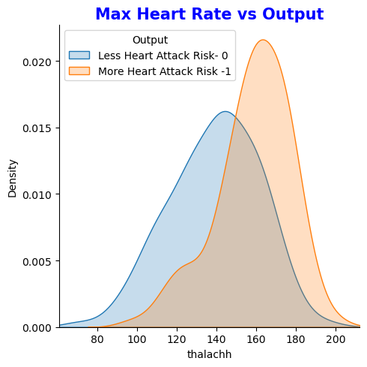
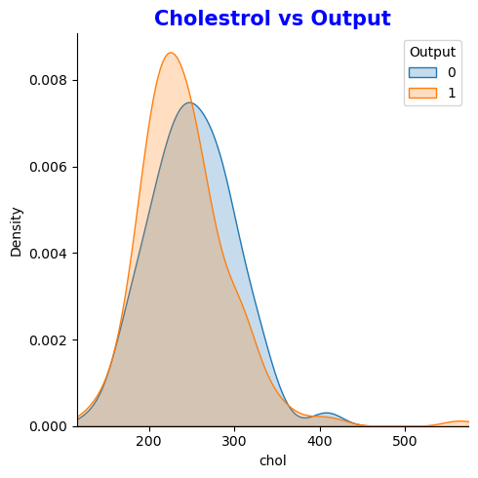
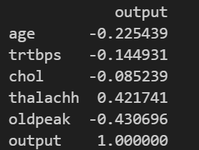
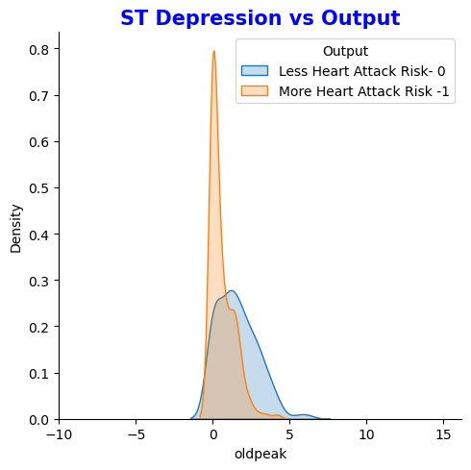
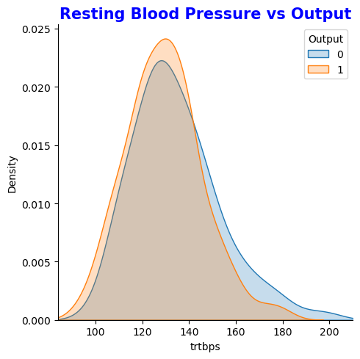
EDA – Bivariate Analysis – Numerical Features vs Output
Features don’t stand separate with output. Hence most of the features are partially correlated
Positive Correlation wrt Output
print(ha_df[numeric_var_uvdef].corr().iloc[:, [-1]])
Negative Correlation wrt Output

Slide 19
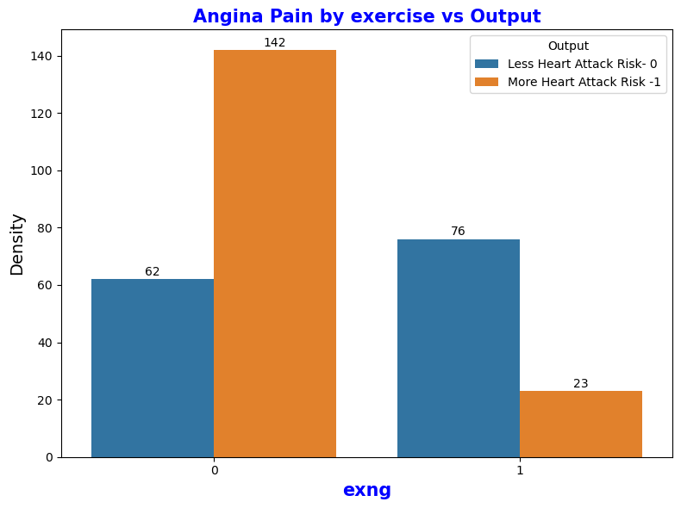
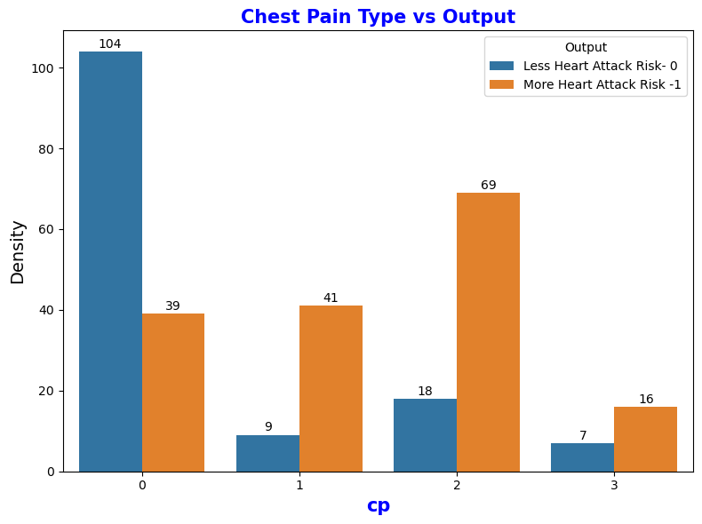
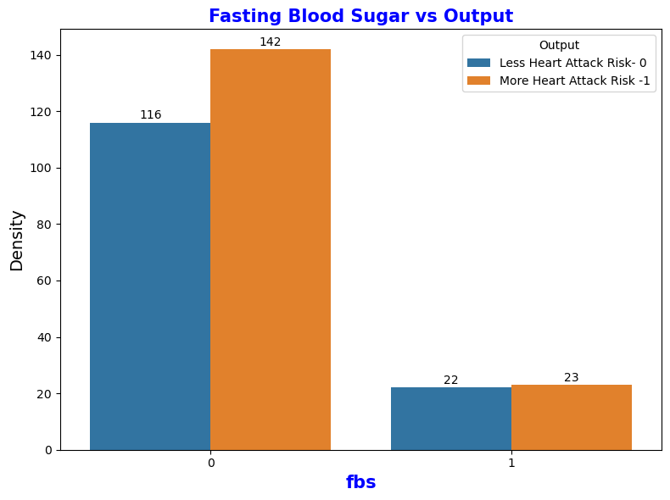
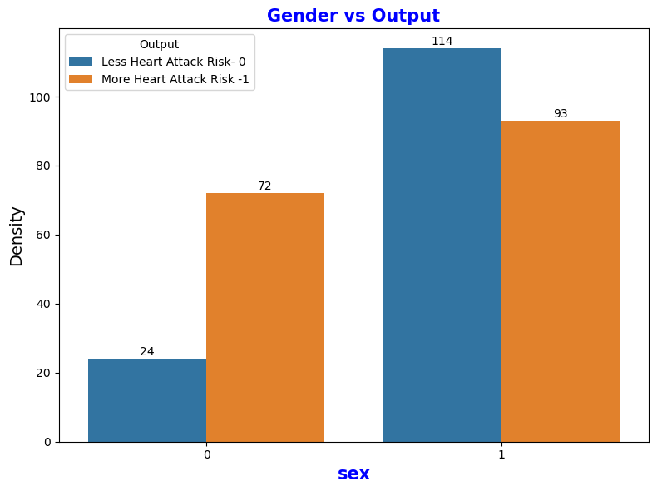
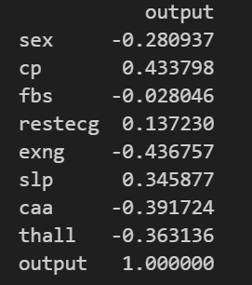
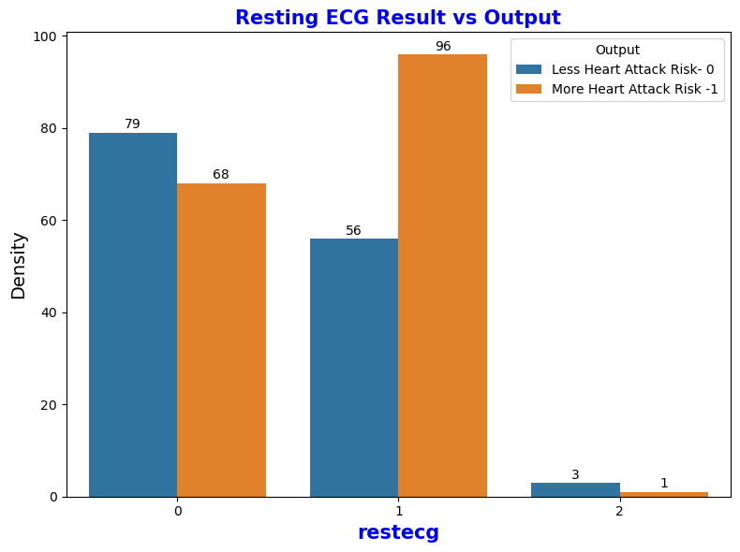
EDA – Bivariate Analysis – Categorical Feature vs Output
Negative Correlation wrt Output

Slide 20
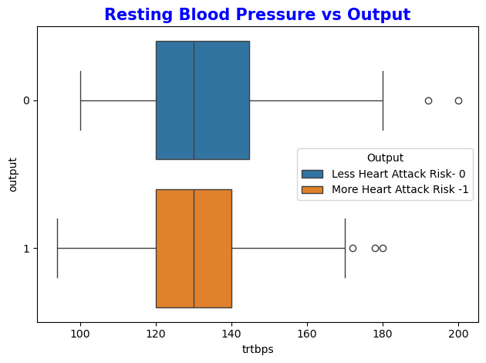
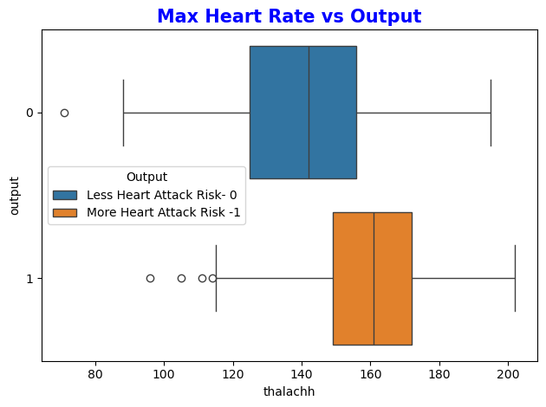
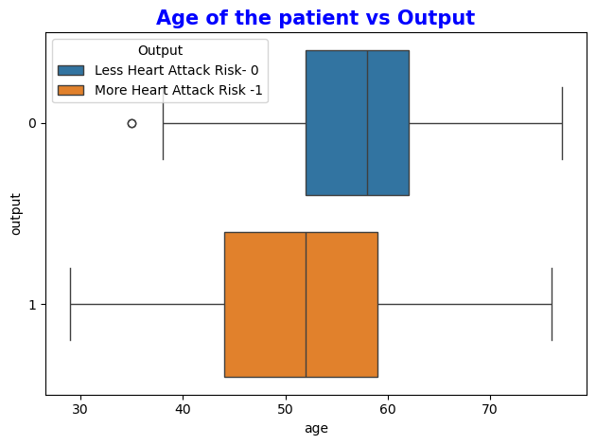
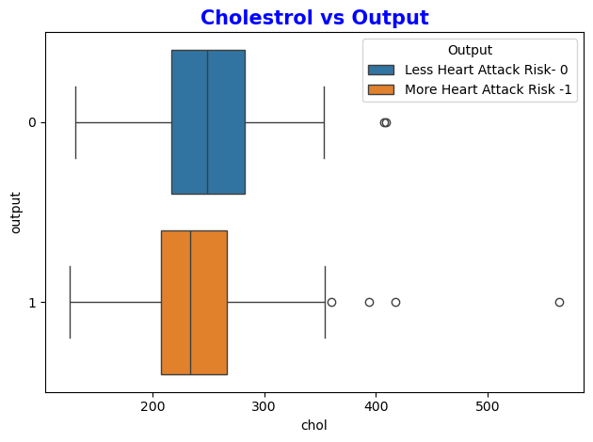
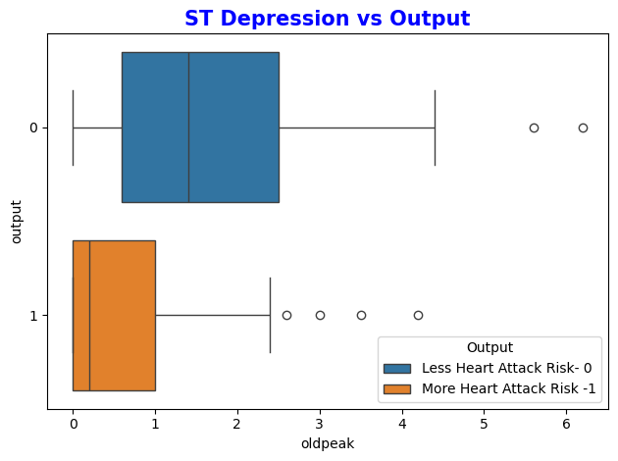
EDA – Bivariate Analysis – Box Plot for numerical variables

Slide 21
Preparation for modelling

Slide 22
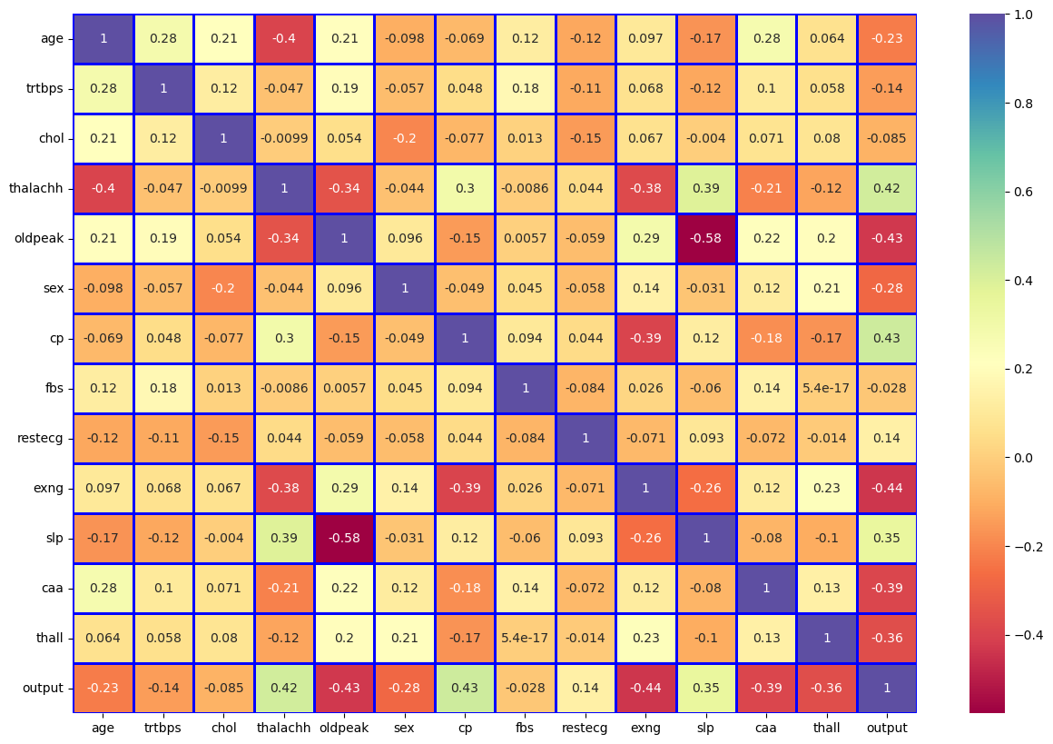
Heat Map – Removing low correlation variables
Positive Correlation
Negative Correlation

Slide 23
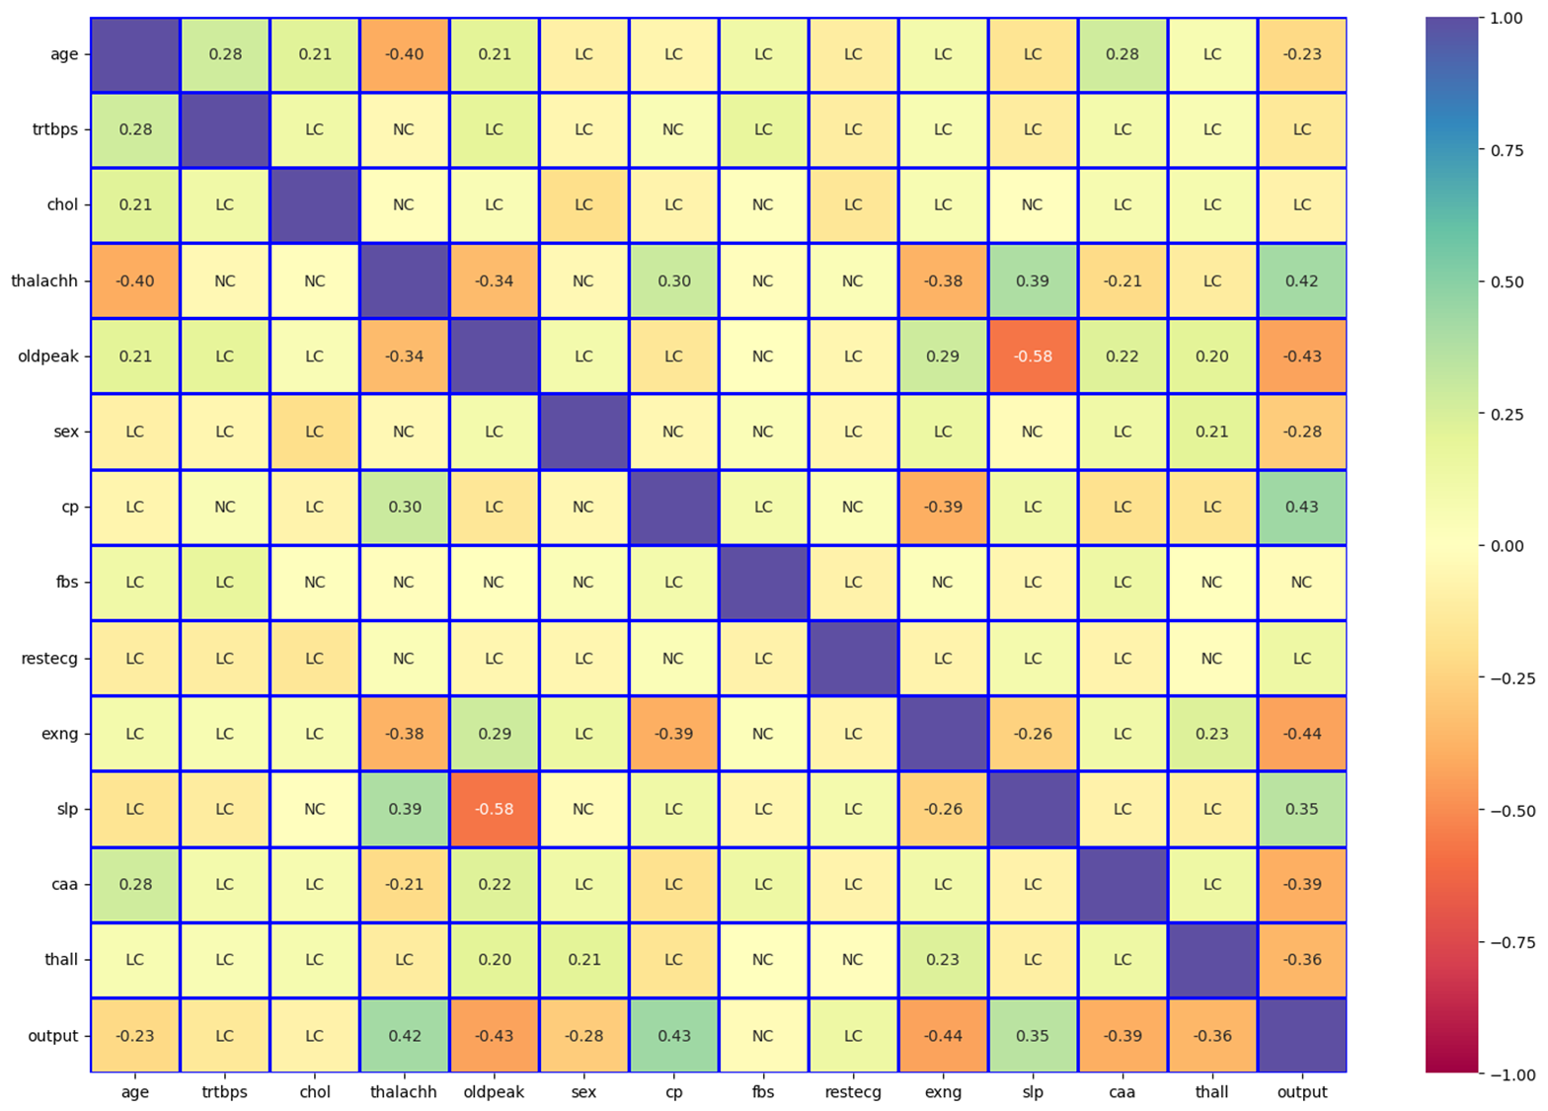
EDA – Heat Map – Removing low correlation variables
Removing Chol, fbs and restecg as they are either low or no correlation with respect to output variable

Slide 24
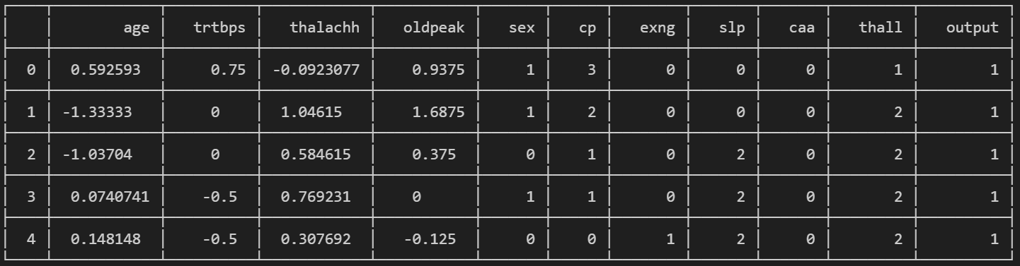
Updated Dataframe

Slide 25


Validating outliers using boxplot
Now, We need to address these outliers

Slide 26


Outlier removal using Z Score & Winsorize method - trtbps variable
Process :
Import scipy and use zscore and winsorize.
Determine the threshold
Get the zscore for all the values and filter out the zscore > threshold
Find the min of the value in zscore list and corresponding max value from the Dataframe
Get the probability percentile of the trtbps column with respect to the min value
Use Winsorize function to filterout the values from the trtbps column > store it new variable
Now visualize the new variable using box plot
There will be no outliers
Normal Distribution
Outlier
Image Source : https://news.mit.edu/2012/explained-sigma-0209
A Z-score measures how many standard deviations a raw data point is from the mean of a population

Slide 27


Outlier removal using Z Score - trtbps variable
Before outlier treatment
After outlier treatment

Slide 28


Outlier removal - thalachh variable – IQR Treatment
Outlier
Before outlier treatment
After outlier treatment

Slide 29


Outlier treatment - oldpeak variable – IQR & Winsorize
Outlier
Before outlier treatment
After outlier treatment

Slide 30


Validating Skewness of numerical variables
Skewness Meaning :
−0.5 to +0.5: Approximately symmetrical.
−1 to −0.5 or +0.5 to +1: Slightly skewed.
Less than −1 or greater than +1: Moderately or substantially skewed. Values beyond −2 and +2 are often indicative of significant non-normality.
Inference > we need to reduce the skewness on oldpeak

Slide 31


Decreasing skewness in oldpeak variable
Two methods used:
Logarithmic
Square root
This skewness is close to what we want as we see the data spread

Slide 32

Categorical Variables – Treating with one hot encoding
Categorical variables need to be one hot encoded[0/1] for machine learning process

Slide 33


Scaling the numerical features using Robust Scalar method
from sklearn.preprocessing import RobustScaler
robust_scaler_usdf = RobustScaler()
(Range : -1 to 1)

Slide 34
Summary before machine learning process
Numerical Features
Analyzed using boxplot, histplots and heatmaps.
Treated for outliers with IQR, Zscore and winsorize method.
Treated for skewness
Finally Scaled using Robust Scaler method
One numerical feature was removed due to low correlation
Categorical features
Analyzed using boxplot, histplots and heatmaps
Treated for outliers
Finally, One hot encoding implemented
Two features were removed due to low or no correlation.
Machine Learning Process

Slide 35
Splitting of Train and Test data using train_test_split
x_train:(271, 20)
y_train:(271, 1)
x_test:(31, 20)
y_test:(31, 1)
x shape : (302, 21)
y shape : (302,1)
from sklearn.model_selection import train_test_split

Slide 36

Machine learning using Logistic regression: Accuracy and Reliability
Logistic regression is used for classification objective and when dependent variable is categorical.
In our case we have the variable output
Model Reliability : Is the model memorizing ?
Checking for overfitting
accuracy_score
(y_true=y_test, y_pred=y_pred_usdf)
0.8709677419354839
Cross validation accuracy_score for 10 folds
0.8484848484848484
Inference:
No overfitting as cross validation scores is close to the predicted accuracy score.
Image Source: https://marini.systems/en/glossary/cross-validation/

Slide 37


Logistic regression : model performance - AUC
Better Area under the curve – better model
AUC Values | Test Quality
0.9 - 1.0 | Excellent
0.8 - 0.9 | Very good
0.8 - 0.7 | Good
0.7 - 0.6 | Satisfactory
0.6 - 0.5 | Unsatisfactory
Image Source: https://spotintelligence.com/2024/06/17/roc-auc-curve-in-machine-learning/
Y axis : True Positive Rate = Recall sensitivity = letting us know the true predictability i.e. 0 as o and 1 as 1
Inference:
AUC is very good

Slide 38

Logistic Regression : Hyperparameter Optimization using GridsearchCV
Inference on AUC:
AUC is very good and similar after hyper Param optimization

Slide 39

Decision Tree Classifier
Desicion tree accuracy_score : 0.7096774193548387
Cross Validation Accuracy Scores Average: 0.8484848484848484
Inference on AUC:
Logistic Regression Classifier is better than Decision Tree AUC is less

Slide 40

SVM classifier
SVM accuracy_score : 0.6451612903225806
Cross Validation Accuracy Scores Average: 0.7272727272727273
Inference on AUC:
Logistic Regression Classifier is better than SVM Classifier

Slide 41

Random Forest classifier
Random Forest accuracy_score : 0.6451612903225806
Cross Validation Accuracy Scores Average: 0.9090909090909091
Inference on AUC:
Random Forest Classifier is better than Logistic Regression

Slide 42
Summary of Model scores
Model | Crossvalidation Accuracy | AUC value
Linear Regression | 0.87 | 0.88
Decision Tree | 0.85 | 0.73
Support Vector Machine | 0.73 | 0.64
Random Forest Classifier | 0.91 | 0.93

Slide 43
Summary of Models
Models tested: |  | Result
Machine Learning Study Process
Models tested:
Linear Regression
Decision Tree
Support Vector Machine
Random Forest Classifier
Good Cross Validation Accuracy:
Random Forest Classifier
Good AUC :
Random Forest Classifier
Model | Crossvalidation Accuracy | AUC value
Linear Regression | 0.87 | 0.88
Decision Tree | 0.85 | 0.73
Support Vector Machine | 0.73 | 0.64
Random Forest Classifier | 0.91 | 0.93

Slide 44
Thankyou

