Slide 1

Exploratory data analysis of Netflix Movies and TV shows
Santosh Kumar Omprakash
DSC530-T301
Week 12 – Term Project

Slide 2
Contents
Introduction
Statistical questions
Important variables
Exploratory Data Analysis
Conclusion

Slide 3
Introduction
Netflix needs no introduction, it is a streaming service that allows members to watch a wide variety of contents like movies, TV shows, documentaries and more. Netflix allows us to enjoy unlimited ad-free viewing of the contents. It was founded in 1997 and has become $100 billion company in 20 years.
The number of movies has decreased by over 2,000 titles since 2000 while the number of TV shows has nearly tripled.
Some important variables will be analyzed to perform exploratory data analysis and also predict the number of Movies and TV shows that will be added in 2020.

Slide 4
Statistical questions
Analyze the contents available in different countries and see which countries produce more movies and TV shows.
In which month are the contents added more?
What is the duration of the contents?
What are the top categories or genre?
What are the types of contents and their rating?
How many contents will be added in 2020?

Slide 5
Important variables
Type – It is the type of content Movies/TV Shows
Country – It is the place where contents are present
Date_added – Date when the contents were added to Netflix
Release_year – Year when the Movies/TV shows were released
Rating – It represents the content type. For example TV-MA is for adults only and may not be suitable for children under 17; TV-G is suitable for all ages.
Listed_in – It is the genre. Example: Comedies, Kid’s TV

Slide 6
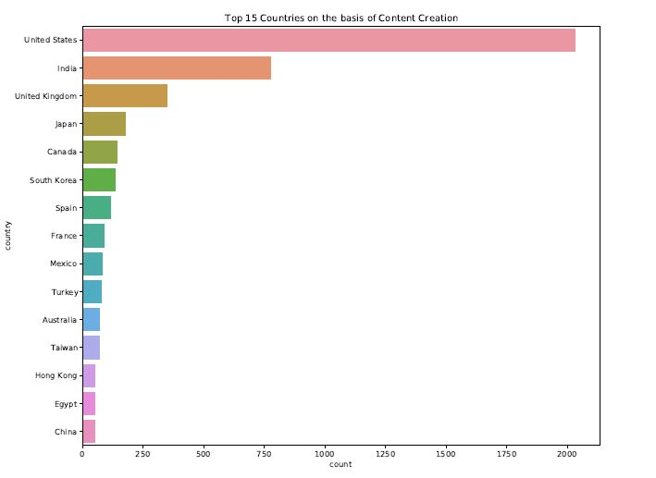
Contents present based on country

Slide 7
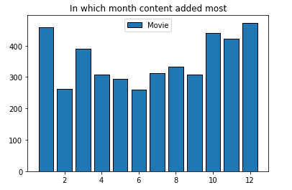
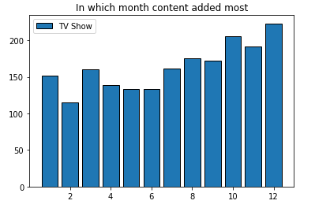
Contents added by month

Slide 8
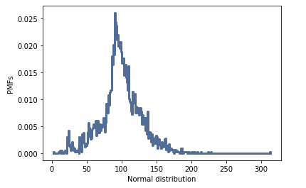
Duration of contents present

Slide 9
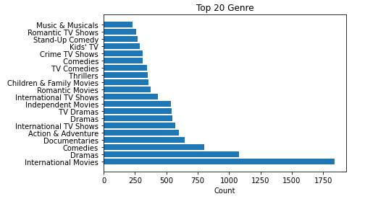
Contents based on genre

Slide 10
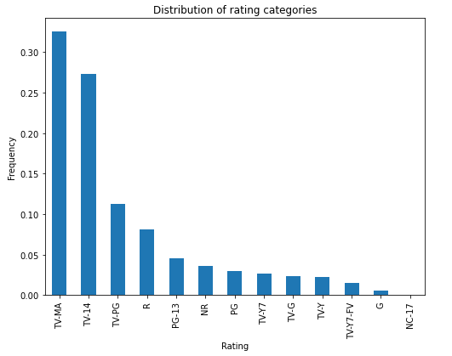
Distribution of rating

Slide 11
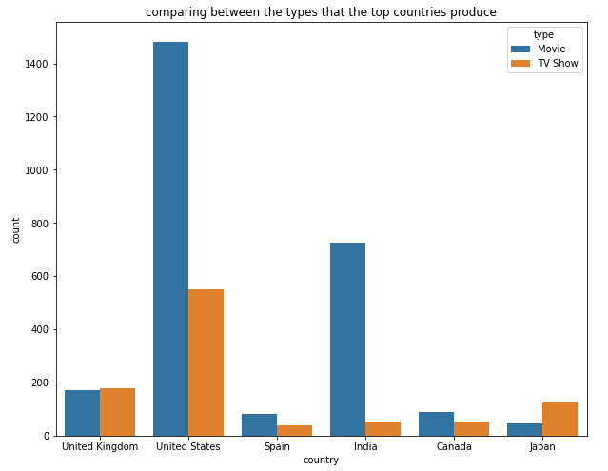
Movies and TV shows added by top countries

Slide 12
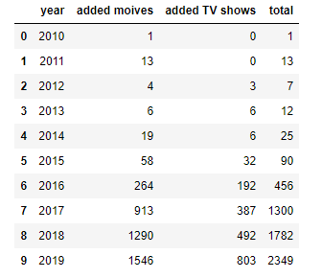
Prediction
Based on the prediction – 2,014 Movies and 933 TV Shows will be added in 2020

Slide 13
THANK YOU

