Slide 1

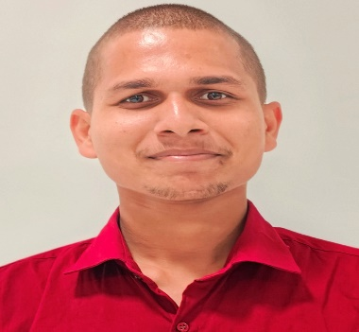
Project Title : Design and Implementation of LDPC Encoder and Decoder
Division : SNPA-SNEG-SNED
Name: Santosh Kumar
Designation: Student
Institution: National Institute of Technology Jamshedpur (NIT JSR)
Guide: Dr.Deepak Mishra
Contact e-mail: santoshkumar1272004@gmail.com
PHOTO
MAJOR OBJECTIVES:
1)Understanding of parity check matrix and tanner graph and variation of LLR’s .
2) Algorithm of Decoder in MATLAB & Simulink
3)Implementing MINSUM decoding algorithm by HDL blocks considering Time analysis and FPGA standards.
4) FPGA in Loop on Kintex KC705 and verification by BER vs SNR plot.
24 MAY 2024 to
9 AUG 2024
METHODOLOGY FLOW CHART:
RESULTS/MAJOR FINDINGS:
* Storing Address of 1’s only in memory saved resources(instead of 7,20,000 bits ,we stored
address of 1’s which comes to 52,800 bits only).
* Using Block RAM helped in efficient resource utilization rather than using distributed memory.
* Timing constraint is very important while converting HDL Simulink blocks into synthesizable logics.
* Dealing with HDL blocks on Simulink needs Speed and Area management of the targeted FPGA with proper timing analysis to implement the generated Verilog code directly on custom hardware.
* Matching of sample times of each HDL blocks according to FPGA clock frequency is required.
* Designed successfully LDPC decoder with HDL blocks and implemented FIL on KC705 evaluation
Studied about PCM and LLRs
Studied about FIL and implemented some examples on different FPGAs
Designed LDPC Encoder in MATLAB Script , Simulink and in Verilog
Did verification of LDPC Encoder by checking BER and SNR value
Designed LDPC Decoder in Simulink by using HDL blocks with RAM and time constraints.
board and got desired BER vs SNR plot at code rate of ½.
CONCLUSION:
1) Studied about LDPC codes, Sparse Check Matrix and LLR.
2) Implemented designs on FPGA in loop (FIL)
3) Designed LDPC Encoder and Decoder using HDL Coder blocks
targeting efficient and low resource utilization.
Implemented the decoder on FIL and verified by BER vs SNR plot

