Slide 1


Slide 2

What is estimation.
Basic of test estimation.
Software test estimation.
Estimation models.
Use Case based estimation
Test Point Analysis
Function Point analysis
WBS
Wide band Delphi

Slide 3

Estimating cost of constructing a table
Size ( dimension)
Add-ons
Quality
Estimating cost of testing a software
Size ( LOC,FP, UCP)
Complexity
Quality

Slide 4

An estimate is a forecast or prediction.
An Estimate is an approximation.
A Rough Idea how long a Task would take to
complete.

Slide 5

Test Estimation is the estimation of the testing size, testing effort, testing cost and testing schedule for a specified software testing project in a specified environment using defined methods, tools and techniques.

Slide 6
Size – the amount (quantity) of testing that needs to be carried out. Something that can be consistently counted and reasonably represents the work that must be done.
Examples of commonly used
size units include Lines of Code (LOC), function points, use cases, objects, requirements, classes, and web pages.
Effort – the amount of effort in either person days or person hours necessary for conducting the tests.
Testing Cost – the expenses necessary for testing, People, H/W,S/W, Other.
Testing Schedule – the duration in calendar days or months that is necessary for conducting the tests.

Slide 7

Use Case based estimation
Test Point Analysis
Function Point analysis
WBS
Wide band Delphi

Slide 8


Slide 9
Obtain unadjusted actor weight (UAW)
Determine unadjusted use case weight (UUCW)
Calculate unadjusted use case points (UUCP)
UUCP = UAW + UUCW
Determine the technical/environmental factor (TEF)
Compute the adjusted use case point (AUCP)
AUCP = UUCP * [ 0.65 + (0.01 * TEF)]
Arrive at final effort using a conversion factor
Total Actual Effort = AUCP * CF

Slide 10

1.Simple
End users are simple actors.
2.Average.
Average actors interact with the system through some protocols etc. or they could be data stores.
3.Complex
Complex actors are separate systems that interact with the SUT through API.
Note: Actor classification for test effort estimation differs from that of development estimation.

Slide 11

Actor type | Description | Factor
Simple | GUI | 1
Average | Interactive or protocol driver interface | 2
Complex | API/low level interaction | 3

Slide 12

=SActor + AActor + CActor

Slide 13

SActor = (No of SimpleActor) * SimpleWeight(1)
AActor = (No of AverageActor) * Average Weight(2)
CActor=( No of ComplexActor) * complex weight(3)

Slide 14

Use case type | Description | Factor
Simple | <=3 | 1
Average | 4-7 | 2
Complex | >7 | 3
The use cases are assigned weights depending on the number of transactions /scenarios.

Slide 15

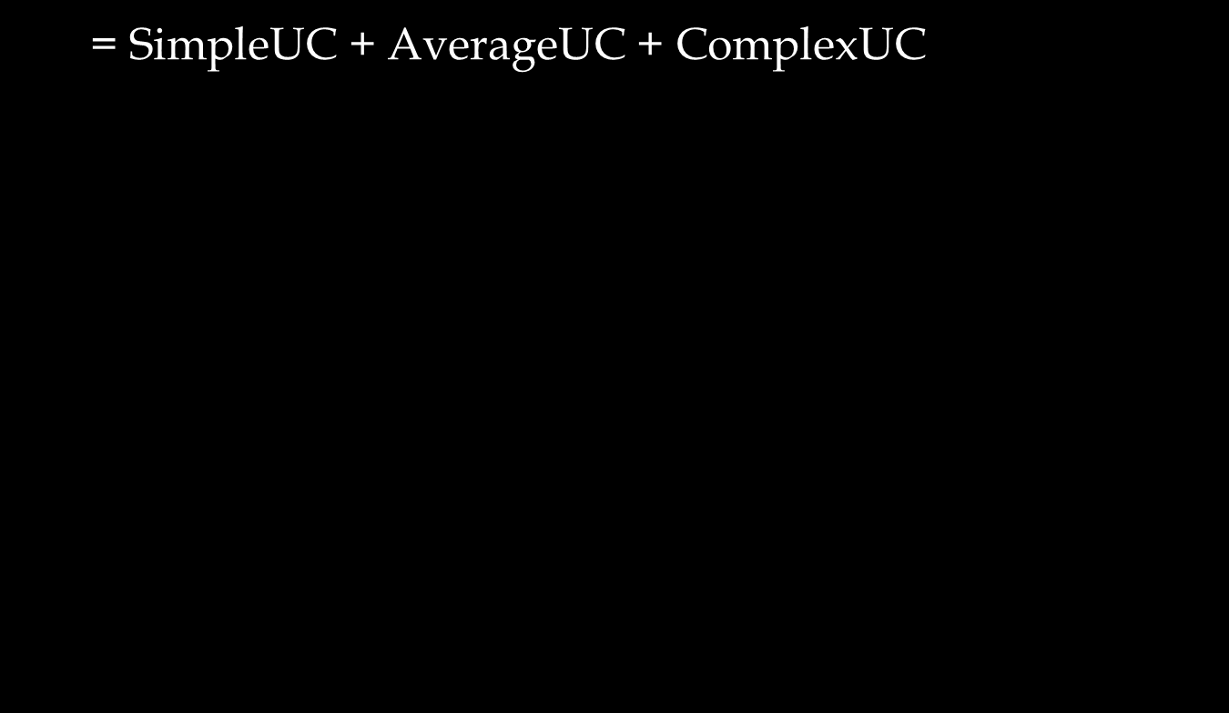

Slide 16

SimpleUC = (No of UC Simple) * SimpleWeight (5)
AverageUC = (No of UCAverage) * AverageWeight (10)
ComplexUC = (NO of UCComplex) * ComplexWeight (15)

Slide 17
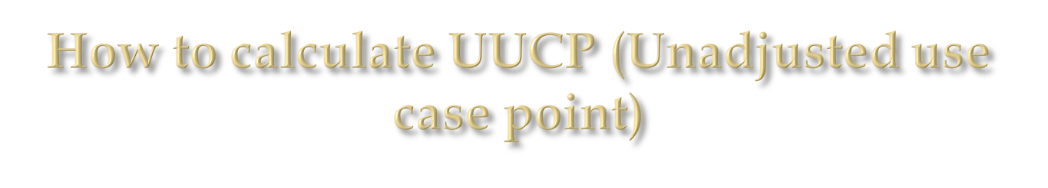
UUCP= UAW (unadjusted actor weight) +
UUCW (unadjusted use case weights)

Slide 18

The technical and environmental factors for a test project are listed in the table below.
To calculate one needs to assign weights and multiply them with the assigned values to give the final values.
1. Technical Complexity Factor :
Factor | Description | Assign value
T1 | Test Tools | 5
T2 | Documented inputs | 5
T3 | Development Environment | 2
T4 | Test Environment | 3
T5 | Test suite reuse | 3

Slide 19

Factor | Description | Assign value
E1 | Domain Experience | .5
E2 | Application experience | .3
E3 | Familiar with the test process | .5
E4 | Part time staff | -1

Slide 20

AUCP =UUCP *[0.65+ (0.01*TEF)]

Slide 21

1.We now have to simply multiply the adjusted UCP with a conversion factor.
(Conversion factor means the man-hours in test effort.)
2. Project Complexity needs 15% of the estimated effort to be added.
3. 10% is spent in co-ordination and management activity.

Slide 22

Actor | No of Use case | Factor | UAW
User | 2 | 1 | 2
PEAB | 1 | 2 | 2
Plugin manager | 1 | 2 | 2
Total UAW |  |  | 6

Slide 23

Use case | Type | Factor | Reason
SendToBackground | simple | 5
HideAllPlugins | Simple | 5
Exit | Simple | 5
CheckAndHidePlugins | Simple | 5
Total |  | 20

Slide 24

UUCP = UAW + UUCW = 6 + 20 = 26

Slide 25

Factor | Descriptoin | Assign value | Weight | Expected value
T1 | Test Tools | 5 | 3 | 15
T2 | Documented inputs | 5 | 5 | 25
T3 | Development Environment | 2 | 1 | 2
T4 | Test Environment | 3 | 1 | 3
T5 | Test-ware reuse | 3 | 2 | 6
T6 | Performance objectives | 2 | 1 | 2
T7 | Security Features | 4 | 2 | 8
Total |  |  |  | 61

Slide 26

Adjusted UCP calculation
AUCP =UUCP *[0.65+ (0.01*TEF)] = 26 *[0.65+0.01*61] = 32.76
6. Final Effort
Effort = AUCP * Conversion Factor for

Slide 27

Effort = AUCP * Conversion Factor for
Effort = 32.76 * 13 = 425.88
Project Complexity needs 15% of the estimated effort to be added. 10% is spent in co-ordination and management activity.
Total Effort = 425.88 + 63.882 + 42.588
= 532.35 man-hours = 66 man-days

Slide 28

1.Break down the test cases into smaller atomic
test steps
2.Classify each step based on its complexity into
Low, Medium and High. Assign points
Low -1
Medium – 2
High - 4
3. Sum up the test points
4.Repeat the process for each test case in the test suite.
5.Apply the productivity factor to get the efforts.

Slide 29

Fine tune as per your project situation and start using
Project Duration (Barry Boehm)
Project Duration = 2.5 * (Cube Root of Work Months)
Work Months = (Project Work Effort (Hours)) / (Hours per Month)
Optimum Staffing Size
Optimum Staffing Size = Square Root of WorkMonths
Minimum Duration
Project Duration = 0.75 * (Cube Root of WorkMonths)

