Slide 1
LDA Project
Paul Charles

Slide 2
Project Goal
The goal of this project is to observe LDA with the 40 samples from the ATT database using the first five images as training and comparing those results with the PCA results for the same criteria (mode)

Slide 3
Steps
Import images from ATT database for first five images from ATT database for training
Obtain the average of the training data and normalize the results
Obtain the Scatter-Within (SW)
Obtain Scatter-Between (SB)
Get vector space and obtain eigenvalues/eigenvectors
Using test images which are last five images from ATT database for all subjects and multiply it by the vector space
Setup labels and run the EZRoc equation to obtain the ROC curve and results

Slide 4

Criteria
FRR (%) = 1-GAR (%) [AREA]
FRR$=\frac{\text{false} \text{attempts}}{\text{t}\text{otal} \text{attempts}}$
FAR (%) = FAR [AREA]
FAR$=\frac{accepted attempts}{total attempts}$
EER (%)
EER: When false positive rate equals false negative rate

Slide 5
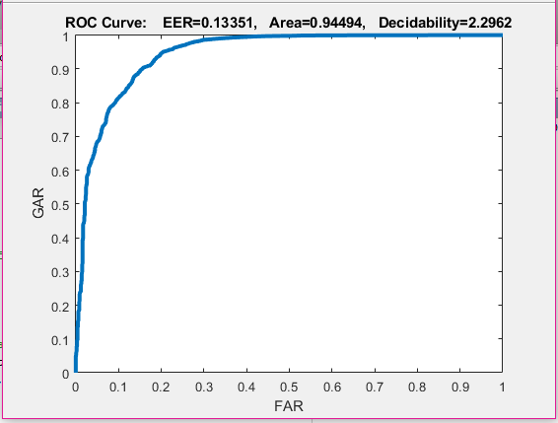
LDA Mode 1 Results

Slide 6
LDA Mode 1 Analysis
FRR: 0.06843
FAR: 0.93157
EER : 0.15581
FAR | GAR
0% | ~18%
5% | ~68%
10% | ~80%

Slide 7
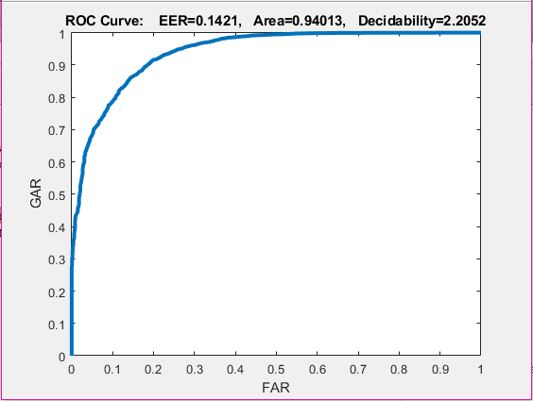
PCA Mode 1 Results (from Earlier Project)

Slide 8
PCA Mode 1 Analysis
FRR: 0.05987
FAR: 0.94013
EER : 0.1421
FAR | GAR
0% | ~30%
5% | ~72%
10% | ~78%

Slide 9
Justification
ROC curves are a plot of false positive rate vs true positive rate. In the ROC curve given in the results, the area under the curve shows accuracy. The larger the area, the more accurate the classifier is. As a result, since the ROC area of LDA for Mode 1 (94.494 %) was greater than the ROC area of PCA Mode 1 (94.013 %), LDA was slightly more accurate than PCA for area.
EER is also a good measurement of classifier accuracy, and since the EER of LDA Mode 1 (13.35%) was less than PCA Mode 1 (14.21%), it also shows that LDA Mode 1 was a little more accurate classifier than PCA Mode 1 for EER.
This makes sense because LDA is known to perform better than PCA given the same situations in which there is a lot of data. This is also supported by paper form the reading assignment “An Efficient LDA Algorithm for Face Recognition” by Yang, Yu, and Kunz, when it says: “…the Linear Discriminant Analysis (LDA) approach outperforms the Principal Component Analysis (PCA) approach in face recognition tasks...” As a result, it is no surprise that the results showed better performance for LDA. Also, in the publication it mentions that “Without any preprocessing step, the best recognition rate for the new algorithm is 95%, which is compatible to the best result obtained by other researchers on the same test set using different algorithms.” Since the results were ~94.5% for LDA and ~94% for PCA, both are pretty close to 95%. Therefore, this shows that the results were fairly accurate.

Slide 10
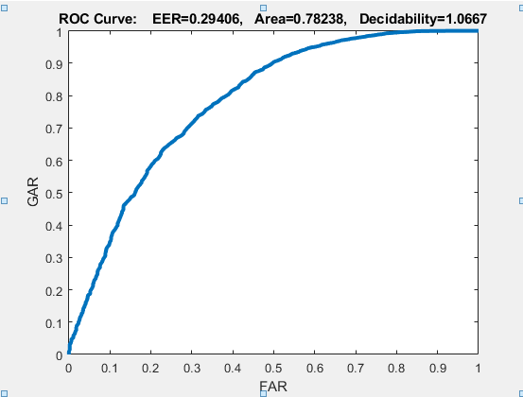
Bonus
The performance for bonus part gave an area curve of 78.23%. This was not expected since it incorporated PCA and LDA. As a result, I was expecting a curve 80% or better.

