Slide 1
Fusion Project
Paul Charles

Slide 2
Project Goal
The goal of this project is to observe Multi-Classifier System (MCS) as well as Multi-Instance (Fusion) systems. These methods are utilized by utilizing simple combinations of previous dimensionality reduction classifiers.

Slide 3
Steps
Part A
Import the vectors for LDA and PCA from the previous projects.
Run simple calculations for min, max, avg between LDA and PCA vectors
Plot them on ezroc for comparison
Part B
Import the vectors for LDA and PCA from the previous projects.
Initialize matrices for PCA and LDA test samples
Compute the average of all the test sample scores (40x200 matrix)
Calculate label matrix that is also in the 40x200 format
Setup labels and run the ezroc equation to obtain the ROC curve and results of comparison

Slide 4

Criteria
FRR (%) = 1-GAR (%) [AREA]
FRR$=\frac{\text{false} \text{attempts}}{\text{t}\text{otal} \text{attempts}}$
FAR (%) = FAR [AREA]
FAR$=\frac{accepted attempts}{total attempts}$
EER (%)
EER: When false positive rate equals false negative rate

Slide 5
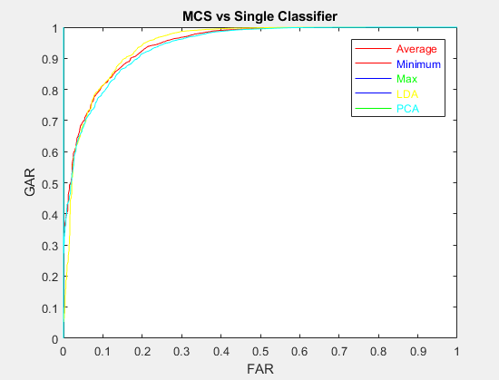
PART A (MCS) Results

Slide 6
PART A (MCS) Analysis
Classifier | ROC Area (FRR) | EER
Min | 0.9453 | 0.13318
Avg | 0.94478 | 0.13759
Max | 0.9400 | 0.14294
PCA | 0.94013 | 0.1421
LDA | 0.9449 | 0.13351

Slide 7
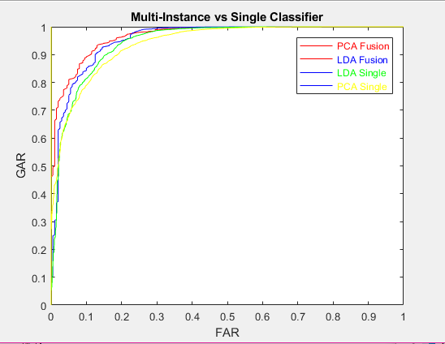
PART B (Fusion) Results

Slide 8
PART B (Fusion) Analysis
Classifier | ROC Area (FRR) | EER
LDA Fusion | 0.95493 | 0.12455
PCA Fusion | 0.96707 | 0.10474
LDA NO Fusion | 0.9449 | 0.1421
PCA NO Fusion | 0.94013 | 0.13351

Slide 9
Justification
ROC curves are a plot of false positive rate vs true positive rate. In the ROC curve given in the results, the area under the curve shows accuracy. The larger the area, the more accurate the classifier is. As a result, the ROC area of MCS Min (94.53%) and LDA (94.49%) produced the higher area for Part A. However, the MCS Max produced the lowest, which was 0.9400. A lot of the MCS Max results were from the PCA. As a result, it can be assumed that the MCS Min is a good classifier while the MCS Max is not. For Part B, the LDA Fusion (95.49%) and PCA Fusion (96.71%) produced significantly higher than their counterparts without fusion [LDA (no fusion) had (94.49%), PCA (no fusion) had 94.01%]. As a result, it can be assumed that multi-instance fusion is a more accurate classifier than single classifiers.
EER is also a good measurement of classifier accuracy, and since the EER of MCS Min (13.32%) and LDA (13.35%) produced lower error for Part A. For Part B, LDA Fusion (12.45%) and PCA Fusion (10.47%) were significantly lower than LDA and PCA without fusion. As a result, it also shows that multi-classifier systems are more effective because of low EER.
Many researchers on this subject have suggested that multi-classifier systems have better performance than that of single classifiers. As a result, since previous research has supported this, it is fair to conclude that the results obtained hinted to the success of the project.

Slide 10
References
[1] Kittler, Josef and Hatef, Mohamad and Duin, Robert P.W., and Matas, Jiri, “On Combining Classifiers”, IEEE Transactions on Pattern Analysis and Machine Intelligence, vol 20, no. 3, March 1998. [Online].
[2] Jain, Anil K. and Ross, Arun and Prabhakar, Salil, “An Introduction to Biometric Recognition”. IEEE Transactions on Circuits and Systems For Video Technology, vol 14, no. 1, January 2004. [Online].
[3] Kuncheva, Ludmila I., “A Theoretical Study on Six Classifier Fusion Strategies”. IEEE Transactions on Pattern Analysis and Machine Intelligence, vol 24, no. 2, February 2002. [Online].
[4] Cano, Albert, “An ensemble approach to multi-view multi-instance learning”. Knowledge-Based Systems, vol 136, January 2017. [Online]. Available: http://www.elsevier.com/locate/knosys.
[5] Alpaydin, Ethem. Introduction to Machine Learning. Cambridge, Massachusetts: The MIT Press, Third Edition, 2014, Sections 17.4-17.7. pp 492-502

