Slide 1
PCA Project
Paul Charles

Slide 2

Criteria
FRR (%) = 1-GAR (%) [AREA]
FRR$=\frac{\text{false} \text{attempts}}{\text{t}\text{otal} \text{attempts}}$
FAR (%) = FAR [AREA]
FAR$=\frac{accepted attempts}{total attempts}$
EER (%)
EER: When false positive rate equals false negative rate

Slide 3
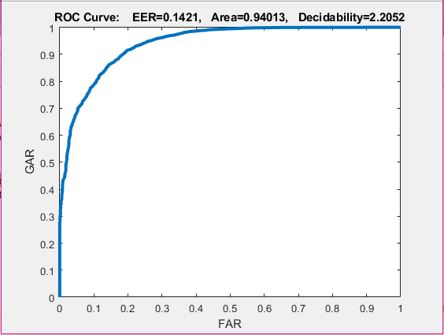
Mode 1 Results

Slide 4
Mode 1 Analysis
FRR: 0.05987
FAR: 0.94013
EER : 0.1421
FAR | FRR
0% | ~30%
5% | ~72%
10% | ~78%

Slide 5
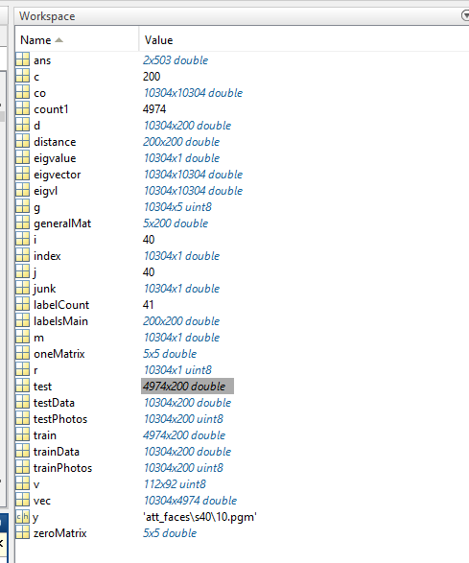
Mode 1 Matlab Results
Eigenvectors for space size: 4974
Feature space size: 10304x4974
Train/Test size: 4974x200
Distance size: 200x200
Labels size 75x75

Slide 6
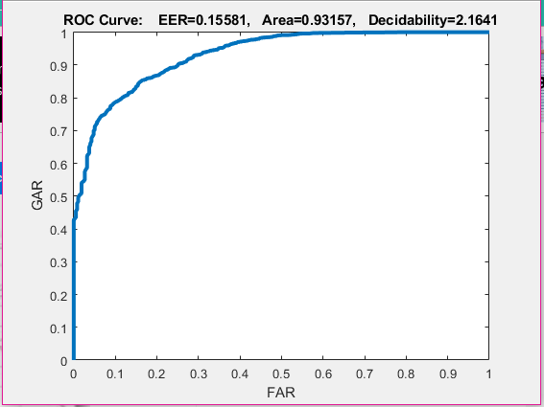
Mode 2 Results

Slide 7
Mode 2 Analysis
FRR: 0.06843
FAR: 0.93157
EER : 0.15581
FAR | FRR
0% | ~41%
5% | ~63%
10% | ~72%

Slide 8
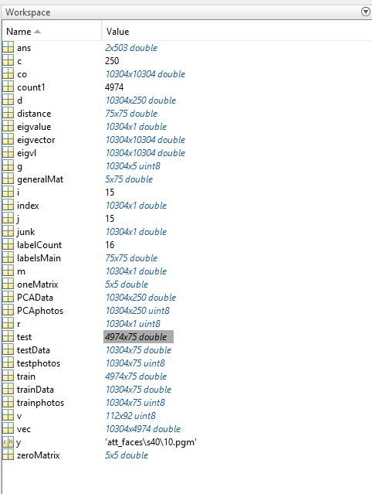
Mode 1 Matlab Results
Eigenvectors for space size: 4974
Feature space size: 10304x4974
Train/Test size: 4974x75
Distance size: 75x75
Labels size 75x75

Slide 9
Justification
ROC curves are a plot of false positive rate vs true positive rate. In the ROC curve given in the results, the area under the curve shows accuracy. The larger the area the more accurate the classifier is. As a result, since ROC area of Mode 1 was greater than the ROC area of Mode 2, Mode 1 was more accurate.
EER is also a good measurement of classifier accuracy, and since EER of Mode 1 was less than Mode 2, it also shows that Mode 1 was a more accurate classifier.

