Slide 1
LDA Project
Paul Charles

Slide 2

Criteria
FRR (%) = 1-GAR (%) [AREA]
FRR$=\frac{\text{false} \text{attempts}}{\text{t}\text{otal} \text{attempts}}$
FAR (%) = FAR [AREA]
FAR$=\frac{accepted attempts}{total attempts}$
EER (%)
EER: When false positive rate equals false negative rate

Slide 3
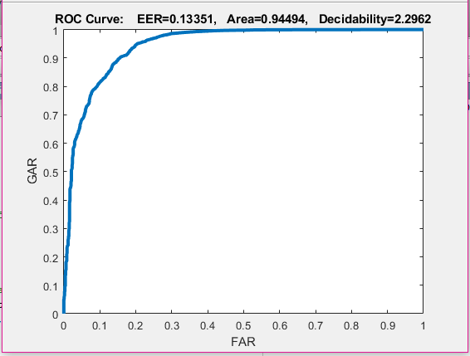
LDA Mode 1 Results

Slide 4
LDA Mode 1 Analysis
FRR: 0.06843
FAR: 0.93157
EER : 0.15581
FAR | FRR
0% | ~82%
5% | ~32%
10% | ~20%

Slide 5
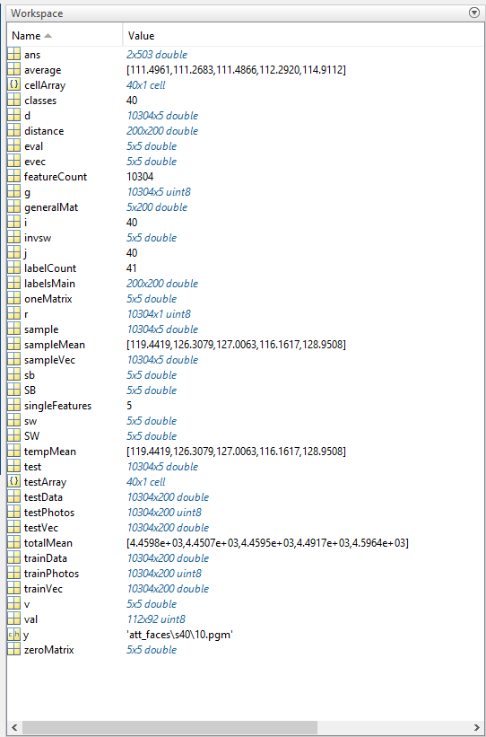
LDA Mode 1 Matlab Results

Slide 6
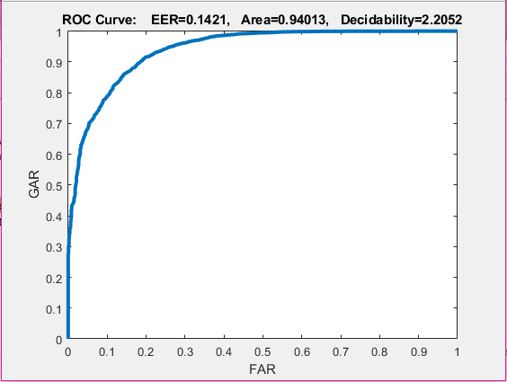
PCA Mode 1 Results

Slide 7
PCA Mode 1 Analysis
FRR: 0.05987
FAR: 0.94013
EER : 0.1421
FAR | FRR
0% | ~70%
5% | ~28%
10% | ~22%

Slide 8
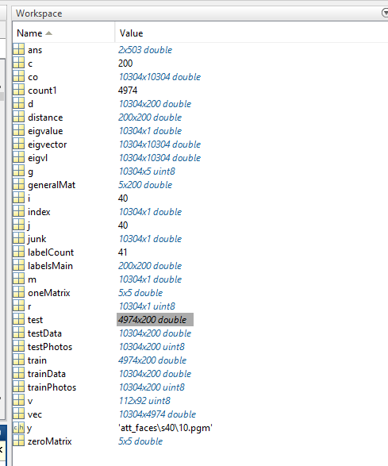
Mode 1 Matlab Results
Eigenvectors for space size: 4974
Feature space size: 10304x4974
Train/Test size: 4974x200
Distance size: 200x200
Labels size 75x75

Slide 9
Justification
ROC curves are a plot of false positive rate vs true positive rate. In the ROC curve given in the results, the area under the curve shows accuracy. The larger the area, the more accurate the classifier is. As a result, since the ROC area of LDA for Mode 1 (94.494 %) was greater than the ROC area of PCA Mode 1 (94.013 %), LDA was slightly more accurate than PCA for area.
EER is also a good measurement of classifier accuracy, and since the EER of LDA Mode 1 (13.35%) was less than PCA Mode 1 (14.21%), it also shows that LDA Mode 1 was a little more accurate classifier than PCA Mode 1 for EER.
This makes sense from a theoretical perspective because the first five photos in each of the 40 subjects, from Mode 1, were used to create the PCA vector space. This was then utilized from a training and testing perspective, with the corresponding labels, to produce the accurate results. The labels were created using the 0 values for each corresponding genuine user and 1 for each imposter. As a result, the testing results, which were images 6-10 from Mode 1 was based on a trained version of images 1-5 from the 40 subjects. On the contrary, Mode 2 had an increased training sample size by 25% in comparison to Mode 1, so that could also lead to the notion that Mode 2 could perform better. However, this is probably why Mode 1 barely performs better than Mode 2, with both models giving very similar results. Therefore, Mode 1 giving slightly better results than Mode 2 makes sense from a theoretical perspective.

