Slide 1


Skin Disease Prediction
Team:Bharath’s AI

Slide 2
INTRODUCTION : The Need for AI in Skin Disease Diagnosis
Rising Skin Health concerns
Skin diseases are common worldwide, yet access to dermatologists is limited, especially in rural areas.
Misdiagnosis can lead to delayed treatment and severe health outcomes.
Increasing global skin disease burden
Shortage of skilled dermatologists
Need for fast, accurate, and affordable solutions
The Case for AI
AI models can detect patterns in skin images and predict diseases like eczema, psoriasis, or melanoma with high accuracy. Our system aims to deliver timely predictions and aid in early diagnosis..

Slide 3
Problem Statement:
Skin diseases are common and require accurate diagnosis for effective treatment. However, in many areas, especially rural regions, access to dermatologists is limited, and manual diagnosis can be time-consuming and error-prone.
To overcome this, there is a need for an AI-based system that can predict skin diseases from images. Such a system would provide quick, reliable results and help in early detection, making dermatological care more accessible and efficient.

Slide 4
Solution Overview:
Our AI-Powered Skin Disease Prediction System: 📸 Image Input: Users upload or capture a skin image. ⚙️ Preprocessing: Images are resized, normalized, and augmented to improve model performance. 🧠 CNN-Based Classification: A trained Convolutional Neural Network (CNN) processes the image and predicts the disease.
📊 Result Display: The predicted skin condition is shown along with confidence scores

Slide 5
Existing Systems:
Strengths
SkinVision
google AI Derm
Weaknesses
More complex to deploy.
Our Differentiation
Advanced deep learning models.
User-friendly.
Easy to deploy.
Expensive to deploy.

Slide 6
Proposed System:
An AI-based application that accepts a skin image, performs preprocessing, and uses a CNN model to predict the type of disease. The system aims to assist dermatologists and individuals with early detection.
WORK FLOW INCLUDES:
Image capture/upload
Preprocessing (resize, normalize, augment)
CNN-based Prediction
Result Display (diagnosis + probability)

Slide 7
Software Requirements :
Programming Language: Python
Libraries: TensorFlow/Keras, OpenCV, Scikit-learn
Dataset: HAM10000

Slide 8
Hardware Requirements:
Processor:Intel Pentium Processor G4400
RAM: Minimum 4 GB (Recommended: 8 GB or higher)
Storage: At least 10 GB free space (for datasets and models)
GPU: NVIDIA GPU with CUDA support (Recommended for training )
Display: HD display (for better visualization and testing)

Slide 9
Architecture:
Input Layer:
User uploads or captures image.
Preprocessing Module:
Resize, normalize, augment.
CNN Model:
Extract features and classify skin disease.
Output Layer:
Displays the skin disease name.

Slide 10
Modules:
Image Processing Module-
Uses OpenCV and PIL to clean and enhance images.
Skin Disease Classifier Module-
CNN model trained on HAM 10000 dataset.
Prediction Module-
Outputs top predicted disease with confidence level.
User Interface Module-
Simple web/app interface for uploading images.

Slide 11
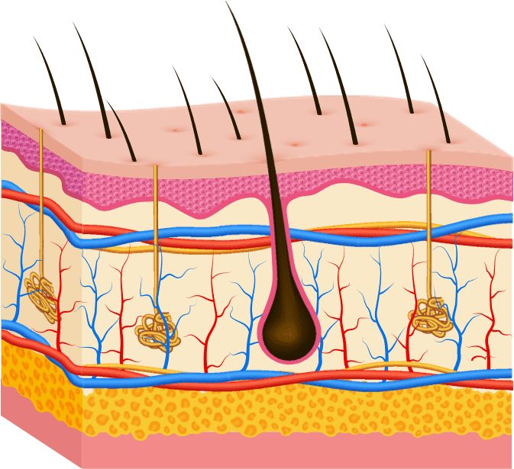
Conclusion:
The proposed AI-based skin disease prediction system demonstrates that Convolutional Neural Networks can effectively classify various skin conditions from dermatoscopic images. By leveraging the HAM10000 dataset and applying preprocessing techniques, the model achieves promising accuracy and reliability. This automated approach enhances early diagnosis, supports dermatologists in clinical decisions, and improves accessibility to skin healthcare—especially in underserved areas. With further optimization and real-time integration, this system has the potential to become a valuable tool in the field of medical diagnostics.

Slide 12


