Slide 1
Patent Classification and Analysis
SANTOSH KADGE

Slide 2
Data Extraction and Preprocessing
DATA EXTRTACTION
Split the xml by the xml tags
Extract following elements
Data Cleaning
Lowercase the text
Data Exploration
Total 8 classes are there in which data is classified
Data is Imbalanced across the classes(Gathered more data do balance the dataset)
invention-title
patent_num
patent_date
application_type
Inventors
Abstract
Description
Claims
Remove stop words
Perform Lemmatization
Remove numbers
Remove punctuation
A- HUMAN NECESSITIES
B - PERFORMING OPERATIONS; TRANSPORTING
H - ELECTRICITY
C - CHEMISTRY; METALLURGY
D - TEXTILES; PAPER
E - FIXED CONSTRUCTIONS
F - MECHANICAL ENGINEERING; LIGHTING; HEATING; WEAPONS; BLASTING
G - PHYSICS
Total 7181 samples have been collected with 1000 samples per each class except TEXTILES having 181 samples
Collect all the data in datframe and save it in csv format

Slide 3
Most correlated unigrams and bigrams for classes
TEXTILES
Wash
Laundry
washing machine
laundry treating
HUMAN NECESSITIES
bone
patient
plant named
medical device
ELECTRICITY
network
semiconductor
semiconductor device
base station
PHYSICS
data
file
computer program
refractive power
FIXED CONSTRUCTIONS
wellbore
door
drill string
wall structure
PERFORMING OPERATIONS; TRANSPORTING
Printing
vehicle
printing apparatus
vehicle body

Slide 4
Model Selection
Supervised machine learning Tfidf vectorization
Number of samples selected = 3681 Train test split = 75:25
Stratified sampling No of top tfidf features used: 100
Algorithm | Features | Accuracy | F1-Score
LinearSVC | Patent title + abstract | 0.60 | 0.61
LinearSVC | description | 0.65 | 0.66
LinearSVC | claims | 0.58 | 0.58
LinearSVC | Patent title + abstract+description+claims | 0.65 | 0.66
K Nearest Neighbor | Patent title + abstract | 0.53 | 0.53
K Nearest Neighbor | description | 0.59 | 0.59
K Nearest Neighbor | claims | 0.48 | 0.47
K Nearest Neighbor | Patent title + abstract+description+claims | 0.57 | 0.57
MultinomialNB | Patent title + abstract | 0.43 | 0.41
MultinomialNB | description | 0.57 | 0.58
MultinomialNB | claims | 0.52 | 0.51
MultinomialNB | Patent title + abstract+description+claims | 0.56 | 0.56
RandomForestClassifier | Patent title + abstract | 0.47 | 0.45
RandomForestClassifier | description | 0.62 | 0.62
RandomForestClassifier | claims | 0.52 | 0.51
RandomForestClassifier | Patent title + abstract+description+claims | 0.63 | 0.63

Slide 5
Hyperparameter tuning
Selected Linear Support vector machine as final classification algorithm
Using GridSearchCV finalized the C parameter to 10
Used K fold cross validation with GridsearchCV
Balanced weight of all the classes using parameter( class_weight='balanced’)
For final model training used only patent description as features
Increased number of samples to 7181 (Textiles: 181, Rest of classes: 1000 each)
Accuracy : 74.88% , F1 Score: 75%

Slide 6
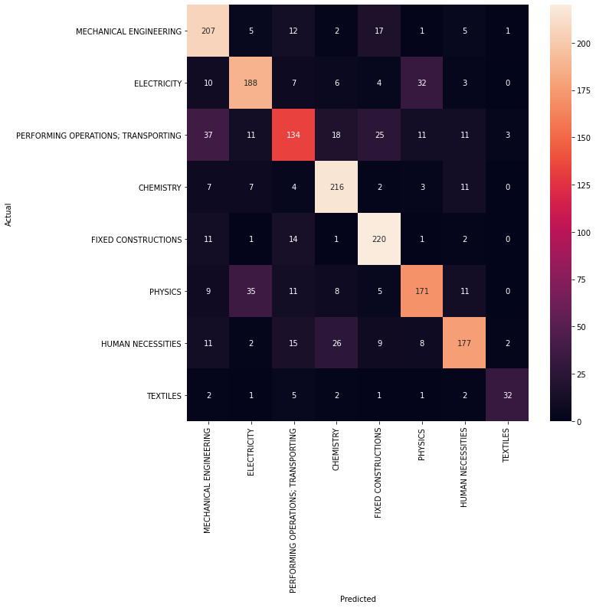
Final Confusion Matrix

Slide 7
BERT Results Analysis
Bert-base-uncased model used
samples: 3681
max_length=256,
batch_size = 12
Model | Features | F1-score | Accuracy
Bert-base-uncased | Patent title + abstract | 0.7471 | 0.75
Bert-base-uncased | claims | 0.69 | 0.71
Bert-base-uncased | Description | 0.7058 | 0.70

Slide 8
Future Scope
Gather more data to train the model which will further enhance the model accuracy
Explore BERT by training on more examples
Use Inventor details for classification because most probably they are going to work in similar industry
Explore topic modelling as a features to train the model

Slide 9
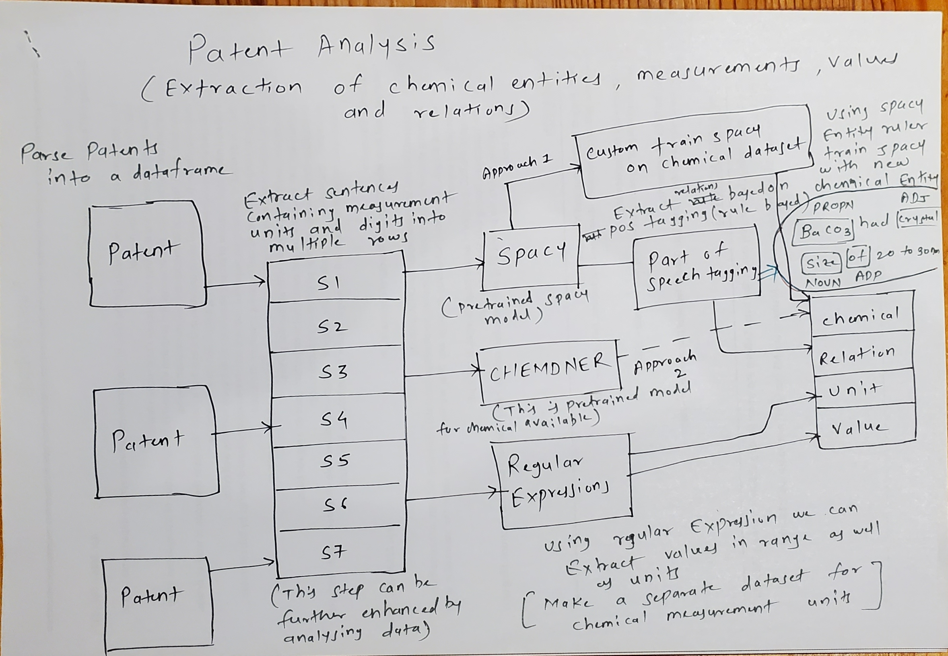
Patent Analysis

