Slide 3
DIVEL CODER'S APP-NOTES
LOOK AT ME, I WILL TELL YOU, HOW TO MAKE FUN OF APPS……..

Slide 4
FEATURES
NOTES
QUIZ
ASSIGNMENT
COLLAGES
NEWS FEED
CHATROOM
TEAM AND PURPOSE

Slide 5


NOTES

Slide 6


QUIZZZZZZ & ASSIGNMENTS

Slide 7

COLLAGES

Slide 8
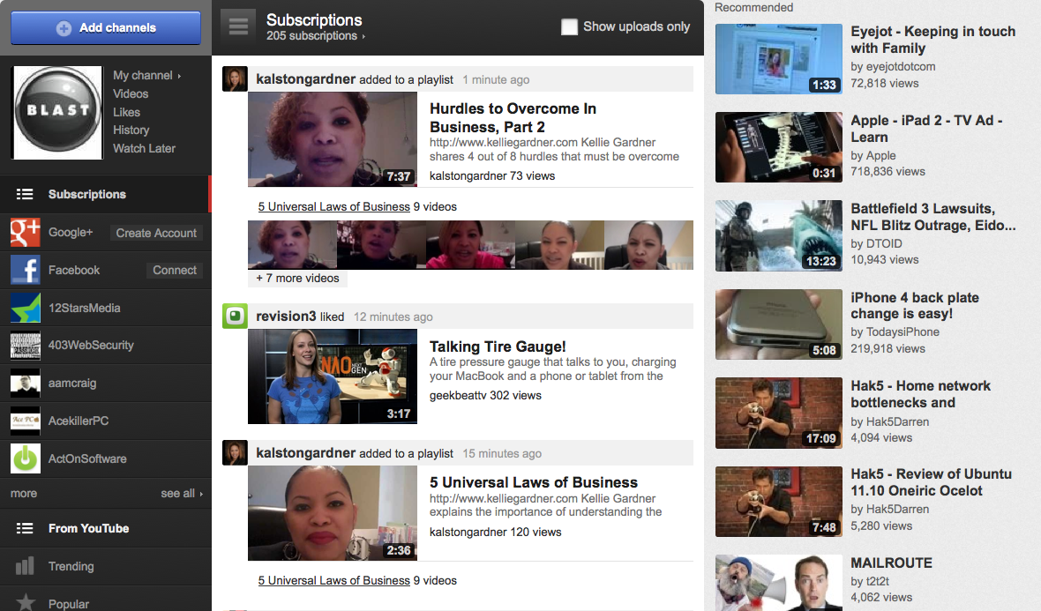
NEWS FEED

Slide 9

CHAT-ROOM

Slide 10


Slide 11
TEAM MEMBERS….
ARORA NIKHAR 😐
SONI SAPNA :p
ROTHOR DIVYA ☺
JUGTAWAT DIVYAVRAT :p
CHOUDHARY SANTOSH 😐
CHOUDHARY GUNJAN ;)

