Slide 1


Slide 2
FEATURES
NOTES
QUIZ
ASSIGNMENT
COLLEGES
NEWS FEED
CHATROOM
TEAM AND PURPOSE

Slide 3


NOTES

Slide 4


QUIZZZZZZ & ASSIGNMENTS

Slide 5

COLLEGES

Slide 6
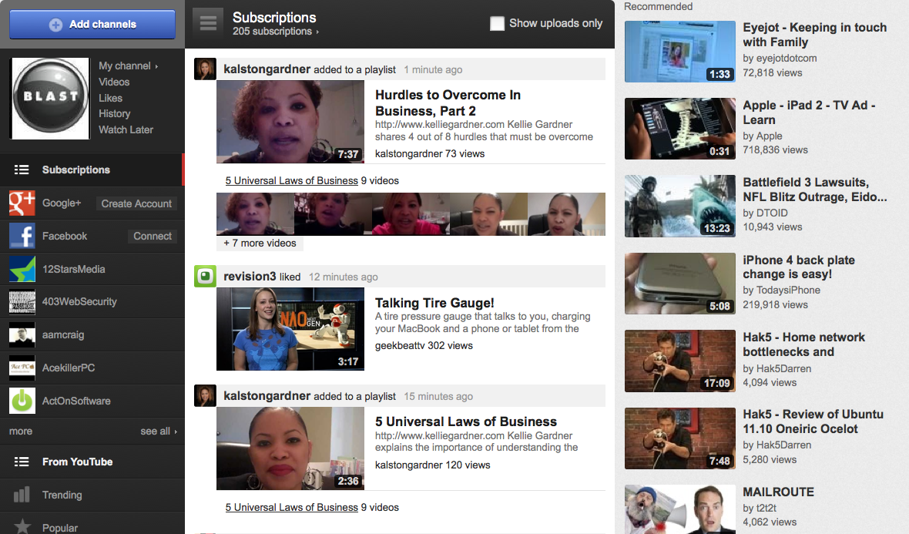
NEWS FEED

Slide 7

CHAT-ROOM

Slide 8


Slide 9
TEAM MEMBERS….
ARORA NIKHAR 😐
SONI SAPNA :p
ROTHOR DIVYA ☺
JUGTAWAT DIVYAVRAT :p
CHOUDHARY SANTOSH 😐
CHOUDHARY GUNJAN ;)

