Slide 1
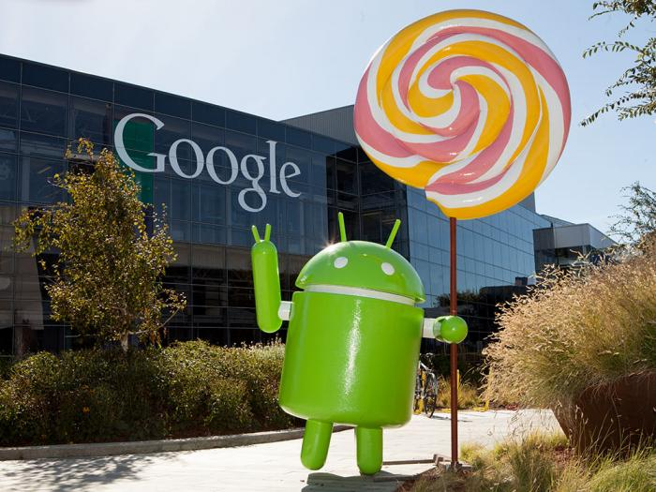
Lolliopop 5.0

Slide 2
COMPONENTS OF ANDROID APPLICATION
Activity
Intent
Broadcast
Receiver
Content provider
Service

Slide 3
Application Components
Activities – visual user interface focused on a single thing a user can do
Services – no visual interface – they run in the background
Broadcast Receivers – receive and react to broadcast announcements
Content Providers – allow data exchange between applications

Slide 4
Activities
Basic components of most applications
Most applications have several activities that start each other as needed
Each is implemented as a subclass of the base Activity class

Slide 5
Activities – The View
Each activity has a default window to draw in (although it may prompt for dialogs or notifications)
The content of the window is a view or a group of views (derived from View or ViewGroup)
Example of views: buttons, text fields, scroll bars, menu items, check boxes, etc.
View(Group) made visible via Activity.setContentView() method.

Slide 6
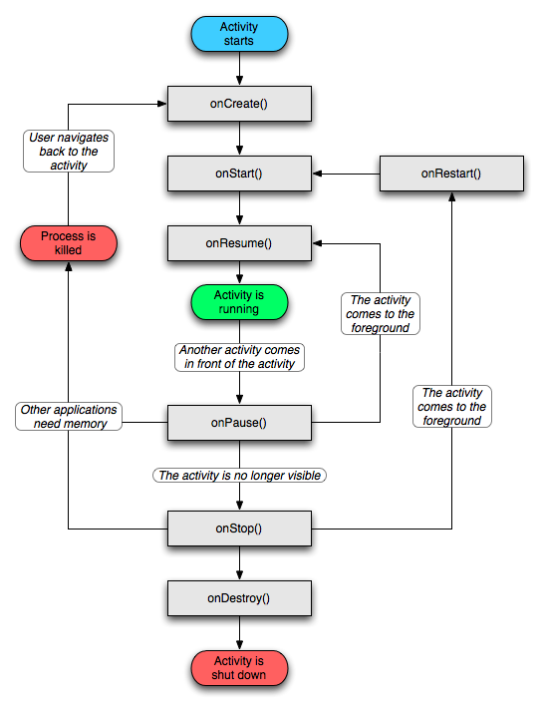
Lifecycle of Activity

Slide 7
Intents
An intent is an Intent object with a message content.
Activities, services and broadcast receivers are started by intents. ContentProviders are started by ContentResolvers:
An activity is started by Context.startActivity(Intent intent)
A service is started by Context.startService(Intent service)
An application can initiate a broadcast by using an Intent in any of Context.sendBroadcast(Intent intent), Context.sendOrderedBroadcast(), and Context.sendStickyBroadcast()

Slide 8
Broadcast Receivers
Receive and react to broadcast announcements
Extend the class BroadcastReceiver
Examples of broadcasts:
Low battery, power connected, shutdown, timezone changed, etc.
Other applications can initiate broadcasts

Slide 9
Content Providers
Makes some of the application data available to other applications
It’s the only way to transfer data between applications in Android (no shared files, shared memory, pipes, etc.)
Extends the class ContentProvider;
Other applications use a ContentResolver object to access the data provided via a ContentProvider.
The provider object receives data requests from clients, performs the requested action, and returns the results.

Slide 10
Services
Run in the background
Can continue even if Activity that started is dies
Should be used if something needs to be done while the user is not interacting with application
Otherwise, a thread is probably more applicable
Should create a new thread in the service to do work in, since the service runs in the main thread
Examples
Network Downloads
Playing Music
Needs to be declared in manifest file
Like Activities, has a structured life cycle

Slide 11
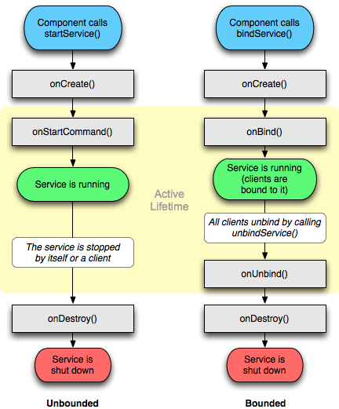
Services (2)

Slide 12
Shutting down components
Activities
Can terminate itself via finish();
Can terminate other activities it started via finishActivity();
Services
Can terminate via stopSelf(); or Context.stopService();
Content Providers
Are only active when responding to ContentResolvers
Broadcast Receivers
Are only active when responding to broadcasts

Slide 13
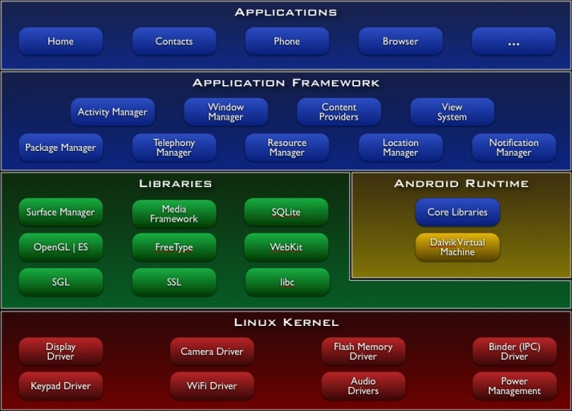

Slide 14
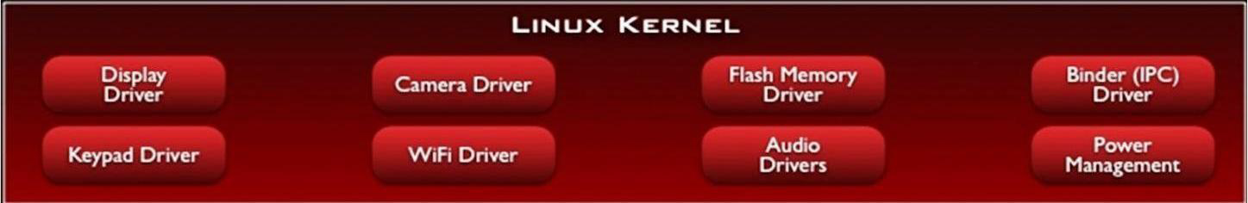
LINUX KERNEL
•The architecture is based on the Linux2.6 kernel. Android use Linux kernel as its hardware abstraction layer between the hardware and rest of the software.
It also provides memory management, process management, a security model, and networking, a lot of core operating system infrastructures that are robust and have been proven over time

Slide 15
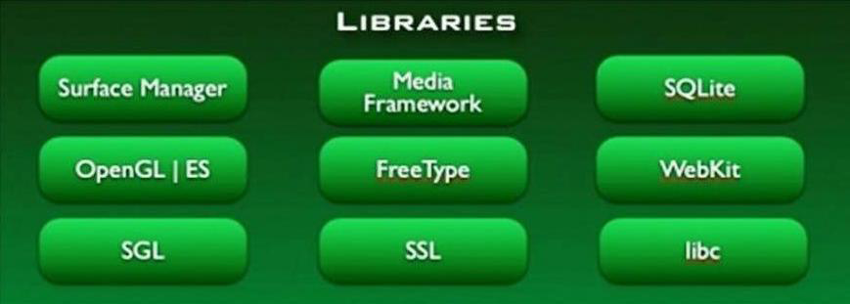
NATIVE LIBRARIES
•The next level up is the native libraries. Everything that you see here in green is written in C and C++.

Slide 16
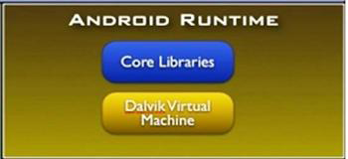

Android Run Time
•The Android Runtime was designed specifically for Android to meet the needs of running in an embedded environment where you have limited battery, limited memory, limited CPU.
•The DVM runs something called dex files, D-E-X and these are byte codes that are the results of converting at build time .Class and JAR Files.

Slide 17
Android Run Time
•This is in blue, meaning that it's written in the Java programming language.
•The core library contains all of the collection classes, utilities, IO, all the utilities and tools that you’ve come to expected to use.

Slide 18
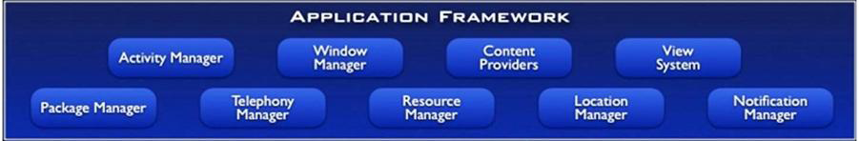
Application Framework
•This is all written in a Java programming language and the application framework is the toolkit that all applications use.
•These applications include the ones that come with a phone like the home applications, or the phone application.
•It includes applications written by Google, and it includes apps that will be written by you.
•So, all apps use the same framework and the same APIs.

Slide 19
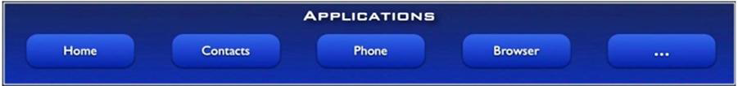
APPLICATION LAYER
•And the final layer on top is Applications.
•This is where all the applications get written.
•It includes the home application, the contacts application, the browser, and your apps.
•And everything at this layer is, again, using the same app framework provided by the layers below.

Slide 20
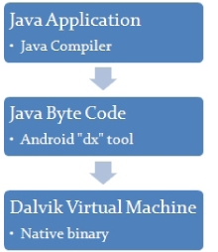
Android Deployment
Apps are packaged in .apk format, variant of .jar, then downloaded to device and installed
.apks contain .dex files (bytecode), manifest and various other files
Manifest contains security and link info, hardware access info, minimum OS release info, etc.

Slide 21
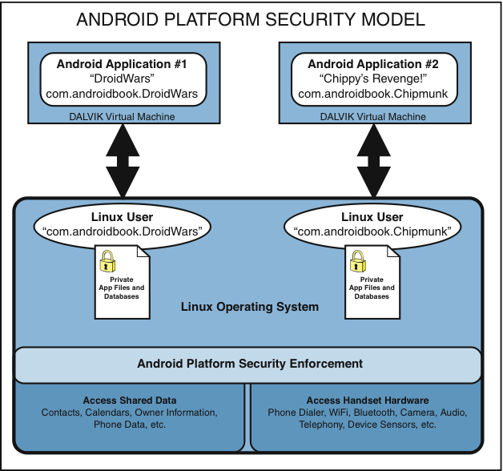
Sams Teach Yourself Android™Application Development in 24 Hours (0321673352)
Simplified Android platform architecture from a security perspective.

Slide 22
Screen Shots
Some say you need to root the phone – that is not true
One option: Android Screen Capture
http://www.mightypocket.com/2010/08/android-screenshots-screen-capture-screen-cast/
It’s slow, but fine for screenshots of applications whose screens aren’t changing fast.

Slide 23
Debugging
Instead of using traditional System.out.println, use the Log class
Imported with android.util.Log
Log is a logging class that you can utilize in your code to print out messages to the LogCat. Common logging methods include:
d(String, String) (debug)
i(String, String) (information)
w(String, String) (warning)
e(String, String) (error
Log.d(<tag>,<string>)

Slide 24
APIs for Android built-ins
Application Program Interface is a set of routines, protocols, and tools for building software applications. The API specifies how software components should interact and are used when programming graphical user interface (GUI) components. A good API makes it easier to develop a program by providing all the building blocks. A programmer then puts the blocks together.
Android OS ships with many built in apps
Web Browser
Google Maps
Navigation
Camera apps
Built in access for these as well as TTS and Voice Recognition, etc.

Slide 25

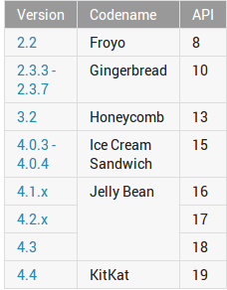
THANK YOU
Queries ?????????
5.0
Lollipop
21

