Slide 1



NALANDA INSTITUTE OF TECHNOLOGY, BHUBANESWAR
NAME: BAIKUNTHA SAHOO
REGD NO: 1901297172
(STUDYING B.TECH FINAL YEAR IN THE BRANCH OF MECHANICAL ENGINEERING)
PRESENTATION BASED UPON:
EXPLORE BUISNESS OPPORTUNITIES IN INDIA, ADVANTECH TECHNOLOGY SOLUTIONS ON TELECOM SECTOR.

Slide 2
CONTENTS
INTRODUCTION
TYPES OF COMMUNICATION
BASIC ELEMENTS OF TELECOMMUNICATION
INDIAN TELECOMMUNICATION INDUSTRY
FUTURE DEVELOPMENT
ADVANTAGES AND DISADVANTAGES OF TELECOMMUNICATION
CONCLUSION

Slide 3
INTRODUCTION
Telecommunication also known as telecom, is the exchange of information over significant distances by electronic means and refers to all type of voice, data and video transmission.
The transmission of information that allows for communication between people who are separated by a distance.
Today telecommunication are used to organize more or less remote computer system into telecommunications networks.
Telecommunication includes:
Mechanical communication
Electrical communication

Slide 4
TYPES OF COMMUNICATION
POINT –TO-POINT COMMUNICATION
Telecommunication over telephone lines.
BROADCAST COMMUNICATION
Telecommunication through radio broadcasts.
MULTIPLEX SYSTEM
Telecommunication in which multiple transmitters and multiple receiver.

Slide 5
BASIC ELEMENTS OF TELECOMMUNICATION
SENDER:
Who uses a transmitter which converts the message into a signal.
TRANSMITTER:
Transmits the information through a medium to the receiver which transmits the signal into information that can be used and understood by people.
CHANNEL:
Responsible to transfer the information from the source to the destination without distortion or loss of information. Channel tend to be affected by external signals or noise. To achieve this variety of “protocols” or rules are used.

Slide 6
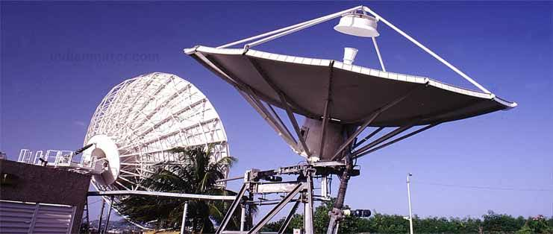
INDIAN TELECOMMUNICATION INDUSTRY
The Indian telecommunications has been zooming up the growth curve at a feverish pace.
The key sectors responsible for India’s resurgent economic growth.
India is has surpassed US to become the second largest wireless network in the world with a subscriber base of over 300 million.

Slide 7
FUTURE DEVELOPMENT
In the mobile business, Bharti Airtel plans to make considerable investments in network expansion to esatablish presence in all census towns and over 5000,000 villages across India by 2010,thereby covering 95% of the country’s total population.
The company’s strategic focus will be on further strengthening the Airtel brand through best – in – class customer service , which is backed by wide national distribution.

Slide 8
ADVANTAGES AND DISADVANTAGES OF TELECOMMUNICATION
ADVANTAGES
Quick and accessible communication .
Lack of time period
Saves time
More than two people can communicate with at list one another at an equivalent time
Easy to exchange ideas and knowledge via phone and/or fax
Develops new products and inventions

Slide 9
DISADVANTAGES
Prank calls
Misunderstanding
Cultural barrier
Sometimes expensive
High electric bills
Poor connections

Slide 10
CONCLUSION
Telecommunication is an inevitable movement since the beginning of the 21st century . It’s better for only businesses but also every individual to take advantage of these technology developments .
The telecommunication world is rapidly changing .
Importance of common management components .

Slide 11
THANK YOU

