Slide 1
Data Prep for LLM
- Santosh Borse, IBM Research

Slide 2
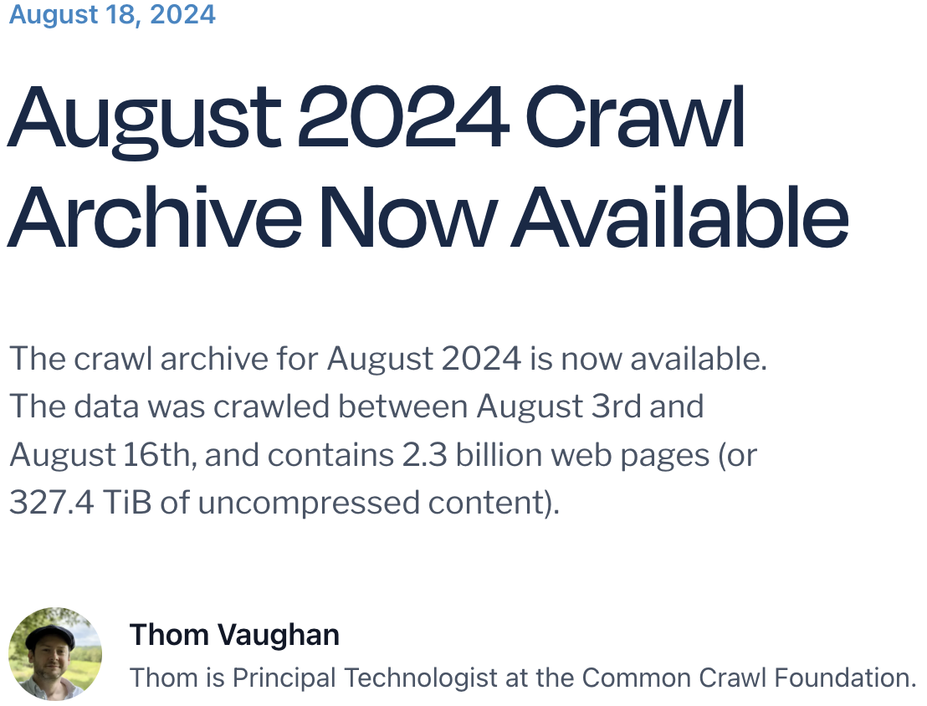
Data is the new oil ( for LLMs growth )
Common crawl
From 2007, 250 Billion Pages
Petabytes of data
Superset for lot of other available datasets
Processed dataset : Refined Web, The Pile, C4, Red Pajama, Wiki etc.
Domain\source Specific Dataset: BookCorpus, MathQA, StarCoder etc
HF has more than 210K datasets
Your Own data
Models evolved from millions of token for training to trillions of token

Slide 3
Data Quality
Variety
Linguistic Pattern
Overfitting vs underfitting
Bias
Personal Information
Bad Data - Hate, abuse, profanity
Time and cost required for training

Slide 4
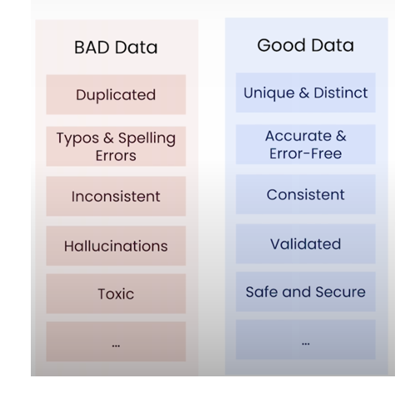
Good vs Bad data

Slide 5
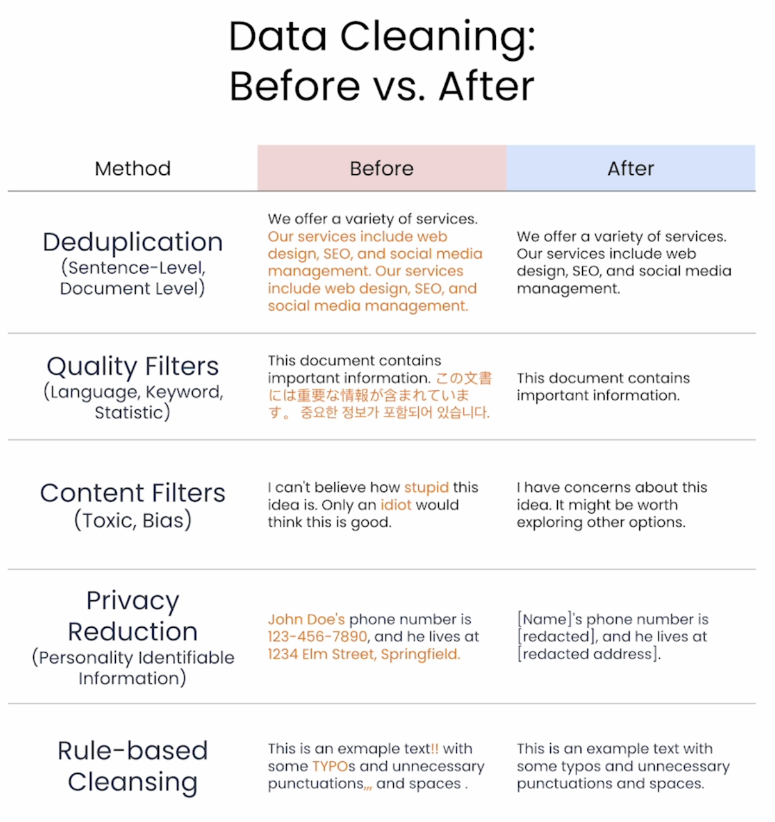

Slide 6
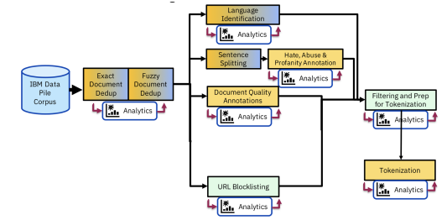
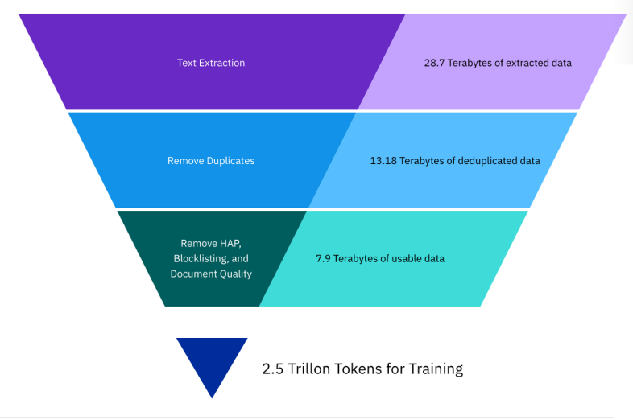
Data Journey for IBM Granite Model

Slide 7
Data Prep Kit
Recently open sourced https://github.com/IBM/data-prep-kit
Tried and Tested - Used for preparing data for IBM’s Granite Models
Ability to scale from laptop to full datacenter scale
Lot of inbuilt transforms & Bring your own Transform
Can run on Pure python, Spark or Ray
Abstracted scaling logic
Ability to checkpointing

Slide 8
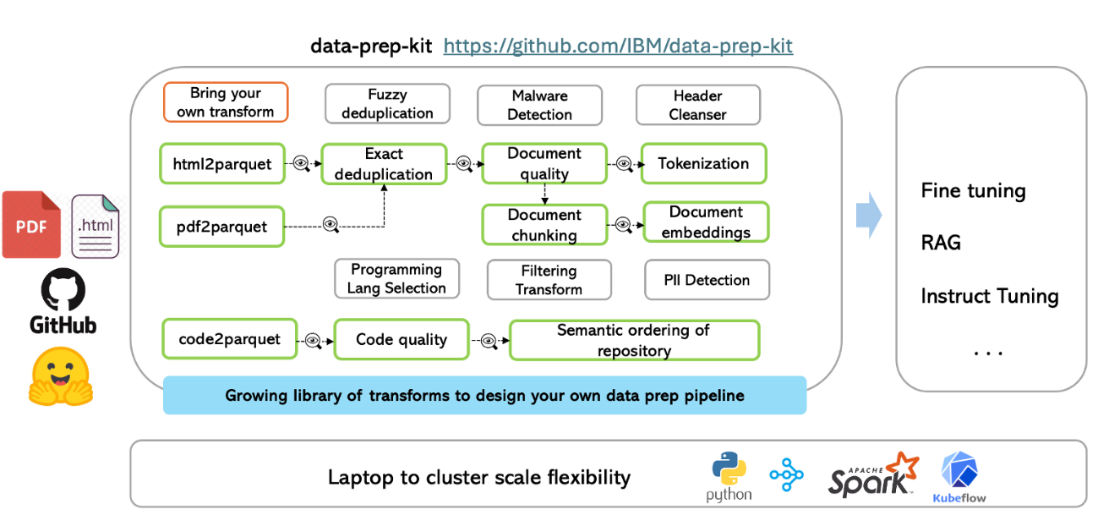
Data Prep Kit

Slide 9
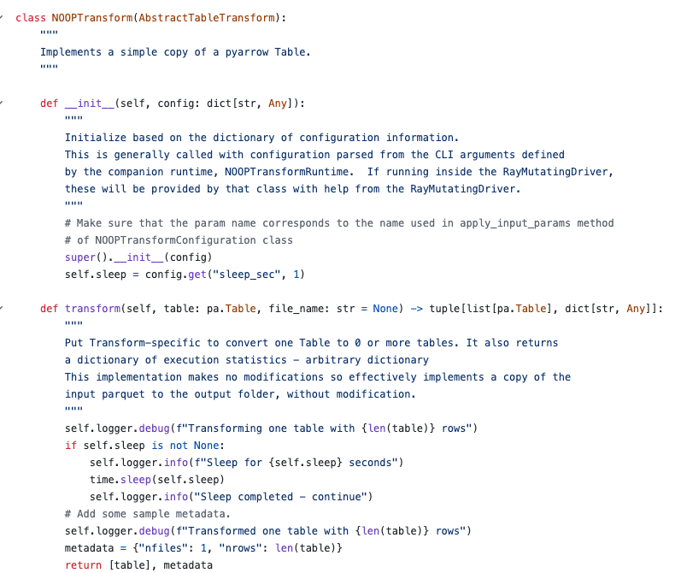
Bring your own transform

Slide 10
DPK Hands-on in colab
https://github.com/sujee/data-prep-kit-examples/blob/main/dpk-intro/README.md

Slide 11
Thank You

