Slide 1

UE23CS320A – Capstone Project Approval
Project Title
:
CALIPER: Calibrating Interpretability Readouts for Language Models
Project ID
:
[PROJECT ID]
Project Guide
:
[GUIDE NAME]
Project Team
:
SANTOSH CHEETHIRALA
PES1UG24CS127
NIVAS REDDY DANDU
PES1UG24AM075
C. SREE KRISHNA KOUSHIK
PES1UG24CS128
MARREDDY RUSHI ESWAR REDDY
PES1UG24AM158
Department of Computer Science and Engineering · PES University

Slide 2
CALIPER: Calibrating Interpretability Readouts for Language Models
Outline
01
Introduction
02
Problem Statement
03
Work Flow
04
Scope and Feasibility study
05
Applications / Use cases
06
Background Study
07
Project Timeline and Team Effort Plan
08
References
SANTOSH CHEETHIRALA_NIVAS REDDY DANDU_C. SREE KRISHNA KOUSHIK_MARREDDY RUSHI ESWAR REDDY

Slide 3
CALIPER: Calibrating Interpretability Readouts for Language Models
Introduction
•
A language model is made of billions of numbers. Almost none of them have a known meaning.
•
Interpretability is the field that tries to read those numbers — to say “this unit responds to X”, “this direction is the model’s honesty trait”, “the model can report on its own internal state”.
•
Every one of those is a reading, produced by an instrument.
•
And an instrument is only worth what its calibration is worth.
SANTOSH CHEETHIRALA_NIVAS REDDY DANDU_C. SREE KRISHNA KOUSHIK_MARREDDY RUSHI ESWAR REDDY

Slide 4
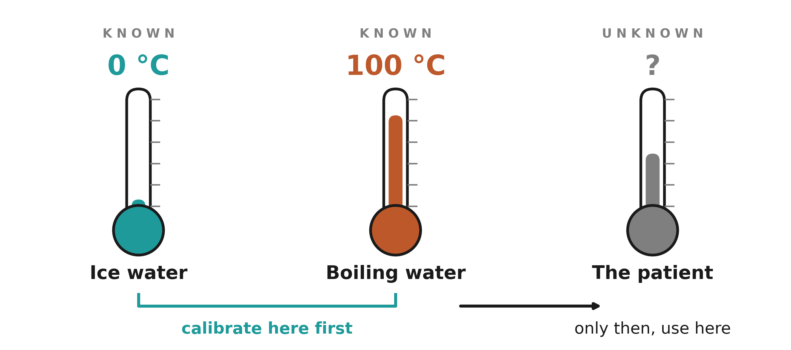
CALIPER: Calibrating Interpretability Readouts for Language Models
Introduction
Why an instrument is trusted
Nobody has done this for the tools that read language models.
SANTOSH CHEETHIRALA_NIVAS REDDY DANDU_C. SREE KRISHNA KOUSHIK_MARREDDY RUSHI ESWAR REDDY

Slide 5
CALIPER: Calibrating Interpretability Readouts for Language Models
Problem Statement
Interpretability tools claim to read a model’s mind: which direction a neuron responds to, which vector encodes a personality trait, whether the model can report on its own internal states. None of these tools has ever been checked against a case where the right answer was already known. Neuroscience solved this a century ago with the preparation — the squid axon, the sea slug, the worm — a system simple enough that a new instrument could be tested against a known answer before being trusted on an unknown one. We build preparations for language models at three levels — unit, trait, self — and use them to measure how often each reading tool is right, how often it is silently wrong, and what it takes to tell the difference.
Does the mind-reading kit work? Building preparations for language models.
SANTOSH CHEETHIRALA_NIVAS REDDY DANDU_C. SREE KRISHNA KOUSHIK_MARREDDY RUSHI ESWAR REDDY

Slide 6
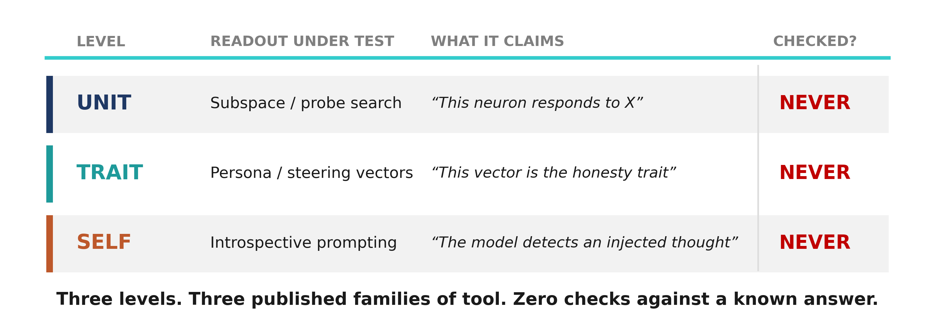
CALIPER: Calibrating Interpretability Readouts for Language Models
Problem Statement
Three levels. Three published families of tool.
SANTOSH CHEETHIRALA_NIVAS REDDY DANDU_C. SREE KRISHNA KOUSHIK_MARREDDY RUSHI ESWAR REDDY

Slide 7
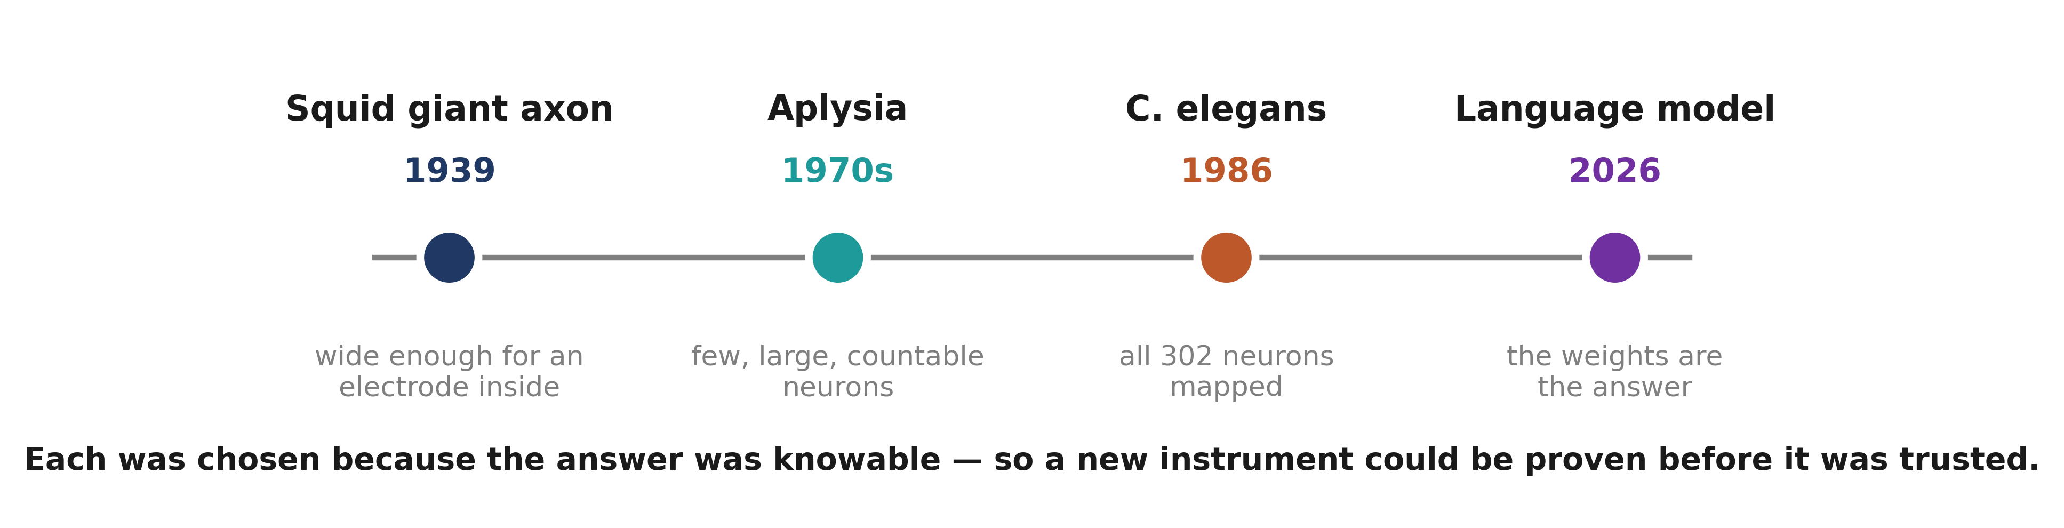
CALIPER: Calibrating Interpretability Readouts for Language Models
The neuroscience framing
A preparation is a system chosen because the answer is knowable
SANTOSH CHEETHIRALA_NIVAS REDDY DANDU_C. SREE KRISHNA KOUSHIK_MARREDDY RUSHI ESWAR REDDY

Slide 8
CALIPER: Calibrating Interpretability Readouts for Language Models
The neuroscience framing
•
In biology a preparation is the system you choose because it makes an otherwise impossible measurement tractable.
•
The squid giant axon was picked because it is wide enough to put an electrode inside. Aplysia, because it has large countable neurons. C. elegans, because every one of its 302 neurons could be mapped.
•
In each case the instrument was proven where the answer was knowable before it was trusted where it was not.
•
A language model is the first system where all three of our questions have a knowable answer.
SANTOSH CHEETHIRALA_NIVAS REDDY DANDU_C. SREE KRISHNA KOUSHIK_MARREDDY RUSHI ESWAR REDDY

Slide 9
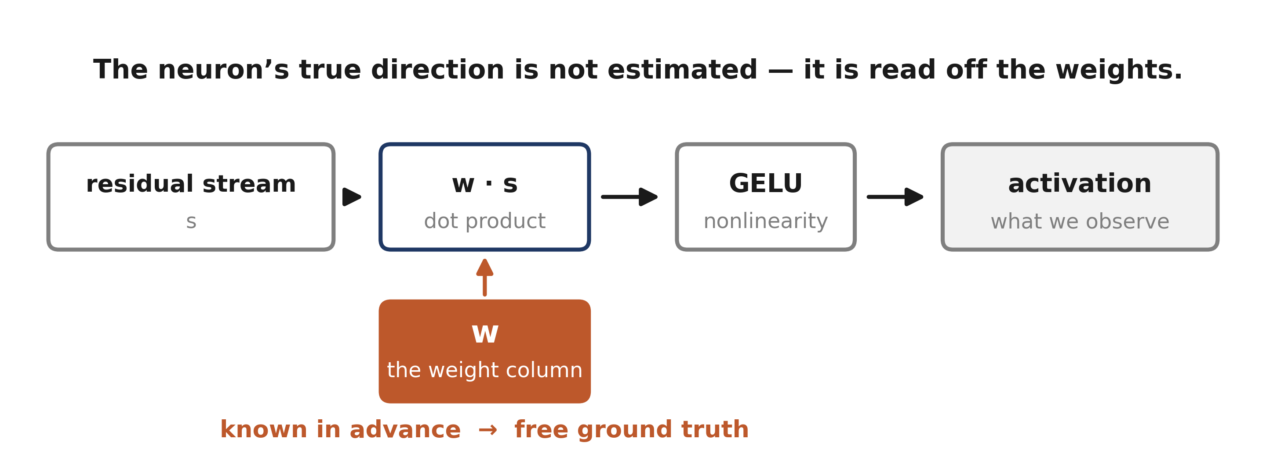
CALIPER: Calibrating Interpretability Readouts for Language Models
Ground truth, for free
At the trait and self levels there is no free truth, so we plant it.
SANTOSH CHEETHIRALA_NIVAS REDDY DANDU_C. SREE KRISHNA KOUSHIK_MARREDDY RUSHI ESWAR REDDY

Slide 10
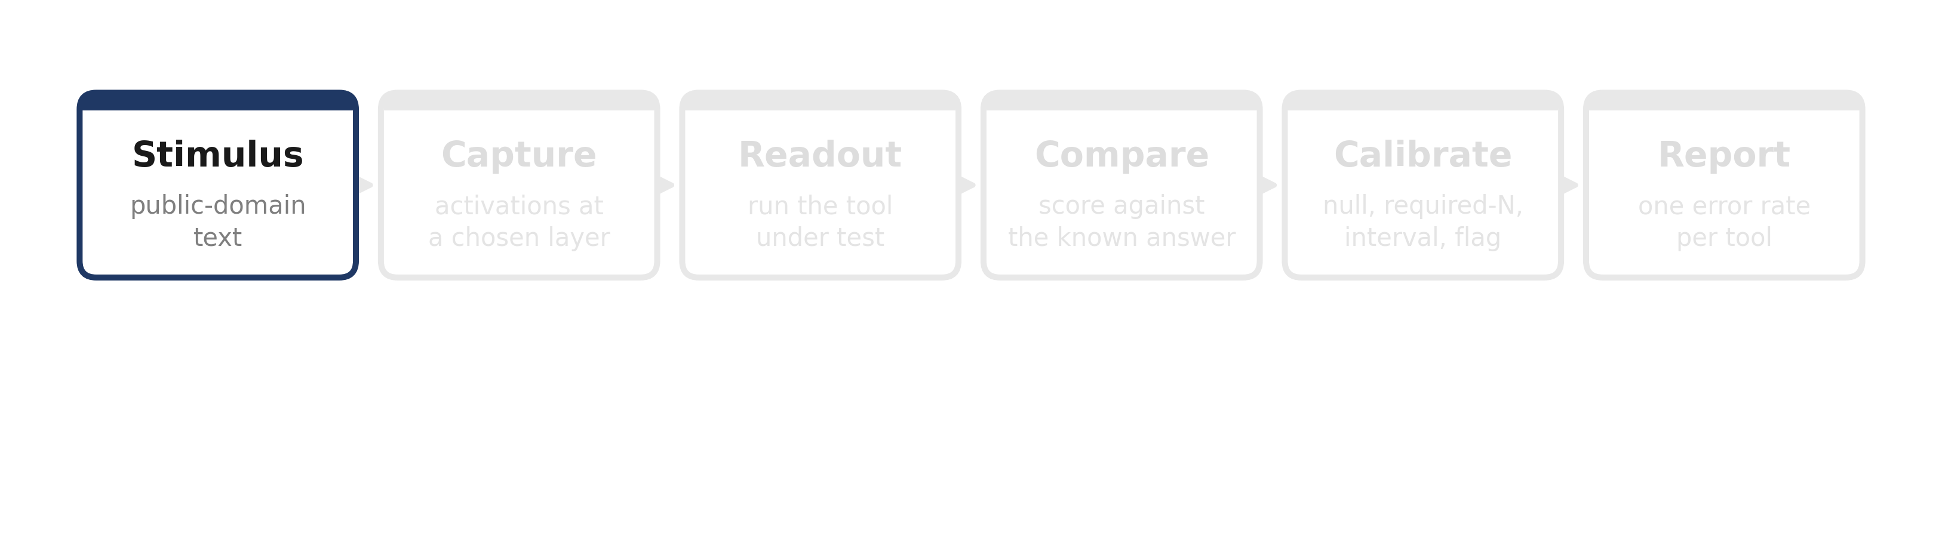
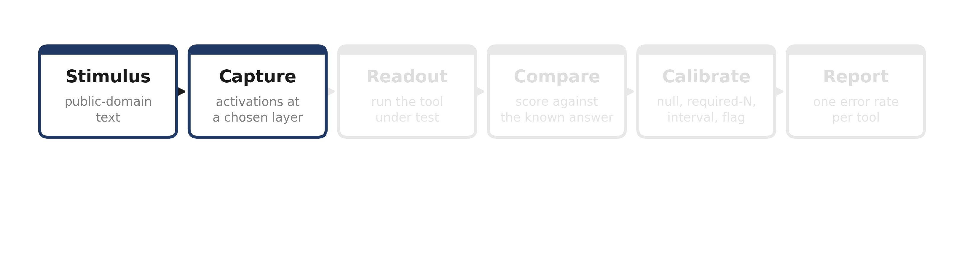
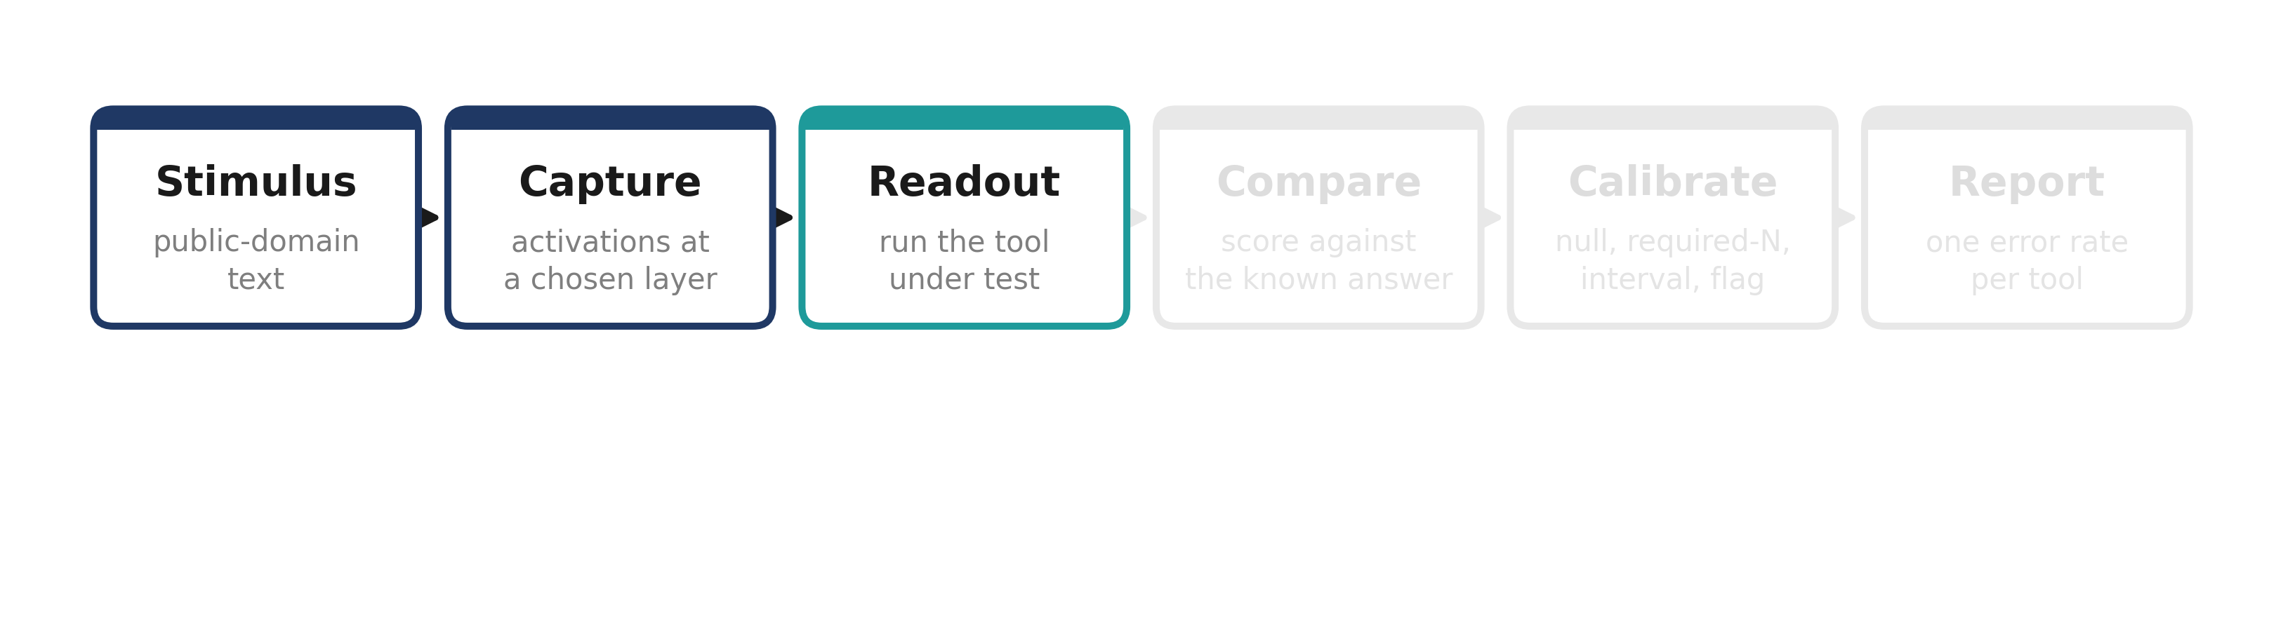
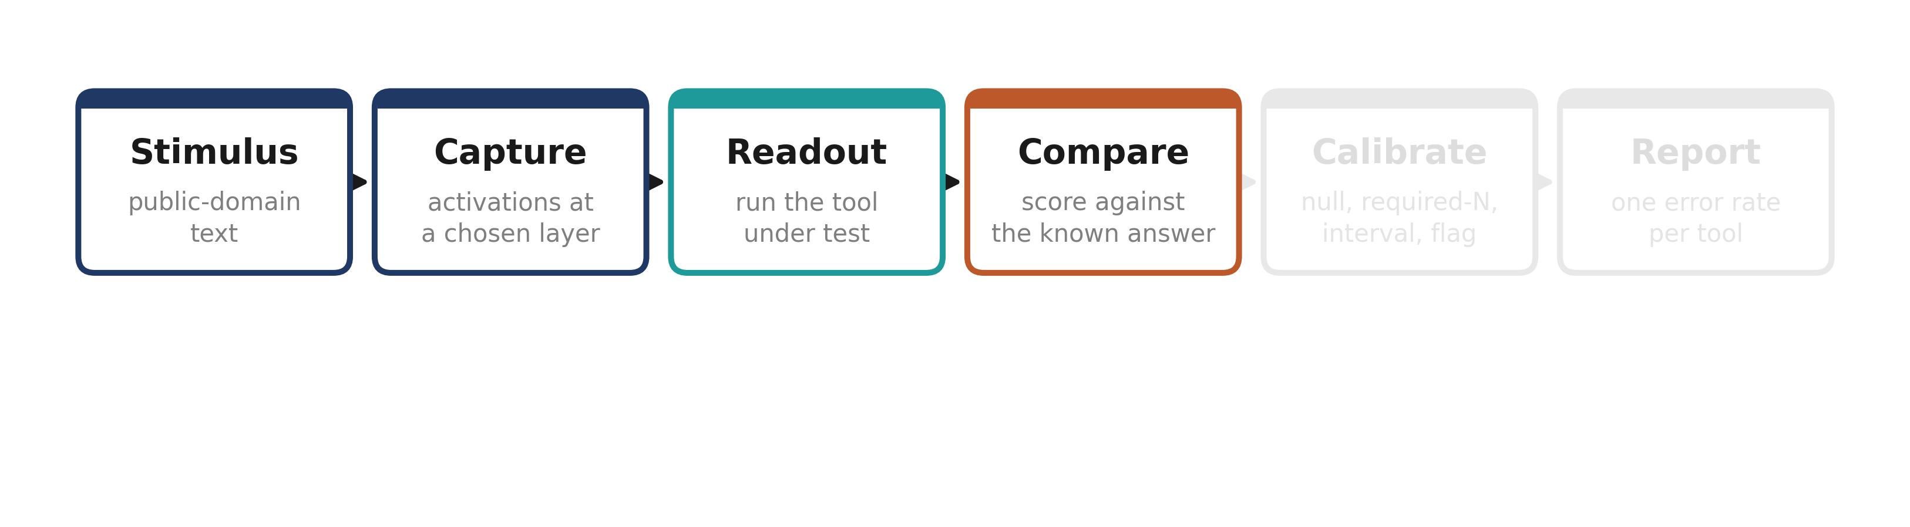
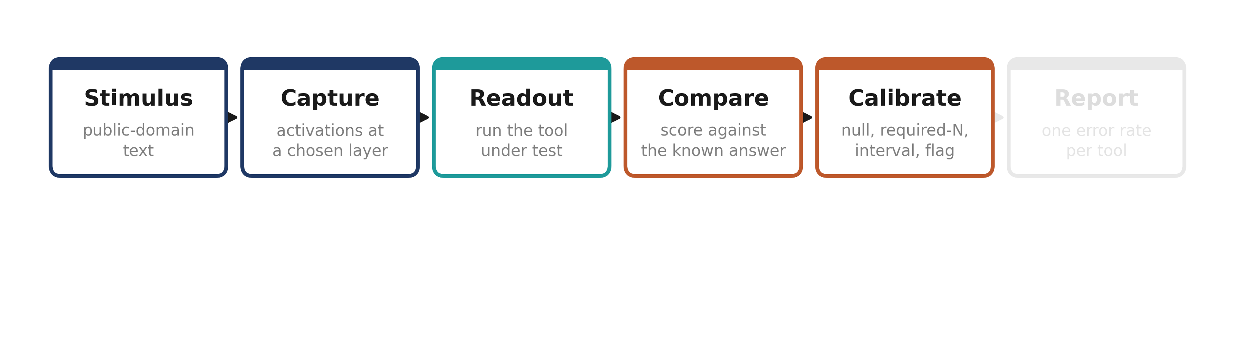
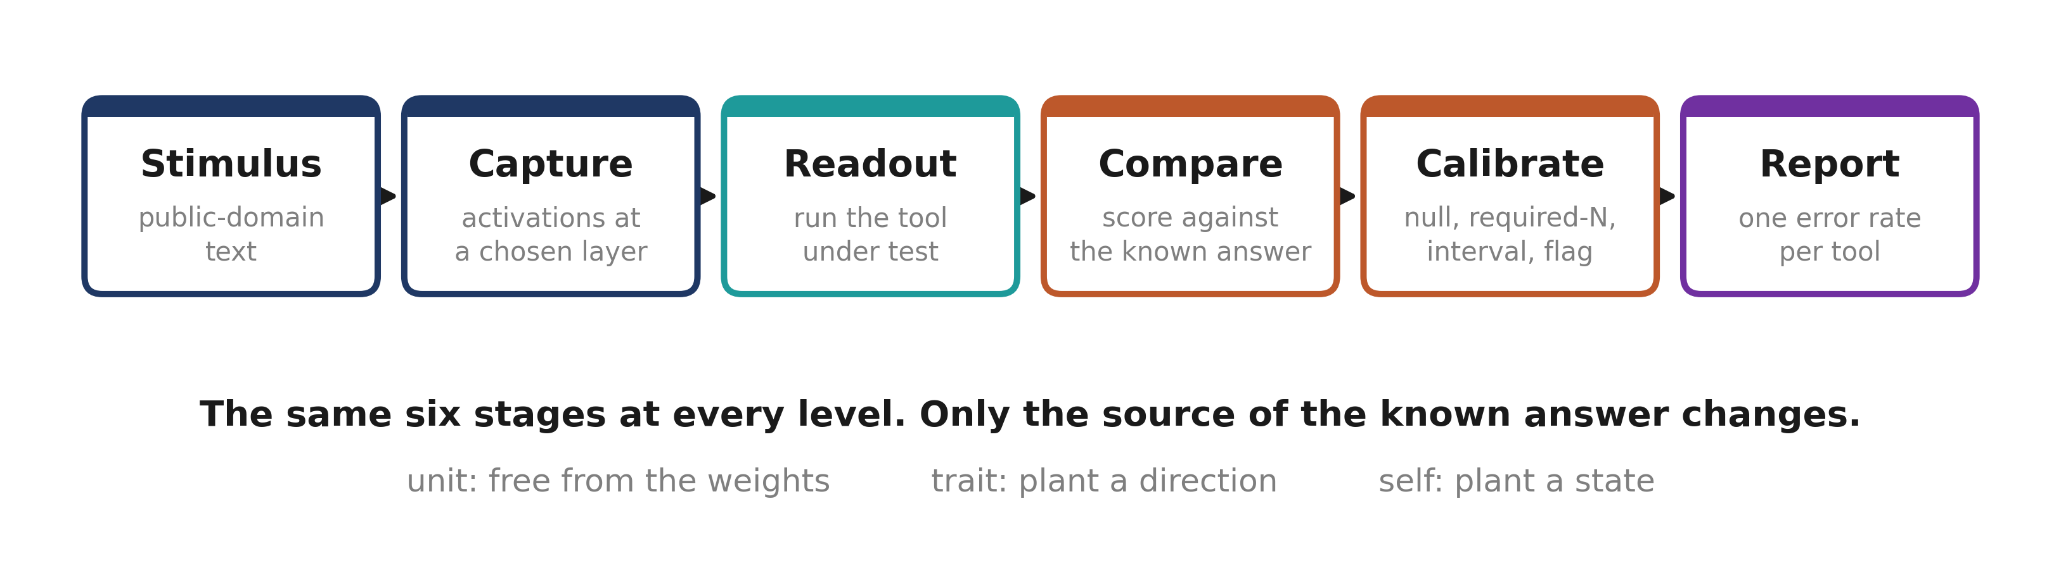
CALIPER: Calibrating Interpretability Readouts for Language Models
Work Flow
One measurement pipeline, applied at each level
Every study reports the same four quantities, so the three levels read as one instrument characterised at three depths rather than three separate projects.
SANTOSH CHEETHIRALA_NIVAS REDDY DANDU_C. SREE KRISHNA KOUSHIK_MARREDDY RUSHI ESWAR REDDY

Slide 11
CALIPER: Calibrating Interpretability Readouts for Language Models
Scope
In scope
Out of scope
•
Three levels of readout: unit, trait, self.
•
No claim about machine consciousness. The terms are introspective accuracy and self-report validity.
•
Open-weight models only — GPT-2 small for the unit level, one ≥ 27B instruct model for trait and self.
•
No training-time work — every experiment is inference only.
•
English text, public-domain corpora.
•
No proprietary or API-only models; results must be reproducible by anyone.
•
Readouts that are already published. We test instruments, we do not invent them.
•
Not a benchmark leaderboard. We measure error rates, not rankings.
SANTOSH CHEETHIRALA_NIVAS REDDY DANDU_C. SREE KRISHNA KOUSHIK_MARREDDY RUSHI ESWAR REDDY

Slide 12
CALIPER: Calibrating Interpretability Readouts for Language Models
Feasibility study
1
Model availability
GPT-2 small, Gemma3-27B-it and Qwen2.5-32B-Instruct are all open-weight and free to obtain.
2
Ground truth
Free at the unit level — it is already in the weights. Planted at the trait and self levels using published injection methods.
3
Compute
Unit level runs on a laptop CPU. Large-model work runs on Kaggle’s free tier, 2× Tesla T4, 30 GPU-hours per week. The pipeline checkpoints and resumes.
4
Methods
The estimators are decades old and published; the injection and persona methods are public. Nothing needs to be invented before measurement can start.
No personal data. No proprietary data. No paid compute.
SANTOSH CHEETHIRALA_NIVAS REDDY DANDU_C. SREE KRISHNA KOUSHIK_MARREDDY RUSHI ESWAR REDDY

Slide 13
CALIPER: Calibrating Interpretability Readouts for Language Models
Applications / Use cases
AI safety audits
Trusting a model’s self-report
Regulators and labs increasingly check for hidden traits — deception, sycophancy, bias — by reading a model’s internals. Every such audit rests on a readout whose error rate nobody has measured.
Models are asked “are you being honest?” and the answer is treated as evidence. Whether that report tracks the model’s actual state has never been tested against a planted state.
Model debugging
Persona and character products
When a model misbehaves, engineers hunt for the responsible direction. A tool that points at the wrong one sends them down the wrong path, and gives no sign it has done so.
Shipped models carry tuned personalities controlled by persona vectors. Whether such a vector captures the trait or a mixture of unrelated things has never been checked against a planted case.
Reproducibility for the field
Foundational
Every experiment runs on a free account. Code, data and pre-registration dates are published, so anyone can repeat the measurement.
Neuroscience learned the hard way that reading tools need preparations. Transferring that discipline is the intellectual contribution.
SANTOSH CHEETHIRALA_NIVAS REDDY DANDU_C. SREE KRISHNA KOUSHIK_MARREDDY RUSHI ESWAR REDDY

Slide 14
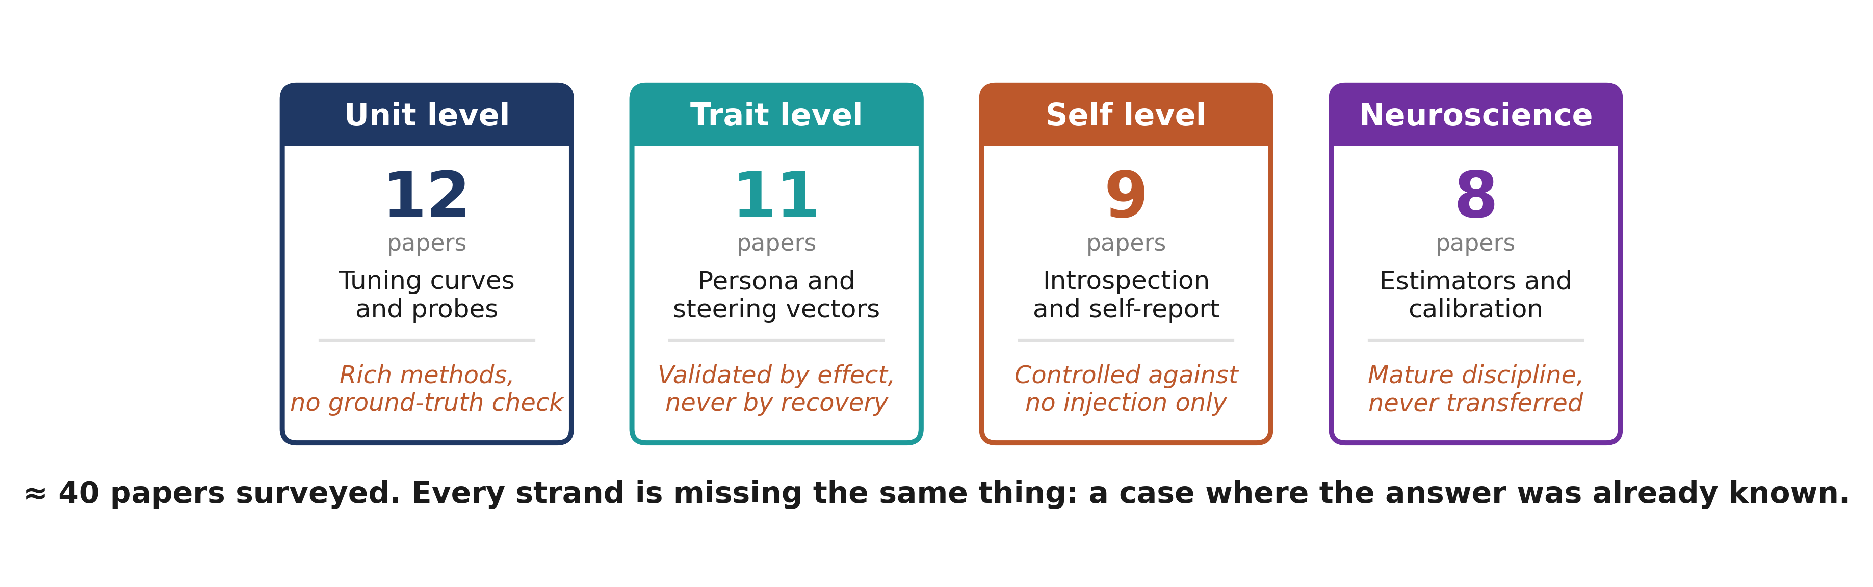
CALIPER: Calibrating Interpretability Readouts for Language Models
Background Study
Four strands, one shared gap
SANTOSH CHEETHIRALA_NIVAS REDDY DANDU_C. SREE KRISHNA KOUSHIK_MARREDDY RUSHI ESWAR REDDY

Slide 15
CALIPER: Calibrating Interpretability Readouts for Language Models
Background Study – Unit level
RESEARCH PAPER
CITATION
KEY OUTCOME
Maximally Informative Dimensions
Sharpee, Rust & Bialek (2004), Neural Computation 16(2)
Introduced the information-theoretic estimator for what a neuron responds to; the method we adapt to language-model units.
Equivalence of MID and maximum likelihood
Williamson, Sahani & Pillow (2015), PLoS Comput Biol 11(4)
Showed MID is maximum likelihood for a linear-nonlinear model, which makes it a rank-K bottleneck regression — the form we implement.
Zoom In: An Introduction to Circuits
Olah et al. (2020), Distill
Established tuning-curve style analysis of individual units in vision models. Prior art we differ from: vision, and no ground-truth check.
Sparse coding and population sparseness
Willmore & Tolhurst (2001), Network 12(3)
Lifetime kurtosis is not population sparseness — a caution we inherit when characterising unit selectivity.
SANTOSH CHEETHIRALA_NIVAS REDDY DANDU_C. SREE KRISHNA KOUSHIK_MARREDDY RUSHI ESWAR REDDY

Slide 16
CALIPER: Calibrating Interpretability Readouts for Language Models
Background Study – Trait level
RESEARCH PAPER
CITATION
KEY OUTCOME
Persona vectors
Chen et al. (2025), arXiv:2507.21509
Extracts trait directions by difference of means and steers behaviour with them; validated by steering effect, never by recovering a known direction.
Steering language models with activation engineering
Turner et al. (2023), arXiv:2308.10248
Established activation addition as a control method; the family of readouts our trait level puts under test.
Convergent and discriminant validation
Campbell & Fiske (1959), Psychological Bulletin 56(2)
The multitrait–multimethod matrix, the psychology standard for validating a trait measure. Level 2 adopts it and adds a truth column.
Construct validity in psychological tests
Cronbach & Meehl (1955), Psychological Bulletin 52(4)
Defines what it means for an instrument to measure the construct it claims to; the question we ask of persona vectors.
SANTOSH CHEETHIRALA_NIVAS REDDY DANDU_C. SREE KRISHNA KOUSHIK_MARREDDY RUSHI ESWAR REDDY

Slide 17
CALIPER: Calibrating Interpretability Readouts for Language Models
Background Study – Self level
RESEARCH PAPER
CITATION
KEY OUTCOME
Emergent introspective awareness
Macar, Yang, Wang, Wallich, Ameisen & Lindsey (2026), Anthropic
Reports that a model can detect an injected concept in its own activations. Controlled against no injection; the control we add is an injection with no content.
Telling more than we can know
Nisbett & Wilson (1977), Psychological Review 84(3)
People confabulate reasons for their own behaviour. The direct parallel for model self-reports, and never measurable against a planted cause.
Consciousness in artificial intelligence
Butlin et al. (2023), arXiv:2308.08708
Fourteen indicator properties; introspective accuracy is the only one where the internal state can be constructed and the report scored.
SANTOSH CHEETHIRALA_NIVAS REDDY DANDU_C. SREE KRISHNA KOUSHIK_MARREDDY RUSHI ESWAR REDDY

Slide 18
CALIPER: Calibrating Interpretability Readouts for Language Models
Background Study – Neuroscience
RESEARCH PAPER
CITATION
KEY OUTCOME
Spike-triggered average and covariance
Schwartz, Pillow, Rust & Simoncelli (2006), J Vision 6(4)
The classical closed-form estimators. We run them as baselines to show which assumptions fail on a residual stream.
Bussgang’s theorem and linear recovery
Bussgang (1952), MIT RLE Technical Report 216
Guarantees that ridge regression recovers a direction under Gaussian stimuli — an assumption the residual stream violates.
Calibration before trust
Systems-neuroscience practice, 1939–present
Null models, required sample size, and instrument validation on a preparation. The package we transfer wholesale.
SANTOSH CHEETHIRALA_NIVAS REDDY DANDU_C. SREE KRISHNA KOUSHIK_MARREDDY RUSHI ESWAR REDDY

Slide 19
CALIPER: Calibrating Interpretability Readouts for Language Models
Where we differ from prior work
Tuning curves on vision models
Distill Circuits (2020–21)
They characterise units in vision networks. We work on language models and, unlike them, score every reading against a known direction.
Number representation tuning
Cacioli (2026)
Overlapping method, different target. Their question is what a unit encodes; ours is whether the instrument that answers that question is correct.
Introspection with a no-injection control
Macar et al. (2026)
Same model, same layer, same prompt. They control against no injection; we control against an injection carrying no content.
What is new, precisely:
▸
Free ground truth at the unit level — an MLP neuron’s true direction is its own weight column, so a real model can serve as its own preparation.
▸
The content-free control at the self level — controlling against an injection with no content, rather than against no injection.
▸
The transfer of the calibration discipline — null, required sample size, pre-registered interval and disagreement flag as one package.
SANTOSH CHEETHIRALA_NIVAS REDDY DANDU_C. SREE KRISHNA KOUSHIK_MARREDDY RUSHI ESWAR REDDY

Slide 20
CALIPER: Calibrating Interpretability Readouts for Language Models
What we do not claim
✕
We do not say the neuroscience methods “don’t work.”
They do not transfer here, and we name the two assumptions that break.
✕
We do not say persona vectors are wrong.
We have not tested them yet. Same family of method, never checked.
✕
We do not claim the validity framing is new.
About twelve 2026 papers already use it. The preparation is what we add.
✕
We do not claim a model can or cannot introspect.
We claim the published protocol cannot distinguish introspection from noticing a disturbance.
Tuning curves have been done on vision models. The neuroscience estimators are decades old. Persona vectors and concept injection are published methods. We are testing them, not inventing them.
SANTOSH CHEETHIRALA_NIVAS REDDY DANDU_C. SREE KRISHNA KOUSHIK_MARREDDY RUSHI ESWAR REDDY

Slide 21
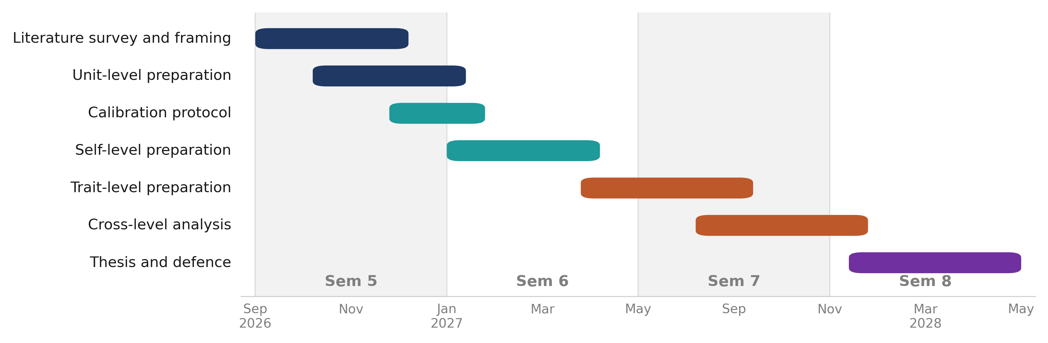
CALIPER: Calibrating Interpretability Readouts for Language Models
Project Timeline
Semester 5 · four reviews
Review 1
Review 2
Review 3
Review 4
Early Sep
Late Sep
Late Oct
Mid Nov
Problem, team, literature survey
Requirements and system design
Initial prototype, unit level
Prototype on a real question; sem 6 plan
SANTOSH CHEETHIRALA_NIVAS REDDY DANDU_C. SREE KRISHNA KOUSHIK_MARREDDY RUSHI ESWAR REDDY

Slide 22
CALIPER: Calibrating Interpretability Readouts for Language Models
Team Effort Plan
Four separable tracks
Stage-wise tasks
Estimator and integration
SANTOSH CHEETHIRALA
Weeks 1–4
Readout implementation, the measurement pipeline, cross-level integration
Problem definition, proposal audit, mentor selection
Literature and framing
[MEMBER B]
Weeks 5–10
The paper matrix, the neuroscience method map, related-work sections
Literature survey across four strands
Second-model replication
[MEMBER C]
Weeks 11–14
Independent replication of every self-level result on a second open model
Requirements, system design, calibration protocol
Calibration and benchmarking
[MEMBER D]
Weeks 15–17
Planted-latent networks, false-discovery rates, statistics. CPU only
Initial prototype and review preparation
SANTOSH CHEETHIRALA_NIVAS REDDY DANDU_C. SREE KRISHNA KOUSHIK_MARREDDY RUSHI ESWAR REDDY

Slide 23
CALIPER: Calibrating Interpretability Readouts for Language Models
Any other information
•
The problem was selected on 18 August 2026 from a set of seven candidate proposals. The mentor chose this one for its neuroscience framing.
•
One earlier framing was audited and killed before any work was committed to it — a published theorem and two prior papers made the claim untenable. Reporting that is part of the method.
•
Every experiment is pre-registered: the criterion is written down and committed before the run, so a result cannot be tuned after the fact.
•
No personal data. No proprietary data. No paid compute.
SANTOSH CHEETHIRALA_NIVAS REDDY DANDU_C. SREE KRISHNA KOUSHIK_MARREDDY RUSHI ESWAR REDDY

Slide 24
CALIPER: Calibrating Interpretability Readouts for Language Models
References
[1]
Sharpee, T., Rust, N. C., & Bialek, W. (2004). Analyzing neural responses to natural signals: maximally informative dimensions. Neural Computation, 16(2), 223–250.
[2]
Williamson, R. S., Sahani, M., & Pillow, J. W. (2015). The equivalence of information-theoretic and likelihood-based methods for neural dimensionality reduction. PLoS Computational Biology, 11(4), e1004141.
[3]
Olah, C., Cammarata, N., Schubert, L., Goh, G., Petrov, M., & Carter, S. (2020). Zoom In: An Introduction to Circuits. Distill, 5(3).
[4]
Willmore, B., & Tolhurst, D. J. (2001). Characterizing the sparseness of neural codes. Network: Computation in Neural Systems, 12(3), 255–270.
[5]
Chen, R., et al. (2025). Persona vectors: monitoring and controlling character traits in language models. arXiv preprint arXiv:2507.21509.
[6]
Turner, A. M., et al. (2023). Steering language models with activation engineering. arXiv preprint arXiv:2308.10248.
[7]
Campbell, D. T., & Fiske, D. W. (1959). Convergent and discriminant validation by the multitrait–multimethod matrix. Psychological Bulletin, 56(2), 81–105.
[8]
Cronbach, L. J., & Meehl, P. E. (1955). Construct validity in psychological tests. Psychological Bulletin, 52(4), 281–302.
[9]
Nisbett, R. E., & Wilson, T. D. (1977). Telling more than we can know: verbal reports on mental processes. Psychological Review, 84(3), 231–259.
[10]
Butlin, P., et al. (2023). Consciousness in artificial intelligence: insights from the science of consciousness. arXiv:2308.08708.
[11]
Schwartz, O., Pillow, J. W., Rust, N. C., & Simoncelli, E. P. (2006). Spike-triggered neural characterization. Journal of Vision, 6(4), 484–507.
SANTOSH CHEETHIRALA_NIVAS REDDY DANDU_C. SREE KRISHNA KOUSHIK_MARREDDY RUSHI ESWAR REDDY

Slide 25
Thank You
Does the mind-reading kit work? Building preparations for language models.
SANTOSH CHEETHIRALA_NIVAS REDDY DANDU_C. SREE KRISHNA KOUSHIK_MARREDDY RUSHI ESWAR REDDY

