Slide 1
Predicting Kickstarter
Project Success
Launch-time features, leakage-safe encodings, gradient boosting
UE24CS352A Machine Learning Mini-Project | Team #18 | Problem #56
Cheethirala Sai Santosh (PES1UG24CS127), Chhavi Siddarth Wadhwa (PES1UG24CS132)
Notes:
Introduce the problem in one sentence: can we predict from launch-time info alone whether a Kickstarter campaign will hit its goal?

Slide 2
The problem
Replicating and extending Khosla, Reinecke & Wittenbrink (Stanford)
• Input: what a creator knows at launch (goal, category, country, currency, location, dates, name, one-line blurb)
• Output: will the campaign reach its funding goal? (binary)
• Why it matters: creators can tune goal and framing; the platform can prioritise promising projects
• Paper's best result: about 83% accuracy
Excluded on purpose
backers count
amount pledged so far
staff pick / spotlight
anything after launch
Notes:
Binary classification. Key constraint: only information known at launch. That makes the model useful BEFORE a creator spends effort, and avoids leakage from backers/pledged amount.

Slide 3
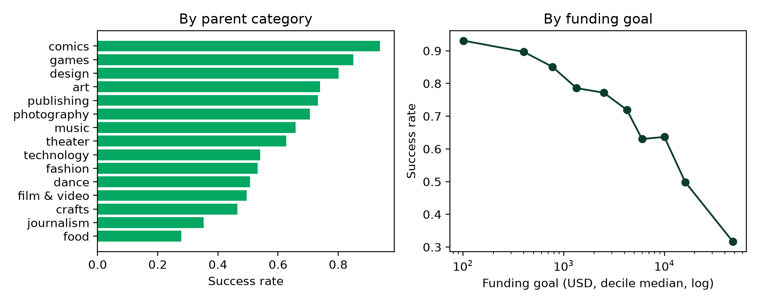
Dataset
Web Robots Kickstarter scrape, finished campaigns only
47,765
70.9%
33,435 / 14,330
70.7%
projects after cleaning
succeeded
train / test (random 70-30)
majority-class accuracy
Notes:
Source: Web Robots monthly scrapes. They are cumulative, so we keep the latest row per project id, keep only successful/failed, and dedupe on (name, blurb, launch, deadline) like the paper. Majority-class baseline is 70.7%, so accuracy must be read against that.

Slide 4
Feature engineering
Most of the performance comes from the first two groups
Metadata
Out-of-fold target encodings
Text (blurb)
• log goal (USD)
• campaign length
• launch month / weekday
• name & blurb length
• one-hot parent category & category
• currency, country, category, parent, location, location type
• mean goal per level
• goal relative to level mean
• TF-IDF → Naive Bayes probability
• VADER sentiment
• 20-topic LDA
• 50-d LSA embedding
Notes:
Three families. The target encodings and NB probability use labels, so they are out-of-fold. Goal means per level do not use labels so they are fitted on all training rows.

Slide 5
Avoiding leakage
Target encodings and the Naive-Bayes probability depend on the label.
On the training set they are computed out-of-fold (5 folds): each row is encoded using only the other folds.
Test and demo rows use encoders fitted on the full training set.
Duplicates removed before splitting, so no project appears in both train and test.
Unit tests check the encoding guard and that no post-launch columns are used.
Notes:
This is the point to emphasise in Q&A. If a row's encoding is computed with its own label, the model can memorise it and accuracy is inflated. Out-of-fold: split train into 5 folds; encode each fold using the other 4. Test rows use encoders fitted on the whole train set. There is a unit test for this in tests/.

Slide 6
Models and protocol
• Gradient boosting (LightGBM)
• Random forest
• Neural net (1 hidden layer, 25 units)
• Linear SVM, logistic regression
• Ridge / OLS / lasso linear probability models
Protocol
• Balanced sample weights
• Fit on train only; test touched once
• Accuracy, F1, per-class P/R, ROC-AUC
• Text ablation over 5 seeds
Notes:
Same model families as the paper. Linear probability models (OLS/ridge/lasso) regress y and threshold at 0.5. Differences from the paper: VADER instead of CoreNLP (no Java server), LSA instead of 3.6GB pretrained Word2Vec, sklearn ReLU MLP instead of SELU Keras net.

Slide 7
Results: metadata + Naive Bayes feature
Test set, 14,330 projects
Model | Acc | F1 | P1 | P0 | R1 | R0 | AUC
G. Boosting | 0.816 | 0.867 | 0.887 | 0.669 | 0.848 | 0.740 | 0.887
Logistic | 0.797 | 0.847 | 0.906 | 0.618 | 0.794 | 0.802 | 0.879
R. Forest | 0.796 | 0.845 | 0.910 | 0.615 | 0.789 | 0.812 | 0.885
SVM | 0.796 | 0.846 | 0.906 | 0.616 | 0.793 | 0.802 | 0.878
Neural Net | 0.794 | 0.845 | 0.906 | 0.614 | 0.791 | 0.801 | 0.882
Ridge | 0.792 | 0.843 | 0.905 | 0.611 | 0.789 | 0.800 | 0.877
OLS | 0.792 | 0.843 | 0.905 | 0.611 | 0.789 | 0.800 | 0.877
Lasso | 0.792 | 0.843 | 0.906 | 0.610 | 0.788 | 0.802 | 0.877
G. Boosting
81.6% accuracy
F1 0.867
+10.9 pts vs baseline
Notes:
Compare to the majority baseline (70.7%) and to the paper (83%). Class 1 is 'successful'. Check whether precision on failed projects (P0) is the weak spot, as in the paper.

Slide 8
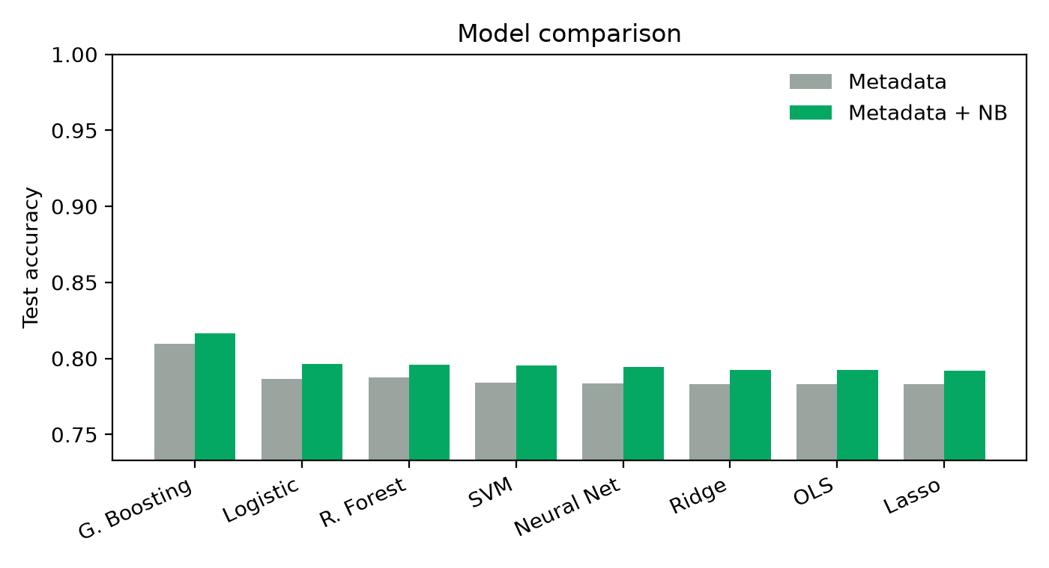
Features matter more than the model
NB feature: 80.9% → 81.8% accuracy (+0.8 pts, LightGBM)
Notes:
Adding the NB feature lifts every model. Top models are close, so features matter more than the model.

Slide 9
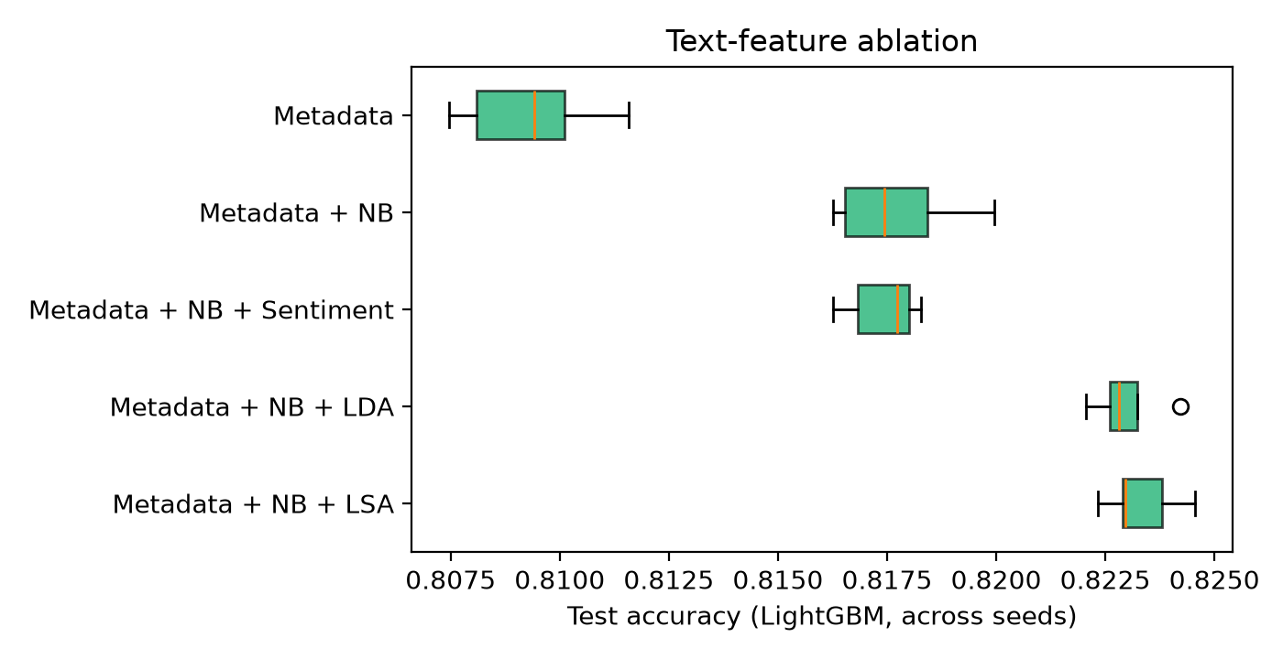
Do extra text features help?
Gain over Metadata + NB (accuracy points): Sentiment -0.03, LDA +0.53, LSA +0.56
Notes:
Be precise, not vague. Beyond metadata + NB: sentiment -0.03 points, LDA +0.53, LSA +0.56. Sentiment adds nothing measurable on a one-line blurb; the topic and embedding blocks each add about half a point - so do not say the text features add nothing. The defensible claim: the blurb supports one well-regularised text feature (the NB probability) and the extra blocks refine it slightly. Boxplots are across random seeds of the boosting model.

Slide 10
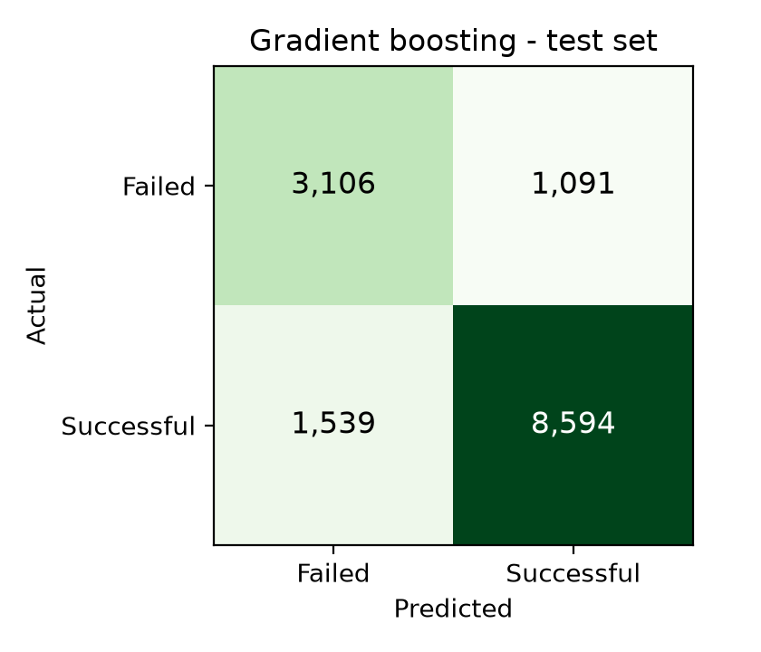
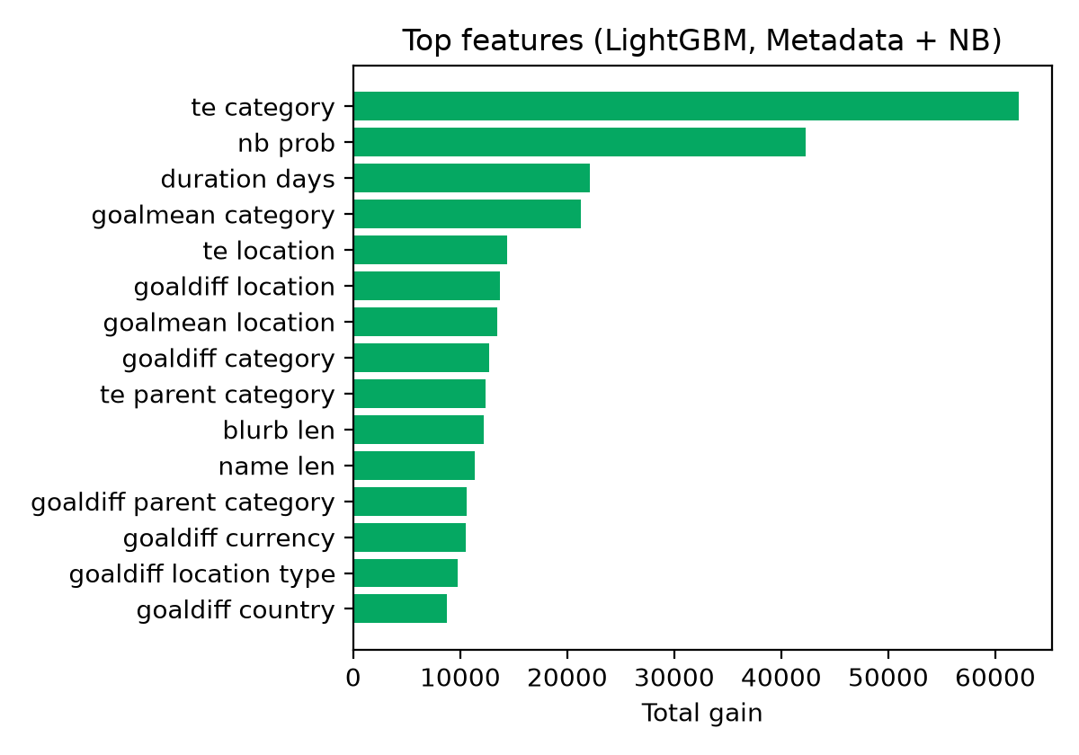
Error analysis and feature importance
1,539 successes predicted as failures; 1,091 failures predicted as successes.
Notes:
Confusion matrix is for gradient boosting. nb_prob, target encodings and goal-relative features dominate the gain importance.

Slide 11
Live demo
streamlit run app.py
• Enter name, blurb, category, country, goal and dates
• Get a success probability from the trained gradient-boosting model
• What-if curve: how the prediction changes as the goal changes
• Per-prediction feature contributions (TreeSHAP) for explainability
Notes:
Live demo: streamlit run app.py. Change the goal and watch the probability; open the contributions chart to show which features drive it.

Slide 12
Conclusions
G. Boosting is best: 81.6% accuracy, F1 0.867 (paper: about 83%).
Out-of-fold Naive-Bayes blurb probability is the main text feature (+0.84 pts); sentiment adds -0.03 pts, LDA +0.53 and LSA +0.56.
Leakage-safe encodings and de-duplication keep the estimate honest.
Future work: temporal validation, transformer embeddings, project story and image features.
Notes:
Close with limitations: only launch-time metadata and a one-line blurb; no story, images, creator history. A temporal split is a stricter test. Next step: transformer sentence embeddings.

