Slide 1
Anonymous Code Sharing iOS App
Team: The Tornadoes
Eyeverify use case 3:
Secret information sharing among untrusted parties (that all use smartphones)
Santosh Kumar
Nagi Reddy Sollapuram
Vilas Mamidyala

Slide 2
Introduction
This iOS app shares sensitive information among ’n’ untrusted smartphones, in a way that no fewer than ‘m’ (where m <= n) participating smartphones can reconstruct the sensitive information.

Slide 3
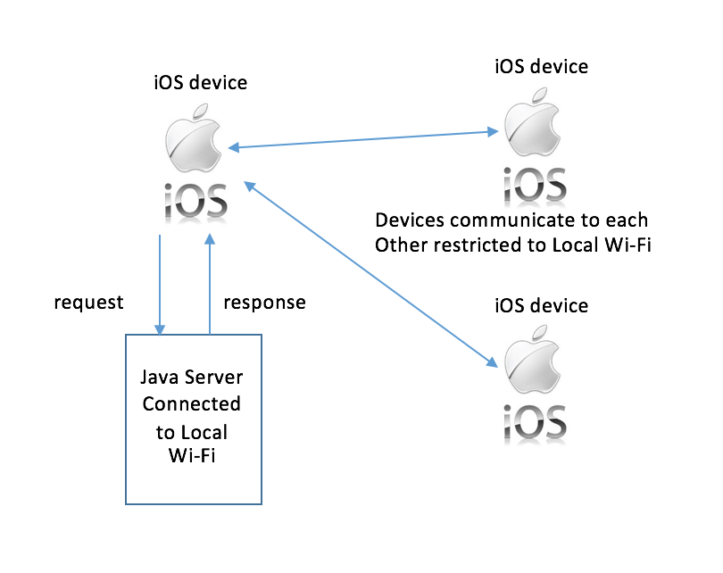
Architecture Diagram

Slide 4
Detailed Explanation
The application has a secure biometric login which enables the user lo login into the application only using his eye scan.
The eyeverify login feature is implemented to make use of the eyeprint id technology.
The app is distributed into m members to whom the secret code is shared.
The group leader shares the secret code to all the member of group.
Here Shamirs’ secret code sharing algorithm is implemented and secret code is shared among the members.

Slide 5
Output
Finally the group leader can reconstruct the secret code only when can get the minimum requirements created in the algorithm.
In this case its 2, so we need minimum 2 secret keys from 2 members of group to successfully regenerate the secret code.
If we use only 1 secret code then we get a false or wrong code.

