Slide 1
REVIEW POINT
Team RooCoders
Sree Rama Raju Pericharla
Akhilesh Gattu
Nagi Reddy
Santosh Kumar

Slide 2
Introduction
Review point will provide the unified review for all the electronic products.
Our application will give you the top 10 reviews for the product you are searching for along with the “Review Point Rating” and “Review Point Suggestion”.

Slide 3
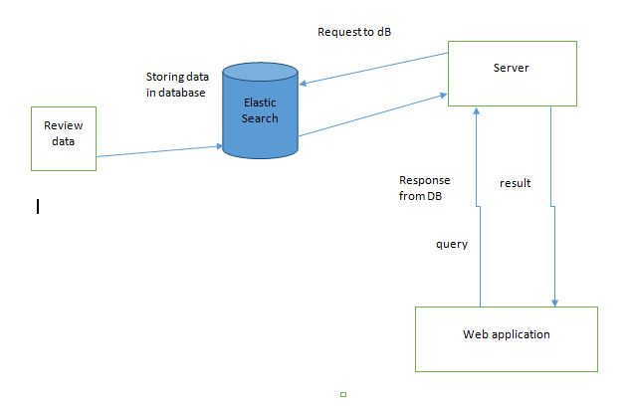
Architecture Diagram

Slide 4
Detailed Explanation
Once you enter the product name and click the “Get Review” button.
The request goes to the “Elastic Search” server, hits the “Elastic DB”.
Get the product Id for the given product name, then get the reviews of the product id.
Then Average of all the reviews is calculated and displayed as overall rating along with the suggestion whether to get the product or not.

Slide 5
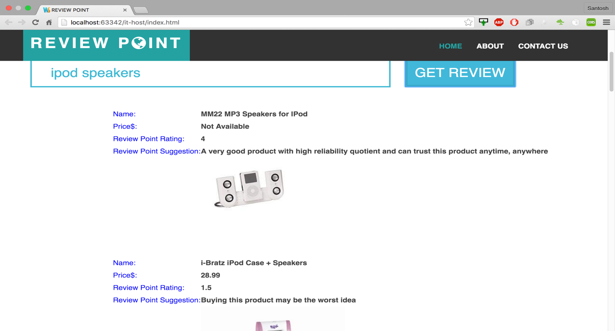
Output

