Slide 1

SImple Gui calculator
Calculator using
tkinter python

Slide 2
Introduction
The calculator is a basic utility to add, subtract, multiply, divide, and do other basic mathematical operations easily. It is simply a simple mathematical operator, one can say.
Using tkinter python
Create GUI calculator is only a calculator but one can use it by clicking buttons, not by typing something like in python print(2+2) , and then will get the result as 4 in the black and white environment. In the GUI calculator, all its operators and numbers are represented graphically and one can click it and use it.

Slide 3
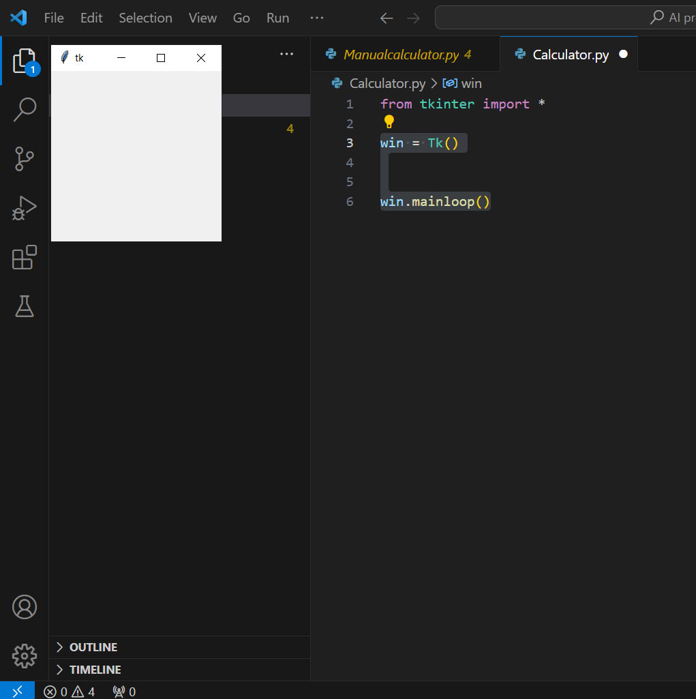
Sept 1
In order to create the calculator, first, we have to install a GUI library tkinter on our system.
from tkinter import *
Create variable ‘win’ to store Tk() library
With below create a window for calculator
win = Tk()
win.mainloop()

Slide 4
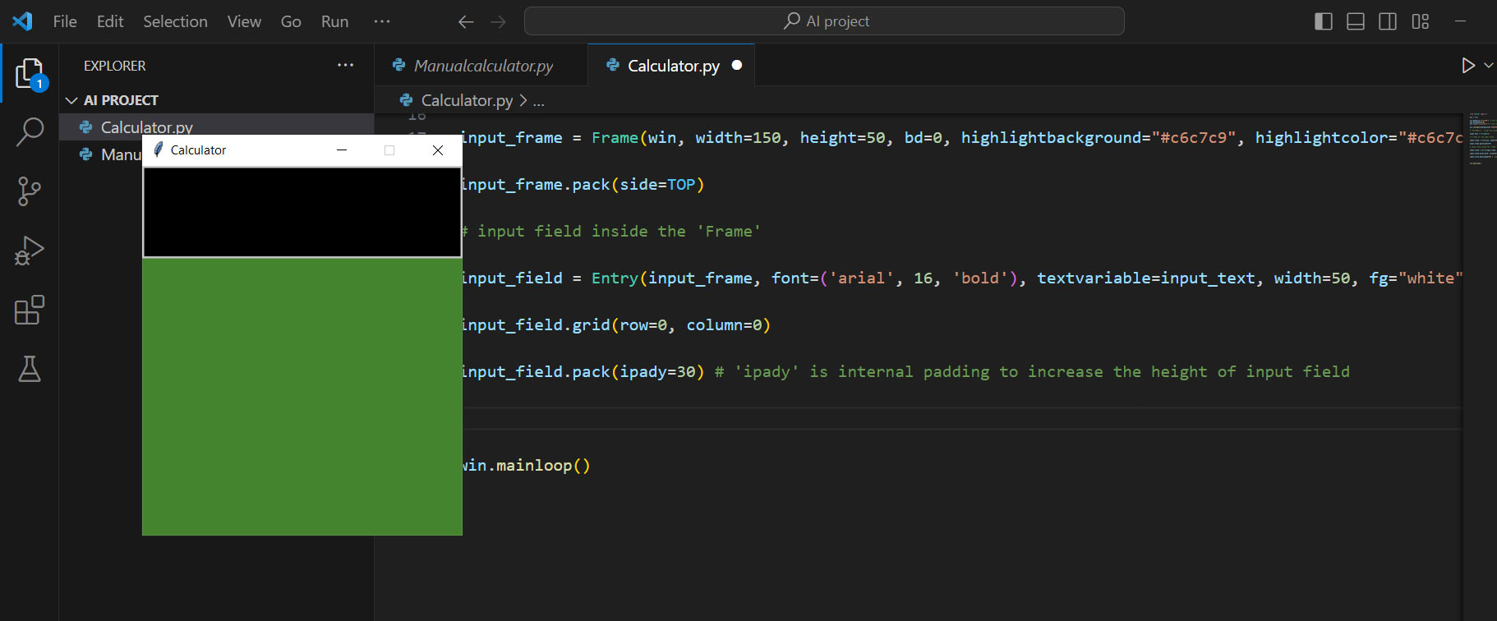
Sept 2
input_text = StringVar()
A variable defined using StringVar() holds a string data where we can set text value and can retrieve it. Also, we can pass this variable to a textvariable parameter for a widget like Entry. The widget will automatically get updated with th new value whenever the value of the StringVar() variable changes.
Create a frame for input field and inside we create input field to show expression
input_frame = Frame( )
input_frame.pack( )
input_field = Entry( )
input_field.grid( )
input_field.pack( )

Slide 5
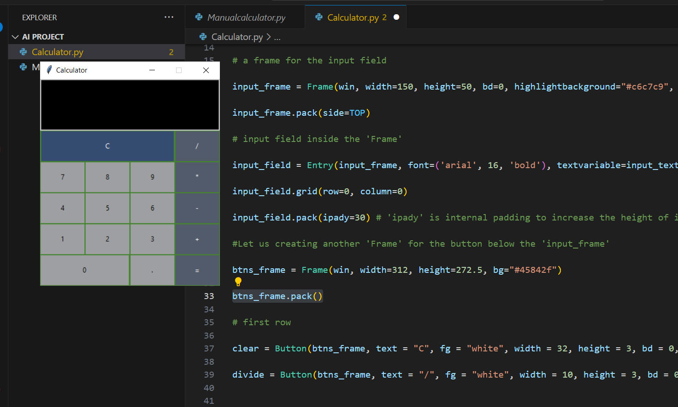
Sept 3
We create the button like digit 1,2,3… , add, del, division and all. We use the below code
btns_frame = Frame( )
btns_frame.pack()
In the first row we create clear and division
clear = Button( )
divide = Button( )
Here we use the command lambda on button click
command = lambda: bt_clear()

Slide 6
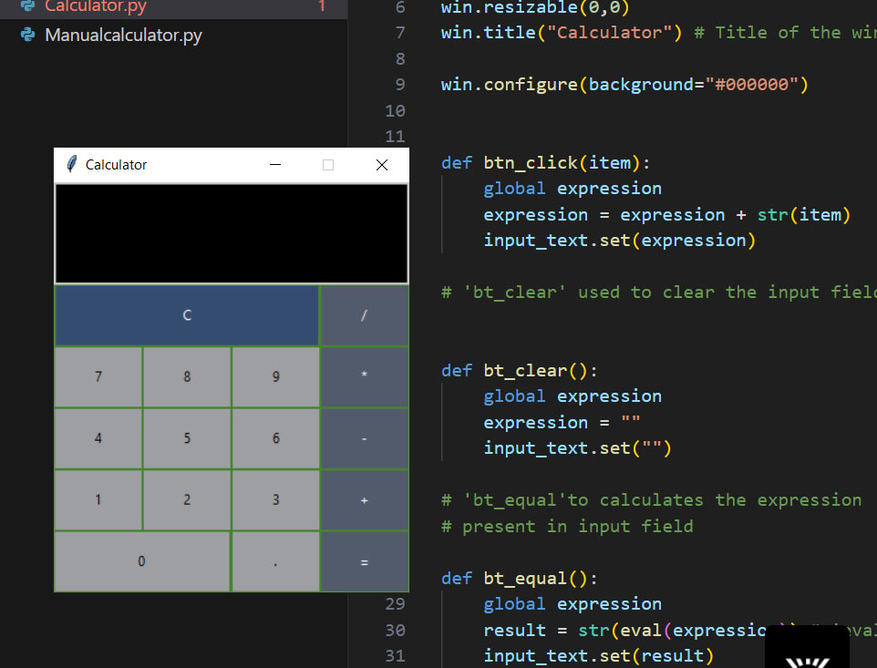
Sept 3
Our calculator Gui is read but not functionally working for this we create clear, click and equal to functions
def bt_clear():
This function is used to handle the clear operation to clean the previous input in the Calculator application.
def btn_click(item):
This function handles the button click on various numeric buttons to add them to the operation.
def bt_equal():
This function is used to handle the equal button to execute the operation and show the result.

Slide 7
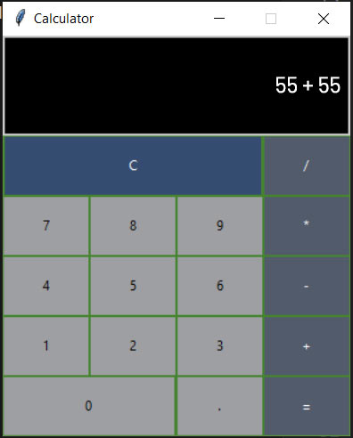
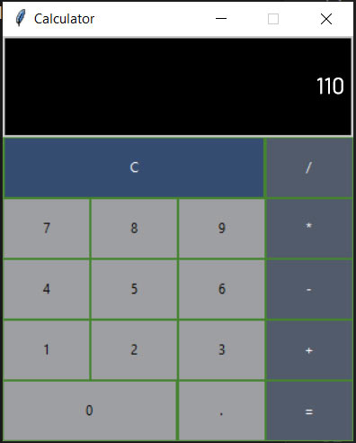
Calculator is ready

Slide 8
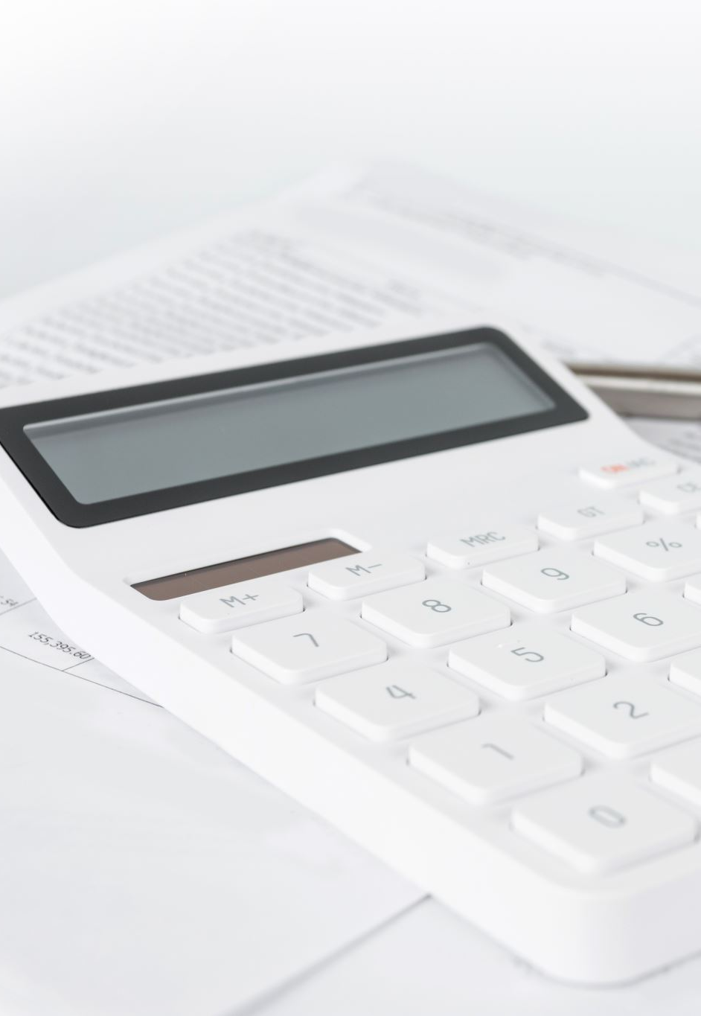
Conclusion
There are a variety of functions in Tkinter with the help of them it becomes easy and convenient to make a simple calculator. And in the GUI calculator, all its operators and numbers are represented graphically and one can click it and use it.

Slide 9

Thank you

