Slide 1
Penn State Health + Experis + SoundHound
Since Go Live — 414 Calls
414 conversations since go live, Wed 10/07 8:17 PM to Thu 10/15 6:00 AM ET • 1 of 6
414
20
4.8%
57
13.8%
337
81.4%
Total conversations
Contained
Abandoned
Escalated
Data: Wed 10/07 8:17 PM – Thu 10/15 6:00 AM ET
Data: Wed 10/07 8:17 PM – Thu 10/15 6:00 AM ET
Data: Wed 10/07 8:17 PM – Thu 10/15 6:00 AM ET
Data: Wed 10/07 8:17 PM – Thu 10/15 6:00 AM ET
Average handle time
Data: Wed 10/07 8:17 PM – Thu 10/15 6:00 AM ET
4:05
1:41
2:10
2:12
Contained (20 calls)
Abandoned (57 calls)
Escalated (337 calls)
All calls (414)
Contained = Amelia gave steps or a link, the caller accepted it, and the call was not transferred.
©2026 SoundHound AI, Inc. Confidential and Proprietary.

Slide 2
Penn State Health + Experis + SoundHound
Calls by Reporting Window (ET)
414 conversations since go live, Wed 10/07 8:17 PM to Thu 10/15 6:00 AM ET • 2 of 6
Calls by window and outcome
Numbers by window
Data: Wed 10/07 8:17 PM – Thu 10/15 6:00 AM ET
Data: Wed 10/07 8:17 PM – Thu 10/15 6:00 AM ET
Window | Calls | C | A | E
Wed 10/07 | 23 | 2 | 6 | 15
Thu 10/08 | 56 | 4 | 12 | 40
Fri 10/09 † | 18 | 1 | 1 | 16
Sat 10/10 | 98 | 3 | 14 | 81
Sun 10/11 | 105 | 5 | 13 | 87
Mon 10/12 early † | 11 | 1 | 0 | 10
Mon 10/12 night | 26 | 2 | 4 | 20
Tue 10/13 night | 48 | 0 | 4 | 44
Wed 10/14 night | 29 | 2 | 3 | 24
All windows | 414 | 20 | 57 | 337
Windows (ET): weekdays 8 PM to 6 AM; Saturday and Sunday for the full 24 hours. † Fri 10/09 ends at 12 AM because Saturday starts at 12 AM; Mon 10/12 early is 12 AM to 6 AM. Weekday daytime calls are not in the data. C = contained, A = abandoned, E = escalated.
©2026 SoundHound AI, Inc. Confidential and Proprietary.

Slide 3
Penn State Health + Experis + SoundHound
Why Calls Abandoned and Escalated
414 conversations since go live, Wed 10/07 8:17 PM to Thu 10/15 6:00 AM ET • 3 of 6
Where callers abandoned (all 57)
What drove escalations (all 337)
Data: Wed 10/07 8:17 PM – Thu 10/15 6:00 AM ET
Data: Wed 10/07 8:17 PM – Thu 10/15 6:00 AM ET
©2026 SoundHound AI, Inc. Confidential and Proprietary.

Slide 4
Penn State Health + Experis + SoundHound
Contained Calls by KB Topic
414 conversations since go live, Wed 10/07 8:17 PM to Thu 10/15 6:00 AM ET • 4 of 6
Contained calls by KB article (all 20)
Contained calls by topic
Data: Wed 10/07 8:17 PM – Thu 10/15 6:00 AM ET
Data: Wed 10/07 8:17 PM – Thu 10/15 6:00 AM ET
KB article | KB number | Calls | Share
Reset Your Penn State Health Password / Requirements | KB0023618 | 14 | 70%
How to enroll a New Device - Microsoft Authenticator | KB0023388 | 4 | 20%
Restarting Computer Instead of Shutting Down | KB0024688 | 1 | 5%
How do I access Smart Square on my mobile device | KB0024440 | 1 | 5%
Total contained |  | 20 | 100%
Password reset made up 70% of the contained calls and Authenticator enrollment 20%. All other KB topics together contained 2 calls.
©2026 SoundHound AI, Inc. Confidential and Proprietary.

Slide 5
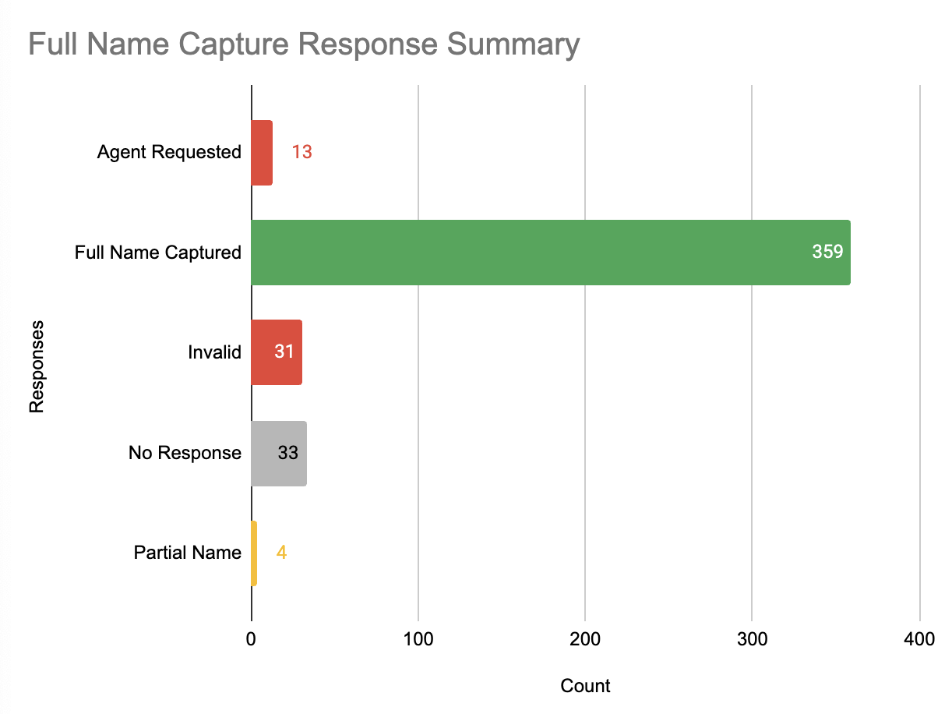
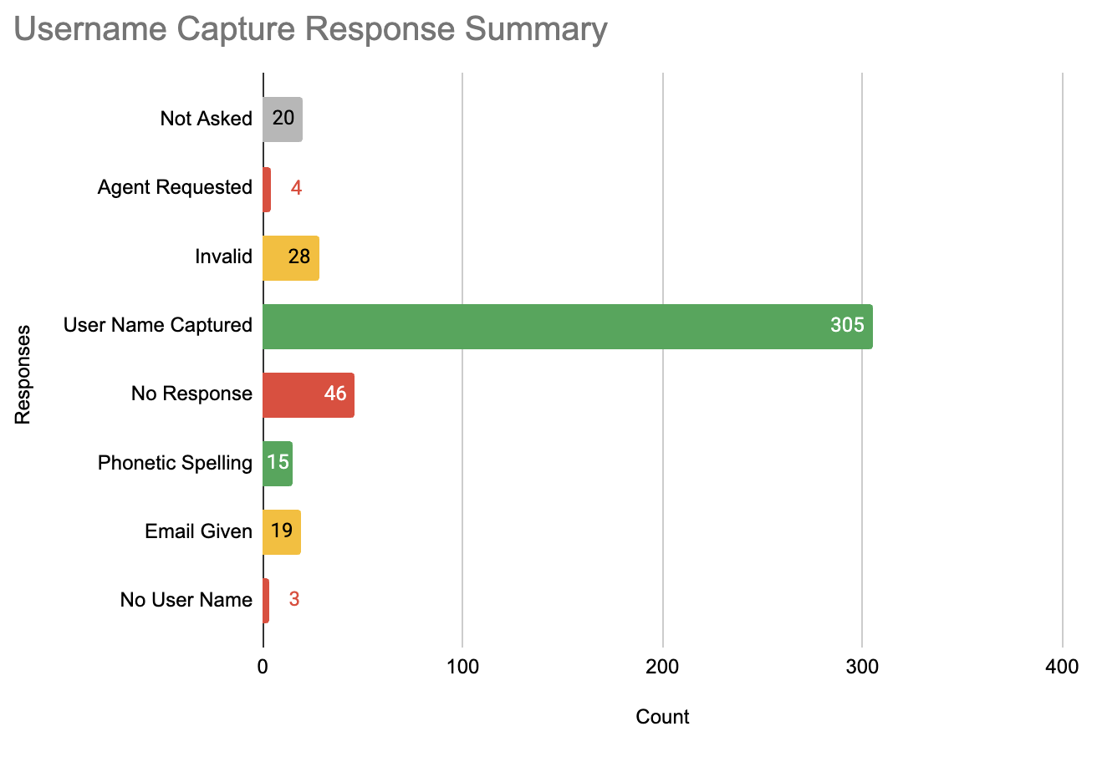
Penn State Health + Experis + SoundHound
Opening Info Gathering
414 conversations since go live, Wed 10/07 8:17 PM to Thu 10/15 6:00 AM ET • 3 of 6
Name Capture
Username Capture
Data: Wed 10/07 8:17 PM – Thu 10/15 6:00 AM ET
Data: Wed 10/07 8:17 PM – Thu 10/15 6:00 AM ET
©2026 SoundHound AI, Inc. Confidential and Proprietary.

Slide 6
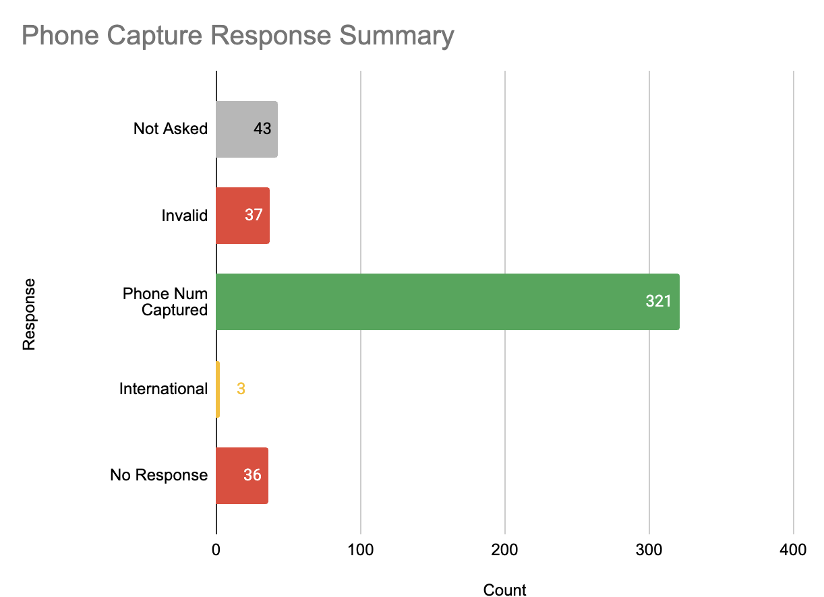
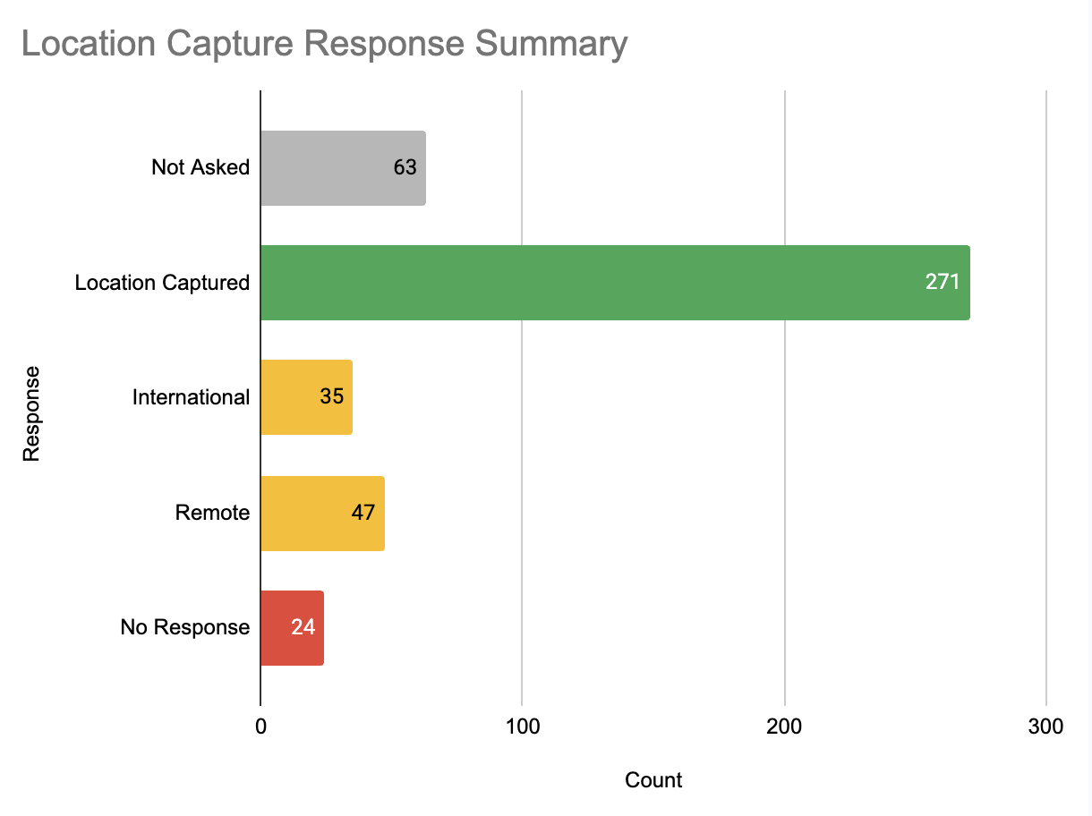
Penn State Health + Experis + SoundHound
Opening Info Gathering
414 conversations since go live, Wed 10/07 8:17 PM to Thu 10/15 6:00 AM ET • 3 of 6
Phone Capture
Location Capture
Data: Wed 10/07 8:17 PM – Thu 10/15 6:00 AM ET
Data: Wed 10/07 8:17 PM – Thu 10/15 6:00 AM ET
©2026 SoundHound AI, Inc. Confidential and Proprietary.

Slide 7
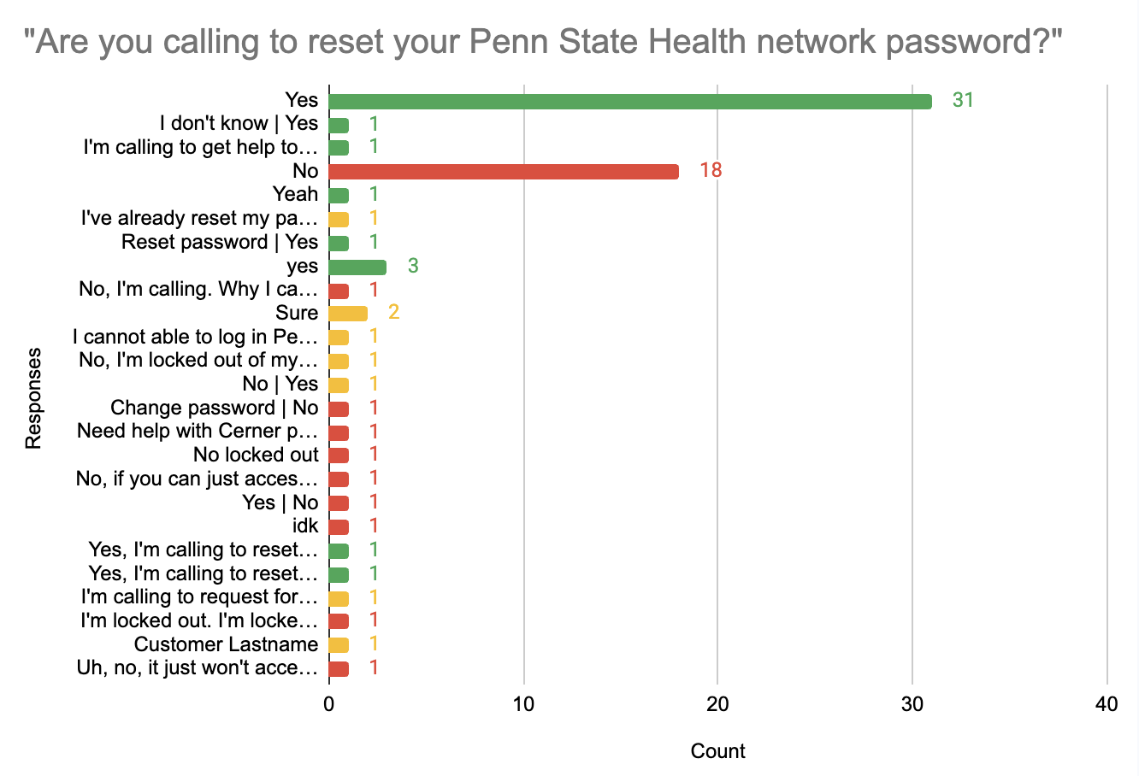
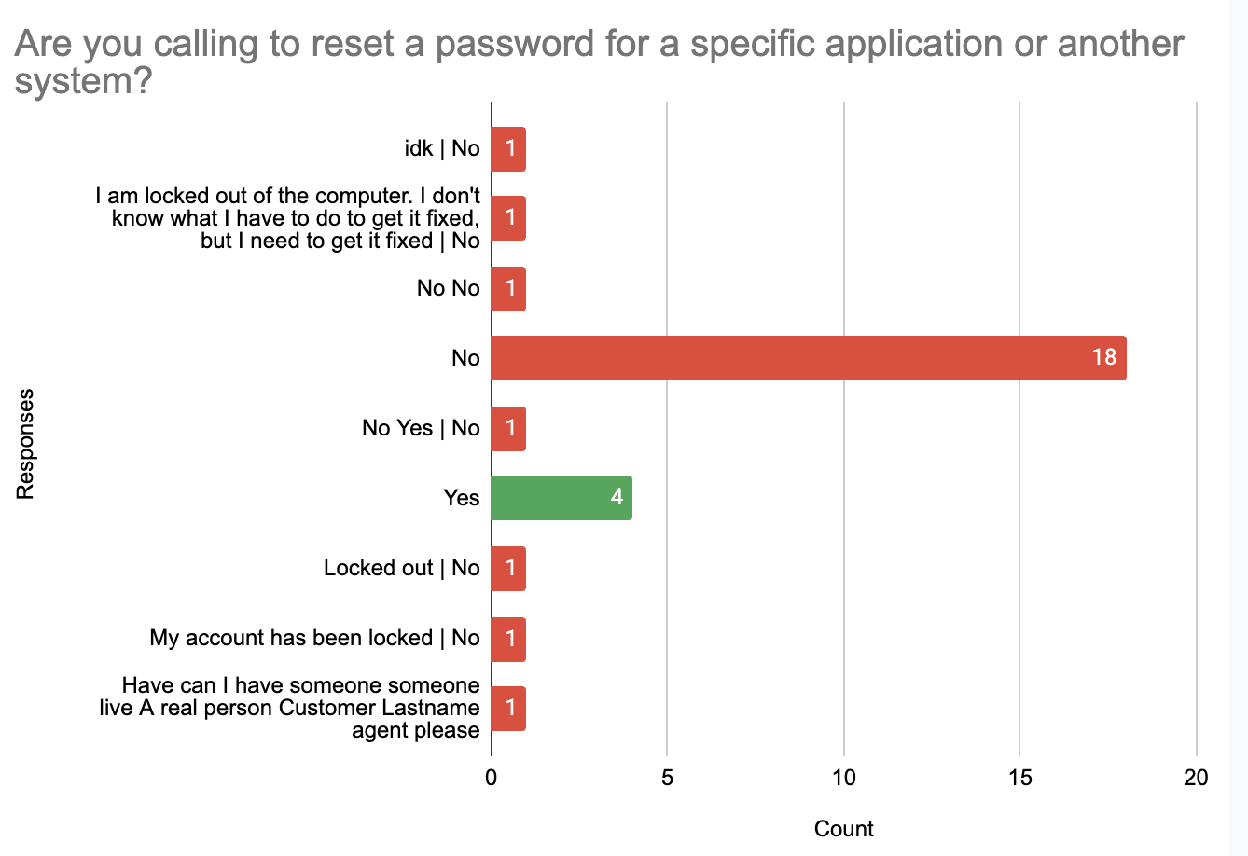
Penn State Health + Experis + SoundHound
Password Reset
414 conversations since go live, Wed 10/07 8:17 PM to Thu 10/15 6:00 AM ET • 3 of 6
PSH Password Reset
Other Password Reset
Data: Wed 10/07 8:17 PM – Thu 10/15 6:00 AM ET
Data: Wed 10/07 8:17 PM – Thu 10/15 6:00 AM ET
©2026 SoundHound AI, Inc. Confidential and Proprietary.

Slide 8
Penn State Health + Experis + SoundHound
Recommendations & Feedback
414 conversations since go live, Wed 10/07 8:17 PM to Thu 10/15 6:00 AM ET • 5 of 6
Opportunities for improvement going forward
Data: Wed 10/07 8:17 PM – Thu 10/15 6:00 AM ET
# | Opportunity | Summary
1 | Adjusting the Demographic Info Capturing Pattern | Shift the call flow around so purpose of call is asked prior to gathering caller info for case/ticket creation.
2 | Live Agent Rebuttal | When callers initially request an agent - attempt to gather purpose of call again prior to escalating.
3 | Password Reset Adjustments | For non-PSH account resets - attempt to gather which password they need to reset.
4 | Onboarding vs Existing Access | Look to better split UX on various topics based on the state of the user’s account
©2026 SoundHound AI, Inc. Confidential and Proprietary.

Slide 9
Penn State Health + Experis + SoundHound
Top 5 Reasons Amelia Could Not Contain Calls
414 conversations since go live, Wed 10/07 8:17 PM to Thu 10/15 6:00 AM ET • 5 of 6
Why 394 of the 414 calls were not contained (each call counted once, under its main reason)
Data: Wed 10/07 8:17 PM – Thu 10/15 6:00 AM ET
# | Main reason Amelia could not contain the call | Calls | Share | What happened
1 | Caller never stated their intent: asked for a person right away, gave no usable answers, or hung up during intake | 119 | 30% | Asked for an agent or IT without describing an issue (60 calls); “idk” or unclear answers at intake (26); hung up during intake (33)
2 | Cerner, PowerChart, FirstNet or Revenue Cycle not opening: no self-service path, so transferred | 105 | 27% | FirstNet, PowerChart, FastPass, Cerner and Revenue Cycle not opening, frozen or not letting the caller sign in; transferred with no self-service answer
3 | Topic Amelia does not support | 60 | 15% | Hospital devices such as TVs, armbands, monitors, pagers and phones (16); internet and Wi-Fi (5); lab and imaging systems (4); onboarding and access requests (4); printers, copiers and fax (4); other or unclear requests (27)
4 | Locked out or cannot log in: qualifying questions did not lead to a fix | 55 | 14% | Locked out, blocked or disabled, or cannot log in. Amelia asked “reset your network password?” and “password for another system?” before transferring (27 of the 55 calls); 7 callers hung up mid-flow
5 | Self-service steps or link did not work for the caller | 55 | 14% | Link or steps given, but the caller did not receive the text, said it did not help, or asked for a person: password reset links (18), Authenticator (17), computer restart and taskbar steps (11), remote access (6), email apps (3)
 | Total (calls not contained) | 394 | 100%
©2026 SoundHound AI, Inc. Confidential and Proprietary.

Slide 10
Penn State Health + Experis + SoundHound
What Callers Needed
414 conversations since go live, Wed 10/07 8:17 PM to Thu 10/15 6:00 AM ET • 6 of 6
Calling reasons (all 414)
Data: Wed 10/07 8:17 PM – Thu 10/15 6:00 AM ET
Reason | Calls | Share
Cerner, PowerChart, FirstNet or Revenue Cycle | 106 | 25.6%
Locked out, password or sign-in problem | 87 | 21.0%
Asked for a person, no issue stated | 60 | 14.5%
No usable answers or hung up during intake | 59 | 14.3%
Other hospital IT requests (devices, printers, onboarding, lab) | 38 | 9.2%
Authenticator on a phone | 25 | 6.0%
Computer, Wi-Fi or app problems | 22 | 5.3%
Email and mobile apps (Outlook, Smart Square, TigerConnect) | 9 | 2.2%
Remote access (Remote Access Portal, VPN, Citrix) | 8 | 1.9%
Total | 414 | 100%
©2026 SoundHound AI, Inc. Confidential and Proprietary.

