Slide 1
2.3 Project Tasks 2: Executive Summary |
Week 2.3 Project Tasks 2
Santosh Kumar Sinha [21355457]
BELLEVUE UNIVERSITY : DS640 Data Presentation and Visualization

Slide 2

Task Agenda
Your PowerPoint Presentation (created in PowerPoint/Prezi/Spark/etc.)
Should have at least 6 slides.
Your Presentation should have at least 6 visualizations on it
Make sure you follow a design methodology that you can defend (colors, labels, chart types, etc.).
Must have used at least 1 supplemental dataset to the original.

Slide 3
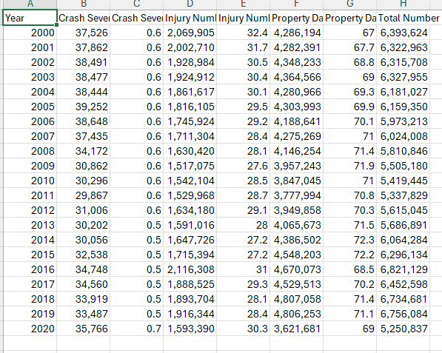
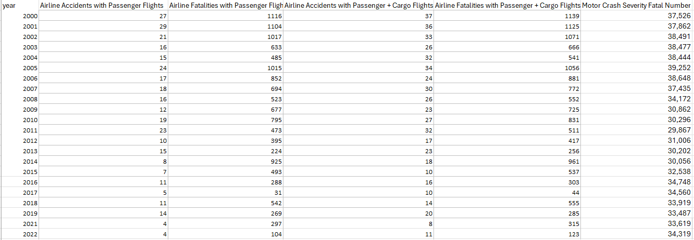
Project Task 2: Data source
Airline Accidents (Passenger + Cargo) data set
Motor Accidents data set

Slide 4
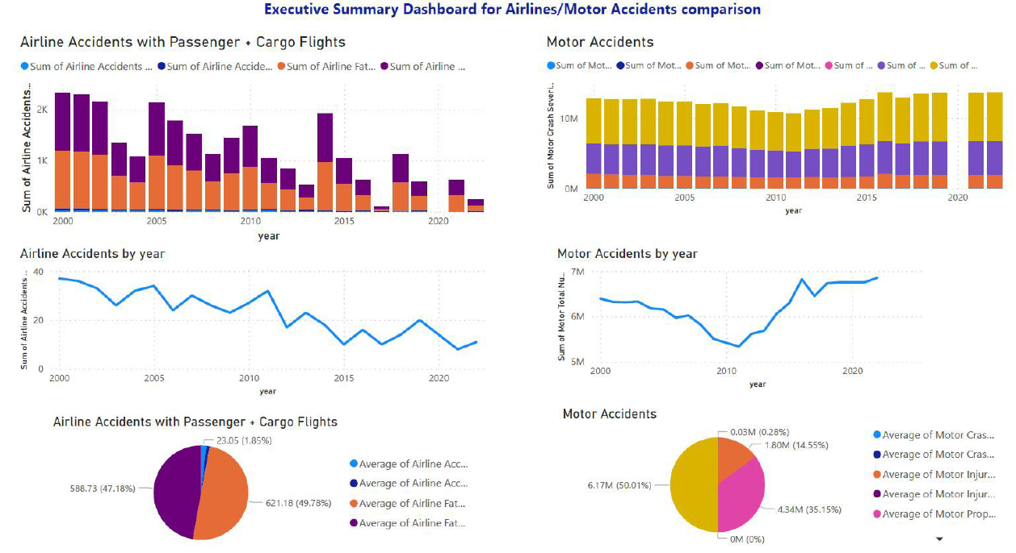
Executive Summary Dashboard for Airlines/Motor Accidents comparison

Slide 5
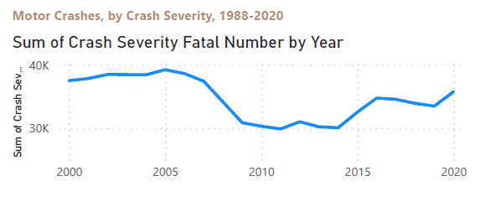
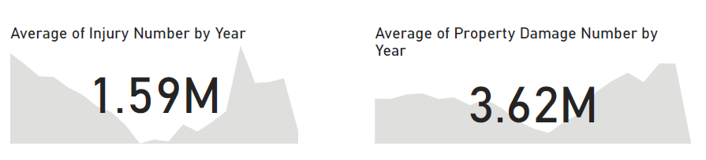
Motor Accidents Analysis
Motor Crash report from year [2000 – 2020] indicate increase in the number of Severity Fatal Numbers
The Average number of Injury cases per year is 1.59 M
The Average number of property damage cases per year is 3.62 M
The sharp increase in the crash report is caused by below factors
Speeding
Dangerous Road
Improper turns
Inclement weather
T-Bone Accident
Rollover Accidents

Slide 6
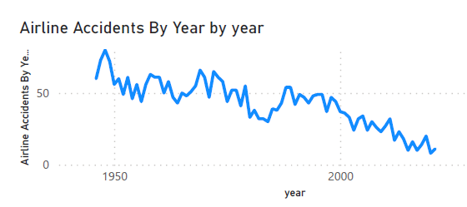
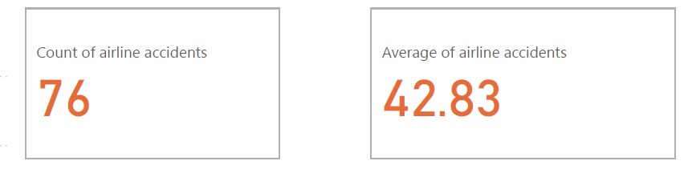
Airplanes Accidents (Passenger + Cargo) Analysis
The Airline Accidents from year [1950 - 2022] indicates decline in the number of cases.
The total number of airline accidents is 76
The average of airline accidents is 42.83
Flying is safer the driving motors is supported by below mentioned factors
Airlines are much more regulated than passenger cars
Strict safety controls and checks help ensure aviation safety
The airline accident rates continue to decline with technology improvements.

Slide 7

References
Power BI Desktop Basics : https://powerbi.microsoft.com/en-us/desktop/
https://www.microsoft.com/en-us/download/details.aspx?id=58494
Visualization In Power BI: https://learn.microsoft.com/en-us/power-bi/visuals/power-bi-visualization-types-for-reports-and-q-and-a
How safe is flying in 2023 : https://travellersworldwide.com/how-safe-is-flying/
Why is flying safer than driving : https://freakonomics.com/podcast/why-is-flying-safer-than-driving/
What are the most common types of car accidents: https://www.prnewswire.com/news-releases/what-are-the-most-common-types-of-car-accidents-nationwide-statistic-overview-301391422.html

Slide 8

BELLEVUE UNIVERSITY : DS640 Data Presentation and Visualization

