Slide 1
5.3 Project Tasks 5: Video and Slide Presentation |
Week 5.3 Project Tasks 5
Santosh Kumar Sinha [21355457]
BELLEVUE UNIVERSITY : DS640 Data Presentation and Visualization

Slide 2

Task Agenda
Your PowerPoint Presentation (created in PowerPoint/Prezi/Spark/etc.)
3-Minute Video Clip.
Needs to have audio and a visual element.
Needs to be geared to an audience that knows nothing about the problem.
Max 3 minutes

Slide 3
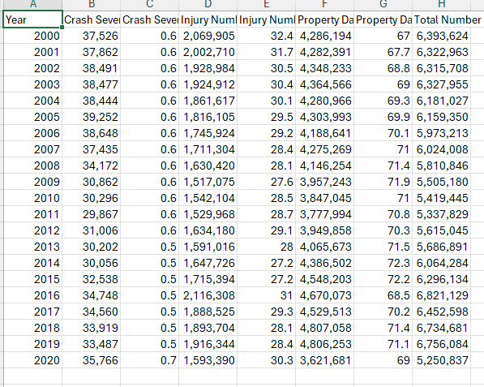
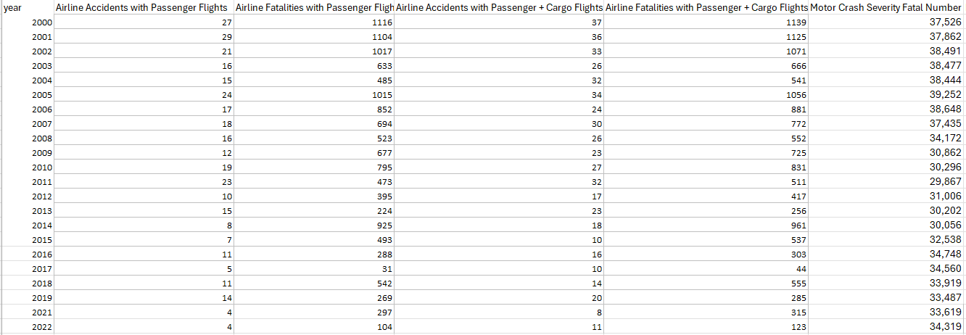
Project Task 2: Data source
Airline Accidents (Passenger + Cargo) data set
Motor Accidents data set

Slide 4
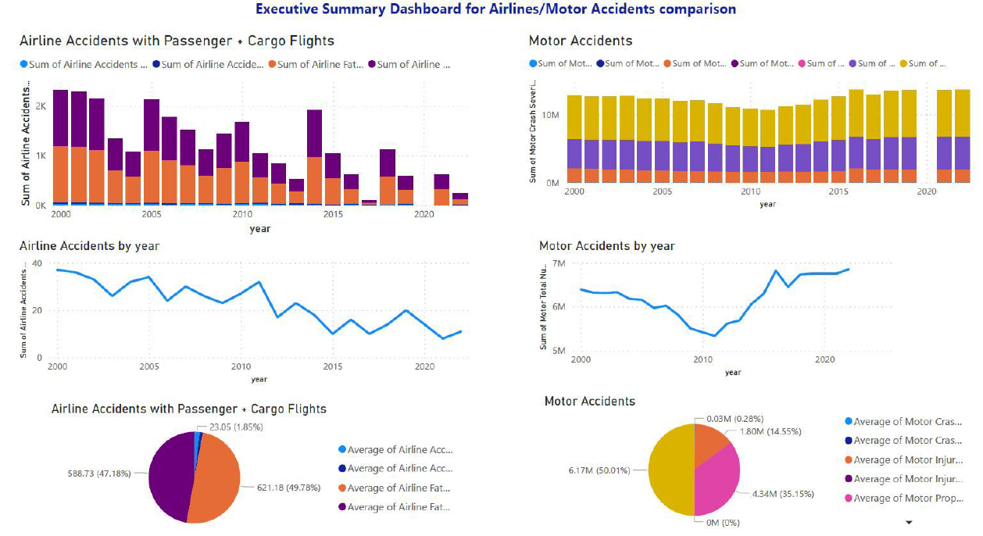
Dashboard summary for Airlines/Motor Accidents comparison based on data statistics

Slide 5
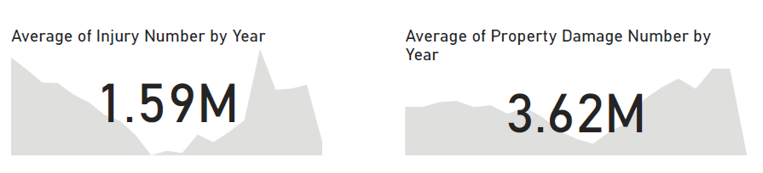
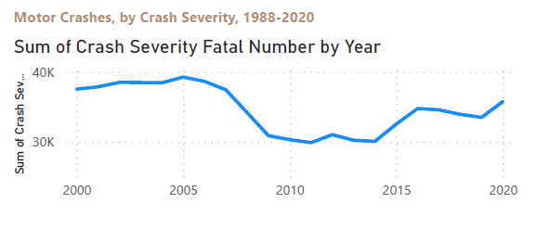
Facts about Road Accidents and general Analysis
Motor Crash report from year [2000 – 2020] indicate increase in the number of Severity Fatal Numbers
The Average number of Injury cases per year is 1.59 M
The Average number of property damage cases per year is 3.62 M
The sharp increase in the crash report is caused by below factors
Speeding
Dangerous Road
Improper turns
Inclement weather
T-Bone Accident
Rollover Accidents

Slide 6
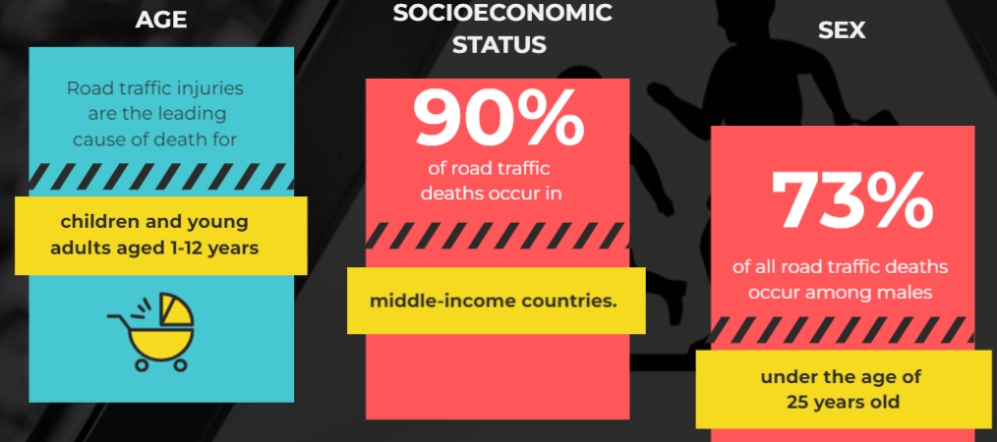
Road accidents ricks determinants

Slide 7
Key determinants that contribute to road accidents
Human Factors:
Driver Behavior: Reckless driving, speeding, distracted driving (e.g., texting), impaired driving (alcohol, drugs), fatigue, and aggressive driving can all lead to accidents.
Driver Experience: Inexperienced drivers may have difficulty making quick decisions in challenging situations.
Infrastructure and Road Design:
Road Conditions: Poor road quality, inadequate signage, lack of proper lighting, and road hazards can increase the risk of accidents.
Intersection Design: Poorly designed intersections, lack of clear traffic signals, and confusing road layouts can contribute to collisions.
Vehicle Factors:
Vehicle Maintenance: Poorly maintained vehicles can experience brake failures, tire blowouts, and other mechanical issues that lead to accidents.
Vehicle Safety Features: Vehicles lacking modern safety features (ABS, airbags, stability control) are more vulnerable in accidents.
Environmental Factors:
Weather Conditions: Rain, snow, ice, fog, and other adverse weather conditions reduce visibility and road traction, increasing accident risk.
Road Surface: Slippery roads due to oil spills, wet leaves, or other factors can result in loss of control.
Regulatory and Policy Factors:
Traffic Laws: Lack of enforcement of traffic laws and regulations can lead to risky driving behavior.
Seat Belt and Helmet Usage: Non-compliance with seat belt and helmet laws contributes to the severity of injuries in accidents.

Slide 8
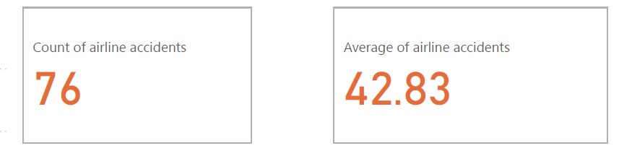
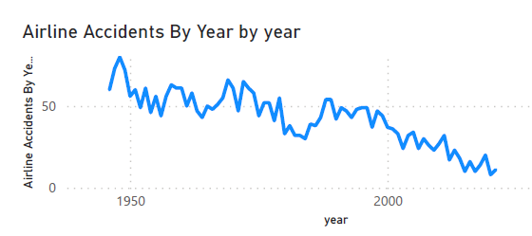
Airplanes Accidents (Passenger + Cargo) Statistical Analysis
The Airline Accidents from year [1950 - 2022] indicates decline in the number of cases.
The total number of airline accidents is 76
The average of airline accidents is 42.83
Flying is safer the driving motors is supported by below mentioned factors
Airlines are much more regulated than passenger cars
Strict safety controls and checks help ensure aviation safety
The airline accident rates continue to decline with technology improvements.

Slide 9
Factors contribute to the safety of airline travel:
Stringent Regulations: The aviation industry is heavily regulated by international and national aviation authorities. Strict safety regulations cover various aspects, from aircraft design and maintenance to pilot training and operational procedures.
1
Advanced Technology: Aircraft are equipped with advanced technology, including sophisticated navigation systems, autopilots, collision avoidance systems, and real-time communication with air traffic control. These technologies enhance the accuracy and safety of flight operations.
2
Rigorous Maintenance: Airlines adhere to rigorous maintenance schedules and standards. Aircraft undergo routine inspections, maintenance, and repairs to ensure they remain in optimal working condition.
3
Pilot Training: Pilots undergo extensive training, including simulator exercises, emergency procedures, and regular proficiency checks. They are trained to handle a wide range of scenarios, ensuring their competence in different situations.
4
Air Traffic Control: Air traffic control systems monitor and manage airspace to prevent collisions and ensure safe separation between aircraft. Air traffic controllers provide guidance to pilots, helping them navigate safely.
5
Safety Culture: Airlines prioritize safety as a core value. A strong safety culture is promoted throughout the industry, encouraging open reporting of safety concerns, continuous improvement, and learning from incidents.
6

Slide 10

References
Power BI Desktop Basics : https://powerbi.microsoft.com/en-us/desktop/
https://www.microsoft.com/en-us/download/details.aspx?id=58494
Visualization In Power BI: https://learn.microsoft.com/en-us/power-bi/visuals/power-bi-visualization-types-for-reports-and-q-and-a
How safe is flying in 2023 : https://travellersworldwide.com/how-safe-is-flying/
Why is flying safer than driving : https://freakonomics.com/podcast/why-is-flying-safer-than-driving/
What are the most common types of car accidents: https://www.prnewswire.com/news-releases/what-are-the-most-common-types-of-car-accidents-nationwide-statistic-overview-301391422.html

Slide 11

BELLEVUE UNIVERSITY : DS640 Data Presentation and Visualization

