Slide 1
Ticket handling using Java
July 6, 2023
By,
Santosh S Gumaste

Slide 2
agenda
Problem Statement
SLA
Functional Requirements

Slide 3

Problem Statement
As a Tech Support Engineer, you are supporting the customer experience on the company’s ecommerce platform. When customers face a challenge accessing products, they raise a ticket detailing the challenge

Slide 4
SLA
SLA – SERVICE LEVEL AGREEMENT
SLA response time - The time taken by provider to respond to an inquiry or request from a client

Slide 5

Functional Requirements
Based on the ticket type, identify the SLA time
Allocate every ticket to a Tech Support Engineer, via an e-mail notification with all the ticket details
At the end of processing all tickets, the detailed summary of the tickets should be sent to the line manager, via e-mail

Slide 6
Functional Requirements
Based on the ticket type, identify the SLA time
Allocate every ticket to a Tech Support Engineer, via an e-mail notification with all the ticket details
At the end of processing all tickets, the detailed summary of the tickets should be sent to the line manager, via e-mail

Slide 7
Functional Requirements
Based on the ticket type, identify the SLA time
Allocate every ticket to a Tech Support Engineer, via an e-mail notification with all the ticket details
At the end of processing all tickets, the detailed summary of the tickets should be sent to the line manager, via e-mail

Slide 8
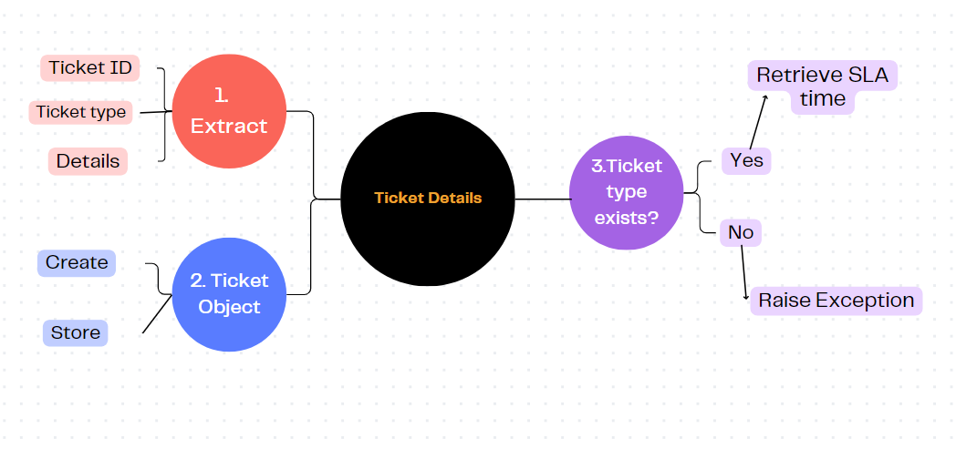
Functional Requirement 1: Based on the ticket type, identify the SLA time
.

Slide 9
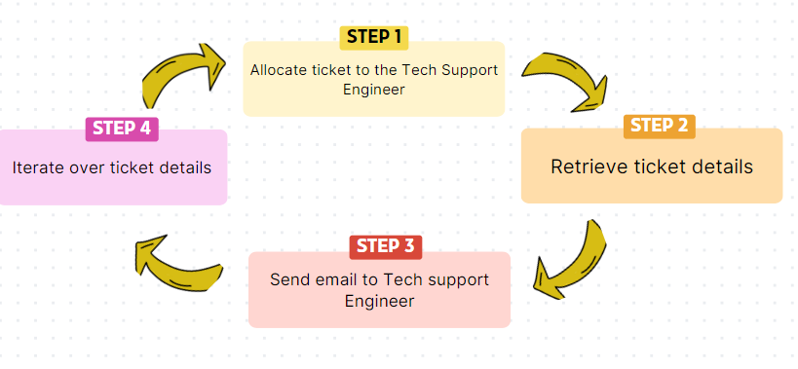
Functional Requirement 2: Allocate every ticket to a Tech Support Engineer, via an e-mail notification with all the ticket details

Slide 10
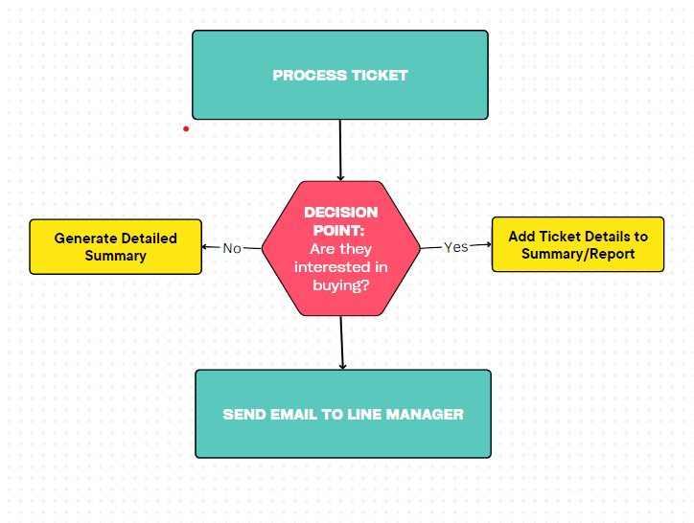
Functional Requirement 3: At the end of processing all tickets, the detailed summary of the tickets should be sent to the line manager, via e-mail

Slide 11
Basic overflow of our case study code
DB Connection Manager
App. java
Util.java
Routing.java
GE Mail Sender.java
Ticket.java
Invalid Exception.java

Slide 12
thank you
copyright publicis sapient | confidential

