Slide 1

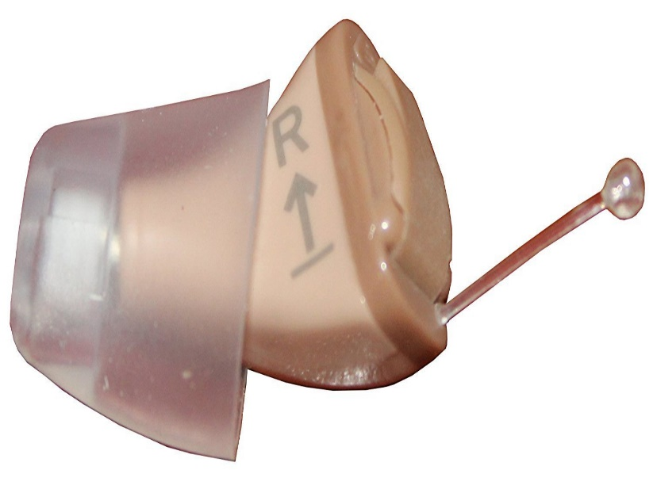

Avertis

Slide 2
Current consequences:
Problem:
Child being in unsafe situation at the start of the seizure which can lead to fatal injuries
12.7 million seizure in infants globally prevalence on an average
41-187 per 100, 000 people get seizures.
Incidence in children: 3.2-5.5 per 1000 children in developed countries.
3.6-44 per 1000 children in underdeveloped countries.
Highest and dangerous in the age group 0-5 years
With seizure recurrence rate of 30-50% in first two years
In India, prevalence stakes up to ~2.2 million
Source: Camfield P, et al. Epileptic Disord. 2015.

Slide 3
Negative Outcomes:
Head injury (Major Problem)
Fracture
Loss of life (Death)
Current existing solutions
No existing solutions to detect seizure. Gadgets and other tech products are available to detect seizure after the on-set

Slide 4
Need Statement
An effective way to forecast the onset of seizure in infants and children in home settings to prevent life threatening consequences

Slide 5
Principle:
Dysrhythmia in brain
Change in the micro electric potential and frequency from baseline
Detection by sensors Alerts to child and parent

Slide 6
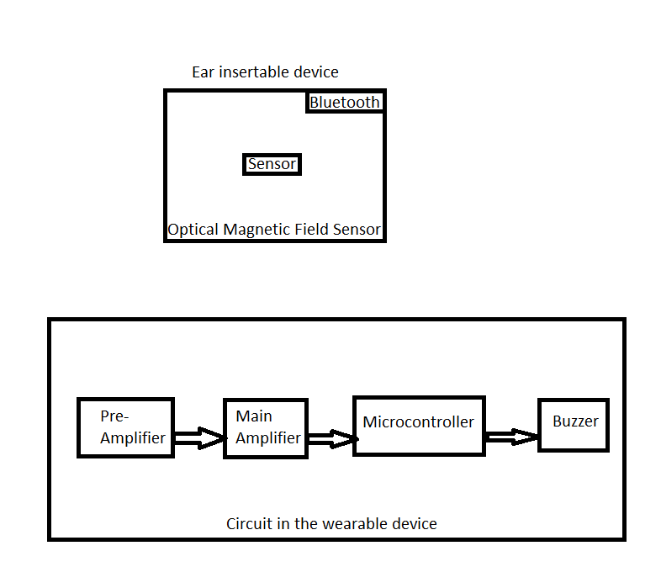
Block Diagram:
SEEG
Detects voltages over 70 millivolts and frequencies over 25 Hz

Slide 7
Advantages:
Prevents head injuries, thereby preventing ICU admissions and its cumulative costs
Prevents death
Cheaper when compared to the costs due to suffering injuries.
Impacts:
Reduction in number of morbidity and mortality overall.
Self-management of seizures.
Decreased hospital visits.

Slide 8
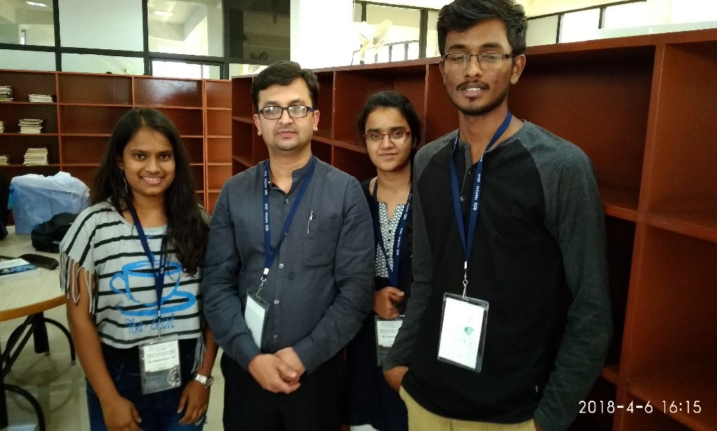
SRISHTI
Dr. Narasimha Murthy (paediatric intensivist)
Vaishnavi M R (Medical Electronics )
Meghashree Y M (Medical Electronics )
Santosh G (Computer Science )

