Slide 1

SEASONAL AGRICULTURE PERFORMANCE ANALYSIS
Student Name: SANTHOSHA J
College Name: Ballari Institute of Technology and Management
AICTE STU ID: STU6903150a9baac1761809674

Slide 2

Problem Statement:
Agricultural activities are influenced by seasonal variations in environmental conditions, farming practices, resource availability and market conditions. As a result, agricultural performance may differ from one season to another.
However, raw agricultural data do not clearly explain how agricultural performance changes across seasons or what patterns can be observed in different seasonal conditions.
The given dataset needs to be analysed to identify seasonal patterns, trends, relationships, and variations in agricultural performance and understand how these differences can support better agricultural planning.

Slide 3
Problem Description:
Seasonal Agriculture Performance Analysis focuses on analysing agricultural data across different seasons, crops, and regions to understand variations in agricultural performance.
The project examines key factors such as yield, production, environmental conditions, resource usage, water efficiency, disease risk, and economic performance.
Using Python-based data cleaning, exploratory data analysis, visualisation, correlation analysis, and statistical techniques, the project identifies important seasonal patterns and relationships and derives evidence-based insights and recommendations for better seasonal agricultural planning.

Slide 4

Who Are The End Users?
Farmers: To understand seasonal crop performance, resource requirements, and profitability for better planning.
Agricultural Planners: To compare seasonal and regional performance and support evidence-based agricultural planning.
Agricultural Organisations & Departments: To identify seasonal trends, resource needs, and areas requiring further attention.
Agribusiness & Resource Managers: To evaluate production, costs, water efficiency, and profitability across seasons.
Researchers & Analysts: To study relationships between environmental conditions, farming practices, and agricultural outcomes.

Slide 5

Technology Used:
Python – Programming language used for data analysis
Jupyter Notebook – Environment used to perform and document the analysis
Pandas – Data cleaning, manipulation, and analysis
NumPy – Numerical and statistical operations
Matplotlib – Data visualisation
Seaborn – Statistical and advanced visualisations

Slide 6
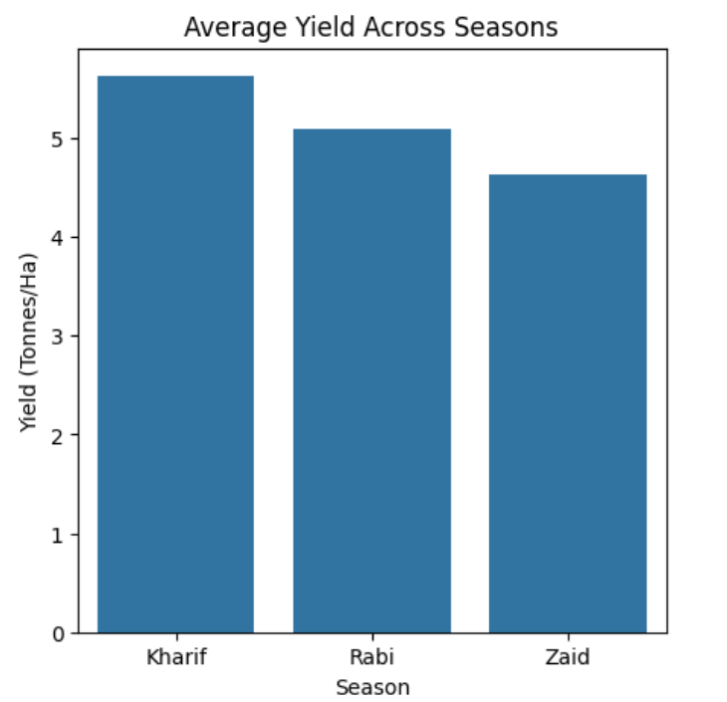
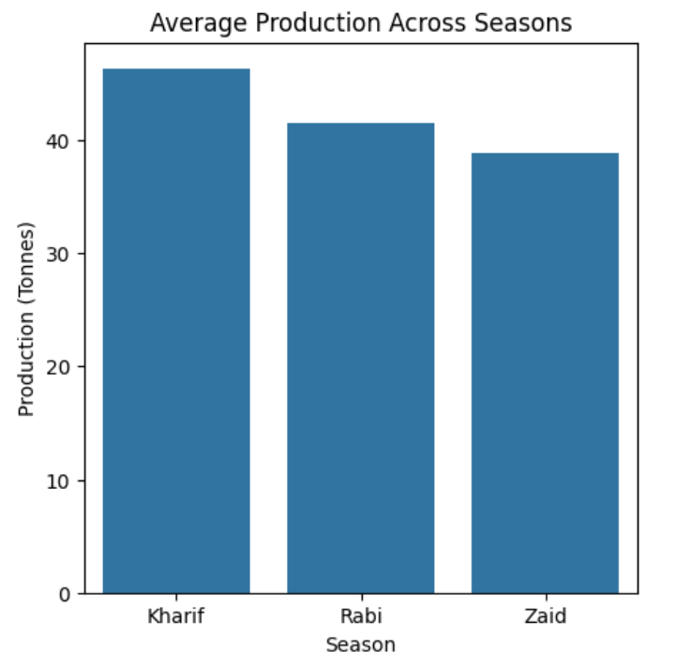
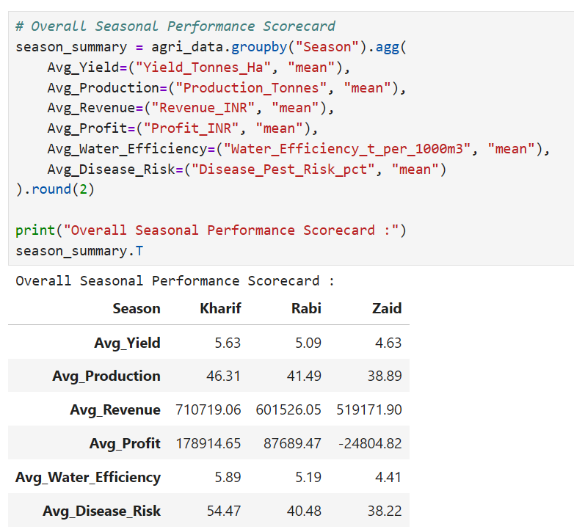
Seasonal Agricultural Performance:
Key Findings:
Kharif recorded the highest average yield (5.63 tonnes/ha) and production (46.31 tonnes).
Kharif also achieved the highest average revenue (₹7.11 lakh) and profit (₹1.79 lakh).
Zaid recorded the lowest performance across these major indicators.
Key Takeaway: Kharif emerged as the strongest-performing season overall.

Slide 7
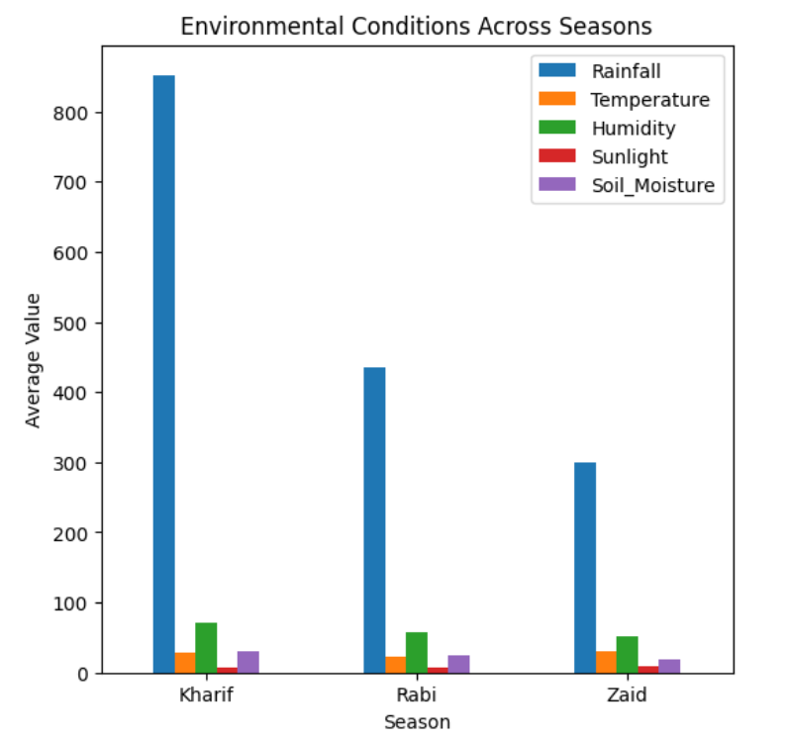
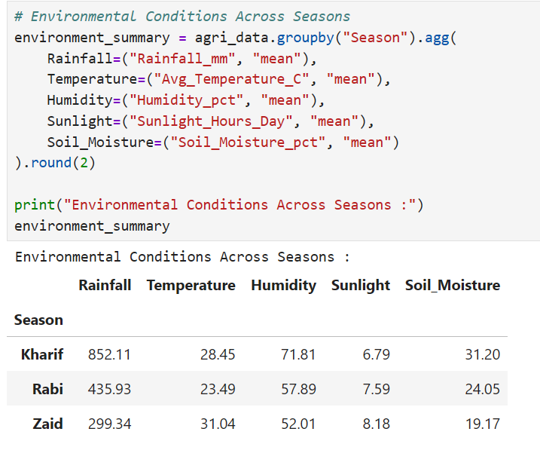
Seasonal Environmental Conditions:
Key Findings:
Kharif had the highest rainfall (852.11 mm), humidity (71.81%), and soil moisture (31.20%).
Zaid had the highest average temperature (31.04°C) and sunlight (8.18 hours/day).
Rabi generally showed moderate environmental conditions between the two seasons.
Key Takeaway: Environmental conditions vary considerably across seasons, with Kharif being wetter and Zaid being hotter and drier.

Slide 8
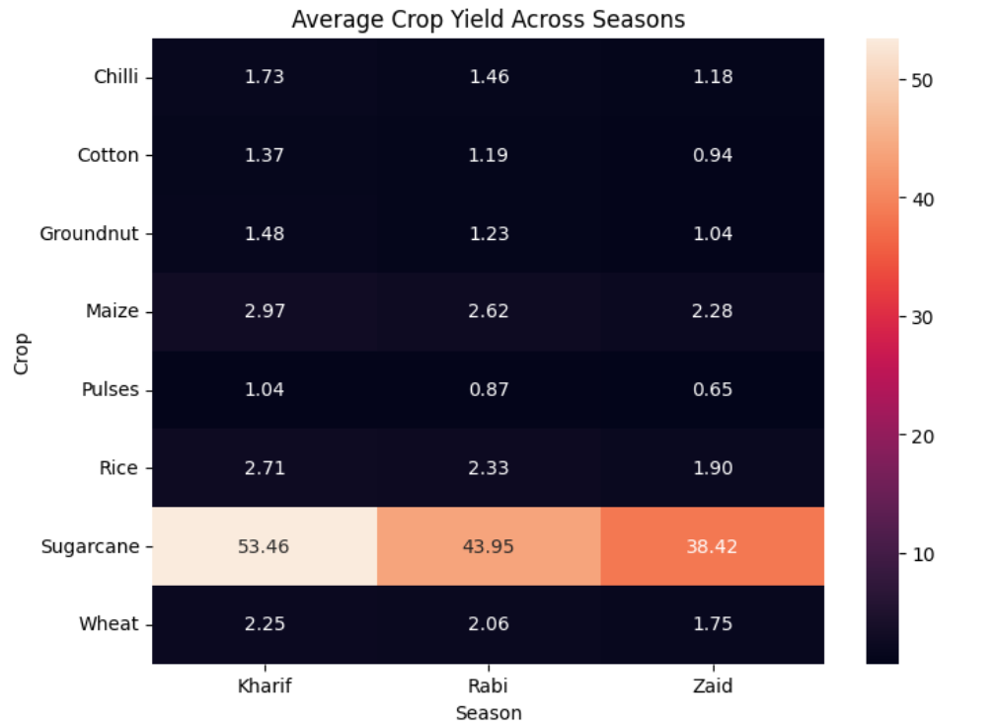
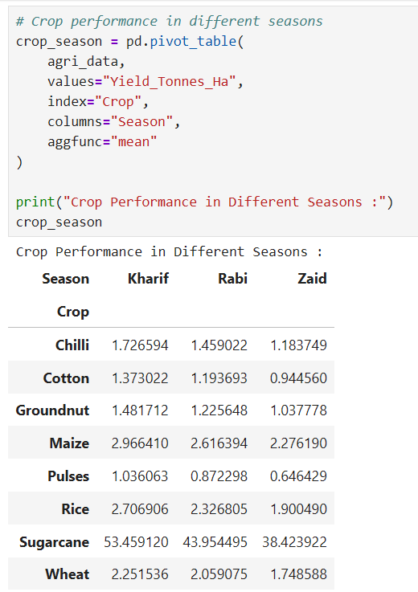
Crop Performance Across Seasons:
Key Findings:
Sugarcane had substantially higher yield levels than the other crops across all seasons.
Kharif generally recorded the highest yield across crops, while Zaid showed the lowest.
Crop performance varies across seasons, indicating that seasonal conditions affect different crops differently.
Key Takeaway: Crop selection should consider seasonal performance rather than using the same crop strategy across all seasons.

Slide 9
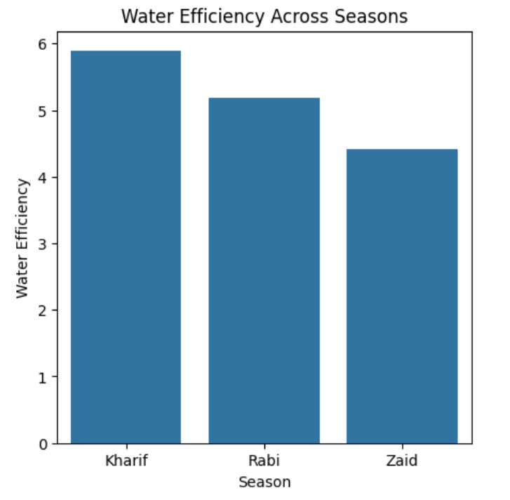
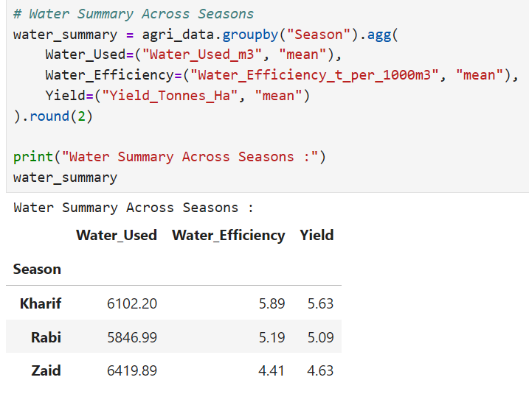
Water Usage & Efficiency:
Key Findings:
Zaid had the highest average water usage (6,419.89 m³).
Kharif achieved the highest water efficiency (5.89) with lower water usage than Zaid.
Zaid had the lowest water efficiency (4.41) and yield (4.63 tonnes/ha).
Key Takeaway: Higher water usage did not necessarily result in better agricultural performance; efficient water use is more important than simply increasing water consumption.

Slide 10
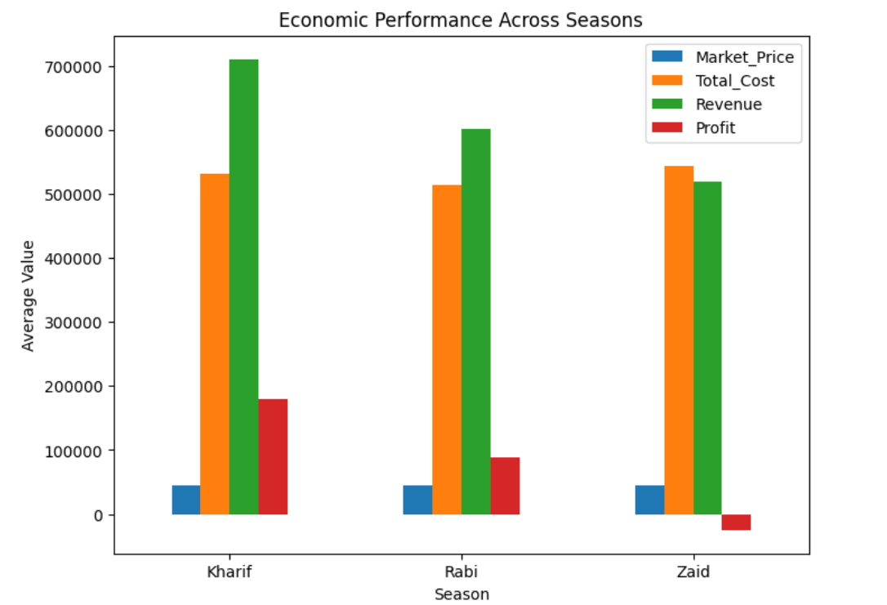
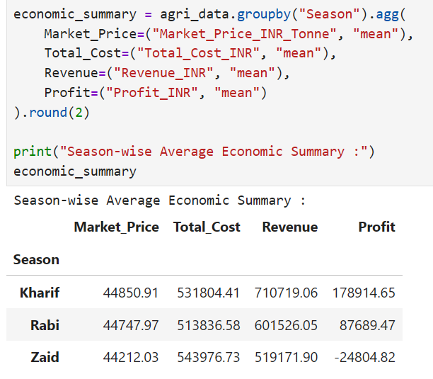
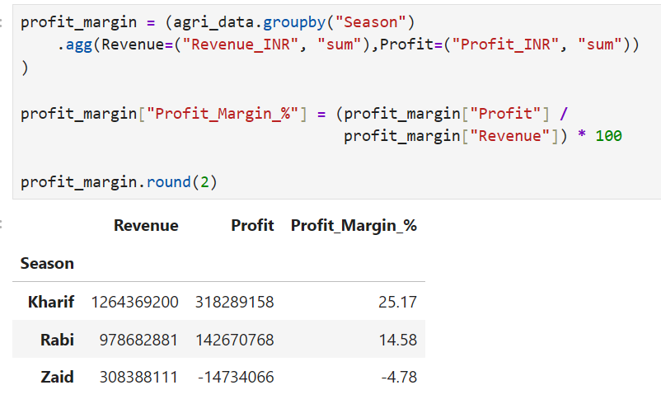
Seasonal Economic Performance:
Key Findings:
Kharif generated the highest total revenue (₹126.44 crore) and profit (₹31.83 crore).
Kharif also achieved the highest profit margin (25.17%).
Rabi recorded a profit margin of 14.58%, while Zaid had a negative margin of -4.78%.
Key Takeaway: Kharif was the most economically efficient season, while Zaid showed the weakest financial performance.

Slide 11
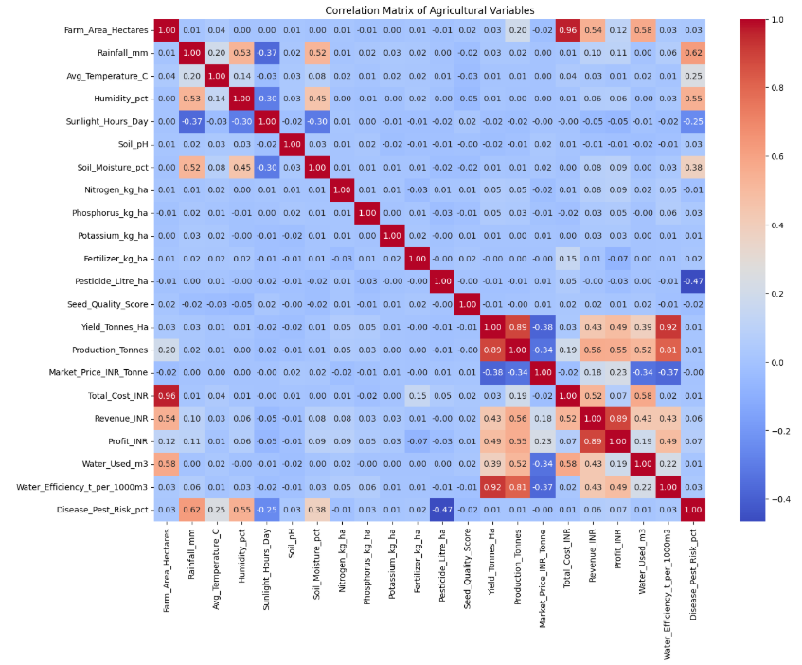
Key Relationships Between Variables:
Key Findings:
Yield has a strong positive correlation with Water Efficiency (0.92) and Production (0.89).
Farm Area has a strong positive correlation with Total Cost (0.96).
Revenue and Profit also show a strong positive correlation (0.89).
Environmental factors such as rainfall, temperature, humidity, and soil moisture show very weak linear relationships with yield.
Key Takeaway: Agricultural performance is more strongly associated with production and resource efficiency than with any single environmental factor.

Slide 12
Overall Key Findings:
Kharif emerged as the best-performing season, with the highest yield, production, revenue, profit, and water efficiency.
Zaid showed the weakest overall performance, with lower yield and revenue, higher water usage, and a negative profit margin.
Crop performance varied across seasons, with Sugarcane showing substantially higher yields than the other crops.
Regional performance varied by season, with different states and districts performing better under different seasonal conditions.
Water efficiency showed a strong association with yield, while individual environmental factors had very weak linear relationships with yield.
Seasonal differences have both agricultural and economic impacts, highlighting the need for season-specific crop and resource planning.

Slide 13
Future Scope:
Predictive Analysis: Develop machine learning models to predict crop yield, production, and profitability based on seasonal and farming conditions.
Real-Time Data Integration: Incorporate real-time weather, soil, and market-price data for more timely agricultural insights.
Long-Term Trend Analysis: Use multi-year agricultural data to study long-term seasonal and regional trends.
Advanced Resource Optimisation: Develop models to recommend efficient irrigation, fertiliser, and pesticide usage.
Crop Recommendation: Build a system that recommends suitable crops for specific seasons and regional conditions.
Decision Support System: Extend the project into an interactive dashboard or decision-support tool to help farmers and agricultural planners make data-driven decisions.

Slide 14
GitHub Link:
Project GitHub Repository -
📁 Seasonal Agriculture Performance Analysis
🔗 View Source Code & Notebook

Slide 15

VOIS Course Completion Certificate -
Course Name: Data Visualisation

Slide 16
Thank you
.
.

