Slide 1


Santosh Kumar Kar,
skkar.2k2@gmail.com

Slide 2
CHAPTER – 3
Spring and Database
Santosh Kumar Kar
skkar.2k2@gmail.com

Slide 3
DAO: Spring and You
DAO (Data Access Object) is used to read and write data to the database.

Slide 4
The table shows what actions Spring will take care of and which actions are the responsibility of you, the application developer.
Action | Spring | You
Define connection parameters. |  | 
Open the connection. | 
Specify the SQL statement. |  | 
Declare parameters and provide parameter values |  | 
Prepare and execute the statement. | 
Set up the loop to iterate through the results (if any). | 
Do the work for each iteration. |  | 
Process any exception. | 
Handle transactions. | 
Close the connection, statement and resultset. | 

Slide 5

Steps for DAO:
You need to follow 3 basic steps while configuring the spring context in XML.
Step 1: Configure Data Source
Driver Based Data Source
JNDI Data source
Pooled Data source
Step 2: Configure JDBC Template
JdbcTemplate
NamedParameterJdbcTemplate
SimpleJdbcTemplate
Step 3: Configure custom DAO Class

Slide 6
Step 1:
Configuring Data Source

Slide 7
Step 1: Configure Data Source
The very first step you need to work on database is configuring the data source in Spring’s context file. If you remember the basic steps of JDBC Connection in Java, first we load the driver using Class.forName(<driver name>), then getting connection using DriverManager providing the URL such as Connection con = DriverManger.getConnection(<URL>, <username>,<password>) and then using Statement or PreparedStatement.
While configuring the DataSource in Spring we may need to pass connection details (such as DriverName, URL, Username, Password) to Spring framework. The benefit of configuring data sources in this way is that they can be managed completely external to the application, leaving the application to simply ask for a data source when it’s ready to access the database.

Slide 8

Step 1: Configure Data Source
Spring offers several options for configuring data source beans in your Spring application,:
Driver Based Data Source
JNDI Data source
Pooled Data source
Note: In production, I would recommend to use JNDI Data Source which draws its connection from a connection pool. Driver Based Data Source is good for unit testing.

Slide 9
Driver Based
Data Source

Slide 10
Driver Based Data Source
Driver Based data source is the simplest data source that can be configured in Spring. This should not be used in Production but it is good to use in Development Environment for unit testing. Spring provides 2 data source classes to choose one of them. They are:
DriverManagerDataSource
SingleConnectionDataSource
Remember, these both provides non-pooled connections but the only difference is, DriverManagerDataSource provides a new connection each time a new connection is requested by the application where as SingleConnectionDataSource provides the same connection.

Slide 11
Driver Based Data Source
<bean id=”myDataSource" class="org.springframework.jdbc.datasource.DriverManagerDataSource">
<property name="driverClassName" value="com.mysql.jdbc.Driver" />
<property name="url" value="jdbc:mysql://localhost/test" />
<property name= "username" value= "" />
<property name="password" value= "" />
</bean>
Confused with so many data sources? Don’t panic, for beginning, you use just one data source. Driver based is the easier one.

Slide 12
Driver Based Data Source
?
How is it if we take the connection details (Driver class name, url, username, password etc. ) from a property file rather than defining in Spring Context XML file itself?
?

Slide 13
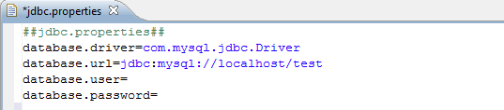
Driver Based Data Source
Yes, it is a good idea to take the database connection details from a property file.
So let’s create a property file. We will name the file as: jdbc.properties
You need this extra entry to include the properties from jdbc.properties file.
The name of property file jdbc.properties
All properties as defined in jdbc.properties
<bean id="propertyConfigurer"
class="org.springframework.beans.factory.config.PropertyPlaceholderConfigurer">
<property name="location" value="jdbc.properties" />
</bean>
<bean id=”mydataSource" class="org.springframework.jdbc.datasource.DriverManagerDataSource">
<property name="driverClassName" value="${database.driver}" />
<property name="url" value=“${database.url}" />
<property name= "username" value= "${database.username}" />
<property name="password" value= "${database.password}" />
</bean>

Slide 14
JNDI
Data Source

Slide 15
JNDI Data Source
Application server are often pooled for greater performance. The application servers such as WebSphere, WebLogic, Jboss allow to configure connection pools. And these connection pools can be retrieved through a JNDI. The benefit of configuring data sources in this way is that they can be managed completely external to the application, leaving the application to simply ask for a data source when it’s ready to access the database. You can google Connection Pool & JNDI to know more about the features, creation and configuration in server.
In driver based data source, we saw any of the 2 classes DriverManagerDataSource and SingleConnectionDataSource can be used to establish the connection. Similarly for JNDI data source, we use JndiObjectFactoryBean.

Slide 16

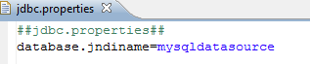
JNDI Data Source
I have created a connection pool my applicaiton server. The JNDI name is “mysqldatasource”. There is a servlet deployed in the same Server which gets the DAO object from the Spring Container. Spring provided the dataSource to the DAO after getting connection from the connection-pool mysqldatasource.
<bean id="MydataSource" class="org.springframework.jndi.JndiObjectFactoryBean” scope="singleton">
<property name="jndiName" value="${database.jndiname}" />
</bean>

Slide 17
JNDI Data Source
JNDI data sources in Spring 2.0 : You can also use the “jee” schema in Driver Based Data Source
Spring 2.0, the XML required for retrieving a data source from JNDI is greatly simplified using the jee namespace.
<bean id="MydataSource" class="org.springframework.jndi.JndiObjectFactoryBean" scope="singleton">
<property name="jndiName" value="${database.jndiname}" />
</bean>

Slide 18
Pooled
Data Source

Slide 19
Pooled Data Source
If you’re unable to retrieve a data source from JNDI, the next best thing is to configure a pooled data source directly in Spring.
Spring doesn’t provide a pooled data source, there’s a suitable one available in the Jakarta Commons Database Connection Pools (DBCP) project (http://jakarta.apache.org/commons/dbcp). To add DBCP to your application, you need to download the JAR file and place it into your build path along with spring library files.

Slide 20
Pooled Data Source
The class you do use for Pooled Data Source is : org.apache.commons.dbcp.BasicDataSource
<bean id="propertyConfigurer"
class="org.springframework.beans.factory.config.PropertyPlaceholderConfigurer">
<property name="location" value="jdbc.properties" />
</bean>
2 new properties in Pooled Data Source
<bean id="MydataSource" class="org.apache.commons.dbcp.BasicDataSource">
<property name="driverClassName" value="${database.driver}" />
<property name="url" value=“${database.url}" />
<property name= "username" value= "${database.username}" />
<property name= "password" value= "${database.password}" />
<property name= "initialSize" value="5" />
<property name= "maxActive" value="10" />
</bean>

Slide 21
3 types of Data Sources
JNDI DS
<bean id=”mydataSource" class="org.springframework.jndi.JndiObjectFactoryBean" scope="singleton">
<property name="jndiName" value="${database.jndiname}" />
</bean>
<bean id="MydataSource" class="org.springframework.jdbc.datasource.DriverManagerDataSource">
<property name="driverClassName" value="com.mysql.jdbc.Driver" />
<property name="url" value="jdbc:mysql://localhost/test" />
<property name= "username" value= "" />
<property name="password" value= "" />
</bean>
Driver Based DS
<bean id="MydataSource" class="org.apache.commons.dbcp.BasicDataSource">
<property name="driverClassName" value="${database.driver}" />
<property name="url" value=“${database.url}" />
<property name= "username" value= "${database.username}" />
<property name= "password" value= "${database.password}" />
<property name= "initialSize" value="5" />
<property name= "maxActive" value="10" />
</bean>
Pooled DS

Slide 22
Step 2:
JDBC Template

Slide 23
JDBC Template
After configuring the Data Source, the next step is configuring the JDBCTemplate.
The JdbcTemplate class is the central class in the JDBC core package. It simplifies the use of JDBC since it handles the creation and release of resources. This helps to avoid common errors such as forgetting to always close the connection. It executes the core JDBC workflow like statement creation and execution, leaving application code to provide SQL and extract results. This class executes SQL queries, update statements or stored procedure calls, imitating iteration over ResultSets and extraction of returned parameter values.
It also catches JDBC exceptions and translates them to the generic, more informative, exception hierarchy defined in the org.springframework.dao package.

Slide 24
JDBC Template
Option 1:
The JdbcTemplate can be used within a DAO implementation via direct instantiation with a DataSource reference
OR
Option 2:
be configured in a Spring IOC container and given to DAOs as a bean reference.

Slide 25
Option -1
The JdbcTemplate within a DAO implementation via direct instantiation with a DataSource reference.
We are injecting DataSource but not the JDBCTemplate
<bean id="employeeDao" class="org.santosh.dao.EmployeeDao" >
<property name="dataSource" ref="MyDataSource" />
</bean>
<bean id= ”myDataSource" class="org.springframework.jndi.JndiObjectFactoryBean">
<property name=“jndiName" value="${database.jndiname}" />
</bean>
Do you remember, we had configured datasource in step2 under Pooled Data Source Section? If not, go back to Step-1 again.

Slide 26
Option-2
Configured in Spring IOC container and given JdbcTemplate to DAOs as a bean reference.
bean id must be jdbcTemplate
MyJdbcTemplate but not MyDataSource
<bean id="employeeDao" class="org.santosh.dao.EmployeeDao" >
<property name=“jdbcTemplate" ref=”myJdbcTemplate" />
</bean>
<bean id= “myDataSource" class="org.springframework.jndi.JndiObjectFactoryBean">
<property name="jndiName" value="${database.jndiname}" />
</bean>
<bean id= “myJdbcTemplate" class="org.springframework.jdbc.core.JdbcTemplate">
<property name="dataSource" ref=”myDataSource" />
</bean>
Do you remember, we had configured datasource in step2 under Pooled Data Source Section? If not, go back to Step-1 again.
Bean for JdbcTemplate added and use in DAO

Slide 27
Step 3:
DAO Layer

Slide 28
Writing DAO Layer
We already discussed that the JdbcTemplate can be used within a DAO implementation via direct instantiation with a DataSource reference OR be configured in a Spring IOC container and given to DAOs as a bean reference.
Now we will see how they can be implemented in the DAO class.

Slide 29
Writing DAO Layer
Option - 1
The JdbcTemplate within a DAO implementation via direct instantiation with a DataSource reference.

Slide 30
Writing DAO Layer
We are injecting DataSource but not the JDBCTemplate
<bean id="employeeDao" class="org.santosh.dao.EmployeeDao" >
<property name="dataSource" ref="MyDataSource" />
</bean>
<bean id= "MyDataSource" class="org.springframework.jndi.JndiObjectFactoryBean">
<property name=“jndiName" value="${database.jndiname}" />
</bean>
Do you remember, we had configured datasource in step2 under Pooled Data Source Section? If not, go back to Step-1 again.
In DAO Class
private JdbcTemplate jdbcTemplate;
public void setDataSource(DataSource dataSource) {
this.jdbcTemplate = new JdbcTemplate(dataSource);
}
jdbcTemplate.update(SQL_ADD_EMPLOYEE,
new Object[] { emp.getEmpId(), emp.getName(),emp.getDeptid(),emp.getSalary() });
Created JdbcTemplate instance and assigned to local object.
Using jdbcTemplate

Slide 31
Writing DAO Layer
Option - 2
Configured in Spring IOC container and given JdbcTemplate to DAOs as a bean reference.

Slide 32
bean id must be jdbcTemplate
MyJdbcTemplate but not MyDataSource
<bean id="employeeDao" class="org.santosh.dao.EmployeeDao" >
<property name=“jdbcTemplate" ref="MyJdbcTemplate" />
</bean>
<bean id= “MyDataSource" class="org.springframework.jndi.JndiObjectFactoryBean">
<property name="jndiName" value="${database.jndiname}" />
</bean>
<bean id= “MyJdbcTemplate" class="org.springframework.jdbc.core.JdbcTemplate">
<property name="dataSource" ref="MyDataSource" />
</bean>
Do you remember, we had configured datasource in step2 under Pooled Data Source Section? If not, go back to Step-1 again.
Bean for JdbcTemplate added and use in DAO
In DAO Class
private JdbcTemplate jdbcTemplate;
public void setJdbcTemplate(JdbcTemplate jdbcTemplate) {
this.jdbcTemplate = jdbcTemplate
}
jdbcTemplate.update(“INSERT into emp(empid, name, dept, sal) values (?, ?, ?, ?)",
new Object[] { 1001, "John Mayor", 23 ,780000 });
Setter method for JdbcTemplate
Using jdbcTemplate

Slide 33
In previous examples we saw DAO class gets the JDBC Template either directly from Spring Container or it takes DataSource from the container and creates the JDBCTemplate instance. Whatever the option you may choose but you are using the template and you can work with the SQL queries through the Templates only. We used the template class - org.springframework.jdbc.core.JdbcTemplate in the last example.
In this section we will see the different Template classes we can use in Spring

Slide 34
Different Template Classes
Template class (org.springframework.*) | Templates used
jdbc.core.JdbcTemplate | JDBC connections
jdbc.core.namedparam.NamedParameterJdbcTemplate | JDBC connections with support for named parameters
jdbc.core.simple.SimpleJdbcTemplate | JDBC connections, simplified with Java 5 constructs
orm.hibernate.HibernateTemplate | Hibernate 2.x sessions
orm.hibernate3.HibernateTemplate | Hibernate 3.x sessions
orm.ibatis.SqlMapClientTemplate | iBATIS SqlMap clients
orm.jdo.JdoTemplate | Java Data Object implementations

Slide 35
Different Template Classes
For JDBC we can use:
org.springframework.jdbc.core.JdbcTemplate
org.springframework.jdbc.core.namedparam.NamedParameterJdbcTemplate
org.springframework.jdbc.core.simple.SimpleJdbcTemplate

Slide 36
Different Template Classes
For Hibernate we can use:
org.springframework.orm.hibernate.HibernateTemplate
org.springframework.orm.hibernate3.HibernateTemplate

Slide 37
Different Template Classes
For JPA (Java Persistence API) we can use:
org.springframeworkorm.jpa.JpaTemplate

Slide 38
Different Template Classes
For IBatics we can use:
org.springframework.orm.jpa.JpaTemplate

Slide 39
Let’s use JdbcTemplate first…

Slide 40
We already have seen how DAO class gets the JDBC Template directly from Spring container or it takes DataSource from the container and creates the JDBCTemplate Instance. But in our examples, we will use only injecting JDBCTemplate.

Slide 41
Step-1: configuring Data Source
Configuring Data Source* using either Driver Based data source or JNDI data source or Pooled Data sources data source.
1
<bean id= “myDataSource" class="org.springframework.jndi.JndiObjectFactoryBean">
<property name="jndiName" value="${database.jndiname}" />
</bean>
I used JNDI Datasource. You can use DriverBased/Pooled Datasource if you want.
*We already have discussed under section Step 1: configure data source

Slide 42
Step-2: configuring the Template
After setting up the Data source, the Second step would be configuring the Template using either
JdbcTemplate or
NamedParameterJdbcTemplate or
SimpleJdbcTemplate
2
<bean id= ”myJdbcTemplate" class="org.springframework.jdbc.core.JdbcTemplate">
<property name="dataSource" ref="MyDataSource" />
</bean>

Slide 43
Step-3: Injecting the template
Third step is injecting the template to your DAO class.
3
<bean id="employeeDao" class="org.santosh.dao.EmployeeDao" >
<property name=“jdbcTemplate" ref=”myJdbcTemplate" />
</bean>

Slide 44
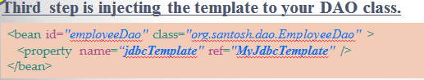
Step-4: Injecting the template
Configuration of Spring Context is now over. This is time and our Forth step - writing our DAO class.
Declare a field jdbcTemplate of type org.springframework.jdbc.core.JdbcTemplate. The name could be different but must be same as the bean name defined in XML.
Define setter method for the field- jdbcTemplate
Implement the DAO logic for any SQL operation such as insertion, deletion, updation etc. using jdbcTemplate.
private JdbcTemplate jdbcTemplate;
public void setJdbcTemplate(JdbcTemplate jdbcTemplate) {
this.jdbcTemplate = jdbcTemplate
}
jdbcTemplate.update("INSERT into emp(empid, name, dept, sal) values (?, ?, ?, ?)",
new Object[] {1001, "John Mayor", 23 ,780000 });

Slide 45
So we understand the configuration of Datasource, template, defining DAO class, injecting template object into DAO class etc. But there is some tricky code in using SQL statements using jdbcTemplate :
jdbcTemplate.update(…);
jdbcTemplate.query (…);
jdbcTemplate.queryForObject (…) ; etc.
Let’s see using such methods in the different templates.

Slide 46
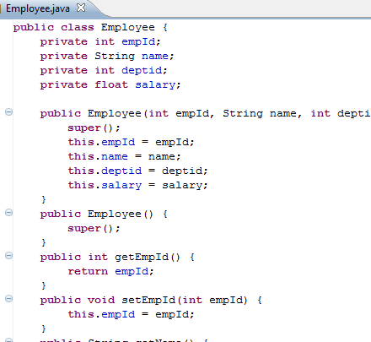
Before going through the different JDBC template, we will create some tables, insert data into those tables.
Lets create 2 tables, emp and dept and VO class.
The structure of the emp table will look like:
Field | type | Null | Key
empid | int(10) | No | primary key
name | varchar(15) | Yes
dept | int(10) | Yes
sal | float(12,2) | yes
The structure of the dept table will look like:
Field | type | Null | Key
deptid | int(10) | No | primary key
deptname | varchar(20) | Yes
dept | varchar(20) | Yes
Now we will work on SQL queries using different templates.

Slide 47
emp
empid | name | dept | sal
1002 | Tom | 21 | 40000
1003 | Jerry | 22 | 39655
dept
deptid | deptname | address
21 | IT | IT Park
22 | Sales | MG Road
23 | BPO | MG Road

Slide 48
org.springframework.jdbc.core.JdbcTemplate
The most basic of Spring’s JDBC templates, this class provides simple access to a database through JDBC and simple indexed-parameter queries.

Slide 49
In Bean declaration
<bean id="employeeDao" class="org.santosh.dao.EmployeeDao" >
<property name=“jdbcTemplate" ref="MyJdbcTemplate" />
</bean>
<bean id= "MyJdbcTemplate" class="org.springframework.jdbc.core.JdbcTemplate">
<property name="dataSource" ref="MyDataSource" />
</bean>
<bean id= “MyDataSource" class="org.springframework.jndi.JndiObjectFactoryBean">
<property name="jndiName" value="${database.jndiname}" />
</bean>
In DAO class
public class EmployeeDao {
…
private JdbcTemplate jdbcTemplate;
public void setJdbcTemplate(JdbcTemplate jdbcTemplate) {
this.jdbcTemplate = jdbcTemplate
}
…
…
…
}

Slide 50
To insert a record(EmployeeDao.java)
public void addEmployee(Employee emp) {
String SQL_ADD_EMPLOYEE = "INSERT into emp(empid, name, dept, sal)"
+ " values (?, ?, ?, ?)";
int no_of_records = getJdbcTemplate().update(SQL_ADD_EMPLOYEE,
new Object[] {
emp.getEmpId(), emp.getName(), emp.getDeptid(), emp.getSalary()
});
System.out.println("Total "+ no_of_records+" records are updated...");
}
To access a record(EmployeeDao.java)
public Employee getEmployeeById(int id) throws SQLException {
String SQL_GET_EMPLOYEE_BY_ID = "SELECT empid, name, dept, sal FROM emp WHERE empid=?";
Employee emp = getJdbcTemplate().queryForObject(
SQL_GET_EMPLOYEE_BY_ID,
new Object[] { Integer.valueOf(id) },
new RowMapper<Employee>() {
public Employee mapRow(ResultSet rs, int rowNum)
throws SQLException, DataAccessException {
Employee employee = new Employee();
employee.setEmpId(rs.getInt(1));
employee.setName(rs.getString(2));
employee.setDeptid(rs.getInt(3));
employee.setSalary(rs.getFloat(4));
return employee;
}
});
return emp;
}

Slide 51
org.springframework.jdbc.core.NamedParameterJdbcTemplate
Named parameters let us give each parameter in the SQL an explicit name and to refer to the parameter by that name when binding values to the statement.

Slide 52
In Bean declaration
See, this is something new. Do you remember we had discussed about dependency injection (DI) – through setter method and constructor? We used constructor DI, where we pass the datasource as constructor argument because I didn’t find a no-parameter constructor for this class in Spring 3.0.
<bean id="employeeDao" class="org.santosh.dao.EmployeeDao" >
<property name=“jdbcTemplate" ref="MyJdbcTemplate" />
</bean>
<bean id= "MyJdbcTemplate" class="org.springframework.jdbc.core.namedparam.NamedParameterJdbcTemplate">
<constructor-arg ref="MyDataSource" />
</bean>
<bean id= “MyDataSource" class="org.springframework.jndi.JndiObjectFactoryBean">
<property name="jndiName" value="${database.jndiname}" />
</bean>
In DAO class
public class EmployeeDao {
…
private NamedParameterJdbcTemplate jdbcTemplate;
public void setJdbcTemplate(JdbcTemplate jdbcTemplate) {
this.jdbcTemplate = jdbcTemplate
}
…
…
…
}
Not JdbcTemplate,
it is now
NamedParameterJdbcTemplate

Slide 53
To insert a record(EmployeeDao.java)
public void addEmployee(Employee emp) {
String SQL_ADD_EMPLOYEE = "INSERT into emp(empid, name, dept, sal)"
+ " values (:empid, :ename, :deptid, :sal)";
Map<String, Object> map = new HashMap<String, Object>();
map.put("empid", emp.getEmpId());
map.put("ename", emp.getName());
map.put("deptid", emp.getDeptid());
map.put("sal", emp.getSalary());
int no_of_records = getJdbcTemplate().update(SQL_ADD_EMPLOYEE, map);
System.out.println("Total ”+ no_of_records+" records are updated...);
}
To access a record(EmployeeDao.java)
Observe this new object;
It is used in JdbcTemplate Query:
SqlParameterSource namedParameters
public Employee getEmployeeById(int id) throws SQLException {
String SQL_GET_EMPLOYEE_BY_ID =
"SELECT empid, name, dept, sal FROM emp WHERE empid = :empId";
SqlParameterSource namedParameters = new MapSqlParameterSource("empId", Integer.valueOf(id));
Employee emp = getJdbcTemplate().queryForObject(
SQL_GET_EMPLOYEE_BY_ID,
namedParameters,
new RowMapper<Employee>() {
public Employee mapRow(ResultSet rs, int rowNum)
throws SQLException, DataAccessException {
Employee employee = new Employee();
employee.setEmpId(rs.getInt(1));
employee.setName(rs.getString(2));
employee.setDeptid(rs.getInt(3));
employee.setSalary(rs.getFloat(4));
return employee;
}
});
return emp;
}

Slide 54
org.springframework.jdbc.core.SimpleJdbcTemplate
Simplifying in Java 5
With Java 5’s new language, constructs (known as varargs), it is possible to pass parameter lists without having to construct an array of Object. Let’s see the examples.
From Spring 3.0 onwards, SimpleJdbcTemplate class is deprecated. So I am not putting any details of how to use SimpleJdbcTemplate with Spring. You can use JdbcTemplate instead of using SimpleJdbcTemplate.

Slide 55
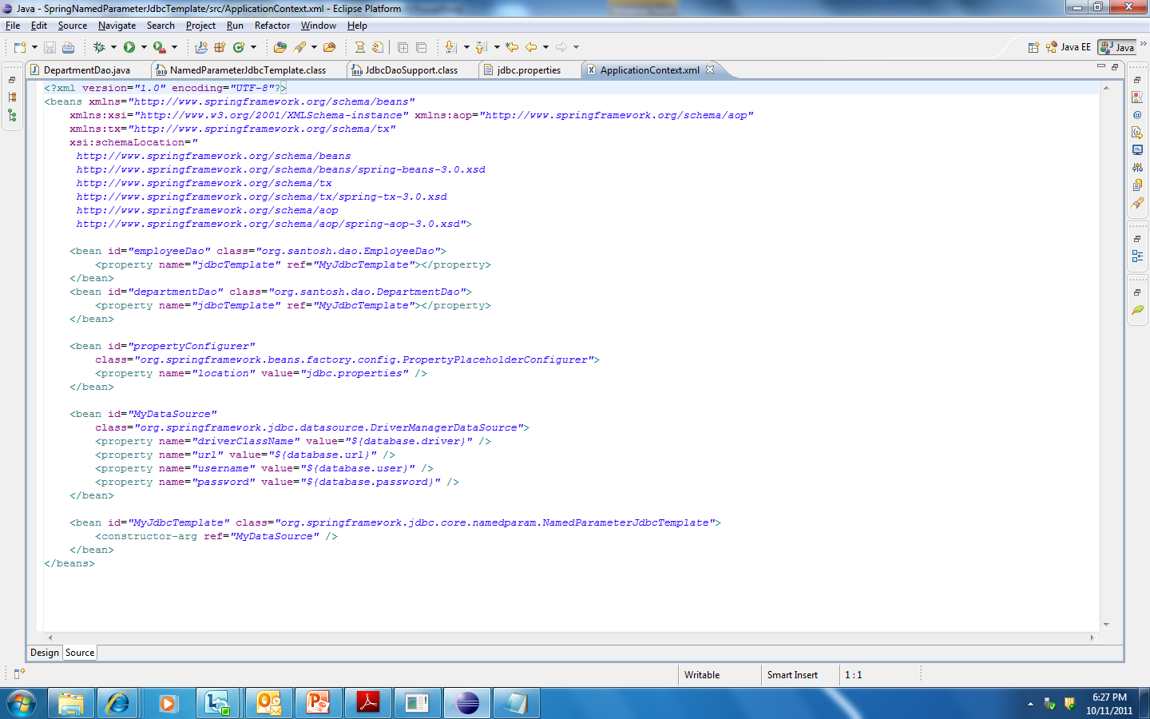
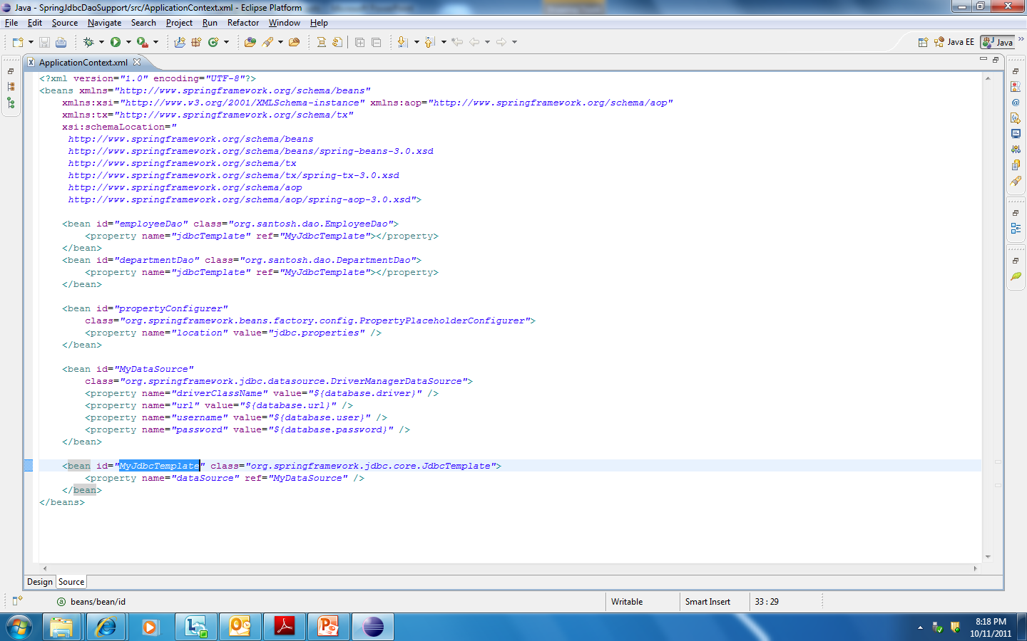
DAO Support class for different Templates
Before going through the details on the DAO Support, we will brush-up using JDBCTemplate which we already have discussed under JdbcTemplate section covered under Different Template classes and their uses. So do you remember how we were configuring jdbcTemplate in the XML for this? Recall,
Now you see the definition of MyJdbcTemplate used as ref with property jdbcTemplate

Slide 56
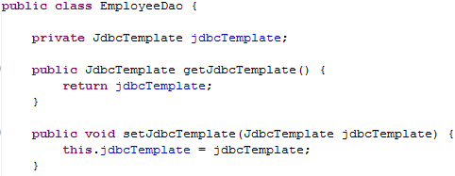
DAO Support class for different Templates
So from both the bean entries we understand that EmployeeDao needs a property - jdbcTemplate and this is of type org.springframework.jdbc.core.JdbcTemplate. Hence we need to declare the property jdbcTemplate in the DAO class with setter and getter methods.
Here in our example the DAO is org.santosh.dao.EmployeeDao. The class would look like:

Slide 57
Now this is ok when you have only one DAO class, here it is only EmployeeDao.java.
But this could be a burden to the programmer because
What if we have many DAO classes?
In every and each DAO, do we need to declare the field for jdbcTemplate and define the setter/getter methods for this field?

Slide 58
Yes, of course it is burden to the programmer to define jdbcTemplate field in every DAO class with the setter and getter methods.
So there is a good solutions provided by Spring framework,
So you simply
Extend JdbcDaoSupport class when you use the template of type org.springframework.jdbc.core.JdbcTemplate
Extend NamedParameterJdbcDaoSupport when you use the template of type org.springframework.jdbc.core.namedparam.NamedParameterJdbcTemplate
Extend SimpleJdbcDaoSupport when you use the template of type org.springframework.jdbc.core.simple.SimpleJdbcDaoSupport
Extend HibernateDaoSupport when you use the template of type org.springframework.orm.hibernate3.HibernateTemplate (we will discussed in part-3 using Spring and hibernate)

Slide 59
When you need to use the JdbcTemplate ,
import org.springframework.jdbc.core.support.JdbcDaoSupport class
In DAO class, extend JdbcDaoSupport
Use getJdbcTemplate().<methods> to run the SQL Queries.
In XML, there should be the property with bean name “jdbcTemplate” but never declare the field for jdbcTemplate in DAO because it is already done in JdbcDaoSupport class.

Slide 60
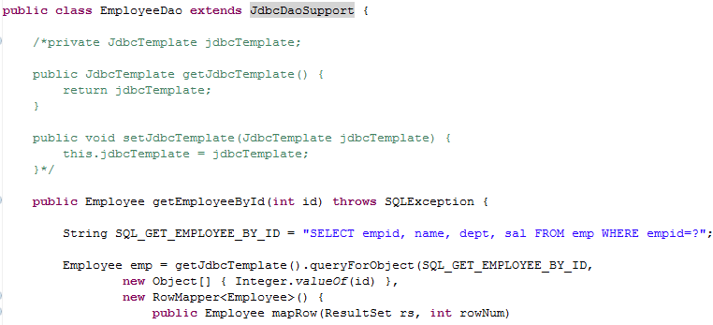
So the XML and the DAO class will look like:
Ignore and don’t use this in any of your DAO class because you extends JdbcDaoSupport and so this class had already done this for you.
Method getJdbcTemplate() is derived from JdbcDaoSupport class

Slide 61
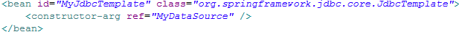
When you need to use the NamedParameterJdbcDaoSupport,
import org.springframework.jdbc.core.namedparam.NamedParameterJdbcDaoSupport class.
In DAO class, extend NamedParameterJdbcDaoSupport
Use getNamedParameterJdbcTemplate().<methods> to run the SQL Queries.
In XML, there should be the property with bean name “jdbcTemplate” but never declare the field for jdbcTemplate in DAO because it is already done in NamedParameterJdbcDaoSupport class.
So the XML and the DAO class will look like:

Slide 62
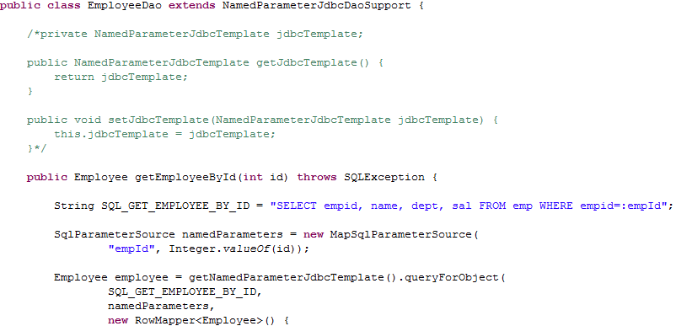
Ignore and don’t use this in any of your DAO class because you extends NamedParameterJdbcDaoSupport and so this class had already done this for you.
Method getNamedParameterJdbcTemplate() is derived from NamedParameterJdbcDaoSupport class

Slide 63


Please write to: skkar.2k2@gmail.com

