Slide 1
Joshimath: Manmade or Natural Disaster?
Submitted by
Yashika Kashyap(22d0377)
Shantanu Mapari(22m0796)
Santosh Kavhar(22m0787)

Slide 2
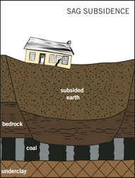
What is Land subsidence?
The downward (vertical) sinking of earth materials.

Slide 3
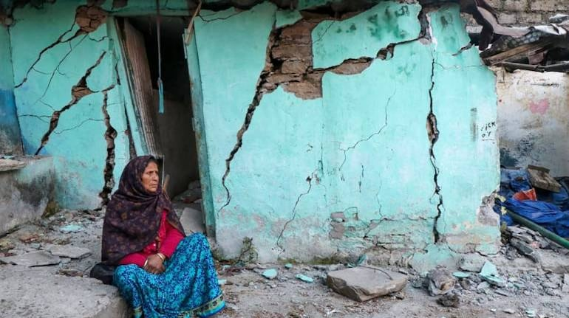
Problem Statement
We aim to find factors that led to this catastrophic change. Is it manmade or some natural calamity?
How do these human-made effects in the area interact with climate change? What are the lessons to be learned?
Could it have been avoided?

Slide 4
Motivation
Joshimath
Land subsidence
Damage to infrastructure
Threat to Human safety
Damages
Loss of property

Slide 5
What causes Land subsidence?
Natural subsidence
Human induced subsidence
Earthquakes
Landslides
Load of building and construction
Poor Drainage system
Floods
Excessive Groundwater extraction

Slide 6
Causal Loop Diagram

Slide 7
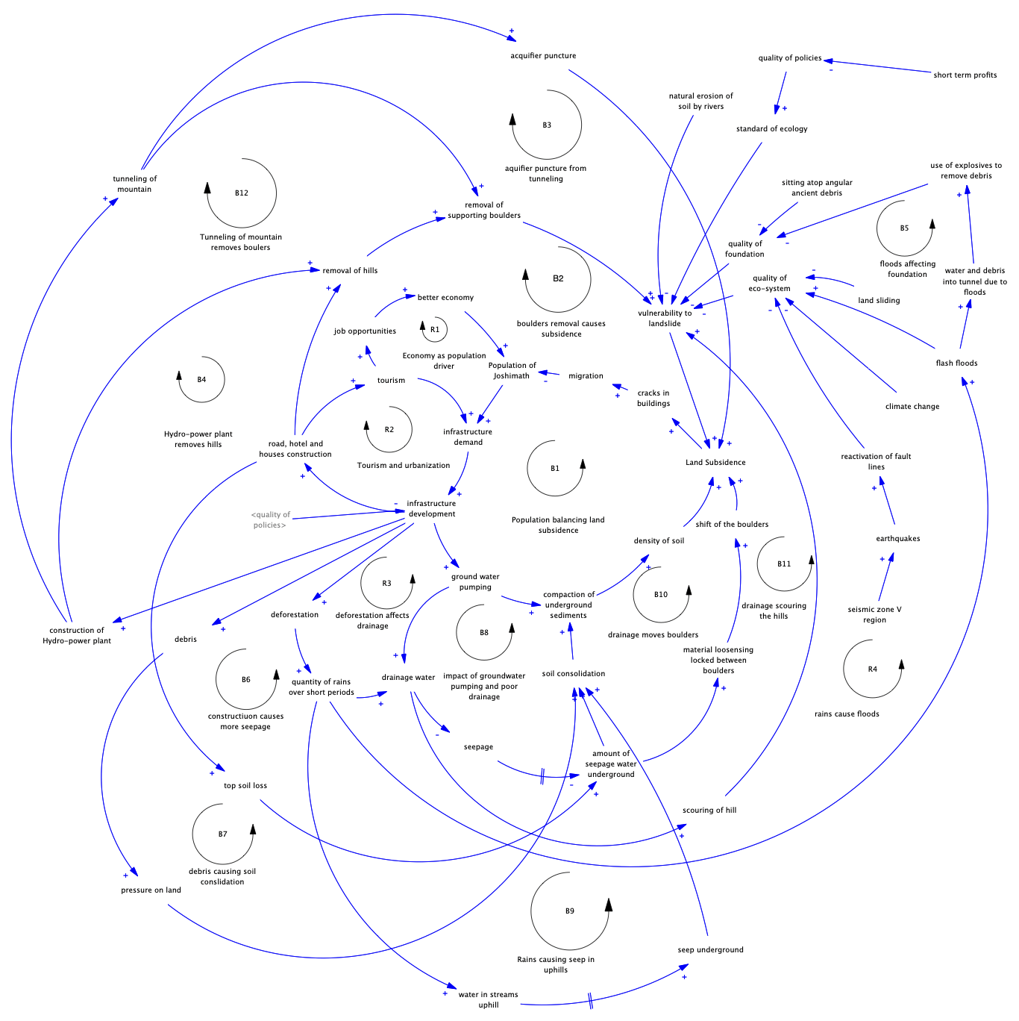

Slide 8
Stock Flow Diagram

Slide 9
Stocks in SFD
Population
Tourist
Economy
Ground water
Water for use
Drainage water
Seepage water underground
Infrastructure
Amount of Debris
Area of forest
Mountain volume
Hills Volume
Land surface elevation
Soil Volume

Slide 10
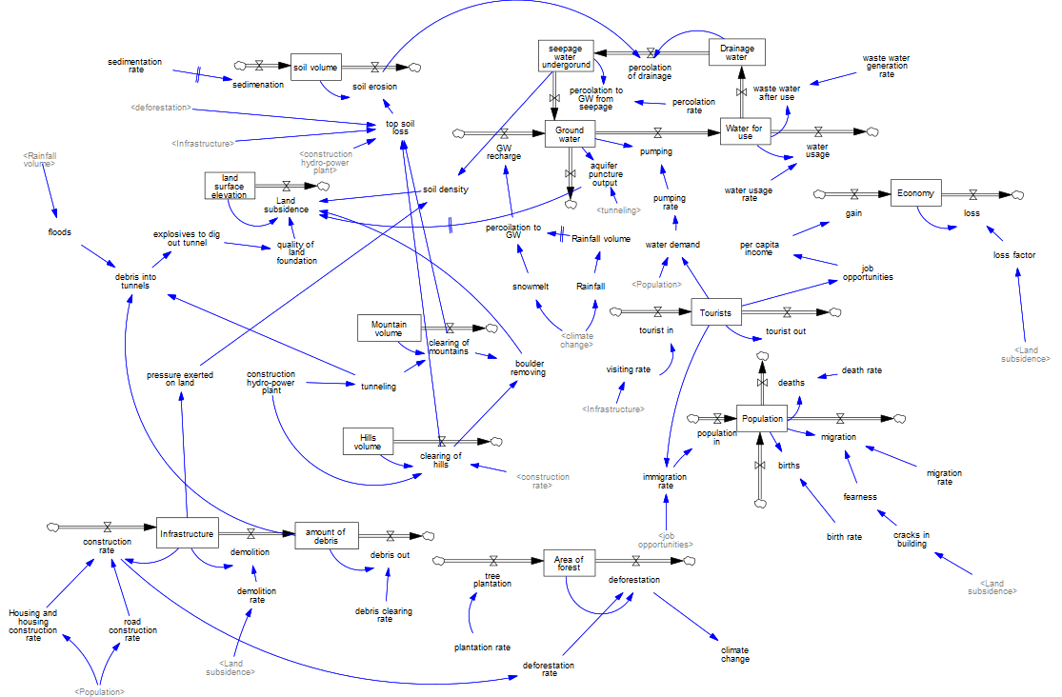

Slide 11

Population

Slide 12
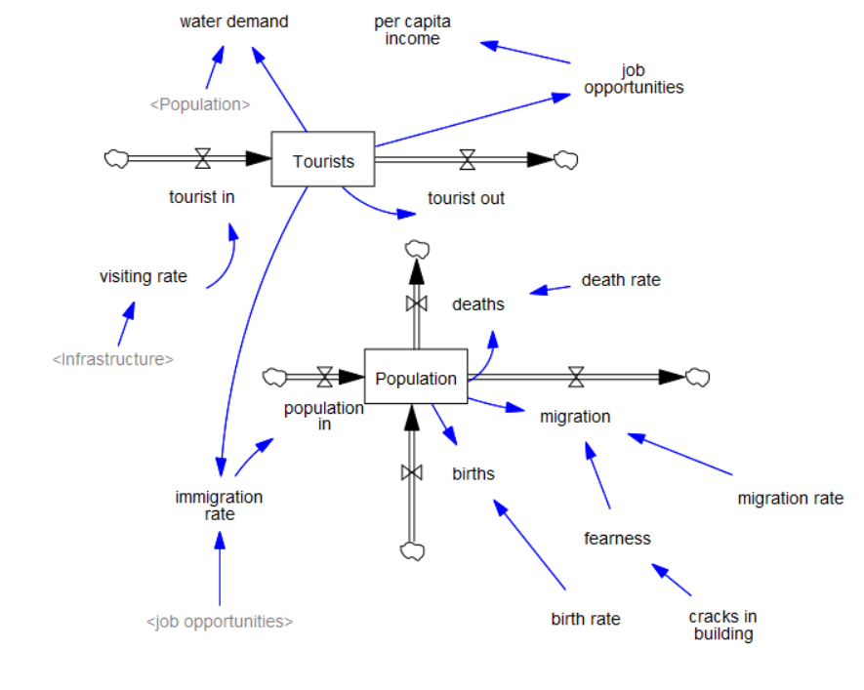
Population

Slide 13

Tourists and Economy

Slide 14
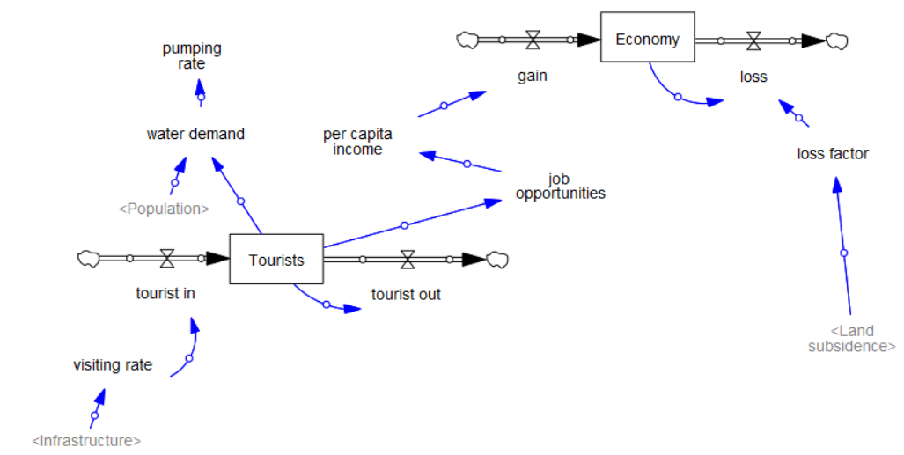
Tourists and Economy

Slide 15
Ground water

Slide 16
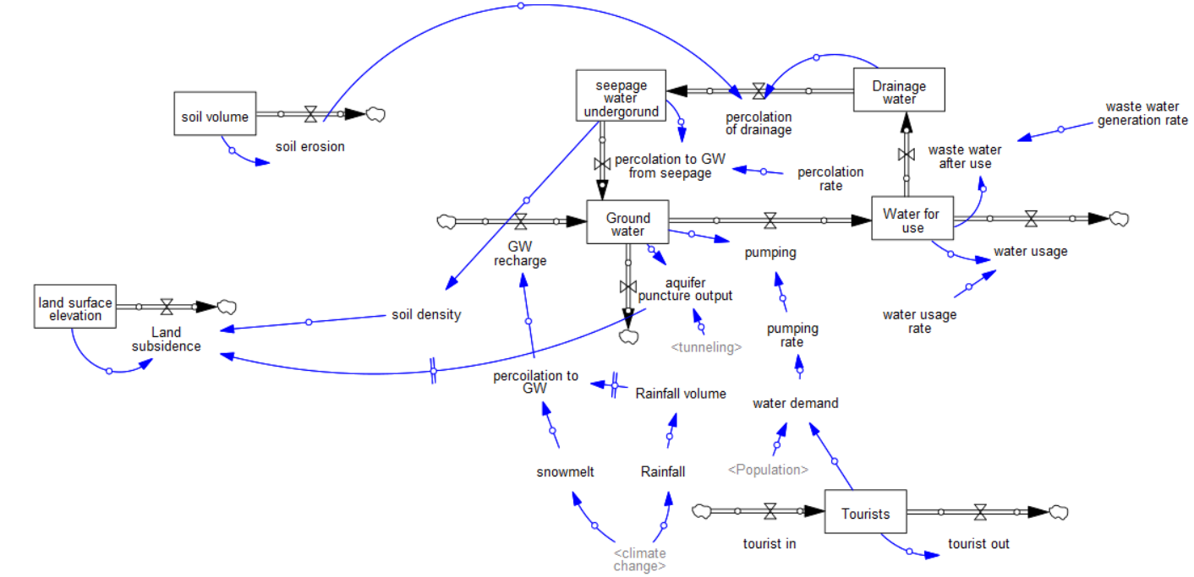
Ground Water

Slide 17

Soil Volume and Land Surface Elevation
Soil Volume and Land Surface Elevation

Slide 18
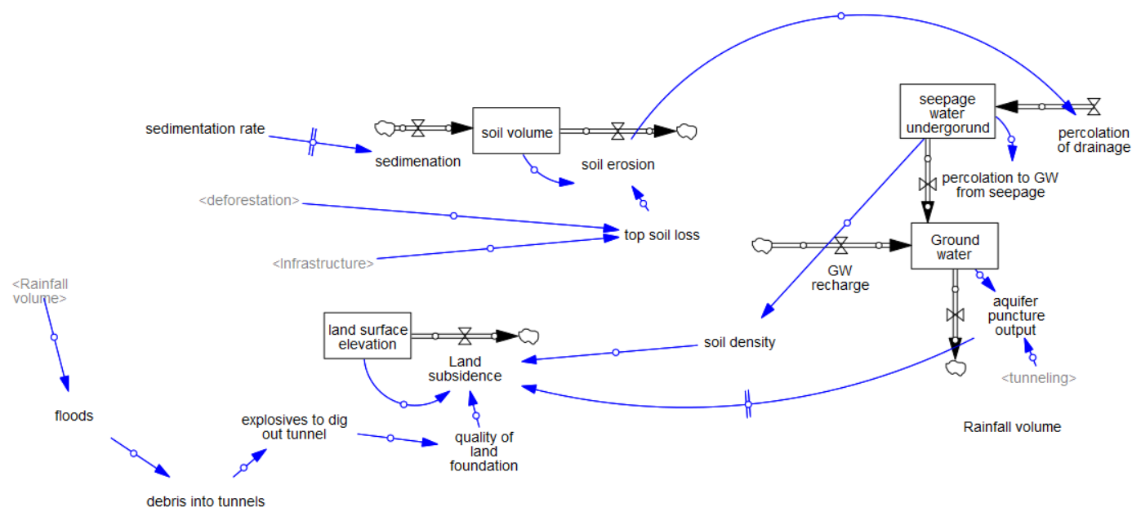
Soil Volume and Land Surface Elevation

Slide 19
Mountain Volume and
Hill Volume

Slide 20
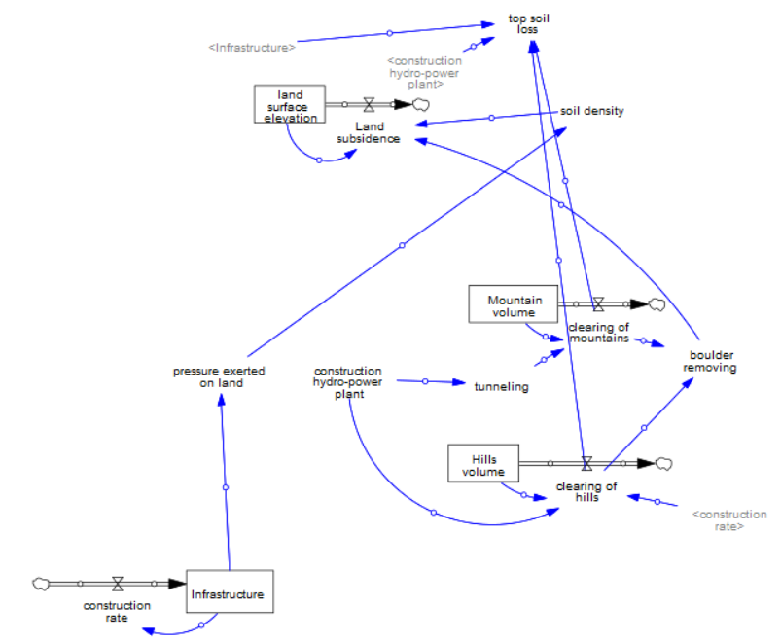
Mountain Volume and Hill Volume

Slide 21
Infrastructure and Area of Forest

Slide 22
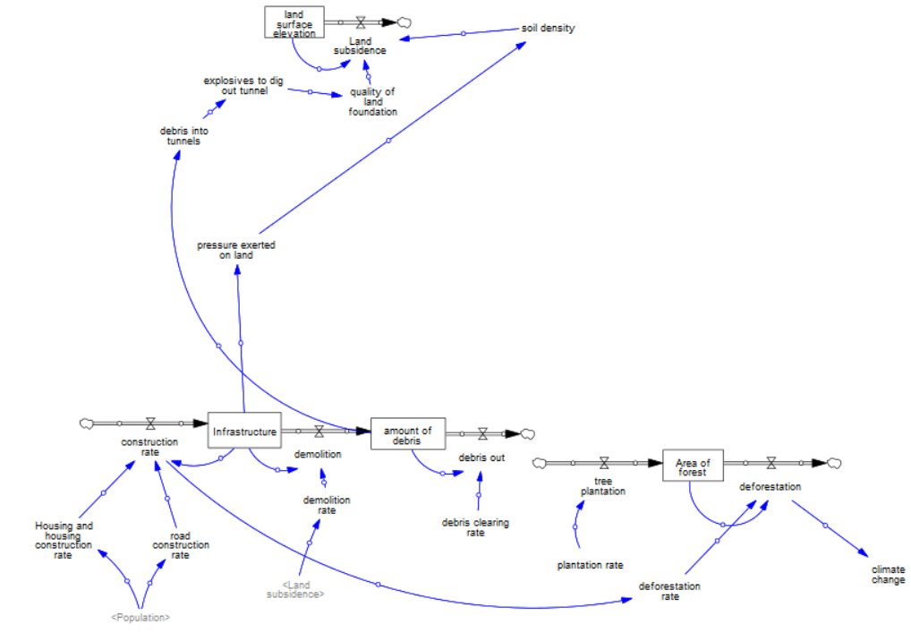
Infrastructure and Area of Forest

Slide 23
Simulation : Bottom-up approach

Slide 24
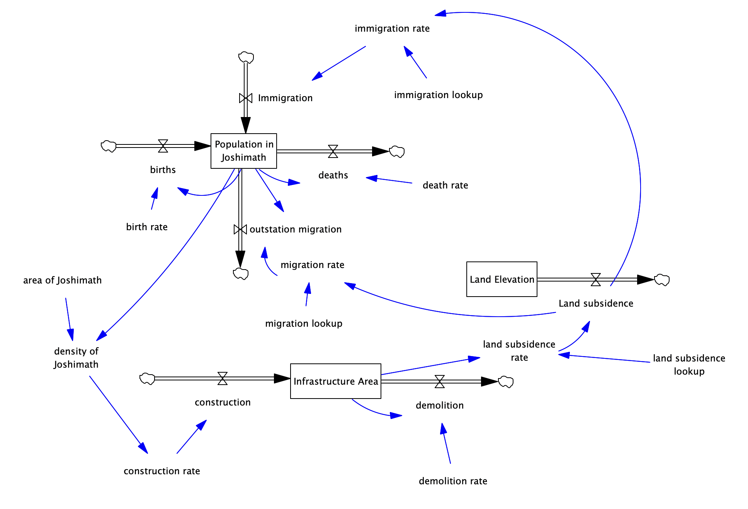

Slide 25
Results

Slide 26
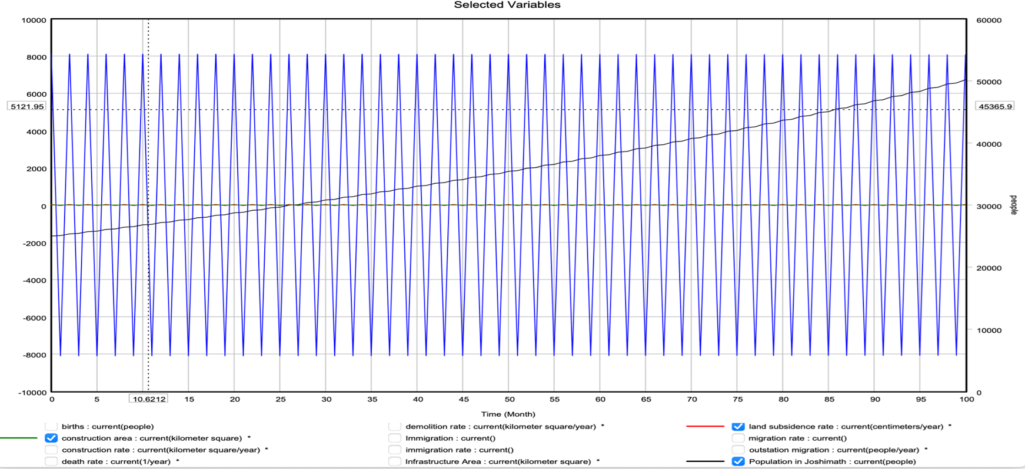
Results Obtained Earlier

Slide 27
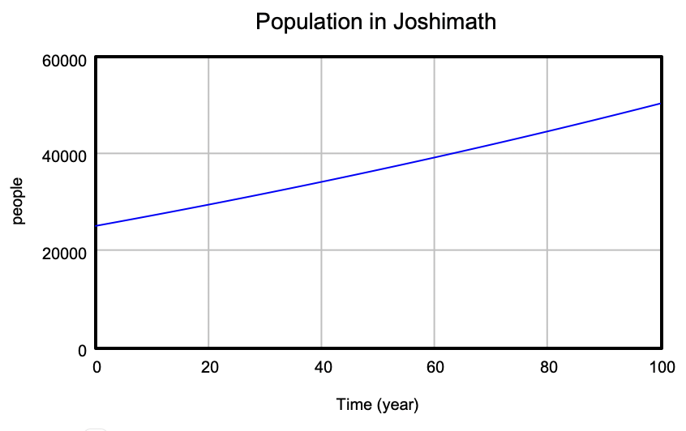
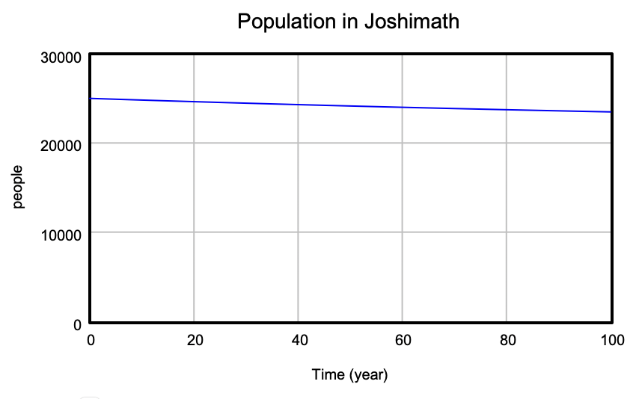
Current Results
Result 1: (Migration rate 0.3 %)
Result 2: (Migration rate 2 to 4 %)

Slide 28
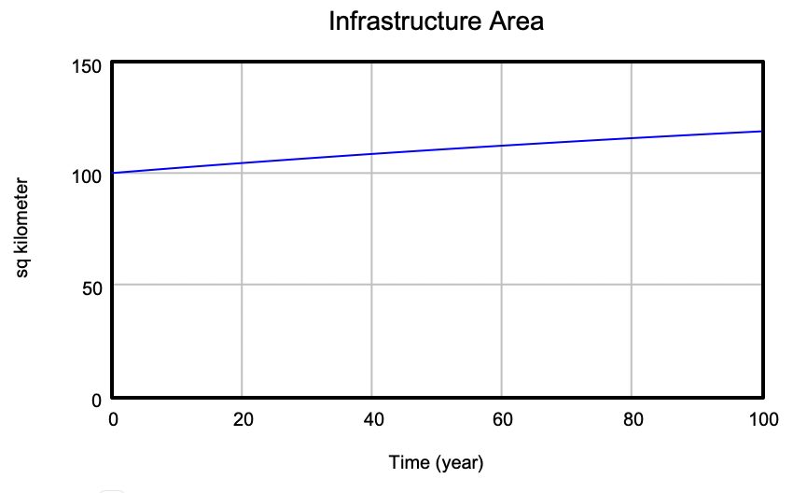
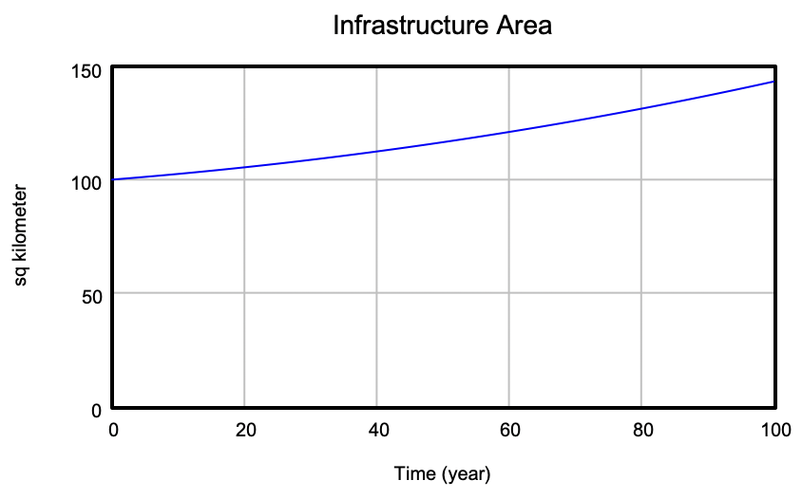
Current Results
Max 147 sq km from 100 sq km
Max 119 sq km from 100 sq km

Slide 29
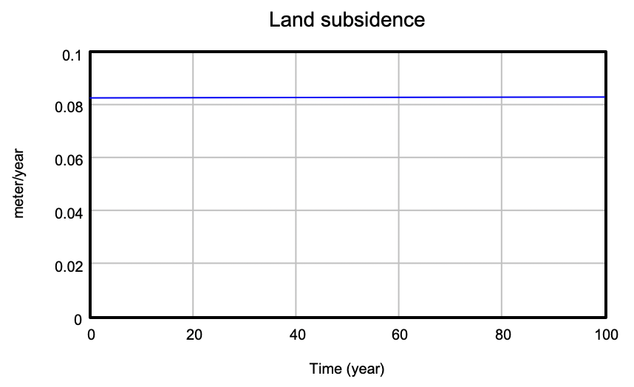
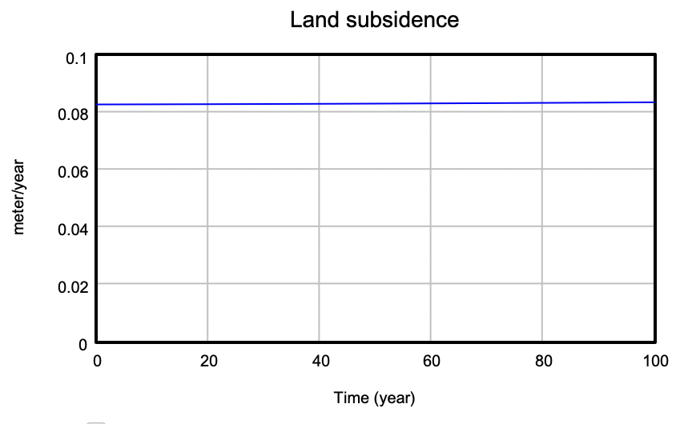
Current Results
8.25 to 8.28 cm/year
8.25 to 8.32 cm/year

Slide 30
Challenges
Getting the stocks and flows right
Too much information
Modeling natural disasters
Modeling government policies
Too many assumptions
Getting the units right everywhere

Slide 31
Conclusions
Man-made as well as natural factors have played role in land subsidence at Joshimath
Population collapse will depend on migration rate out, if it is between 1 to 2 % then population will reduce
Prevention is better than cure lesson learnt here

