Slide 1

Facets Batch processing
& Reporting
Claims

Slide 2



Agenda
Batch Processing
  Description
  Program Flow
  Input/Output
  Batch Specific Parameters
Reporting

Slide 3
ErCmcRunXc00 – Xc00 : “TRUE” XC Claims – Batch Description
XC Batch job will convert and load "True" Facets XC Formatted Claims to the Facets Database for processing.

Slide 4
ErCmcRunXc00 – Xc00 : “TRUE” XC Claims - Batch Process Flow
Program Execution
  Read the file containing XC formatted claims
  Map XC fields to Facets fields
  Write Claims to intermediate work file
  Report on errors and run controls
  Read intermediate file created in previous step
  Create Claim Number if necessary
  Optionally space fill ClmeGrgrId
  Fill default values if necessary
  Import to Facets XC (temporary) database
  Optionally create SQL files to delete rows added to database
  Report on errors and run controls

Slide 5
Input
Keyword File - Sample
  @pRecType="A",@pA100="KS2A01",@pA110="KATHY SMITH"
  @pRecType="C",@pC020="95016EDI0001",@pC010="M",@pC015="M",@pC030="",@pC050="",@pC040="", @pC120="P",@pC121="",@pC210="N",@pC220="",@pC221="000000000",@pC222="000000000", @pC230="",@pC231="",@pC232="",@pC240="",@pC241="",@pC124="",@pC122="",@pC112="000050000", @pC110="000010000",@pC060="B",@pC080=""
  @pRecType="E",@pE110="1",@pE111="2500"
  @pRecType="P",@pP010="$$",@pP130="123456",@pP210="Provider Participating",@pP140="", @pP150="227802123",@pP110="E",@pP220="Participating",@pP230="Provider", @pP240="",@pP310="169 Second Avenue",@pP320="",@pP330="",@pP340="LITTLE FALLS", @pP350="NJ", @pP360="07424",@pP370="2015551212“
  @pRecType="P",@pP010="SE",@pP130="123456",@pP210="Provider Participating",@pP140="", @pP150="227802123", @pP110="E",@pP220="Participating",@pP230="Provider",@pP240="", @pP310="169 Second Avenue",@pP320="",@pP330="",@pP340="LITTLE FALLS",@pP350="NJ", @pP360="07424", @pP370="2015551212"
  @pRecType="S",@pS010="",@pS020="PTNET0001",@pS110="NET",@pS111="P",@pS112="T",@pS120="", @pS121="",@pS122="",@pS125="",@pS126="",@pS127="",@pS130="",@pS211="NET", @pS212="P", @pS213="T",@pS231="M",@pS234="",@pS232=-1,@pS221="M", @pS222="19600101", @pS223="", @pS310="1700 Broadway",@pS311="25th Floor", @pS312="", @pS315="NewYork",@pS316="NY", @pS317="10900",@pS330="2125551212", @pS410="M",@pS420=""
  @pRecType="X",@pX210="",@pX120="01",@pX121="11",@pX131="99213",@pX133="2500",@pX010="19941201",@pX020="19941201",@pX220="",@pX141="000010000",@pX142="000000000", @pX143="000000000", @pX145="",@pX147=10

Slide 6

ErCmcRunXc00 – Xc00 : “TRUE” XC Claims– Batch Sample Output
Facets XC tables
CMC_CLCL_CLAIM
CMC_CLMD_DIAG
CMC_CLEB_EOB_AMTS
CMC_CLST_STATUS
CMC_CLOR_CL_OVR
CMC_CLOV_OVERPAY
CMC_CDML_CL_LINE
CMC_CLHP_HOSP
CMC_CLHC_COND_CODE
CMC_CLHI_PROC
CMC_CDDC_DNLI_COB
CMC_CLED_EDI_DATA
CMC_CLPR_PROVIDER
CMC_CLME_MEMBER
CMC_CLMS_EXT_MISC
CMC_CDCB_LI_COB
CMC_CDOR_LI_OVR
CMC_CLDN_CLM_DEN
CMC_CDDL_CL_LINE
CMC_CLVC_VAL_CODE
CMC_CLMI_MISC
CMC_CDDO_DNLI_OVR

Slide 7
ErCmcRunXc00 – Xc00 : “TRUE” XC Claims - Batch
Specific Parameters
Job Level Overrides
  InputDir
    Specifies directory from where XC claim files are read.
  OutputDir
    Specifies default output directory.
  MultipleInputFiles
    Is set to the name of the file which has to be processed. Or it may contain a wild
    card to process multiple files.
  InputFileExtension
    The extension of the input file(s). Used to default the various other file variables.
  HistoryDir
    Specifies the directory for the backup input file.
  ErrorFile
    Specifies the name of the Error File to write.
  ErrorFileInd
    Is set to “Y” or “N”. “Y” to produce the Error File. “N” to not produce the Error File.

Slide 8
ErCmcRunXc00 – Xc00 : “TRUE” XC Claims - Batch
Specific Parameters
Job Level Overrides
    DisplayInd
    If this variable is set to “Y” additional output is written for each claim
    converted. The default is “N”.
    DeleteDir
    Specifies the directory in which to store output files containing the SQL that
    will Roll-Back the applied data for each specified input file.
    HistoryDir
    Specifies the Directory in which to store the backup input files.
    DeadlockRetryWaitSeconds
    Specifies the number of seconds to wait between retry attempts.

Slide 9
XC Backout (ErCmcRunEdid)– Batch Description
This job will back out the XC table updates from program CMCBEDI0 in Job ErCmcRunTsi0 or Job ErCmcRunXc00.
The job consists of one utility program - ISQL

Slide 10
XC Backout (ErCmcRunEdid) – Batch Specific Parameters
Job Level Overrides
    DeleteDir
    This directory will be used as the input directory for the delete files.
    DeleteFile
    This file is the one created in the job that loaded the XC tables
    MultipleDeleteFiles
    “Y” - If “y”, the shell will iterate thru all files matching the DeleteFile
    parameter. If ‘n’, the shell will execute the single file.
    DeleteFileExtension
    “.del” - The extension for the DeleteFiles. This is only used if
    MultipleDeleteFiles=Y.
    HistoryDir
    This directory will be used to store backups of the delete files as they are
    processed.

Slide 11
Medical Electronic Adjudication – Multiple Engine Enabled
(ErCmcRunClmu) – Batch Description
This job executes an enhanced version of the electronic adjudication application.
The purpose of the “multi-engine” functionality is to increase transaction throughput and reduce job run time.

Slide 12
Medical Electronic Adjudication – Multiple Engine Enabled
(ErCmcRunClmu) - Batch Process Flow
Program Execution
  Truncates the CMC_CLWQ_WORK_QUE Table before processing begins.
  Populates the CMC_CLWQ_WORK_QUE Table with pended claims for mass relese.
  Populates the CMC_CLWQ_WORK_QUE Table with 16 (logged) claims from the main Facets database for processing.
  Populates the CMC_CLWQ_WORK_QUE Table with 16 (logged) claims from the the XC database.
  passes the claim type being processed to the Workflow server.
  Workflow processing then moves available rows to the CMC_CLWQ_WORK_QUE table for input into the adjudication process.
  evaluate the parameters and the transaction workload and allocate the work queues.

Slide 13
Medical Electronic Adjudication – Multiple Engine Enabled
(ErCmcRunClmu) - Batch Process Flow
Program Execution
  Executes the designated number of electronic adjudication engines.
  Reviews the CER_QWK0_WORK_QUE table for warning and/or error conditions.
  Cleanup step which assigns any bypassed transactions to one queue.
  Executes the “clean-up” engine for processing against the “clean-up” queue.

Slide 14
Medical Electronic Adjudication – Multiple Engine Enabled
(ErCmcRunClmu)– Batch Input/Output
Input/Output
CER_SENG_ENGINE
CMC_CLCL_CLAIM
CMC_CLWQ_ WORK_QUE
CMC_CDML_CL_LINE
CMC_CLST_STATUS
CMC_CLHP_HOSP
CMC_CLOR_CL_OVR
CMC_CDOR_LI_OVR
CMC_CLEB_EOB_AMTS
CMC_CLHC_COND_CODE
CMC_CLHO_OCC_CODE
CMC_CLED_EDI_DATA
CMC_CLIP_ITS_PATNT
CMC_CLIS_ITS_SUBSC
CMC_CLIO_ITS_OPL
CMC_CDMI_LI_ITS
CMC_CLMI_MISC
CMC_CLSM_MED_SUPP
CMC_CLVC_VAL_CODE
CMC_CLCB_CC_COB
CMC_CDSM_LI_MSUPP
CMC_CLAP_ALT_PAYEE
CMC_CDCB_LI_COB
CMC_CLHI_PROC

Slide 15
Medical Electronic Adjudication – Multiple Engine Enabled
(ErCmcRunClmu)– Batch Input/Output
Input
CER_SYMD_MSG_DEF
CER_QWK0_WORK_QUE
CMC_CLUE_USER_ENT
CMC_CLME_MEMBER
CMC_CLNT_NOTES
CMC_CLUF_USER_FIELD
CMC_CLPR_PROVIDER
CMC_CLMS_EXT_MISC
CMC_CDMD_LI_DISALLOW
NWX_WAWQ_ADJ_BATCH (from Workflow Processing server)
CER_QWK0_SELECT_BY_PZAP
CER_RCML_RUN_CNTLS
Output
CER_SYML_MSG_LOG
CMC_CDCE_LI_EDIT
CMC_CDFM_LI_ORIG

Slide 16
Medical Electronic Adjudication – Multiple Engine Enabled
(ErCmcRunClmu)– Batch Specific Parameters
Job Level Overrides
    NumberOfEnginesClmu
    Specify the desired number of electronic adjudication processes to be run
    simultaneously.
    NumberofQuesClmu
    Indicates the total number of work queues that will be allocated and assigned
    across the specified number of engines.
    DeadlockRetryAttempts
    Specifies the desired number of retries to be attempted for a deadlocked
    transaction.
    DeadlockRetryWaitSeconds
    Specifies the number of seconds to wait between retry attempts.
    BatchId
    Specify the Batch ID parameter for the job.
    BypassBCBSProcessITS
    Job level override to process ITS claims for BCBS.

Slide 17
Medical Electronic Adjudication – Multiple Engine Enabled
(ErCmcRunClmu)– Batch Specific Parameters
Job Level Overrides
    DeleteXcClaims
    Job level override to allow the deletion of pended XC claims from the XC
    database.
    QueCapture
    Job level override to capture the content of the CER_QWK0_WORK_QUE and
    CMC_CLWQ_WORK_QUE tables to an output file in the job's work directory for
    diagnostic purposes.
    JobRetCdThreshold
    The highest return code allowed for subsequent steps.
    BatchId
    Specify the Batch ID parameter for the job.
    WarningRetCd
    The return code to be used for warning conditions identified by the CheckQues
    step that follows the multi-engine step.

Slide 18
FSA Dependent Care Electronic Adjudication – Multiple Engine Enabled (ErCmcRunClfu) – Batch Description
This job executes an enhanced version of the electronic adjudication application.
The “multi-engine” version is to accommodate multiple instances of the electronic adjudication application executing simultaneously.

Slide 19
FSA Dependent Care Electronic Adjudication – Multiple Engine Enabled (ErCmcRunClfu) - Batch Process Flow
Program Execution
  Truncates the CMC_CLFQ_WORK_QUE table before processing begins.
  Populates the CMC_CLFQ_WORK_QUE table with pended claims for mass release.
  Populates the CMC_CLWQ_WORK_QUE table with status 16 (logged) claims from the main Facets database for processing.
  Evaluate the parameters and the transaction workload and allocate the work queues.
  Executes the designated number of electronic adjudication engines.
  The processes run simultaneously until all queues are exhausted.
  Reviews the CER_QWK0_WORK_QUE table for warning and/or error conditions.

Slide 20
FSA Dependent Care Electronic Adjudication – Multiple Engine Enabled (ErCmcRunClfu) - Batch Process Flow
Program Execution
  Cleanup step which assigns any bypassed transactions to one queue.
  Executes the “clean-up” engine for processing against the “clean-up” queue.

Slide 21
FSA Dependent Care Electronic Adjudication – Multiple Engine Enabled (ErCmcRunClfu)– Batch Input/Output
Input
CER_SYMD_MSG_DEF
CER_QWK0_WORK_QUE
CER_QWK0_SELECT_BY_PZAP
CER_RCML_RUN_CNTLS
Output
CER_SYML_MSG_LOG
Input/Output
CER_SENG_ENGINE
CMC_CLCL_CLAIM
CMC_CLFQ_ WORK_QUE
CMC_CLST_STATUS
CMC_CDFL_CL_LINE
CMC_CLFS_FSA_CLAIM
CMC_CLOR_CL_OVR
CMC_CDFO_CDFL_OVR
CMC_CLAP_ALT_PAYEE
CMC_SBFS_FSA_ACCUM
CER_QWK0_WORK_ENGINE

Slide 22
FSA Dependent Care Electronic Adjudication – Multiple Engine Enabled (ErCmcRunClfu)– Batch Specific Parameters
Job Level Overrides
    NumberOfEnginesClfu
    Specify the desired number of electronic adjudication processes to be run
    simultaneously.
    NumberofQuesClfu
    Indicates the total number of work queues that will be allocated and assigned
    across the specified number of engines.
    DeadlockRetryAttempts
    Specifies the desired number of retries to be attempted for a deadlocked
    transaction.
    DeadlockRetryWaitSeconds
    Specifies the number of seconds to wait between retry attempts.
    QueCapture
    Job level override to capture the content of the CER_QWK0_WORK_QUE and
    CMC_CLFQ_WORK_QUE tables to an output file in the job's work directory for
    diagnostic purposes.

Slide 23
FSA Dependent Care Electronic Adjudication – Multiple Engine Enabled (ErCmcRunClfu)– Batch Specific Parameters
Job Level Overrides
    JobRetCdThreshold
    The highest return code allowed for subsequent steps.
    WarningRetCd
    The return code to be used for warning conditions identified by the CheckQues
    step that follows the multi-engine step.
    ErrorRetCd
    The return code to be used for error conditions identified by the CheckQues step
    that follows the multi-engine step.

Slide 24
Dental Electronec Adjudication Multiple Engine
Enabled (ErCmcRunCldu)– Batch Description
This job executes an enhanced version of the dental electronic adjudication application.
The application assigns the input transactions to the queues in a manner designed to minimize database contention across the number of specified engines.

Slide 25
Dental Electronic Adjudication Multiple Engine
Enabled (ErCmcRunCldu) – Batch Process Flow
Program Execution
  truncates the CMC_CLDQ_WORK_QUE_DENT table before processing begins.
  populates the CMC_CLDQ_WORK_QUE_DENT table with pended claims for mass release.
  populates the CMC_CLDQ_WORK_QUE_DENT table with status 16 (logged) claims from the main Facets database for processing.
  populates the CMC_CLDQ_WORK_QUE_DENT table with status 16 (logged) claims from the XC database for processing.
  evaluate the parameters and the transaction workload and allocates the work queues accordingly.
  executes the designated number of electronic adjudication engines.
  The processes run simultaneously until all queues are exhausted.

Slide 26
Dental Electronic Adjudication Multiple Engine
Enabled (ErCmcRunCldu)– Batch Input/Output
Input
  CMC_CLCL_CLAIM (from XC database)
  CMC_CLME_MEMBER (from XC database)
  NWX_WAWQ_ADJ_BATCH (from Workflow Processing server)
  CMC_CLST_STATUS
  CMC_CLHR_WARN_REL
  XC Tables
  CER_RCML_RUN_CNTLS
Output
  CMC_CLDQ_WORK_QUE_DENT
  CER_SYML_MSG_LOG

Slide 27
Dental Electronic Adjudication Multiple Engine
Enabled (ErCmcRunCldu)– Batch Input/Output
Input/Output:
  CER_SENG_ENGINE
  CMC_CLCL_CLAIM
  CMC_CLDQ_ WORK_QUE_DENT
  CMC_CDDL_CL_LINE
  CMC_CLDN_CLM_DEN
  CMC_CLST_STATUS
  CMC_CLOR_CL_OVR
  CMC_CDDO_DNLI_OVR
  CMC_CLEB_EOB_AMTS
  CMC_CLED_EDI_DATA
  CMC_CDDC_DNLI_COB
  CMC_CLAP_ALT_PAYEE
  CMC_CLCB_CL_COB
  CMC_CDDD_DNLI_DIS

Slide 28
Dental Electronic Adjudication Multiple Engine
Enabled (ErCmcRunCldu)– Batch Specific Parameters
Job Level Overrides
    NumberOfEnginesClfu
    Specify the desired number of electronic adjudication processes to be run
    simultaneously.
    QuesPerEngineCldu
    Specify the desired number of transaction work queues to be allocated.
    DeleteXcClaims
    Job level override to allow the deletion of pended XC claims from the XC database.
    DeadlockRetryAttempts
    Specifies the desired number of retries to be attempted for a deadlocked transaction.
    DeadlockRetryWaitSeconds
    Specifies the number of seconds to wait between retry attempts.
    NumberOfEnginesClfu
    Specify the Batch ID parameter for the job.

Slide 29
Dental Electronic Adjudication Multiple Engine
Enabled (ErCmcRunCldu)– Batch Specific Parameters
Job Level Overrides
    DeleteXcClaims
    Job level override to allow the deletion of pended XC claims from the XC database.
    QueCapture
    Job level override to capture the content of the CER_QWK0_WORK_QUE and
    CMC_CLDQ_WORK_QUE_DENT tables to an output file in the job's work directory
    for diagnostic purposes.
    JobRetCdThreshold
    The highest return code allowed for subsequent steps.
    WarningRetCd
    The return code to be used for warning conditions identified by the CheckQues
    step that follows the multi-engine step.
    ErrorRetCd
    The return code to be used for error conditions identified by the CheckQues step that
    follows the multi-engine step.

Slide 30
Medical Claim Payment Batch – Multiple Engine
Enabled (ErCmcRunCkmm) – Batch Description
This job contains an enhanced version of the Medical Claim Payment Batch – Multiple Engine Enabled.
The multi-engine version is specialized to execute multiple Medical Claim Payment Batches simultaneously.
The purpose of this functionality is to reduce job run time by increasing transaction throughput.

Slide 31
Medical Claim Payment Batch – Multiple Engine
Enabled (ErCmcRunCkmm)– Batch Input/Output
Input
  CMC_CLCL_CLAIM
  CMC_CMML_CL_LINE
  CMC_CLST_STATUS
  CMC_AGAG_AGREEMENT
  CMC_CLST_STATUS
  CMC_AGPP_PROMPT
  CMC_ACPE_PER_DTS
  CMC_LOBD_LINE_BUS
  CMC_MEME_MEMBER
  CMC_NWNW_NETWORK
  CMC_PRPR_PROV
  CMC_PYPY_PAYOR
  CMC_CLAP_ALT_PAYEE
  CMC_SBSB_SUBSC
Input/Output
  CMC_CKMM_TEMP_CLCK
  CER_QWK0_WORK_QUE
  CER_SENG_ENGINE
  CER_SYIN_INST
  CMC_PYBA_BANK_ACCT
  CMC_ACPR_PYMT_RED
  CMC_BPID_INDIC
  CMC_PYBA_BANK_ACCT
  CMC_CKCK_CHECK
  CMC_CKST_STATUS

Slide 32
Medical Claim Payment Batch – Multiple Engine
Enabled (ErCmcRunCkmm)– Batch Input/Output
Output
  CMC_CLCK_CLM_CHECK
  CMC_CKPY_PAYEE_SUM
  CMC_CKNO_CK_NUM
  CMC_CKCK_CHECK
  CMC_CKST_STATUS
  CMC_CKID_INDIC
  CMC_CKZP_INDIC
  CMC_ACRH_RED_HIST
  CMC_ACBR_REC_ST
  CMC_BPID_INDIC
  CMC_BPCL_CLM
  CMC_BPCE_EOB_AMT
  CMC_BPCD_CLM_DTL
  CMC_BPEX_EXPL
  CMC_BPST_STATUS
  CMC_BPCI_CLM
  CMC_BPIC_(ITS Only)
  CMC_BPIO_COB (ITS Only)
  CMC_BPIL_(ITS Only)
  CMC_BPHS_HSA_CLM (HRA Only)
  CMC_BPHL_HSA_DTL (HRA Only)
  CMC_BPHM_CLM_DTL (835 Only)
  CMC_BPHP_CLM_DTL (835 Only)

Slide 33
Medical Claim Payment Batch – Multiple Engine
Enabled (ErCmcRunCkmm)– Batch Specific Parameters
Job Level Overrides
    Server
    The Server name (Data Source).
    NumberOfEnginesClmm
    The desired number of application engines.
    NumberOfQuesClmm
    Desired number of work.
    DeadlockRetryAttempts
    The number of times a deadlocked transaction will attempt database update before
    being bypassed.
    DeadlockRetryWaitSeconds
    The number of seconds between a deadlocked transaction’s database update retry
    attempts.

Slide 34
Medical Claim Payment Batch – Multiple Engine
Enabled (ErCmcRunCkmm)– Batch Specific Parameters
Job Level Overrides
    InputDataSelectProc
    Selection procedure name.
    SecurityLimit
    The default security limit which will stop any claims where the total payable is equal to
    or over this amount.
    EngWaitTimeCkmm,
    The delay time (in seconds) between engine start up for Eng-Wait TimeCkmm.
    WarningRetCd
    The return code to be used for warning conditions identified by the CheckQues step that follows the multi-engine step.
    ErrorRetCd
    The return code to be used for error conditions identified by the CheckQues step that
    follows the multi-engine step.

Slide 35
Flexible Spending Account Payment Batch – Multiple
Engine Enabled (ErCncRybCkfm) – Batch Description
This job contains the Flexible Spending Account Payment Batch -- Multiple Engine Enabled.
The multi-engine version is specialized to execute multiple FSA Claim Payment Batches simultaneously.
The purpose of this functionality is to reduce job run time by increasing transaction throughput.

Slide 36
Flexible Spending Account Payment Batch – Multiple
Engine Enabled (ErCncRybCkfm)– Batch Input/Output
Input
  CMC_CLMM_WORK_FSA
  CMC_CLAP_ALT_PAYEE
  CMC_CLOR_CL_OVR
  CMC_LOBD_LINE_BUS
  CMC_FSEC_EXP_CAT
  CMC_SBSB_SUBSC
  CMC_SBFS_FSA_ACCUM
  CMC_CLFM_WORK_PAY_MED
  CMC_CLCL_CLAIM
  CMC_CLFS_FSA_CLAIM
  CER_RCML_RUN_CTRLS
  CER_ATAD_ADDRESS_D
Input/Output
  CER_QWK0_WORK_QUE
  CMC_CDFL_CL_LINE
  CMC_CLCL_CLAIM
  CMC_CLST_STATUS

Slide 37
Flexible Spending Account Payment Batch – Multiple
Engine Enabled (ErCncRybCkfm)– Batch Input/Output
Output
  CMC_CKPY_PAYEE_SUM
  CMC_CKNO_CK_NUM
  CMC_CKCK_CHECK
  CMC_CKST_STATUS
  CMC_ACRH_RED_HIST
  CMC_BPID_INDIC
  CMC_BPFL_FSA_LINE
  CMC_BPST_STATUS
  CMC_CKZP_INDIC
  CMC_CKID_INDIC
  CER_SENG_ENGINE
  CMC_ACPR_PYMT_RED
  CMC_CLOV_OVERPAY
  CMC_CLFC_FSA_SUM
  CMC_CLFM_WORK_FSA

Slide 38
Flexible Spending Account Payment Batch – Multiple
Engine Enabled (ErCncRybCkfm)– Batch Specific Parameters
Job Level Overrides
    NumberOfEnginesClmm
    The desired number of application engines.
    NumberOfQuesClfm
    Desired number of work queues.
    DeadlockRetryAttempts
    The number of times a deadlocked transaction will attempt database update before
    being bypassed.
    DeadlockRetryWaitSeconds
    The number of seconds between a deadlocked transaction’s database update retry
    attempts.

Slide 39
Flexible Spending Account Payment Batch – Multiple
Engine Enabled (ErCncRybCkfm)– Batch Specific Parameters
Job Level Overrides
    InputDataSelectProc
    selection procedure name.
    EngWaitTimeClfm
    The delay time (in seconds) between engine start up
    JobRetCdThreshold
    The highest return code allowed for subsequent
    WarningRetCd
    The return code to be used for warning conditions identified by the CheckQues step that
    follows the multi-engine step.
    ErrorRetCd
    The return code to be used for error conditions identified by the CheckQues step that
    follows the multi-engine step.

Slide 40
Prepriced Claims Processing (ErCmcRunCpc0) – Batch Description
This job executes an enhanced version of the medical prepriced claims application, which processes status “13” claims.
Processing includes updating the claim data with a processed status of “14” and a paid date.

Slide 41
Prepriced Claims Processing (ErCmcRunCpc0)– Batch
Input/Output
Input
  CMC_AGAG_AGREEMENT
  CMC_AGPP_PROMPT
  CMC_ACPE_PER_DTS
  CMC_LOBD_LINE_BUS
  CMC_MEME_MEMBER
  CMC_NWNW_NETWORK
  CMC_PRPR_PROV
  CMC_PYPY_PAYOR
  CMC_CLAP_ALT_PAYEE
  CMC_SBSB_SUBSC
  CMC_PYBA_BANK_ACCT

Slide 42
Prepriced Claims Processing (ErCmcRunCpc0)– Batch
Input/Output
Input/Output
  CER_SYIN_INST
  CMC_CLCL_CLAIM
  CMC_CDML_CL_LINE
  CMC_CLST_STATUS
  CER_SENG_ENGINE
  CMC_CLPI_WORK_MEDPP
  CER_QWK0_WORK_QUE
Output
  CMC_BPID_INDIC
  CMC_BPCL_CLM
  CMC_BPCE_EOB_AMTS
  CMC_BPCD_CLM_DTL
  CMC_BPEX_EXPL
  CMC_BPST_STATUS

Slide 43
Prepriced Claims Processing (ErCmcRunCpc0)– Batch
Specific Parameters
Job Level Overrides
    NumberOfEnginesClmm
    Enter the Server name (Data Source).
    NumberOfEnginesClpp
    Enter the desired number of application engines. The job defaults to one
    application instance.
    NumberOfQuesClpp
    Enter the desired number of work for 3500. Note this is the total number of queues, not
    queues per engine.
    DeadlockRetryAttempts
    Enter the number of times a deadlocked transaction will attempt database update before
    being bypassed.
    DeadlockRetryWaitSeconds
    Enter the number of seconds between a deadlocked transaction’s database update retry attempts.

Slide 44
Dental Claim Payment Batch – Multiple Engine
Enabled (ErCmRunCkdm) – Batch Description
This job contains an enhanced version of the Dental Claim Payee Summary application.
The multi-engine version is specialized to execute multiple Dental Claim Payee Summary application instances simultaneously.

Slide 45
Dental Claim Payment Batch – Multiple Engine
Enabled (ErCmRunCkdm) – Batch Input/Output
Input/Output
  CMC_CKDM_TEMP_CLCK
  CER_QWK0_WORK_QUE
  CER_SENG_ENGINE
  CER_SYIN_INST
  CMC_PYBA_BANK_ACCT
  CMC_ACPR_PYMT_RED
  CMC_CDDL_CL_LINE
  CMC_CLCL_CLAIM
  CMC_CLST_STATUS
Input
  CMC_CLCL_CLAIM
  CMC_CDML_CL_LINE
  CMC_CLST_STATUS
  CMC_AGAG_AGREEMENT
  CMC_AGPP_PROMPT
  CMC_ACPE_PER_DTS
  CMC_LOBD_LINE_BUS
  CMC_MEME_MEMBER
  CMC_NWNW_NETWORK
  CMC_PRPR_PROV
  CMC_PYPY_PAYOR
  CMC_CLAP_ALT_PAYEE
  CMC_SBSB_SUBSC
  CER_ATAD_ADDRESS_D

Slide 46
Dental Claim Payment Batch – Multiple Engine
Enabled (ErCmRunCkdm) – Batch Input/Output
Output
  CMC_CLCK_CLM_CHECK
  CMC_CKPY_PAYEE_SUM
  CMC_CKNO_CK_NUM
  CMC_CKCK_CHECK
  CMC_CKST_STATUS
  CMC_CKID_INDIC
  CMC_CKZP_INDIC
  CMC_ACRH_RED_HIST
  CMC_ACBR_REC_ST
  CER_SENG_ENGINE
  CMC_ACPR_PYMT_RED
  CMC_CLOV_OVERPAY
  CMC_CKDM_TEMP_CLCK
  CMC_BPID_INDIC
  CMC_BPCL_CLM
  CMC_BPCE_EOB_AMTS
  CMC_BPCD_CLM_DTL
  CMC_BPEX_EXPL
  CMC_BPST_STATUS
  CMC_BPCI_CLM
  CMC_BPHP_CLM_DTL (835 only)
  CMC_BPHD_CLM_DTL (835 only)

Slide 47
Dental Claim Payment Batch – Multiple Engine
Enabled (ErCmRunCkdm)– Batch Specific Parameters
Job Level Overrides
    NumberOfEnginesCldm
    the desired number of application engines.
    NumberOfQuesCldm
    the desired number of work for 3500. Note this is the total number of queues, not
    queues per engine.
    NumberOfQuesCkdm
    Enter the desired number of work for 5500.
    DeadlockRetryAttempts
    the number of times a deadlocked transaction will attempt database update before
    being bypassed .
    DeadlockRetryWaitSeconds
    the number of seconds between a deadlocked transaction’s database update retry
    attempts.

Slide 48
Dental Claim Payment Batch – Multiple Engine
Enabled (ErCmRunCkdm)– Batch Specific Parameters
Job Level Overrides
    InputDataSelectProc
    the selection procedure name.
    EngWaitTimeCldm,EngWaiTimeCkdm
    The delay time(in seconds) between engine startupfor.
    JobRetCdThreshold
    The highest return code allowed for subsequent steps.
    WarningRetCd
    The return code to be used for warning conditions identified by the CheckQues step
    that follows the multi-engine step.
    ErrorRetCd
    The return code to be used for error conditions identified by the CheckQues step that
    follows the multi-engine step.

Slide 49
Dental Predetermination Claims
(ErCmcRunDpd0) – Batch Description
This job executes an enhanced version of the dental predetermination claims application, which processes status “17” dental predetermination claims.
generates report data for printing Dental Predetermination claim forms.

Slide 50
Dental Predetermination Claims
(ErCmcRunDpd0) - Batch Process Flow
Program Execution
  Read System Tables (SYAC) for Predetermination Claims that have been accepted.
  creates a work set of dental predetermination claims.
  System Action (CER_SYAC_ACTION) rows associated with dental predetermination claims of a status “01” are updated with a status “02”.
  Process the dental predetermination claims and trigger the Reporting system to produce Predetermination forms by making entries in the Batch Print Tables.
  Report on errors and run controls.
  reads the tagged “02” status SYAC rows and processes the associated predetermination claims

Slide 51
Dental Predetermination Claims (ErCmcRunDpd0)– Batch
Input/Output
Input
  CMC_AGAG_AGREEMENT
  CMC_AGPP_PROMPT
  CMC_ACPE_PER_DTS
  CMC_LOBD_LINE_BUS
  CMC_MEME_MEMBER
  CMC_NWNW_NETWORK
  CMC_PRPR_PROV
  CMC_PYPY_PAYOR
  CMC_CLAP_ALT_PAYEE
  CMC_SBSB_SUBSC
  CMC_CLPD_WORK_PREDE
Output
  CMC_BPID_INDIC
  CMC_BPCL_CLM
  CMC_CLDL_CLM_DTL
  CMC_DNEX_EXPL
  CMC_BPST_STATUS
Input/Output
  CER_SYIN_INST
  CMC_CLCL_CLAIM
  CMC_CDDL_CL_LINE
  CMC_CLST_STATUS
  CER_QWK0_WORK_QUE

Slide 52
Dental Predetermination Claims
(ErCmcRunDpd0)– Batch Specific Parameters
Job Level Overrides
    DatabaseServer
    the Server name (Data Source).
    NumberOfEnginesDcpd
    the desired number of application engines
    NumberOfQuesDcpd
    the desired number of work for 3500. Note this is the total number of queues, not
    queues per engine.
    DeadlockRetryAttemptsEnter
    the number of times a deadlocked transaction will attempt database update before
    being bypassed.
    DeadlockRetryWaitSeconds
    the number of seconds between a deadlocked transaction’s database update retry
    attempts.

Slide 53
Dental Claim History Batch Load
(ErCcsRunDhl0) – Batch Description
This job loads member level line-item data in Facets.
Creates CLDH Dental History rows in Facets table CMC_CLDH_DEN_HIST from a user supplied KeyWord file.

Slide 54
Dental Claim History Batch Load
(ErCcsRunDhl0) - Batch Process Flow
Program Execution
  Reads input Keyword file.
  Validate/Edit required Keyword fields - Claim ID, Group/Subscriber ID and Member Relation and name.
  Determine member contrived key.
  Validate/Edit non-key Keyword data.
  Create Facets CLDH rows.
  Create Error Listing.

Slide 55
Dental Claim History Batch Load
(ErCcsRunDhl0)– Batch Input/Output
Input
Keyword file
Output:
CMC_CLDH_DEN_HIST

Slide 56
Dental Claim History Batch Load
(ErCcsRunDhl0)– Batch Specific Parameters
Job Level Overrides
    UserId
    Enter your name.
    KeywordFile
    Enter input file path and name for Keyword File.

Slide 57
Payment Drag Override (ErCmcRunClp0) – Batch Description
This job will override the Claim Payment Drag Date for all valid claims entered via a flat file.

Slide 58
Payment Drag Override (ErCmcRunClp0) - Batch
Input/Output
  Input
  CMC_EXCD_EXPL_CD
  Output
  CER_SYAC_ACTION
  CMC_CLOR_CL_OVR
  CMC_CLST_STATUS
  Input/Output
  CMC_CLCL_CLAIM

Slide 59
Payment Drag Override (ErCmcRunClp0) - Batch Sample Input
  @pRecType=“R”,
  @pCLCL_ID=“FACETCLAIM00”,@pDRAG_DT=“19981201”, @pEXCD_ID=“004”
  @pRecType=“R”,
  @pCLCL_ID=“FACETCLAIM01”,@pDRAG_DT=“19981203”, @pEXCD_ID=“005”

Slide 60
Payment Drag Override (ErCmcRunClp0)– Batch
Specific Parameters
Job Level Overrides
    InputDir
    Specifies directory from where input files are read.
    MultipleInputFiles
    Is set to either “Y” or “N” depending whether or not multiple files are to be processed.
    The default is “N”.
    InputFile
    Is set to the name of the file you wish to process. Use this parameter to process a
    sample input file or to process one input file
    InputFileExtension
    The extension of the multiple input files. The default is “txt”.

Slide 61
Confinement Batch Processing
(ErCdsProcConf) – Batch Description
This job creates a set of confinement data for a specified period.
The data is keyed by job instance ID, which allows the user to uniquely access this data for reporting and purging.

Slide 62
Confinement Batch Processing
(ErCdsProcConf)– Batch Input/Output
Output
  CDS_CAST_STAY
  CDS_CADE_DETAIL
  CDS_CADX_DIAG
  CDS_CACG_CHARGE
  CER_SYIN_INST
Input
  CMC_CLCL_CLAIM
  CMC_CDML_CL_LINE
  CMC_CLHP_HOSP
  CMC_CLMD_DIAG
  CMC_CLHI_PROC
  CMC_CDCB_LI_COB
  CMC_CASV_SERVICE
  CMC_MCTR_CD_TRANS
  CMC_GRGR_GROUP
  CMC_SGSG_SUBGROUP
  CMC_SBSB_SUBSCRIBER
  CMC_MEME_MEMBER
  CMC_IDCD_DIAG

Slide 63
Confinement Batch Processing
(ErCdsProcConf)– Batch Specific Parameters
Job Level Overrides
    BeginDate
    Beginning CLCL_PAID_DT in mm/dd/yyyy
    EndDate
    Ending CLCL_PAID_DT in mm/dd/yyyy hh:mm:ss:000 format.

Slide 64
Claim Fund Depletion Batch Processing
(ErCmcProcClpf) – Batch Description
This job reads paid claims optionally including external paid claims for the requested date range.
It then updates the expense amount on the Capitation Pool/Fund table (CRPF) based on the key elements.
It also processes adjustments if a claim was originally paid outside the period being processed.

Slide 65
Claim Fund Depletion Batch Processing
(ErCmcProcClpf) - Batch Input/Output
Input
  CMC_CLCL_CLAIM
  CMC_CDML_CL_LINE
  CMC_PDDS_PROD_DESC
Output
  CMC_RCML_RUN_CTRLS
  CMC_CRPF_POOL_FUND
Input/Output
  CMC_SYPM_PARM

Slide 66
Claim Fund Depletion Batch Processing
(ErCmcProcClpf)– Batch Specific Parameters
Job Level Overrides
    RunThruDate
    The date in mm/dd/yyyy hh:mm:ss.000 format.
    BeginDate
    Date used to select paid claims starting from this date to be processed.
    EndDate
    End date used to select paid claims thru this date to be processed.
    Password
    Enter your Password.

Slide 67
Claim Pool/Fund Correction Batch Processing
(ErCmcProcClre) – Batch Description
This job reads paid awaiting batch, paid claims and optionally external paid claims for the period specified.
It then recalculates the Fund ID and Pool ID for all line items.
If there is change and if this line item previously updated the Capitation Pool/Fund table (CRPF), the expense amount on the CRPF table will be adjusted.

Slide 68
Claim Pool/Fund Correction Batch Processing
(ErCmcProcClre) - Batch Process Flow
Program Execution
  Main Batch execution.
  Creates a temporary table of Claims to be processed based on the RunMode selected.
  Returns each Claim one at a time in a fetch loop.
  Reads the required data for the Claim to be processed.
  Determines the new Fund ID and Pool ID.
  If an adjustment is required, it updates Claim and Claim Line Item table.
  If the Claim has previously updated the Expense amount on the CRPF table, the original amount is backed out of the appropriate row.
  If the Claim should update the Expense amount on CRPF, the amount is added to appropriate row.

Slide 69
Claim Pool/Fund Correction Batch Processing
(ErCmcProcClre) - Batch Input/Output
Input
  CMC_PDBC_PROD_COMP
  CMC_PRPR_PROVIDER
  CMC_AIAI_ADM_INFO
  CMC_PDDS_PROD_DESC
  CMC_SYPM_PARM
Output
  CMC_RCML_RUN_CTRLS
Input/Output
  CMC_CLCL_CLAIM
  CMC_CDML_CL_LINE
  CMC_CRPF_POOL_FUND

Slide 70
Claim Pool/Fund Correction Batch Processing
(ErCmcProcClre)– Batch Specific Parameters
Job Level Overrides
    Password
    Enter your Password.
    BeginDate
    Begin date used to select paid claims starting from this datedate used to select paid
    claims starting from this date to be processed.
    EndDate
    End date used to select paid claims thru this date to be processed.
    RunMode
    RunMode controls how claims are selected to process.
    SearchParm
    SearchParm is a list of values comma delimitered to select on based on RunMode.

Slide 71
Selection of Claims Process (ErCmcRunClac) – Batch Description
This job selects claims for archiving.
This process marks paid claims for archiving based on user input parameter data.
The Selection of Claims Process is run using multiple engines where the workload is determined using predefined parameters

Slide 72
Selection of Claims Process (ErCmcRunClac) - Batch Process Flow
Program Execution
  Multi-engine Claim Archive Work Allocation (Create queues by paid dates.)
  Delete rows in CER_SENG_ENGINE for this PZPZ_ID and PZAP_APP_ID.
  Delete rows in CER_QWK0_WORK_QUE for this PZPZ_ID and PZAP_APP_ID.
  Execute the CMCSP_CLAC_CREATE_WORK stored procedure to create rows in CER_QWK0_WORK_QUE with ranges of CLCL_PAID_DT.
  Select rows to process from CER_QWK0_WORK_QUE by PZAP_ID and PZPZ_ID.
  Multi-engine Claim Archive (Create CMC_CLAR_ARCHIVE Rows).
  Execute multiple instances of CMCBCLAC which read CLCL rows via the
  CLCL_PAID_DT index. If the archive selection criteria are met, rows are inserted into
  the archive table (CLAR) with a status of pending.

Slide 73
Selection of Claims Process (ErCmcRunClac) - Batch Process Flow
Program Execution
  Select rows from CER_QWK0_WORK_QUE by PZAP_ID and PZPZ_ID.
  Select rows from CER_QWK0_WORK_QUE by PZPZ_ID and PZAP_ID for duration.
  Reviews the CER_QWK0_WORK_QUE table for warning and/or error conditions.
  Execute the CMCSP_CLAC_COUNT stored procedure. These stored procedures will display the row counts of the associated claim tables that have been selected for archiving.

Slide 74
Selection of Claims Process (ErCmcRunClac) - Batch
Input/Output
Input
  (Claim Tables)
  CMC_GRGR_GROUP
  CMC_SGSG_SUB_GROUP
  CMC_SESE_SERVICE
  CMC_SERL_RELATED
  CMC_AIAI_ADM_INFO
  CMC_CSCS_CLASS
  CMC_PLDS_PLAN_DESC
  CMC_PRPR_PROV
  CMC_CSPD_DESC
  CER_PZAP_APP
  CMC_PDBC_PROD_COMP
Input/Output
  CER_QWK0_WORK_QUE
Output
  CMC_CLAR_ARCHIVE

Slide 75
Selection of Claims Process (ErCmcRunClac)– Batch
Specific Parameters
Job Level Overrides
    NumberofEngines
    The number of claim archive (CMCBCLAC) processes that will be allocated
    simultaneously.
    QuesPerEngine
    The number of claim worksets that will be allocated to each engine.
    DeadlockRetryAttempts
    The number of times a deadlocked transaction will attempt database update before
    being bypassed.
    DeadlockRetryWaitSeconds
    The number of seconds between a deadlocked transaction’s database update retry
    attempt.
    JobRetCdThreshold
    The highest return code allowed for subsequent steps.

Slide 76
Selection of Claims Process (ErCmcRunClac)– Batch
Specific Parameters
Job Level Overrides
    WarningRetCd
    The return code to be used for warning conditions identified by the CheckQues step
    That follows the multi-engine step.
    ErrorRetCd
    The return code to be used for error conditions identified by the CheckQues step that
    follows the multi-engine step.
    EngineTimeQueues
    Enter the number of billing worksets that will be allocated to each engine.
    PastPaidDate
    This date is used to read claims via the “paid_date” index for claims that are old
    enough to be likely archive candidates.

Slide 77
Archiving of Claims Process (ErCmcRunClar)– Batch Description
This process performs the actual archiving of claims.
All claims in the archive table (CLAR) with a CLAR_STATUS of pending are processed.
This job depends on ErCmcRunClac having already created the pending status archive table (CLAR) rows.
The Archiving of Claims Process is run using multiple engines where the workload is determined using predefined parameters and is split into logical work sets.

Slide 78
Archiving of Claims Process (ErCmcRunClar)– Batch
Process Flow
Program Execution
  Multi-engine Claim Archive Work Allocation.
  Create queues by member contrived key.
  Delete rows in CER_SENG_ENGINE for this PZPZ_ID and PZAP_APP_ID.
  Delete rows in CER_QWK0_WORK_QUE for this PZPZ_ID and PZAP_APP_ID.
  Execute the CMCSP_CLAR_CREATE_WORK stored procedure to create rows in CER_QWK0_WORK_QUE with MEME_CK ranges.
  Write rows to archive database, delete rows from main database.
  􀂊Select rows from CER_QWK0_WORK_QUE by PZPZ_ID and PZAP_ID.
  Execute multiple instances of CMCBCLAR. CMCBCLAR passes MEME_CKs to a stored
  procedure that archives claims for a MEME_CK that also have pending status rows in the archive table (CLAR).

Slide 79
Archiving of Claims Process (ErCmcRunClar)– Batch
Process Flow
Program Execution
  Change status of CLAR rows form “P” ending to “C” complete.
  Select rows from CER_QWK0_WORK_QUE by PZAP_ID and PZPZ_ID for duration
  Execute the CMCSP_ARCL_CLAR_UPDATE_STATUS stored procedure. Changes rows
  in the archive table (CLAR) to a status of complete.
  Single-engine Claim Archive Work Allocation - Deadlock Clean Up.
  Create queues by member contrived key and running single engine, single queue.
  Delete rows in CER_QWK0_WORK_QUE for this PZPZ_ID and PZAP_APP_ID.
  Delete rows in CER_SENG_ENGINE for this PZPZ_ID and PZAP_APP_ID.
  Execute the CMCSP_CLAR_CREATE_WORK stored procedure to create a row in CER_QWK0_WORK_QUE with MEME_CK range.
  Select rows from CER_QWK0_WORK_QUE by PZAP_ID and PZPZ_ID

Slide 80
Archiving of Claims Process (ErCmcRunClar)– Batch
Process Flow
Program Execution
  Execute CMCBCLAR. CMCBCLAR passes MEME_CKs to a stored procedure that archives claims for a MEME_CK that also have pending status rows in the archive table (CLAR).
  Update statistics on the Archive Database CLCL table.
  Execute the CMCSP_ARCL_CLAR_UPDATE_STATUS stored procedure. Changes rows in the archive table (CLAR) to a status of complete.

Slide 81
Archiving of Claims Process (ErCmcRunClar)– Batch
Input/Output
Input/Output
  Claim Tables in Archive Database have rows added.
  CER_QWK0_WORK_QUE
  CMC_CLAR_ARCHIVE
  CMC_CLCL_CLAIM
  CMC_CLMD_DIAG
  CMC_CLED_EDI_DATA
  CMC_CLMI_MISC
  CMC_CLST_STATUS
  CMC_CLEB_EOB_AMTS
  CMC_CLOR_CL_OVR
  CMC_CLAP_ALT_PAYEE
  CMC_CLOV_OVERPAY
  CMC_CLHP_HOSP
  CMC_CLHC_COND_CODE
  CMC_CLHO_OCC_CODE
  CMC_CLHI_PROC
  CMC_CLVC_VAL_CODE
  CMC_CDML_CL_LINE
  CMC_CDOR_LI_OVR
  CMC_CDCB_LI_COB
  CMC_CDCE_LI_EDIT
  CMC_CDFM_LI_ORIG
  CMC_CLES_EXTR_STS
  CMC_CLDN_CLM_DEN
  CMC_CDDO_DMLI_OVR
  CMC_CDDC_DNLI_COB
  CMC_CDDL_CL_LINE

Slide 82
Archiving of Claims Process (ErCmcRunClar)– Batch
Input/Output
Input/Output
  CMC_CLIM_ITS_MSG
  CMC_CLIO_ITS_OPL
  CMC_CLIP_PATNT
  CMC_CLPP_ITS_PROV
  CMC_CDPP_LI_ITS_PR
  CMC_CDIO_L_ITS_OPL
  CMC_CDMI_LI_ITS
  CMC_CDMP_MED_PRCNG
  CMC_CDIM_L_ITS_MSG
  CMC_CLCB_CL_COB
  CMC_CLSM_MED_SUPP
  CMC_CDSM_LI_MSUPP
  CMC_CDMD_LI_DISALL
Input
  CMC_MEME_MEMBER
  CMC_SBSB_SUBSC

Slide 83
Archiving of Claims Process (ErCmcRunClar)– Batch
Input/Output
Output
  CMC_CLCL_CLAIM
  CMC_CLMD_DIAG
  CMC_CLED_EDI_DATA
  CMC_CLMI_MISC
  CMC_CLST_STATUS
  CMC_CLEB_EOB_AMTS
  CMC_CLOR_CL_OVR
  CMC_CLAP_ALT_PAYEE
  CMC_CLOV_OVERPAY
  CMC_CLHP_HOSP
  CMC_CLHC_COND_CODE
  CMC_CLHO_OCC_CODE
  CER_QWK0_WORK_QUE
  CMC_CLHI_PROC
  CMC_CLVC_VAL_CODE
  CMC_CDML_CL_LINE
  CMC_CDOR_LI_OVR
  CMC_CDCB_LI_COB
  CMC_CDCE_LI_EDIT
  CMC_CDFM_LI_ORIG
  CMC_CLES_EXTR_STS
  CMC_CLDN_CLM_DEN
  CMC_CDDO_DMLI_OVR
  CMC_CDDC_DNLI_COB
  CMC_CDDL_CL_LINE

Slide 84
Archiving of Claims Process (ErCmcRunClar)– Batch
Input/Output
Output
  CMC_CLIO_ITS_OPL
  CMC_CLIP_PATNT
  CMC_CLPP_ITS_PROV
  CMC_CDPP_LI_ITS_PR
  CMC_CDIO_L_ITS_OPL
  CMC_CDMI_LI_ITS
  CMC_CDMP_MED_PRCNG
  CMC_CDIM_L_ITS_MSG
  CMC_CLCB_CL_COB
  CMC_CLSM_MED_SUPP
  CMC_CDSM_LI_MSUPP
  CMC_CDMD_LI_DISALL
  CMC_CLIM_ITS_MSG

Slide 85
Archiving of Claims Process (ErCmcRunClar)– Batch
Specific Parameters
Job Level Overrides
    NumberofEngines
    The number of claim archive (CMCBCLAC) processes that will be allocated
    simultaneously.
    QuesPerEngine
    The number of claim worksets that will be allocated to each engine.
    DeadlockRetryAttempts
    The number of times a deadlocked transaction will attempt database update before
    being bypassed.
    DeadlockRetryWaitSeconds
    The number of seconds between a deadlocked transaction’s database update retry
    attempt.
    JobRetCdThreshold
    The highest return code allowed for subsequent steps.

Slide 86
Archiving of Claims Process (ErCmcRunClar)– Batch
Specific Parameters
Job Level Overrides
    WarningRetCd
    The return code to be used for warning conditions identified by the CheckQues step
    That follows the multi-engine step.
    ErrorRetCd
    The return code to be used for error conditions identified by the CheckQues step that
    follows the multi-engine step.

Slide 87
Clinical Editing Merge Process
(ErCcsRunCemg)– Batch Description
The Clinical Editing Merge Process compares the prior and current year criteria to the customers’ existing data and determines which data should be retained as the new Clinical Editing Criteria data.
This includes additions, deletions, and changes to the criteria, related procedure, and related diagnosis tables.
The Clinical Editing Merge Process is optional.

Slide 88
Clinical Editing Merge Process
(ErCcsRunCemg)– Batch Process Flow
Program Execution
  Prepare all of the filenames, the execution path, and settings for the selected Run- Mode.
  Extract customer CECE, CEIP, and CEID data from the database.
  Place date into a flat sequential file to be processed
  Compare the output with the previous and current (newest) years’ supplied data.
  Generate update files representing the changes that need to be made to the Facets database.
  Take output from new supplied data, depending on the RunMode.
  Update the Facets database.

Slide 89
Clinical Editing Merge Process
(ErCcsRunCemg)– Batch Input/Output
Input
  CMC_CECE_CRITERIA table
  CMC_CEIP_REL_CRIT table
  CMC_CEID_REL_ID table
  Previous year supplied CECE flat file
  Previous year supplied CEIP flat file
  Previous year supplied CEID flat file
  New year supplied CECE flat file
  New year supplied CEIP flat file
Input/Output
  CECE.EXT flat file
  CEIP.EXT flat file
  CEID.EXT flat file
Input/Output
  CECE.UPD flat file
  CEIP.UPD flat file
  CEID.UPD flat file
  CMC_CECE_CRITERIA table
  CMC_CEIP_REL_CRIT table
  CMC_CEID_REL_ID table

Slide 90
Clinical Editing Merge Process
(ErCcsRunCemg)– Batch Specific Parameters
Job Level Overrides
    CemgDataDir
    Path where the Facets Supplied Clinical Editing Criteria data was installed.
    RunMode
    Controls the execution path of CE Merge.
    OldSuppliedYear
    Supply year, including century of the previous years’ supplied data.
    NewSuppliedYear
    Supply year, including century of the new supplied data.
    TermDt
    Supply the termination date to be used when terminating data.
    EffDt
    Supply the effective date to be used for new rows on the Facets database.

Slide 91
Clinical Editing CEVM Initial Load
(ErCcsRunCevm)– Batch Description
This job provides Facets Clinical Editing Merge customers the ability to load the CEVM (Clinical Editing Valid Modifiers) table for the first time.
Clinical Editing includes a table that stores valid 2 digit modifiers for procedure codes.
This job must only be run once per customer

Slide 92
Clinical Editing CEVM Initial Load
(ErCcsRunCevm)– Batch Input/Output
Input
  CEVM input file
Input/Output
  CMC_CEVM_VALID_MOD

Slide 93
Clinical Editing CEVM Initial Load
(ErCcsRunCevm)– Batch Specific Parameters
Job Level Overrides
    InputFile
    The full path and the file name. (Required) File name format cevmYYYY.dat
    where YYYY represents the year when the file is created.
    UpdateFile
    Uncomment UpdateFile switch to update the database with CEVM rows.
    The default is "N".
    "Y" = Update the database with CEVM rows.
    "N" = Report on CEVM rows missing corresponding CECE rows without update to the
    database. Use this method to check if the parent CECE rows were deleted
    accidentally.

Slide 94
Length of Stay Batch Maintenance
(ErCcsRunLos0)– Batch Description
The Length of Stay Batch Maintenance is a method for batch loading Length of Stay input data to the Facets database while at the same time editing the data for validity.
The batch program moves the Length of Stay input files to the Facets Length of Stay tables.

Slide 95
Length of Stay Batch Maintenance
(ErCcsRunLos0)– Batch Process Flow
Program Execution
  Load the following Length of Stay tables on the Facets Database:
  CMC_LSND_LOS_DIAG
  CMC_LSNP_LOS_PROC
  CMC_ICD9_PROC_CD
  CMC_IPLS_PROC_CNV

Slide 96
Length of Stay Batch Maintenance
(ErCcsRunLos0)– Batch Input/Output
Input
  HCIA LOS Operation File
  HCIA ICD-9-CM Codes and
  Abbreviated Titles File
  HCIA CPT to ICD-9-CM Procedure Conversation File
  HCIA LOS Diagnosis File
Output
  Facets Length of Stay Tables

Slide 97
Length of Stay Batch Maintenance
(ErCcsRunLos0)– Batch Specific Parameters
Job Level Overrides
    LosDiagFile
    The path and filename for the Solucient (HCIA) Length of Stay by Diagnosis file.
    LosOperFile
    The path and filename for the Solucient (HCIA) Length of Stay by Operation file.
    LosDescFile
    The path and filename for the Solucient (HCIA) ICD-9- CM Codes and
    abbreviated Titles file.
    LosConvFile
    The path and filename for Solucient (HCIA) the CPT to ICD-9-CM Procedure
    Conversion file.
    PdbcPrefix
    The PDBC_PFX for the Length of Stay data to be generated for this job.

Slide 98
REPORTING

Slide 99
Agenda
Reporting
  FR2500 Claim Dollars Per Member Per Month
  FR2510 Paid Claim Listing - Line of Business
  FR2511 Paid Claim Listing - Group
  FR2512 Summary of Paid Claims - Line of Business
  FR2513 Summary of Paid Claims - Group
  FR2514 Dental Paid Claim Listing - Group
  FR2515 Summary of Paid Dental Claims - Group
  FR2520 Claim Lag Report-Medical

Slide 100
Agenda – Contd..
  FR2521 Claim Lag Report-Dental
  FR2530 Claim Turnaround Report - Summary
  FR2531 Claim Turnaround Report - Detail
  FR2540 COB Savings Report
  FR2541 COB Savings Report - Dental
  FR2550 Pended Claim Log
  FR2255 Pended Archive Claim Register
  FR2560 Logged Claims Register
  FR2570 Productivity Register
  FR2590 Closed Out Claim Listing
  FR 2591 FSA Paid Claim Listing - Group
  FR2600 Utilization By Service Code

Slide 101
Agenda – Contd..
  FR2601 Utilization by Dental Service Code
  FR2610 Top 10 Procedures by Highest Charges
  FR2611 Top 10 Procedures by Highest Claimants
  FR2620 Top 10 Diagnoses by Highest Charges
  FR2621 Top 10 Diagnoses by Highest Claimants
  FR2630 Top 10 Providers by Highest Dollars Paid
  FR2631 Top 10 Dental Providers by Highest Dollars Paid
  FR2700 Confinement Utilization by Admission Type
  FR2710 Confinement Utilization by Admission Type
  FR2810 Disallow Report - Line Summary
  FR2811 Line Item Savings Report
  FR2812 Disallow Report - Line Detail

Slide 102
Agenda – Contd..
  FR2813 Disallow Report - Line Detail - Dental
  FR2820 Risk Withhold Summary by Provider
  FR2830 Member Utilization Past Termination Date
  FR2840 Archive Claim Register Report
  FR2900 SF Creation - Error Register*
  FR2910 SF Invalid - Error Register*
  FR2920 DF Receipt Process - No Match Found Error Register*
  FR2930 DF Receipt Process - Pend Register*
  FR2940 ITS Current Status Code Summary*
  FR2950 ITS Current Status Code Detail*
  FR0700 Clinical Edit - Provider Activity
  FR0701 Clinical Edit - Provider Activity - Format Changes

Slide 103
Agenda – Contd..
  FR0710 Clinical Edit - Calculated Savings
  FR0711 Clinical Edit - Calculated Savings - Format Changes
  FR0400 Electronic Adjudication - Pended Error Register
  FR0401 ITS Electronic Adjudication - Pended Error Register*
  FR0410 Electronic Adjudication - Exception Register
  FR0411 Electronic Adjudication - Exception Register - Security
  FR0420 Electronic Adjudication - Critical Error Register
  FR0421 ITS Electronic Adjudication - Critical Error Register*
  FR2080 Pre Priced Claim Savings by Type of Service
  FR2090 Pre Priced Claim Listing
  FR2100 Pre Priced Hospital Claim Output
  FR2120 Pre Priced Medical Claim Output

Slide 104
Claim Dollars Per Member Per Month - Report Description
Allows for the analysis of claim costs per member per month over a rolling twelve month period

Slide 105
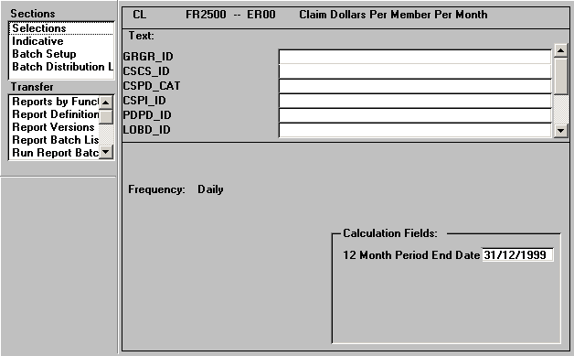
Claim Dollars Per Member Per Month - Input Parameters

Slide 106
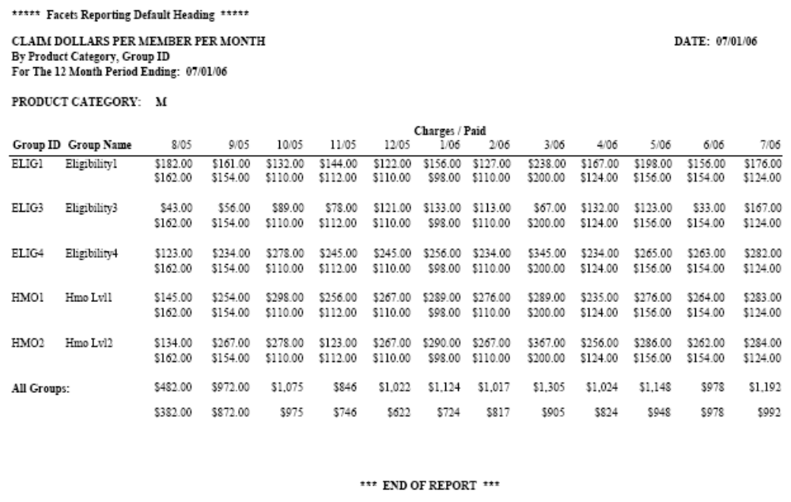
Claim Dollars Per Member Per Month – Report Output

Slide 107
Paid Claim Listing - Line of Business - Report Description
To provide detail information for each claim that was paid within a specified date range

Slide 108
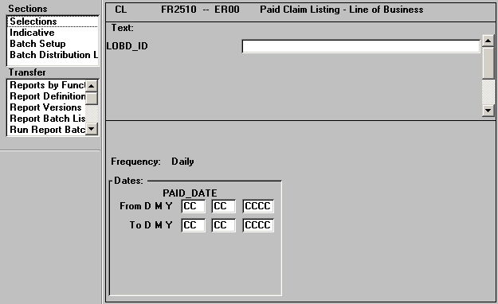
Paid Claim Listing - Line of Business - Input Parameters

Slide 109
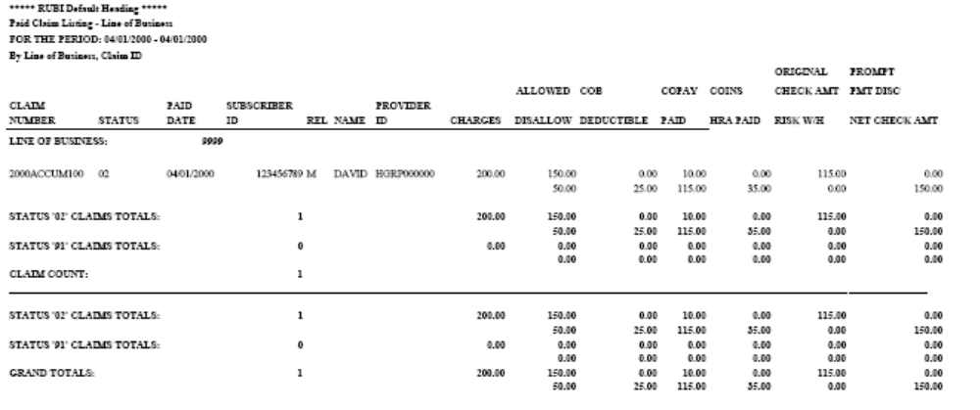
Paid Claim Listing - Line of Business – Report Output

Slide 110
Paid Claim Listing - Group - Report Description
To provide detail information for each claim that was paid within a specified date range.
This report is the same as FR2510, except it is sorted by Group, not Line of Business

Slide 111
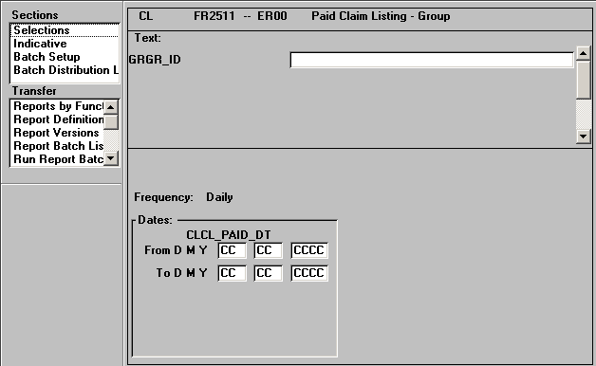
Paid Claim Listing – Group - Input Parameters

Slide 112
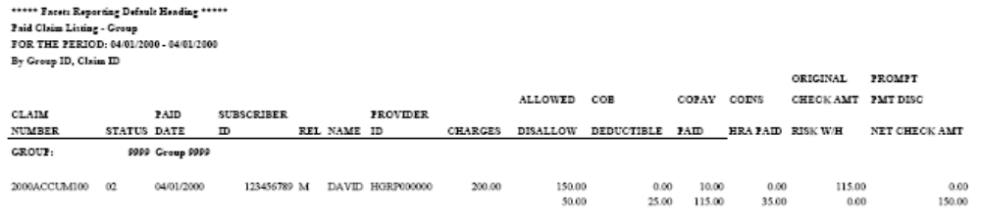
Paid Claim Listing - Group – Report Output

Slide 113
Summary of Paid Claims - Line of Business - Report Description
This report provides a summary of paid claims including the number of providers and claims paid as well as dollar amounts for the claims by Line of Business

Slide 114
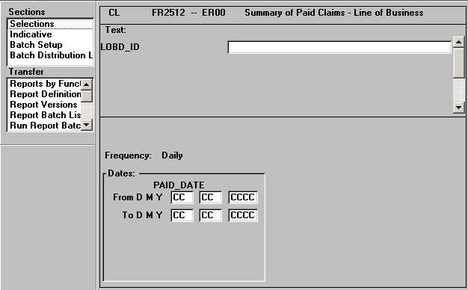
Summary of Paid Claims - Line of Business - Input Parameters

Slide 115
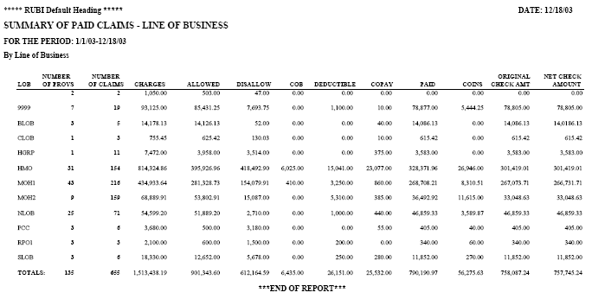
Summary of Paid Claims - Line of Business – Report Output

Slide 116
Summary of Paid Claims - Group - Report Description
This report provides a summary of paid claims including the number of providers and claims paid as well as dollar amounts for the claims by Group

Slide 117
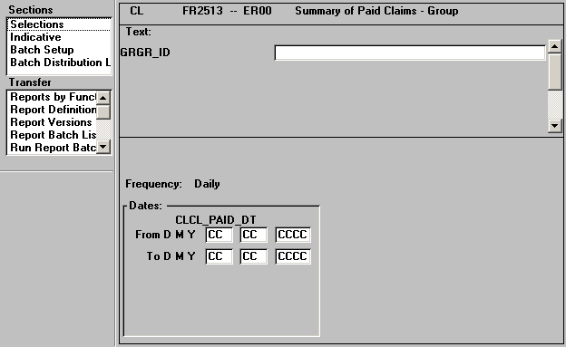
Summary of Paid Claims - Group - Input Parameters

Slide 118
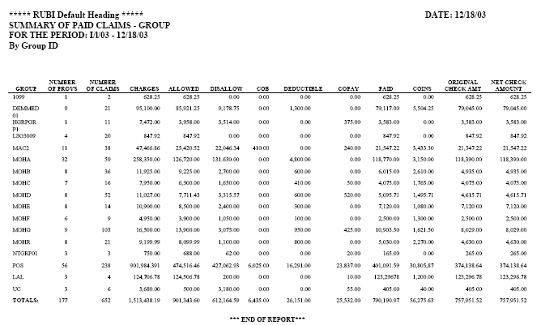
Summary of Paid Claims - Group – Report Output

Slide 119
Dental Paid Claim Listing – Group - Report Description
This report provides detailed financial information on dental claims which have been paid during a specific time period including : allowed, disallowed, copay and coinsurance amounts

Slide 120

Dental Paid Claim Listing – Group - Input Parameters

Slide 121
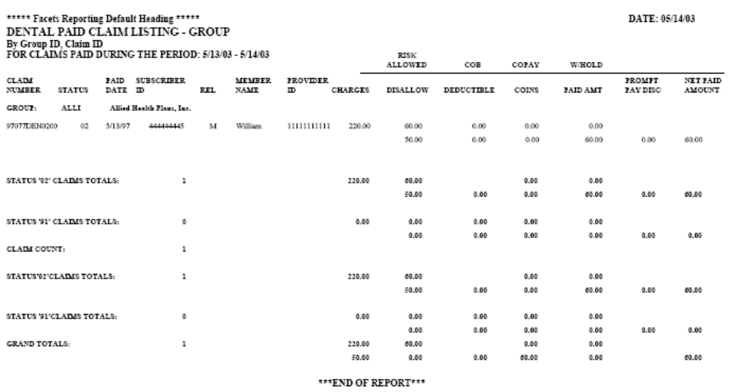
Dental Paid Claim Listing – Group – Report Output

Slide 122
Summary of Paid Dental Claims - Group- Report Description
This report summarizes the detailed service line information from FR2514 and includes the total number of providers and total number of claims

Slide 123
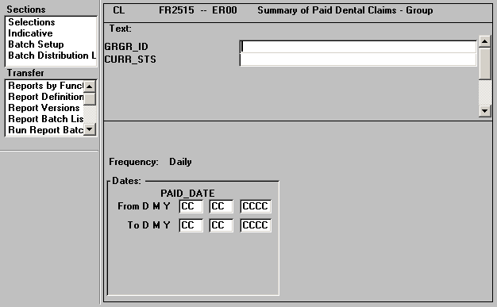
Summary of Paid Dental Claims – Group - Input Parameters

Slide 124
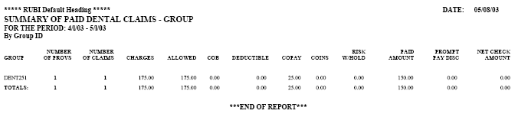
Summary of Paid Dental Claims - Group- Report Output

Slide 125
Claim Lag Report - Medical - Group- Report Description
This report provides the dollar amounts by month/year incurred and month/year paid and claim counts by month/year paid for claims paid in the previous 12 months from specified date

Slide 126
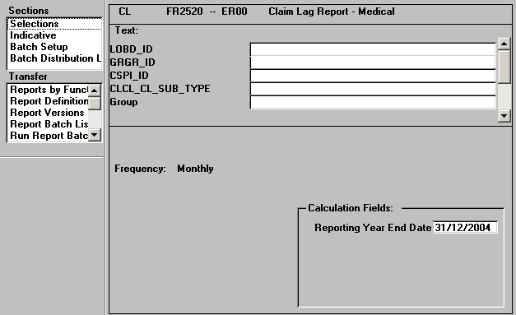
Claim Lag Report – Medical - Input Parameters

Slide 127
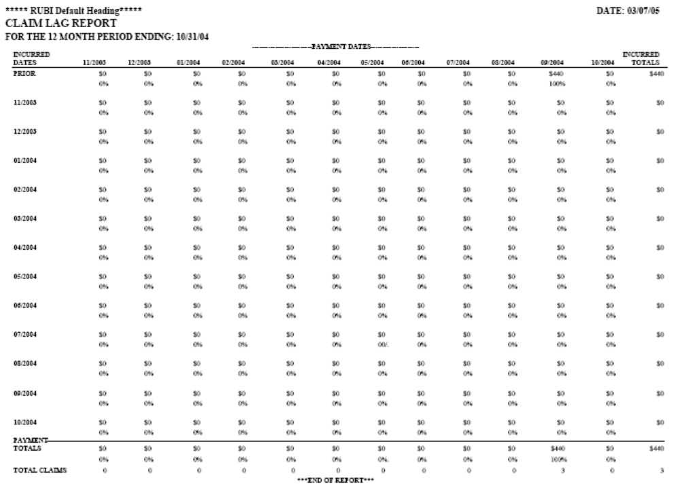
Claim Lag Report - Medical - Group- Report Output

Slide 128
Claim Lag Report – Dental – Group - Report Description
This report provides the dollar amounts by month/year incurred and month/year paid and dental claim counts by month/year paid for dental claims paid in the previous 12 months from specified date

Slide 129
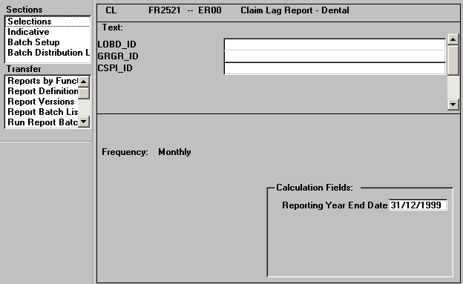
Claim Lag Report – Dental - Input Parameters

Slide 130
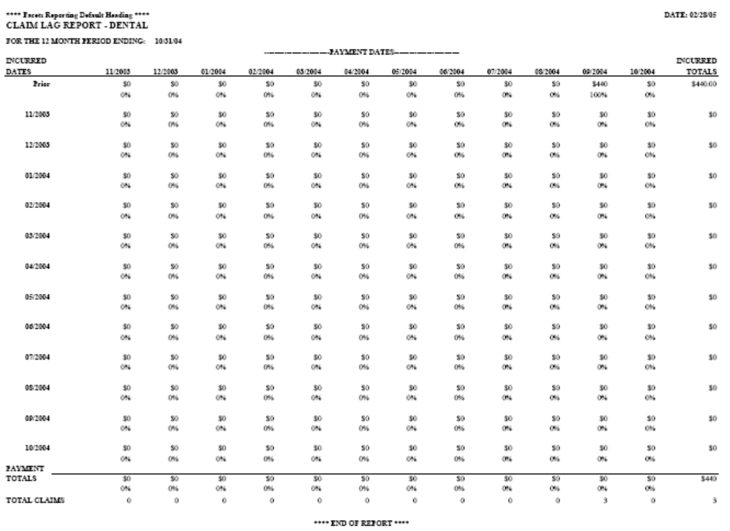
Claim Lag Report – Dental – Group – Report Output

Slide 131
Claim Turnaround Report - Summary - Report Description
To provide a summary of claim processing turnaround for claims paid within a specified period

Slide 132
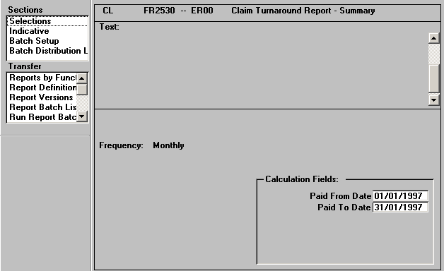
Claim Turnaround Report – Summary - Input Parameters

Slide 133
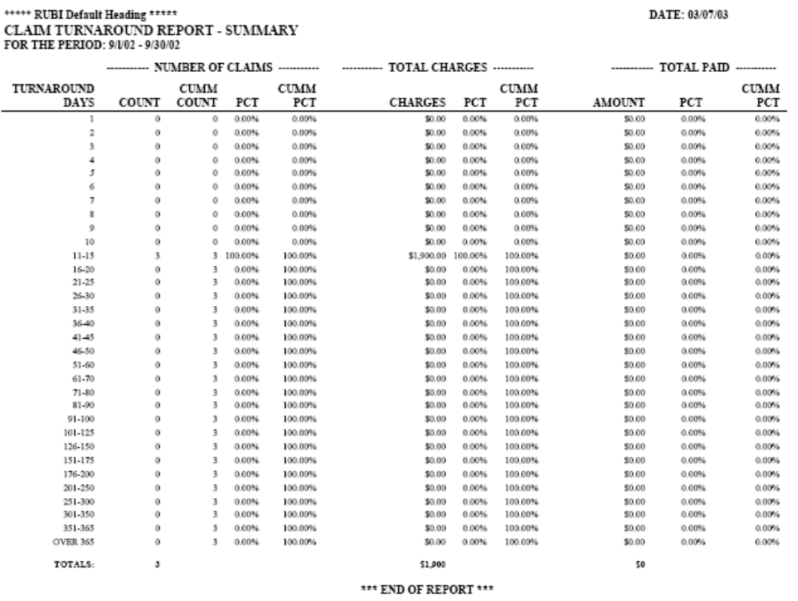
Claim Turnaround Report - Summary – Report Output

Slide 134
Claim Turnaround Report - Detail/>= 60 Days - Report Description
To provide a detail list of claims that were paid within a specified number of days.
Turnaround days represent the number of days between the received and paid dates

Slide 135
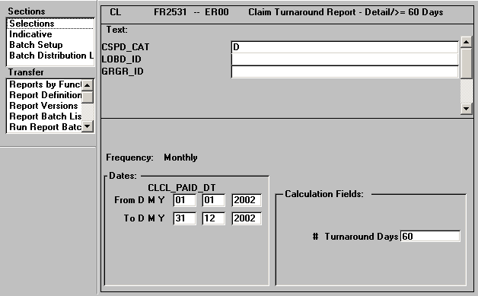
Claim Turnaround Report - Detail/>= 60 Days - Input Parameters

Slide 136
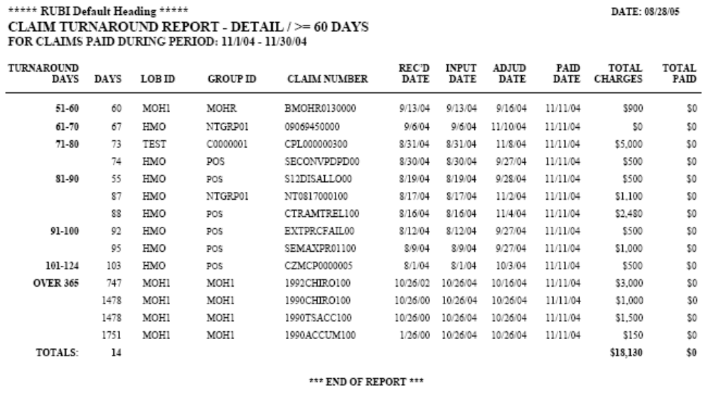
Claim Turnaround Report - Detail/>= 60 Days – Report Output

Slide 137
COB Savings Report - Report Description
Allow for review of COB dollars compared to submitted charges for a user defined period of time

Slide 138
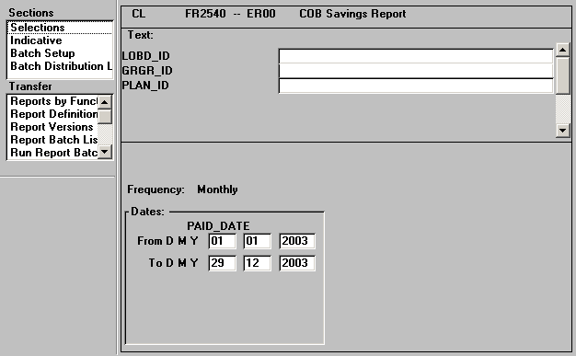
COB Savings Report - Input Parameters

Slide 139
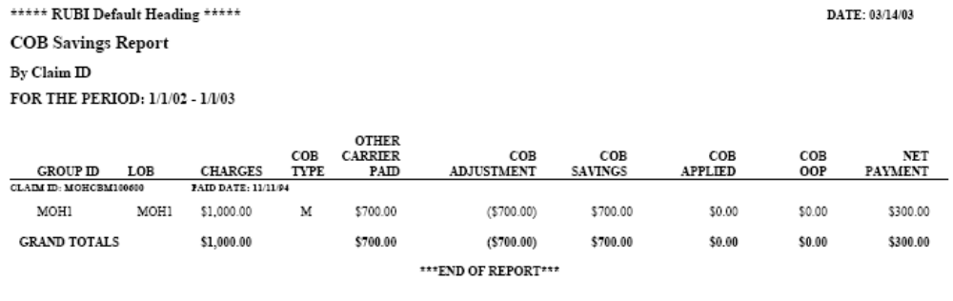
COB Savings Report – Report Output

Slide 140
COB Savings Report – Dental - Report Description
Allow for review of dental COB dollars compared to submitted charges for a user defined period of time

Slide 141
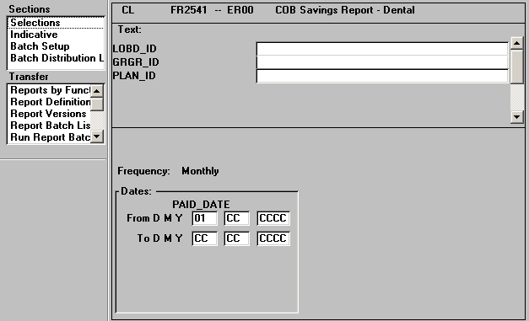
COB Savings Report – Dental - Input Parameters

Slide 142
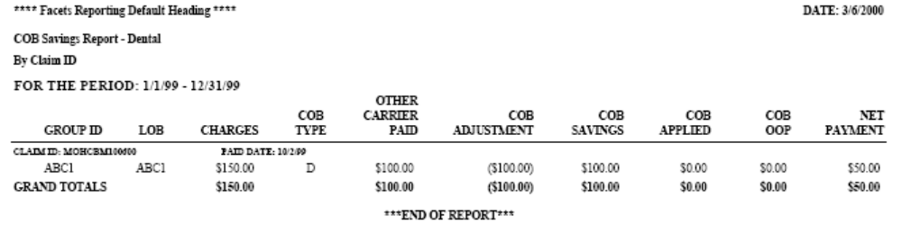
COB Savings Report – Dental – Report Output

Slide 143
Pended Claim Log - Report Description
To track the status of pended claims

Slide 144
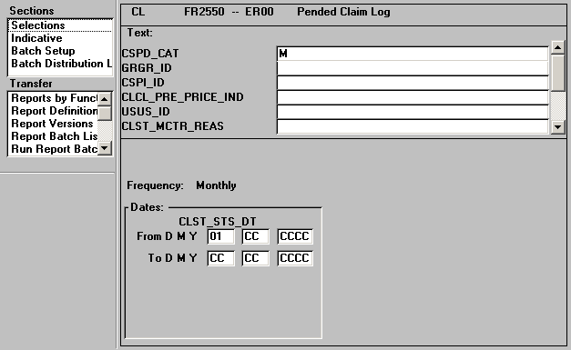
Pended Claim Log - Input Parameters

Slide 145
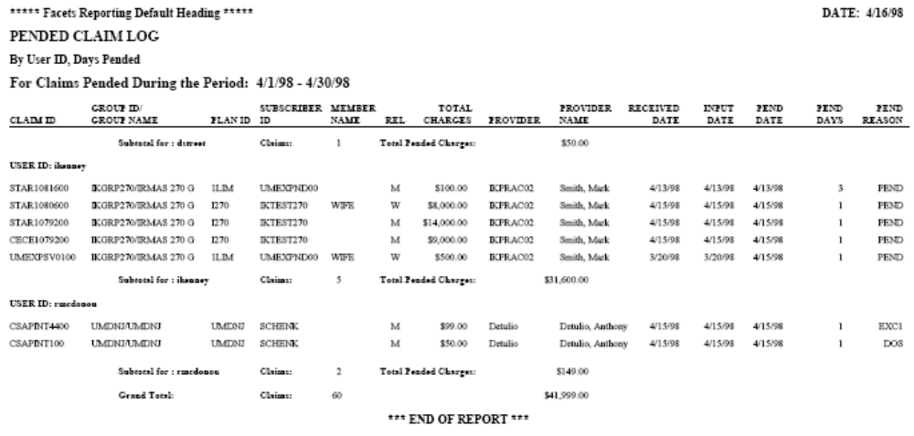
Pended Claim Log – Report Output

Slide 146
Pended Archive Claim Register - Report Description
This report identifies claims that have been selected for archiving based upon the chosen parameters defined within the .ini file. It generates a list of claims pending final archiving. This information is captured prior to the completion of the actual archive and removal of claims from the online database. It allows you to determine whether to continue with the archiving process, and serves as a point of reference if selected claims are indeed archived.

Slide 147
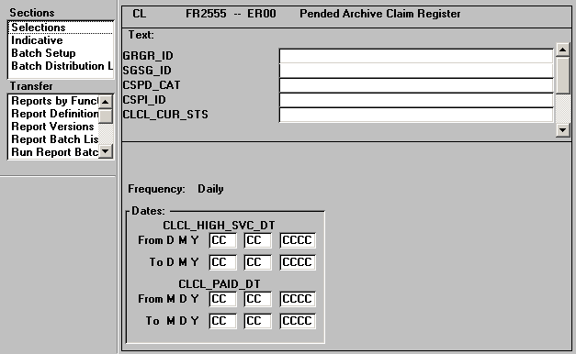
Pended Archive Claim Register - Input Parameters

Slide 148
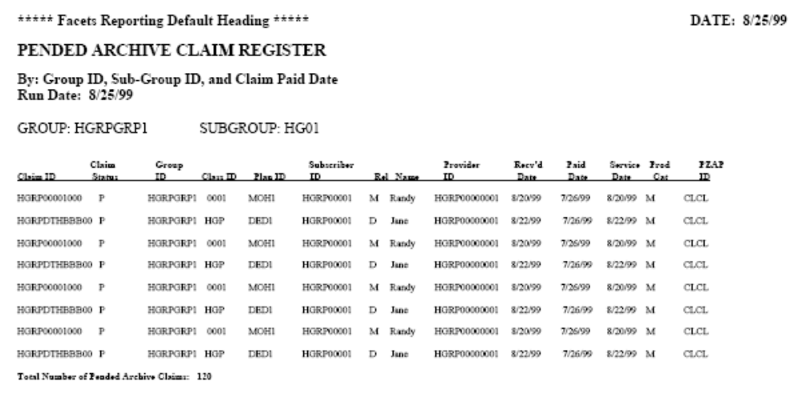
Pended Archive Claim Register – Report Output

Slide 149
Logged Claims Register - Report Description
Track claims that have been received and logged into the system but not processed

Slide 150
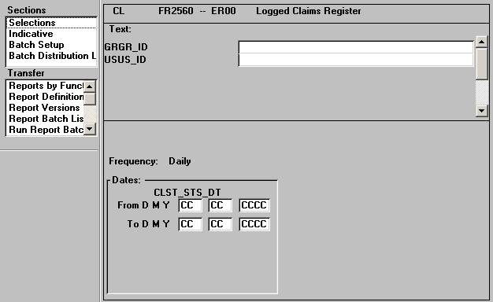
Logged Claims Register - Input Parameters

Slide 151
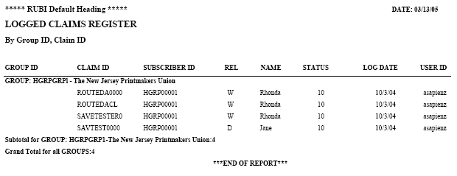
Logged Claims Register – Report Output

Slide 152
Productivity Register - Report Description
Used to evaluate claim processor performance by tracking claims processed

Slide 153
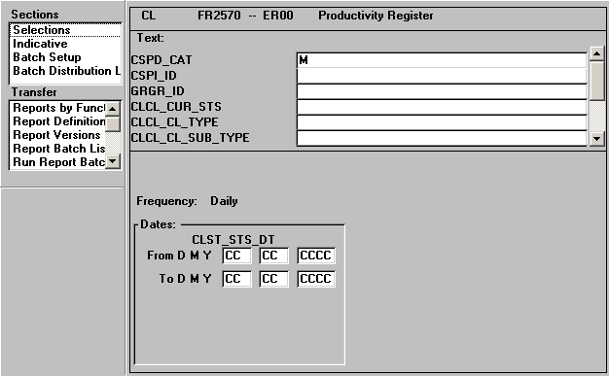
Productivity Register - Input Parameters

Slide 154
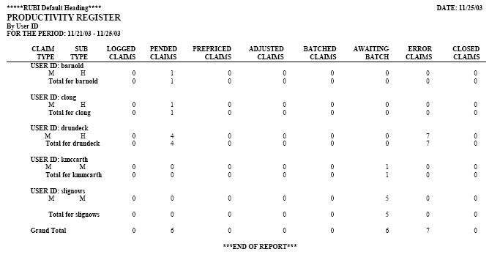
Productivity Register – Report Output

Slide 155
Closed Out Claim Listing - Report Description
To provide a summary list of claim information for all claims that were closed out with a status codes of 93 and/or 99 within a specified period

Slide 156
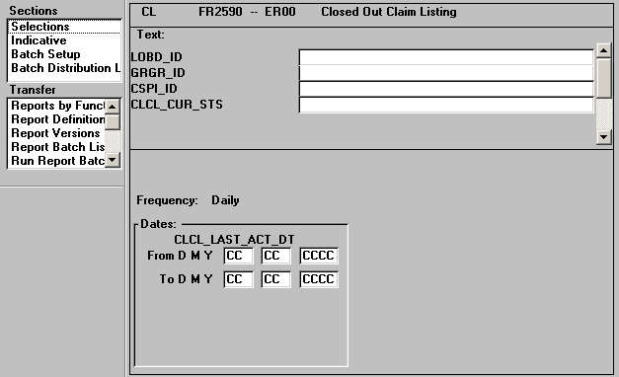
Closed Out Claim Listing - Input Parameters

Slide 157
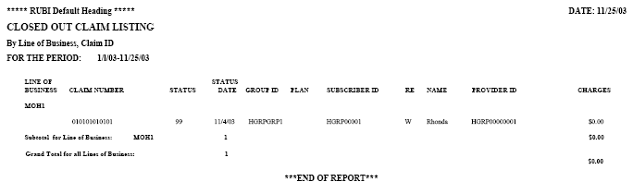
Closed Out Claim Listing – Report Output

Slide 158
FSA Paid Claim Listing - Group- Report Description
To provide detail information for each FSA claim that was paid within a specified date range.

Slide 159
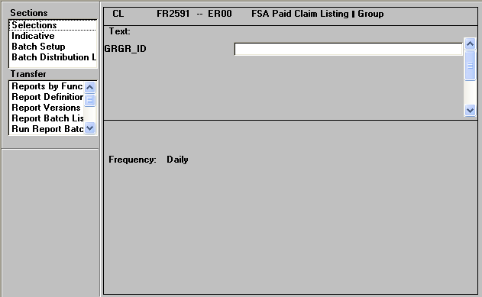
FSA Paid Claim Listing – Group - Input Parameters

Slide 160
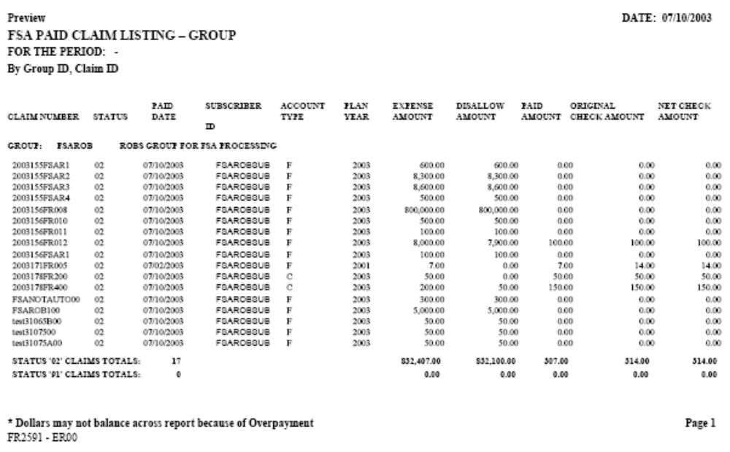
FSA Paid Claim Listing - Group- Report Output

Slide 161
Utilization By Service Code - Report Description
To provide cost and utilization information by service code

Slide 162
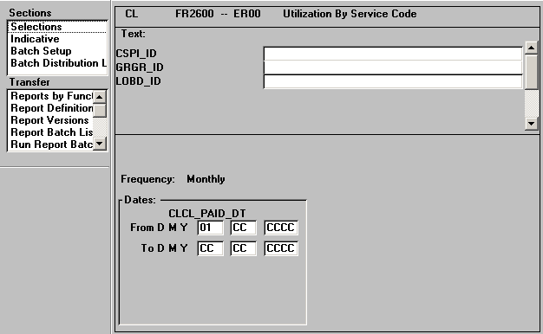
Utilization By Service Code - Input Parameters

Slide 163
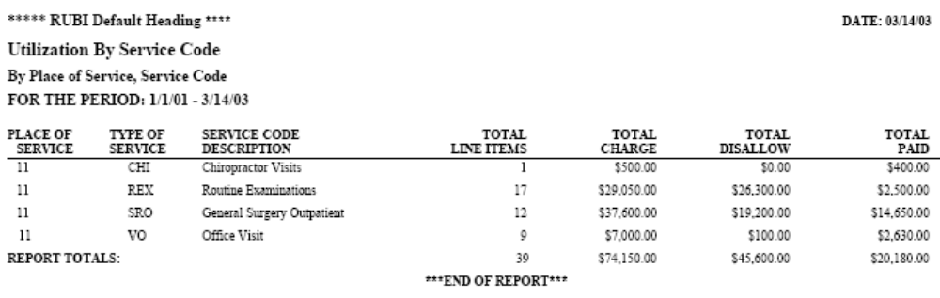
Utilization By Service Code – Report Output

Slide 164
Utilization By Dental Service Code - Report Description
This report provides total changes disallowed and paid amounts for each dental service code

Slide 165
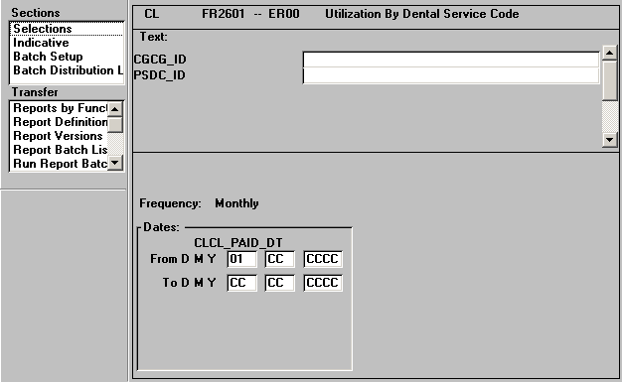
Utilization By Dental Service Code - Input Parameters

Slide 166
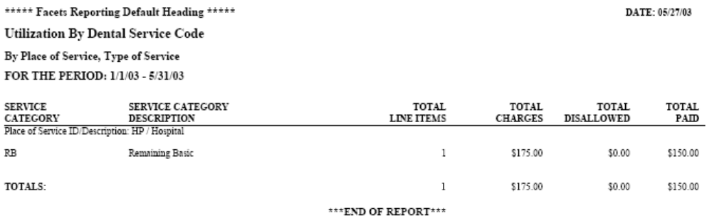
Utilization By Dental Service Code – Report Output

Slide 167
Top 10 Procedures by Highest Charges - Report Description
This report is used to examine CPT4 procedure codes by highest total cost

Slide 168
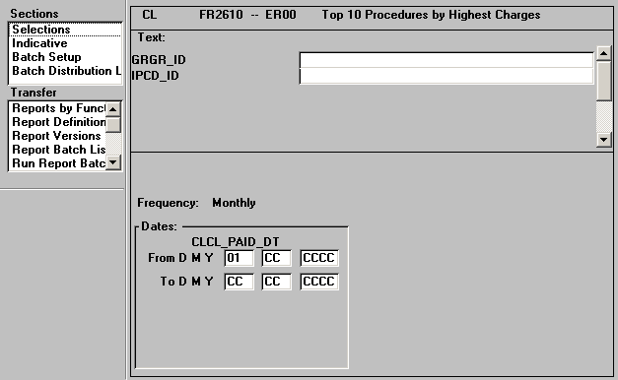
Top 10 Procedures by Highest Charges - Input Parameters

Slide 169
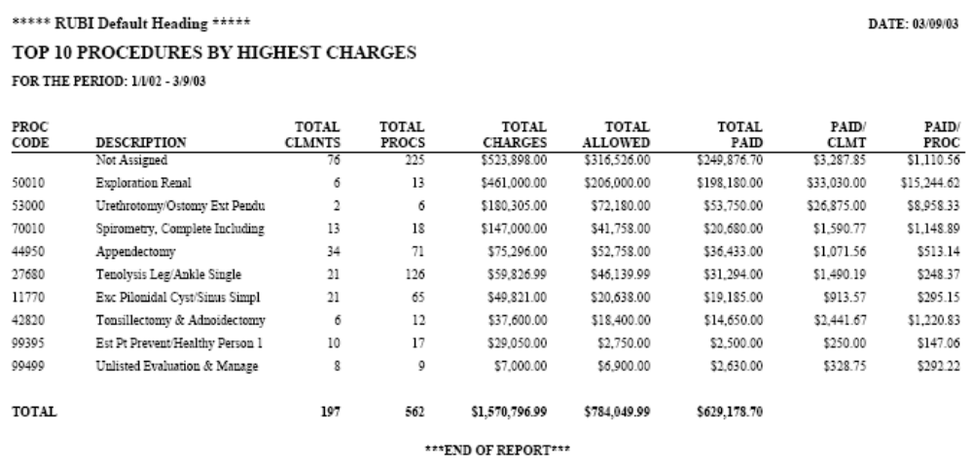
Top 10 Procedures by Highest Charges – Report Output

Slide 170
Top 10 Procedures by Highest Claimants - Report Description
This report is used to examine the CPT4 procedure codes responsible for the highest utilization represented by number of claimants

Slide 171
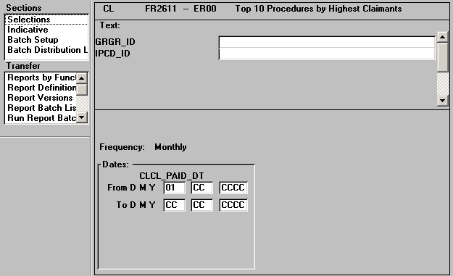
Top 10 Procedures by Highest Claimants - Input Parameters

Slide 172
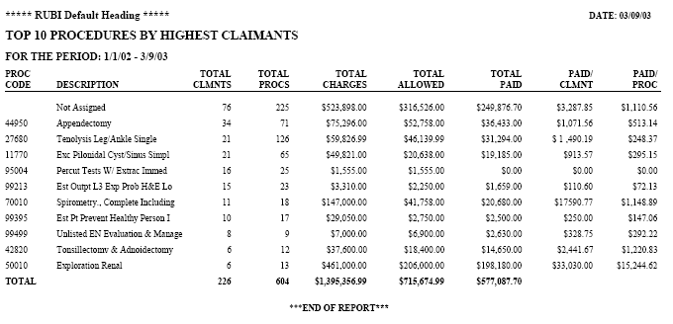
Top 10 Procedures by Highest Claimants – Report Output

Slide 173
Top 10 Diagnoses by Highest Charges - Report Description
This report is used to examine the experience of ICD9 diagnosis codes by highest total charges

Slide 174
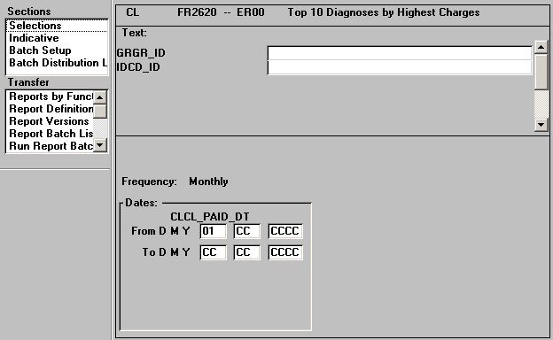
Top 10 Diagnoses by Highest Charges - Input Parameters

Slide 175
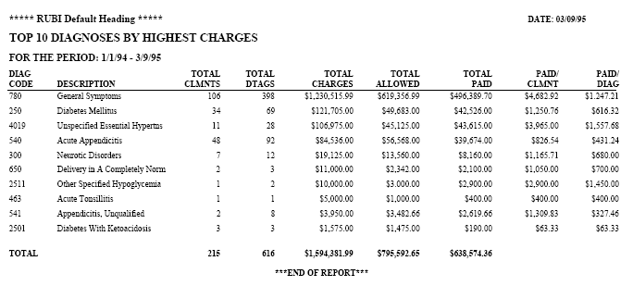
Top 10 Diagnoses by Highest Charges – Report Output

Slide 176
Top 10 Diagnoses by Highest Claimants - Report Description
This report can be used to examine ICD9 diagnosis codes by highest total claimants

Slide 177
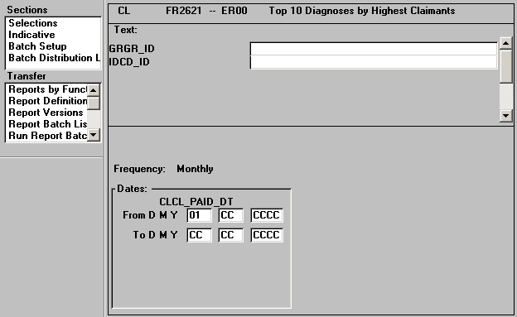
Top 10 Diagnoses by Highest Claimants - Input Parameters

Slide 178
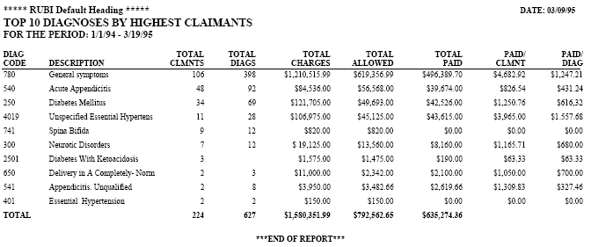
Top 10 Diagnoses by Highest Claimants – Report Output

Slide 179
Top 10 Providers by Highest Dollars Paid - Report Description
To allow for the review of provider experience for those providers responsible for the highest dollars paid

Slide 180
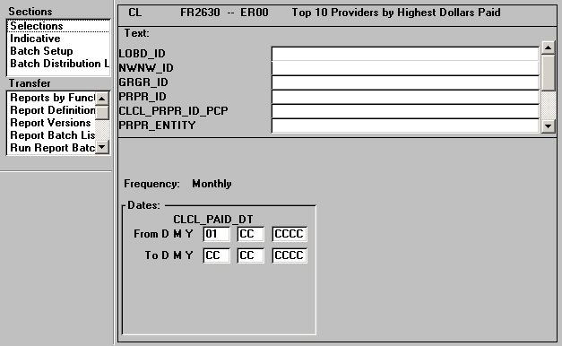
Top 10 Providers by Highest Dollars Paid - Input Parameters

Slide 181

Top 10 Providers by Highest Dollars Paid – Report Output

Slide 182
Top 10 Providers by Highest Dollars Paid – Dental - Report Description
To allow for the review of provider experience for those dental providers responsible for the highest dollars paid

Slide 183

Top 10 Providers by Highest Dollars Paid – Dental - Input Parameters

Slide 184

Top 10 Providers by Highest Dollars Paid – Dental – Report
Output

Slide 185
Confinement Utilization by Admission Type - Report Description
This report uses hospital stay data to summarize utilization and cost information including number of admits, bed days, charges and benefits by type of admission.
This report can facilitate inpatient cost and utilization analysis

Slide 186

Confinement Utilization by Admission Type - Input Parameters

Slide 187

Confinement Utilization by Admission Type – Report Output

Slide 188
Confinement Utilization by Admission Type - Report Description
This report uses hospital stay data to track the number of admissions and bed days and the rate per 1,000 covered lives.
The per 1,000 calculation is derived from the Member Months Table

Slide 189

Confinement Utilization by Admission Type - Input Parameters

Slide 190

Confinement Utilization by Admission Type – Report Output

Slide 191
Disallow Report - Line Summary - Report Description
Used to examine the types and volume of disallowed dollars by disallow reason for a group

Slide 192

Disallow Report - Line Summary - Input Parameters

Slide 193

Disallow Report - Line Summary – Report Output

Slide 194
Line Item Savings Report - Report Description
This report can be used to track total savings for line items where pricing was used.
Savings are presented by type of pricing used

Slide 195

Line Item Savings Report - Input Parameters

Slide 196

Line Item Savings Report – Report Output

Slide 197
Disallow Report - Line Detail - Report Description
This report provides detailed information on disallows taken at the line item level to allow for analysis of type and amount of disallows

Slide 198

Disallow Report - Line Detail - Input Parameters

Slide 199

Disallow Report - Line Detail – Report Output

Slide 200
Disallow Report - Line Detail – Dental - Report Description
This report provides detailed information on dental claim disallows taken at the line item level to allow for analysis of type and amount of disallows

Slide 201

Disallow Report - Line Detail – Dental - Input Parameters

Slide 202

Disallow Report - Line Detail – Dental – Report Output

Slide 203
Risk Withhold Summary by Provider - Report Description
To analyze dollar amounts withheld from paid claims by network and provider for a user specified period of time

Slide 204

Risk Withhold Summary by Provider - Input Parameters

Slide 205

Risk Withhold Summary by Provider – Report Output

Slide 206
Member Utilization Past Termination Date - Report Description
This report provides a list of claims for members who had claim paid after a termination date.
This can be utilized to determine whether members who are retroactively terminated had any claims activity

Slide 207

Member Utilization Past Termination Date - Input Parameters

Slide 208

Member Utilization Past Termination Date – Report Output

Slide 209
Archive Claim Register - Report Description
This report identifies claims that have been archived based upon the chosen parameters defined within the .ini file. It allows you to track those claims that have been removed from the database.

Slide 210

Archive Claim Register - Input Parameters

Slide 211

Archive Claim Register – Report Output

Slide 212
Clinical Edit - Provider Activity - Report Description
This report provides summary information by provider on the types of billing edits done.
It can be used by management and provider relations to evaluate provider billing practice patterns.
This report may be sent to Networks or employer groups.
Only non-format change claims are included

Slide 213

Clinical Edit - Provider Activity - Input Parameters

Slide 214

Clinical Edit - Provider Activity – Report Output

Slide 215
Clinical Edit - Provider Activity - Format Changes - Report Description
This report provides summary information by provider on billing edits performed.
This report is used by management and provider relations to evaluate provider billing practice patterns.
This report may be sent to Networks or employer groups.
Only claims with format changes are included.

Slide 216

Clinical Edit - Provider Activity - Format Changes - Input Parameters

Slide 217

Clinical Edit - Provider Activity - Format Changes – Report
Output

Slide 218
Clinical Edit - Calculated Savings - Report Description
This report provides users with a breakdown of calculated savings that resulted from editing claims for providers with aberrant billing practices.
Only non-format changed claims are included in this report.

Slide 219

Clinical Edit - Calculated Savings - Input Parameters

Slide 220

Clinical Edit - Calculated Savings – Report output

Slide 221
Clinical Edit - Calculated Savings - Format Changes - Report Description
This report provides users with a breakdown of calculated savings for a group, plan, network that resulted from editing claims for providers with aberrant billing practices.
Only claims with format changes are included in this report.

Slide 222

Clinical Edit - Calculated Savings - Format Changes - Input Parameters

Slide 223

Clinical Edit - Calculated Savings - Format Changes – Report
Output

Slide 224
Electronic Adjudication - Pended Error Register - Report Description
To allow users to identify the reasons for claims erroring during the electronic adjudication process.
This information can be used to review claims and make corrections prior to resubmitting.

Slide 225

Electronic Adjudication - Pended Error Register - Input Parameters

Slide 226

Electronic Adjudication - Pended Error Register – Report Output

Slide 227
ITS Electronic Adjudication - Pended Error Register - Report Description
This report is used to identify the reason for pend in electronic adjudication.
The information can be used to reroute the claims to appropriate personnel for review

Slide 228

ITS Electronic Adjudication - Pended Error Register - Input Parameters

Slide 229
ITS Electronic Adjudication - Pended Error Register – Report
Output
Sample report not available

Slide 230
Electronic Adjudication - Exception Register - Report Description
This report is used to identify the reason for pend in electronic adjudication. The information can be used to reroute the claims to appropriate personnel for review and/or completion

Slide 231

Electronic Adjudication - Exception Register - Input Parameters

Slide 232

Electronic Adjudication - Exception Register – Report Output

Slide 233
Electronic Adjudication - Exception Register – Security - Report Description
To allow users to review claims pended for security and global table pends and reroute claims where possible

Slide 234

Electronic Adjudication - Exception Register – Security - Input Parameters

Slide 235

Electronic Adjudication - Exception Register – Security – Report
Output

Slide 236
Electronic Adjudication - Critical Error Register - Report Description
Allows users to review those claims that have critical errors causing them not to be converted to a Facets claim record for electronic adjudication

Slide 237

Electronic Adjudication - Critical Error Register - Input Parameters

Slide 238

Electronic Adjudication - Critical Error Register – Report Output

Slide 239
Pre Priced Claim Savings by Type of Service - Report Description
Summary listing of charge, priced amount and calculated savings for all claims that were pre-priced within a user specified time period

Slide 240

Pre Priced Claim Savings by Type of Service - Input Parameters

Slide 241

Pre Priced Claim Savings by Type of Service – Report Output

Slide 242
Pre Priced Claim Listing - Report Description
Detail listing of charge, priced amount and savings for all pre-priced claims processed in a user specified time period.

Slide 243

Pre Priced Claim Listing - Input Parameters

Slide 244

Pre Priced Claim Listing – Report Output

Slide 245
Pre Priced Hospital Claim Output - Report Description
Formatted claim output for pre-priced hospital claims which can be used to send to the payor.
Detail information including descriptions are included.

Slide 246

Pre Priced Hospital Claim Output - Input Parameters

Slide 247

Pre Priced Hospital Claim Output – Report Output

Slide 248
Pre Priced Medical Claim Output- Report Description
Formatted claim output for pre-priced medical claims which can be used to send to the payor.
Detail information includingdescriptions are included with a pre-priced indicator of 'P'.

Slide 249

Pre Priced Medical Claim Output- Input Parameters

Slide 250

Pre Priced Medical Claim Output- Report Output

Slide 251
THANK YOU

