Slide 1

Facets
Claims Processing

Slide 2
Agenda:
1. Facets - Overview
2. Key Terms
3. Claims Processing
4. Modules in Claims Processing
5. Databases - Tables
6. Sample Report

Slide 3
1. Facets - Overview
Facets is an integrated health care management system designed to handle the
complex requirements of managed care programs.
Facets Addresses to the needs of
Health Maintenance Organizations
Preferred Provider Organizations
Physician Hospital Organizations
Insurance Carriers
Third Party Administrators

Slide 4
Facets is a modular system
Facets is a modular system, allowing
customers to use Facets’ base components
or modules and optionally select
additional components to meet their key
business requirements.

Slide 5
Facets Modules
Accounting
Application support
Customer Service
Dental and Medical plans
Dental and Medical provider agreements
Pricing Profile
Provider
Subscriber/Member.

Slide 6
Facets Modules - Optional
Billing
Capitation
Claims Processing
Commission
Criteria Maintenance
Utilization Management

Slide 7
Facets also offers electronic commerce
1. Electronic Data Interchange
EDI - automates standard transactions such as claims processing
2. eFacets
eFacets - provides authorized individuals access to information such as member eligibility, claim status, referrals and pre-authorizations, and physician
directories

Slide 8
Claims
Information submitted by a provider or covered person to establish that medical services were provided to a covered person, from which processing for payment to the provider or covered person is made.
The term generally refers to the liability
for health care services received by covered persons.

Slide 9
COB
Coordination of Benefits. An agreement that prevents payment for services from exceeding 100% of the charge or 100% of the benefit when a member has cover-age from more than one source.
Co payment
The member is usually responsible for payment at the time the health care is rendered.
Typical co payments are fixed or variable flat amounts for physician office visits, prescriptions, or hospital services.

Slide 10
EOB
Explanation of Benefits (statement).
A statement received by a member or covered
insured explaining how and why a claim was or was not paid.
LOB
Line of Business. A health plan that is set up as a separate business within another organization, usually an insurance company.

Slide 11
LOS
Length of Stay. The number of days that a member stayed in an inpatient facility.
Member
A participant in a health plan (subscriber/enrollee or eligible dependent) who makes up the plan’s enrollment. Also used to describe an individual specified within a subscriber contract who may or may not receive health care services according to the terms of the subscriber policy.

Slide 12
PCP
Primary Care Physician. A physician the majority of whose practice is devoted to internal medicine, family/general practice, and pediatrics. An obstetrician/gynecologist may also be considered a primary care physician.
Practitioner
An individual who contracts with a managed care organization to provide health care services to enrollees of a health plan.
A practitioner can be a physician,
nurse, or any other individual licensed to practice the health care profession.

Slide 13
Subscriber
The person responsible for payment of premiums or whose employment is the basis for eligibility for membership in an HMO or other health plan..

Slide 14
Claims
FACETS offers a high degree of automation and data capture, and provides three options for claims management:
Claims adjudication
Claims pre-pricing
Claims logging.
Dental, medical, and hospital claims can be processed online or electronically.

Slide 15
Claims Processing
Every claim you process is automatically edited by Erisco’s proprietary clinical claims editing soft-ware, with tens of thousands of clinical rules and recommendations.
This allows you to consistently catch fraudulent, erroneous or inconsistent billing
practices.

Slide 16
Claims Processing
Following are the parameters used for Claims Processing.
member-ship eligibility
product benefits
provider pricing agreements
medical management requirements
clinical editing information

Slide 17
Claims Processing
Following are the parameters used for Claims Processing also.
Limits Deductibles
Co pays Revenue Code
Diagnosis codes Procedure Codes
Service based rules COB

Slide 18
Facets EDI - (Electronic data interchange)
Facets EDI, combined with Facets Electronic Adjudication, allows Managed Care Organizations (MCOs) to process more claims, faster and with a greater degree of accuracy when compared to the paper claim process.
Erisco has enabled Facets to accept EDI health care claims in one of three formats.
The 837 Health Care Claim Transaction Set
The National Standard Format (NSF)
The External Claim Format (XC)

Slide 19
Claims Adjudication
Electronic adjudication is the high-productivity method for paying claims.
All claims that are electronically adjudicated go
through a detailed series of edits before processing to ensure that claims with data entry errors, or incorrect or missing information, are not processed.

Slide 20
Claims Adjudication
Electronic Adjudication will also process claims entered through the on line Claims Electronic Log applications as well as pended claims that have been mass- released for re-adjudication.
The adjudication routines used to electronically process claims are exactly the same as those used in the on line applications.

Slide 21
Claims Pre-Pricing
Facets accommodates pre-pricing, which is frequently used by PPOs to provide claims payer organizations with information on negotiated provider price amounts without generating payment or updating benefit accumulators.
Pre-pricing allows you to access provider contracts for pricing allowables, validate claim data and verify membership status. It also provides extensive data storage on claims for reporting and communicating to payers.

Slide 22
Claims Logging
For high productivity, you can use data entry staff
to quickly log claims that can then be recalled
online to complete the adjudication process.

Slide 23
Facets Client 2.92 - Claims Processing
We have the following option for Claim Processing in Facets Client.
  Claims Inquiry application
  Dental Claims Logging application
  Dental Claims Processing application
  Dental Claim Line-Item History application
  External Claims Editing application
  Hospital Claims Logging application
  Hospital Claims Pre-Pricing application
  Hospital Claims Processing application

Slide 24
Facets Client 2.92 - Claims Processing - (CONTD).
We have the following option for Claim Processing in Facets Client
  Medical Claims Logging application
  Medical Claims Pre-Pricing application
  Medical Claims Processing application
  Payment Drag Override Processing application

Slide 25
Claims Inquiry application
The Claims Inquiry application allows you to run inquiries on medical, hospital and dental claims and review detailed information about these claims, including member and provider information, claim status, line item details, products and prefixes, disallow amounts, overrides, clinical edits, UM match details, batch messages and EDI information.
Dental Claims Logging application
The Dental Claims Logging application allows you to process dental claims

Slide 26
Dental Claims Processing application
The Dental Claims Processing application allows you to process dental claims.
Dental Claim Line-Item History application
The Dental Claim Line-item History application allows you to view a member's dental history.

Slide 27
External Claims Editing application
Open the External Claims Editing application to correct claims errors produced during the last batch run
Hospital Claims Electronic Logging application
Open these applications to log hospital claims.

Slide 28
Hospital Claims Pre-Pricing application
Open this application to pre-price hospital claims
Hospital Claims Processing application
Open this application to process hospital claims

Slide 29
Medical Claims Logging application
Open this application to log medical claims.
Medical Claims Pre-Pricing application
Open this applications to pre-price medical claims.

Slide 30
Medical Claims Processing application
Open this application to process medical claims
Payment Drag Override Processing application
The Payment Drag Override Processing application allows you to update claims that have been kept pending . You can update Medical, Hospital and Dental claims

Slide 31
Facets Database
Database
Facets 2.95 uses Sybase 11.92 / MS SQL Server 7.0 as the backend.
The system uses two databases:
      Facets database
      XC External Claims database.
The Facets database comprises of over 705 tables
The XC database comprises of 46 tables.
The system consists of nearly 9098 stored procedures.

Slide 32
Facets Database
Tables - Naming Convention
  System Tables - Prefix by CER_
  Application Tables - Prefix by CMC_
  Reporting tables - Prefix by CDS_
  Virtual Tables – Suffix by _V

Slide 33
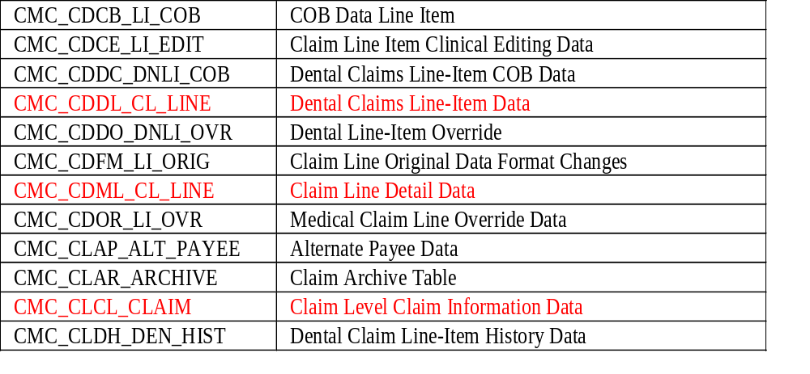
Facets Database
Following are Tables Related to Claims

Slide 34
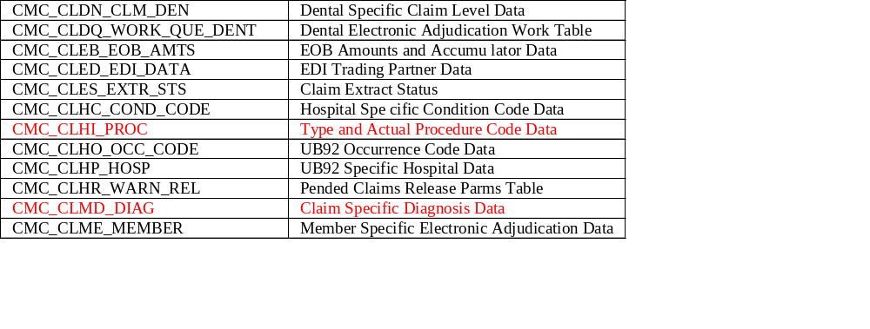
Facets Database
Following are Tables Related to Claims

Slide 35
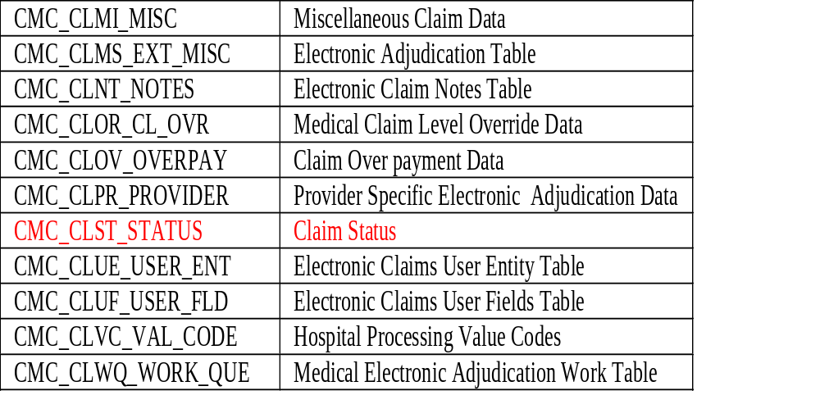
Facets Database
Following are Tables Related to Claims

Slide 36


Slide 37
Sample Report
Paid Claims By Group
This report lists the total paid claims for each sub-group
within a user-specified group for a specified date range
and product category.
Input Parameters
Payor Name Business Category
Paid Date Group
Product Category
Report Fields
Sub Group Contrived Key
Amount

