Slide 1


PSG COLLEGE OF TECHNOLOGY Department of Electrical And Electronics Engineering M.E – APPLIED ELECTRONICS
15EA72 – PROJECT WORK II
Object Recognition and Collision Avoidance by Vehicle Using Deep Learning CNN Algorithm
PRESENTED BY External Guide GUIDED BY
Aiswarya Devi R S Mr.Shanthosh Mishra Dr.Ila Vennila 17MR01 Felskinn solutins private LTD Professor ,EEE department
PRESENTATION 1
DATE:11-04-2019

Slide 2
Table of contents
ADAS
OBJECTIVE
PROPOSED METHOD
BLOCK DIAGRRAM
FLOW DIAGRAM
DEEP LEARNING CNN ALGORITHM
SOFTWARE USED
PACKAGES INSTALLED
INPUT
OUTPUT
REFERENCES

Slide 3
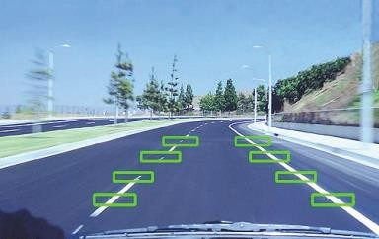
Advanced Driver Assistance Systems
ADAS are systems that support the driver in her/his task of driving a vehicle in order to increase safety, efficiency and comfort.
Examples:
Electronic Stability Control (ESC)
Adaptive Cruise Control (ACC)
Lane Departure Warning (LDW)

Slide 4
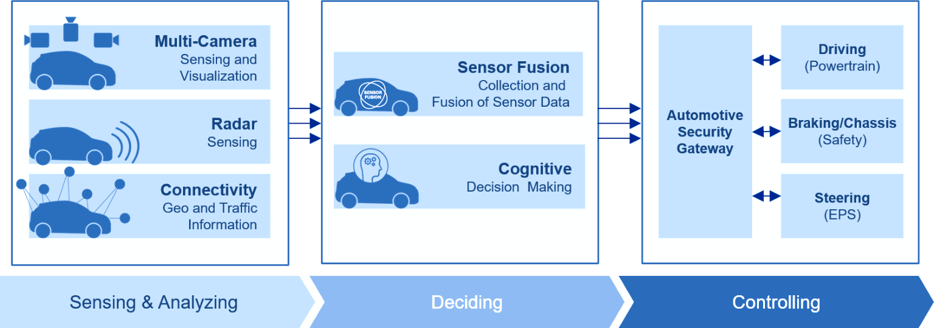
Basic Block Diagram

Slide 5
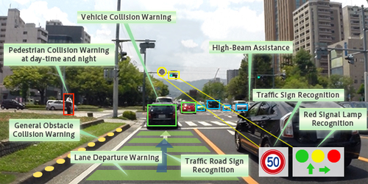
Objectives
The system is used as one of the features in vehicle Advance Driver Assistance System for Collision Avoidance by detecting and classifying the objects such as Vehicles and Pedestrian. Object detection technology is to detect the specific location and size of a particular object in a database of image or a video scene.
Main task :
Object Detections and Recognitions
It should also able to complete these task :
Barricade Detections
Night Visions Capability
Objects in Indian Road like vehicles,
Human, animals etc
Alert systems object Detections
Implementations

Slide 6
PROPOSED METHOD
In this proposed method , which mainly used with the deep learning convolution neural network (cnn) algorithm.
Deep learning cnn algorithm which process the image and used to identify and classify the object .
The code is written using python language.
It is controlled using raspberry pi controller.
Notes:
.

Slide 7
BLOCK DIAGRAM
INPUT IMAGE
IMAGE PREPROCESSING
RASPBERRY PI
OBJECT DETECTION
ALERT MESSAGE
OBJECT REGONISATION
CREATING BOUNDING BOX

Slide 8
WORK FLOW
Start
Adjustment parameter
Initialize
Whether the training times acheved
no
Start training
yes
Import sample data
Import training data
Cnn algorithm
Cnn algorithm
Output object regonisation
Calculate error
End

Slide 9

PYTHON
Python is an interpreted, object-oriented, high-level programming language with dynamic semantics. Python's simple, easy to learn syntax emphasizes readability and therefore reduces the cost of program maintenance
Features:
Easy-to-learn
Easy-to-read
Easy-to- maintain
A broad standard library
Portable Extendable
GUI Programming

Slide 10
MACHINE LEARNING
Machine learning is a field of computer science that gives computers the ability to learn without being explicitly programmed.
Most machine learning methods work well because of human-designed representations and input features
ML becomes just optimizing weights to best make a final prediction

Slide 11
Block diagram for Machine learning algorithm
Labeled Data
Machine Learning algorithm
Training
Prediction
Learned model
Labeled Data
Prediction

Slide 12
Types of Learning
Supervised: Learning with a labeled training set Example: email classification with already labeled emails
Unsupervised: Discover patterns in unlabeled data Example: cluster similar documents based on text
Reinforcement learning: learn to act based on feedback/reward Example: learn to play Go, reward: win or lose

Slide 13
DEEP LEARNING
Deep learning is a subset of machine learning in Artificial Intelligence (AI) that has networks capable of learning unsupervised from data that is unstructured or unlabeled. Also known as Deep Neural Learning or Deep Neural Network.
Applications :
Colorization of Black and White Images.
Adding Sounds To Silent Movies.
Automatic Machine Translation.
Object Classification in Photographs.
Automatic Handwriting Generation.
Character Text Generation.
Image Caption Generation

Slide 14
Deep Learning
A machine learning subfield of learning representations of data. Exceptional effective at learning patterns.
Deep learning algorithms attempt to learn (multiple levels of) representation by using a hierarchy of multiple layers
If you provide the system tons of information, it begins to understand it and respond in useful ways.

Slide 15
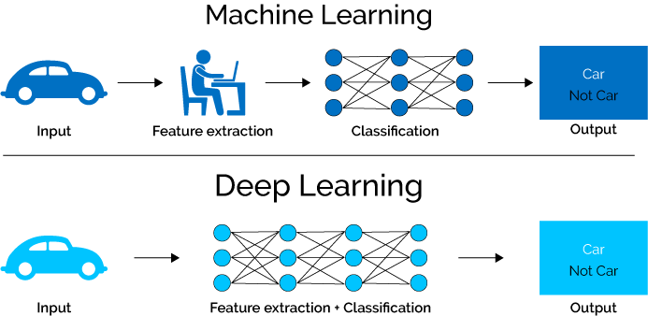
Machine Learning Vs Deep Learning

Slide 16
Advantages of Deep Learning
Manually designed features are often over-specified, incomplete and take a long time to design and validate
Learned Features are easy to adapt, fast to learn
Deep learning provides a very flexible, (almost?) universal, learnable framework for representing world, visual and linguistic information.
Can learn both unsupervised and supervised
Effective end-to-end joint system learning
Utilize large amounts of training data

Slide 17
Neural network
Is a machine learning algorithm, which is built on the principle of the organization and functioning of biological neural networks.
Neural networks consist of individual units called neurons. Neurons are located in a series of groups.
Data comes from the input layer to the output layer along these compounds.

Slide 18
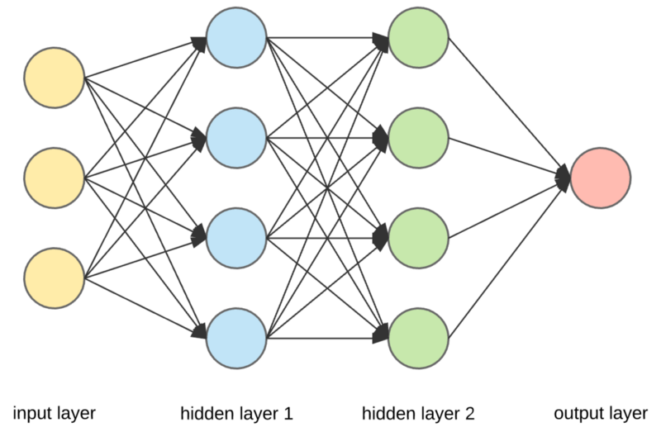
Block Diagram of Neural Networks

Slide 19
DEEP LEARNING CNN ALGORITHM
In neural networks, Convolutional neural network (ConvNets or CNNs) is one of the main categories to do images recognition, images classifications.
Objects detections, recognition faces etc., are some of the areas where CNNs are widely used.
CNN image classifications takes an input image, process it and classify it under certain categories (Eg., Dog, Cat, Tiger, Lion).
Computers sees an input image as array of pixels and it depends on the image resolution.
Based on the image resolution, it will see h x w x d( h = Height, w = Width, d = Dimension ). Eg., An image of 6 x 6 x 3 array of matrix of RGB (3 refers to RGB values)

Slide 20
The Convolution layer is always the first. The image (matrix with pixel values) is entered into it. Imagine that the reading of the input matrix begins at the top left of image.
Next the software selects a smaller matrix there, which is called a filter (or neuron, or core).
Then the filter produces convolution, i.e. moves along the input image. The filter’s task is to multiply its values by the original pixel values. All these multiplications are summed up.

Slide 21
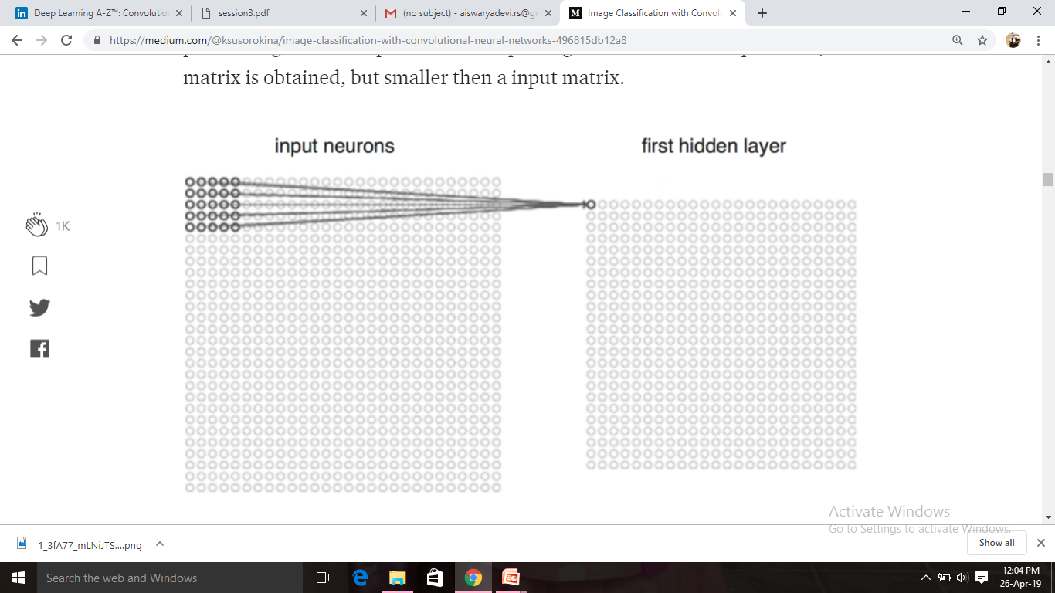

Slide 22
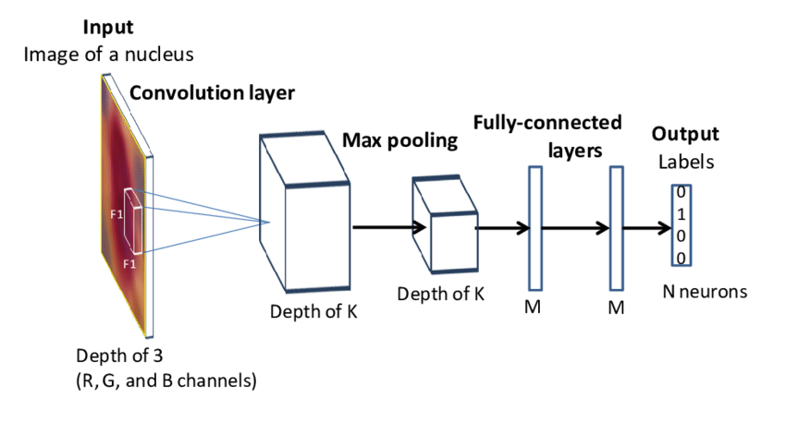
BLOCK DIAGRAM FOR CNN ALGORITHM

Slide 23
Non-Linear Layer
The nonlinear layer is added after each convolution operation. It has an activation function, which brings nonlinear property. Without this property a network would not be sufficiently intense and will not be able to model the response variable

Slide 24
Pooling Layer
The pooling layer follows the nonlinear layer. It works with width and height of the image and performs a downsampling operation on them.
As a result the image volume is reduced. This means that if some features (as for example boundaries) have already been identified in the previous convolution operation, than a detailed image is no longer needed for further processing, and it is compressed to less detailed pictures.

Slide 25
Fully-connected Layer
After completion of series of convolutional, nonlinear and pooling layers, it is necessary to attach a fully connected layer.
This layer takes the output information from convolutional networks. Attaching a fully connected layer to the end of the network results in an N dimensional vector, where N is the amount of classes from which the model selects the desired class.

Slide 26
FLOW DIAGRAM
Start
Convolution layer 2
Normalize
Pooling layer
De mean
Convolution layer 3
Convolution layer 1
softmax
Pooling layer
End

Slide 27
LIBRARIES INCLUDED
Computer Vision – OpenCV
NumPy – Numerical Operations in Python
Matplotlib – Plot the images graph
Keras – Deep Learning Library
Pil – Python Image Library
Time – time library in python
Random - library for randomly generations of numbers images
Os – library for operating system support
Glob – library it supports large object processing

Slide 28
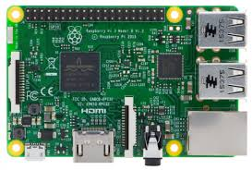
RASPBERRY PI
The Raspberry Pi is a fully featured microcomputer squashed onto a circuit board measuring approximately 9cm x 5.5cm.
Features :
Ultra low-cost (Model A $25, Model B $35)
Ultra low-power ~1W
Credit-card sized, fanless, instant start-up
Complete easy-to-program computer Features
Provide a fun environment for experimenting with programming and electronics
Inexpensive, simple, open and easy to maintain computer for schools
Fun computer for children to experiment with at home(programming, robotics, etc...)

Slide 29
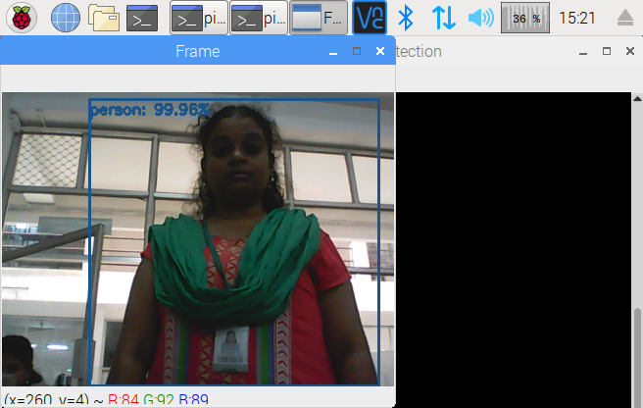
OUTPUT

Slide 30
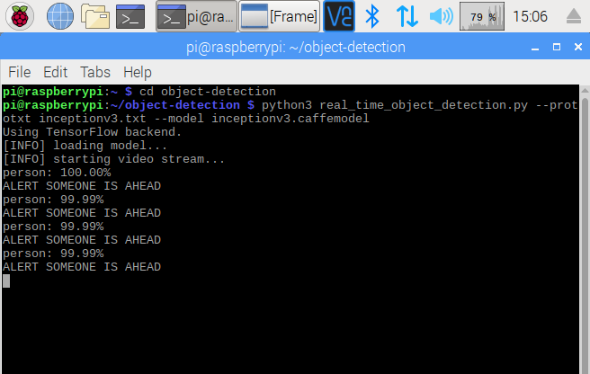

Slide 31
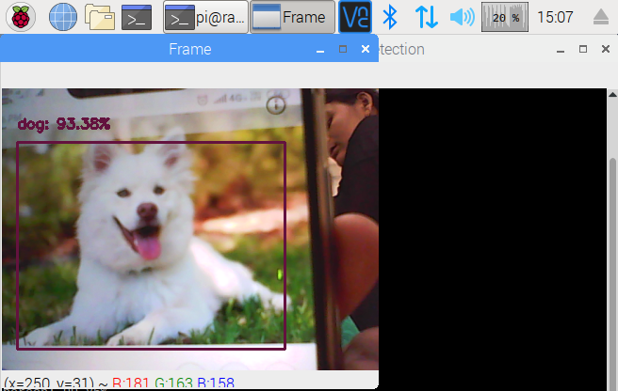

Slide 32
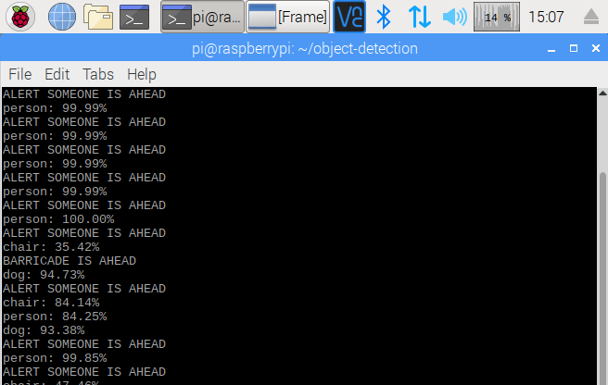

Slide 33
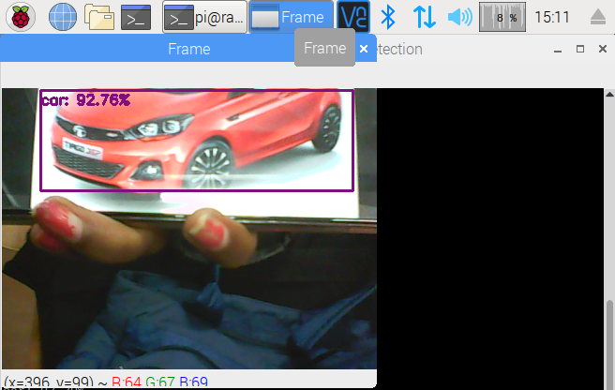

Slide 34
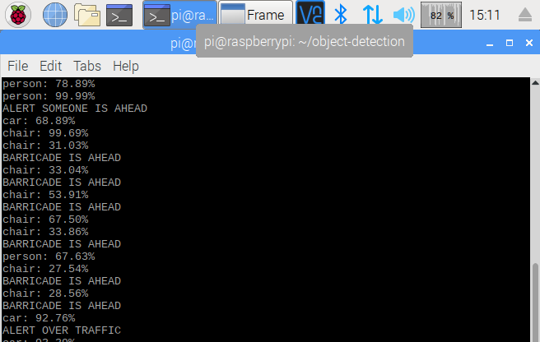

Slide 35
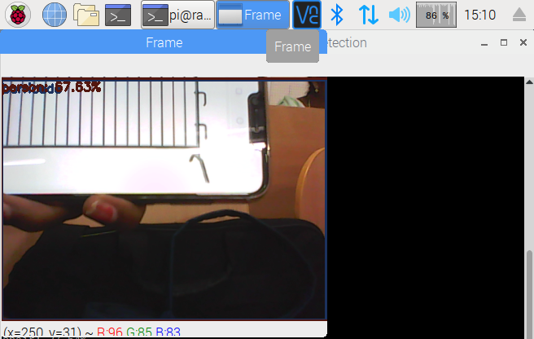

Slide 36
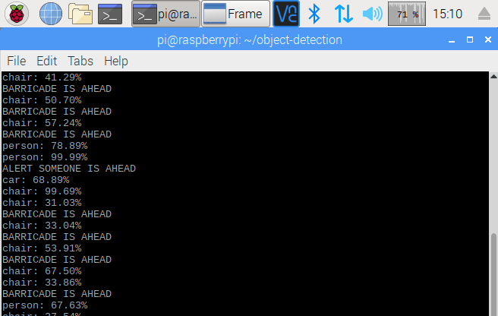

Slide 37
REFERENCES
B. Zhang, V. Appia, I. Pekkucuksen, A. Z. Batur, P. Shastry, S. Liu, S. Sivasankaran, K. Chitnis, and Y. Liu, “A surround view camera solution for embedded systems”, in Proc. the 10th IEEE Embedded Vision Workshop (Held in conjunction with IEEE CVPR 2014), Columbus, Ohio, June 2014
C. C. Lin and M. S. Wang, “A vision based top-view transformation model for a vehicle parking assistant,” Sensors, vol. 12, pp. 4431–4446, 2012.
Yu-Chih Liu, Kai-Ying Lin, and Yong-Sheng Chen, “Bird’seye view vision system for vehicle surrounding monitoring,” International Workshop on Robot Vision, pp. 207–218, 2008.
Frank Nielsen, “Surround video: a multihead camera approach,” Vis. Comput., vol. 21, pp. 92–103, 2005.
Kapje Sung, Joongryoul Lee, Junsik An, and Eugene Chang, “Development of image synthesis algorithm with multicamera,” 2012 IEEE Vehicular Technology Conference (VTC Spring), pp. 1–5, 2012.
Din Chang Tseng, Tat Wa Chao, and Jiun Wei Chang, “Imagebased parking guiding using ackermann steering geometry,” Appl. Mech. Mater., vol. 437, pp. 823–826, 2013.
C. Harris and M. Stephens, “A combined corner and edge detector,” Proc. Alvey Vision Conf., pp. 147–151, 1988. [7] M. Calonder, V. Lepetit, C. Strecha, and P. Fua, “BRIEF: Binary robust independent elementary features,” Proc. European Conf. on Comput. Vis. (ECCV), 2010.

Slide 38
THANK YOU

