Slide 1
Spring Freamwork
Lightweight freamwork with many sub freamwork (Layers/modules)
Developed by Rod Johnson
Started in 2002/2003
First version released in 2004
Used with Java and .Net

Slide 2
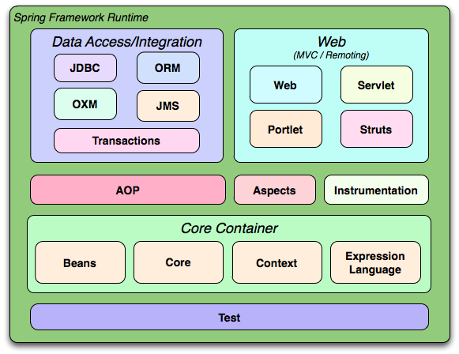
Modules

Slide 3
Features/Benefits
Lightweight
Loose coupling between classes
Uses POJO(Plain Old Java Object)
Reduce code (Increase reuseability)
Speed up development
Easy testing & improve code quality
Declarative transaction management

Slide 4
Fundamental Concepts
Inversion of Control (IoC) or Dependency Injection
Aspect Oriented Programming (AOP)
BeanFactory and Application Context

Slide 5
Inversion of Control
Instead of creating objects, objects are injected by external entity/container
Hollywood principle- Don't call me I will call you
Prevents hard-coded object creation.
Dependency injection
  Setter injection, Constructure Injection, Method injection
Provide Singleton pattern of object
Loose coupling

Slide 6
BeanFactory
BeanFactory is core to Spring Freamwork
Lightweight container that load bean definitions
Provide configration & basic functionality of beans.
  Create, manage & locate beans
  Manage lifecycle of beans
  Define scope of beans (singleten or prototype)
Bean – (backbone of spring) - Reusable components which are basically instances of a class and
created by spring as late as possible.

Slide 7
ApplicationContext
Sub interfase of BeanFactory
Includes all functionality of the BeanFactory
Allows to get access to the objects that are configured in BeanFactory
It adds some extra features-
  Integration of Spring's AOP features;
  Message resource handling ( for use in internationalization),
  Event publication and application-layer specific contexts such as the WebApplicationContext

Slide 8
Aspect Oriented Programming (AOP)
Provide Modularity in term of aspect allowing separation of concerns
Aspect - combination of the pointcut and the advice
Declarative transaction management.
Logging
Security Management

Slide 9
DispatcherServlet
View Resolver
  InternalResourceViewResolver
Url Handler Mapping
  SimpleUrlHandlerMapping
Method Name Resolver
  PropertiesMethodNameResolver
ModelAndView
Controller

Slide 10
Request
Handler Mapping
Controller
Request
Dispatcher
Servlet
Handle request
Request
Controller
Model And View
Processing
Response
Create Model
And View
View Name (Logical)
View (Physical)
View Resolver
Response
Model
View

