Slide 1
IMDB Movie Insights
Santosh Prasad D

Slide 2
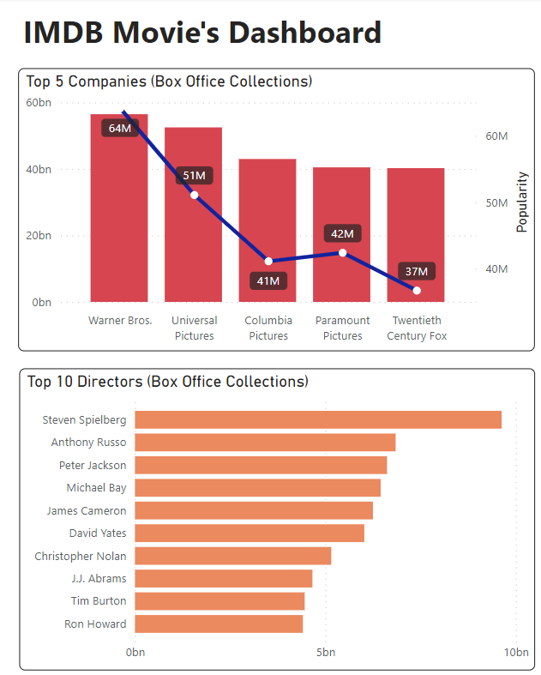
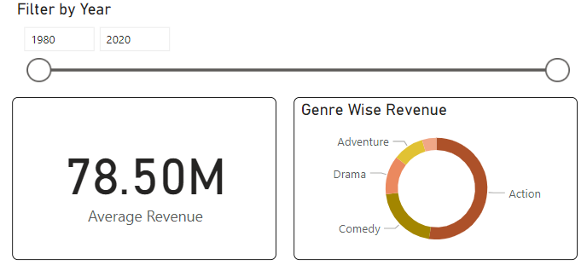
Companies in order to generate more Box Office Collections & Votes could utilize the highly ranked Directors in terms of Collections and create Action Movies which is the highest revenue collected genre.

Slide 3
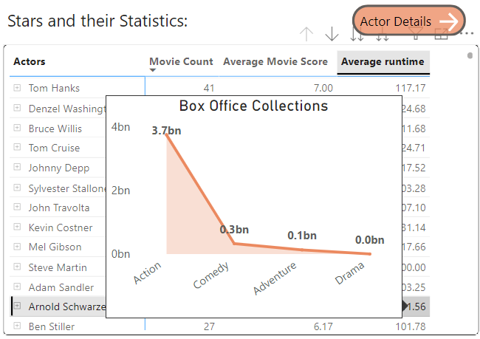
Directors could select the actors based on their Movie Score to generate Blockbuster Hits by Analysing their Versatility in terms of Genre(Tool Tip). Additionally, A drill through button which leads to the In depth details of Actors.

Slide 4
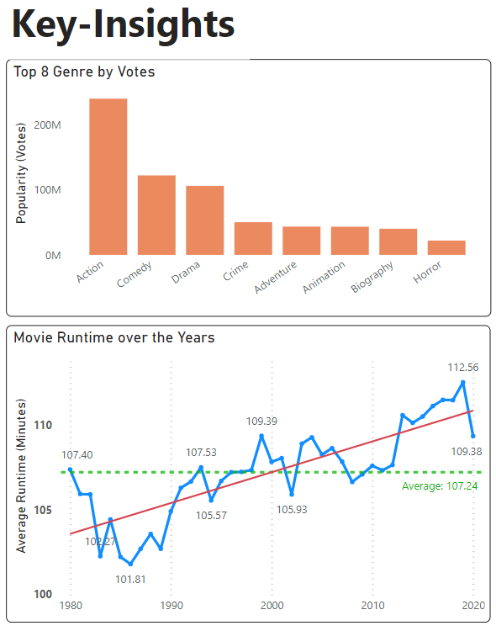
The most voted Genre as displayed in the Bar Graph is Action with a difference more than 100M Votes.
There has been a rising trend on Movie Runtime over the past 4 decades with an average runtime of 107.23 minutes.

Slide 5
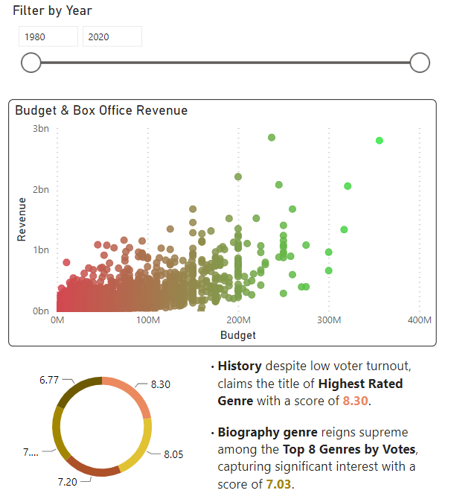
Using the scatter plot we can clearly derive insights that, As the Budget increases, the Box-Office Collection(Revenue) generated also increases.

Slide 6
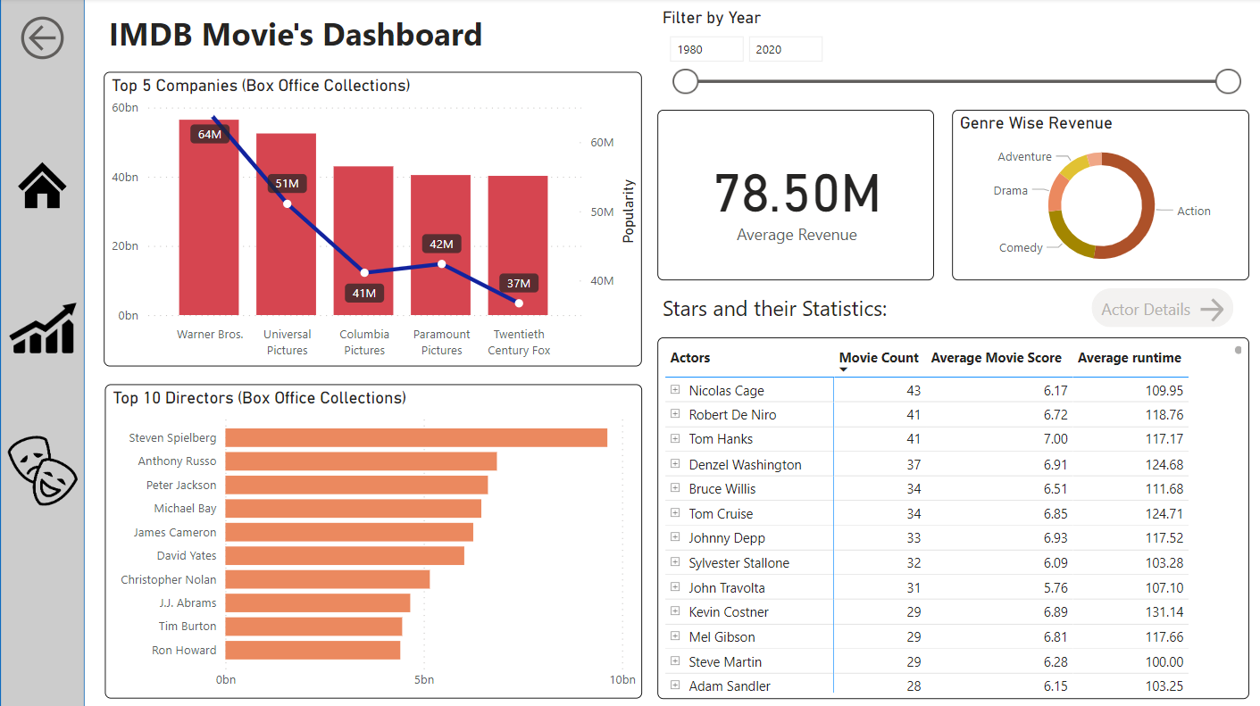
Dashboard Screenshots

Slide 7
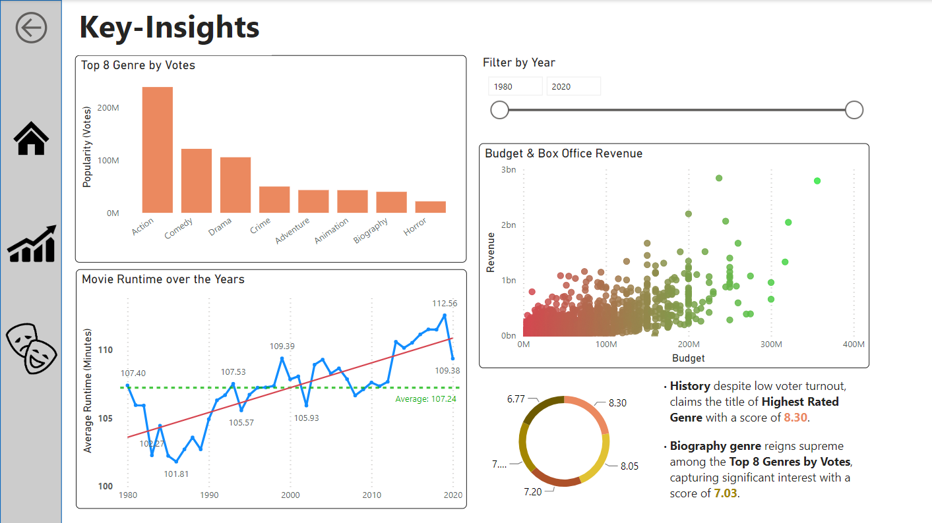
Dashboard Screenshots

Slide 8
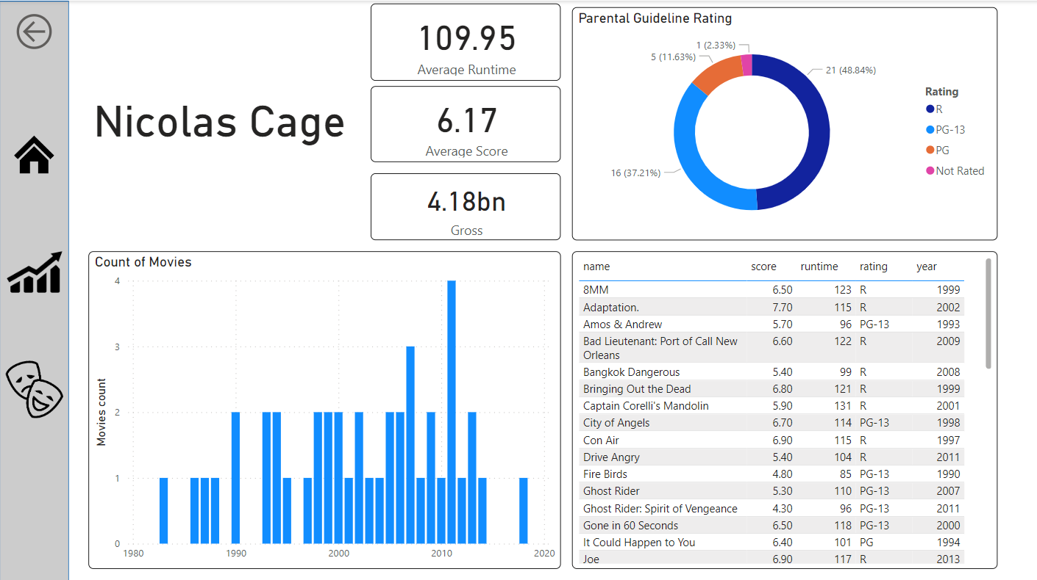
Dashboard Screenshots

Slide 9
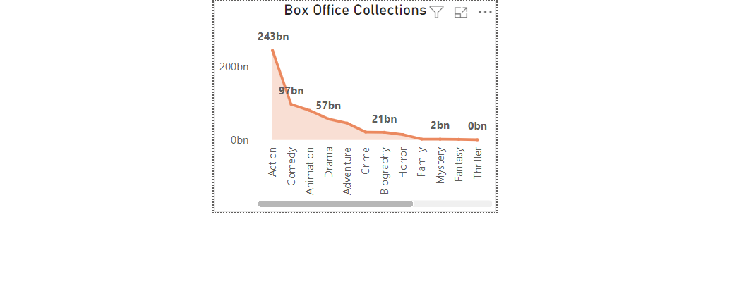
Report Filter (Customised Tooltip)

Slide 10
Thank you
Santosh Prasad D

