Slide 1

Deep dive in Python
Santosh R

Slide 2
Agenda
Python Functions
Built-in functions
Anonymous / Lambda functions
Iterators
Generators
Decorators
Advance data structures
Collections
Counter
Defaultdict
Deque
Namedtuple
OrderedDict
Unit test
Import Modules

Slide 3
Python Function
function is a group of related statements that perform a specific task.
Syntax
def function_name(parameters):
"""docstring"""
# statement(s)
function_name(params)
# Scope and Lifetime of variables
def my_func():
x = 10
print("Value inside function:", x)
x = 20
my_func()
print("Value outside function:", x)

Slide 4
map()
map() is a function that takes in two arguments: a function and a sequence iterable. In the form: map(function, sequence)
map() applies the function to all the elements of the sequence. It returns a new list with the elements changed by function.
filter()
The function filter(function, list) offers a convenient way to filter out all the elements of an iterable, for which the function returns True.
The function filter(function(),l) needs a function as its first argument. The function needs to return a Boolean value (either True or False). This function will be applied to every element of the iterable. Only if the function returns True will the element of the iterable be included in the result.
reduce()
The function reduce(function, sequence) continually applies the function to the sequence. It then returns a single value.
If seq = [ s1, s2, s3, ... , sn ], calling reduce(function, sequence) works like this:
At first the first two elements of seq will be applied to function, i.e. func(s1,s2)
The list on which reduce() works looks now like this: [ function(s1, s2), s3, ... , sn ]

Slide 5
zip()
zip() makes an iterator that aggregates elements from each of the iterables.
Returns iterators of tuples.
enumerate()
Enumerate allows you to keep a count as you iterate through an object. It does this by returning a tuple in the form (count,element)
Anonymous functions / Lambda expressions
One of Pythons most useful tools is the lambda expression.
Lambda expressions allow us to create "anonymous" functions. This basically means we can quickly make ad-hoc functions without needing to properly define a function using def.
Key difference that makes lambda useful in specialized roles:
lambda's body is a single expression, not a block of statements.
Lambda args: expression

Slide 6
Python Iterators
Iterators are the objects / containers over which one can traverse. They can be iterated upon. The object will return you data, one element at a time.
Python iterator object must implement 2 special methods, __iter__() and __next__() collectively called as Iterator protocol.
An object is called iterable if we can get iterator from it, Most built-in containers in Python like list, tuple, string etc are iterables.
Lets code
Python generator functions
There is a lot of overhead in building an iterator in Python.
Generator comes into rescue in such situations.
Python generators are a simple way of creating iterators. All the overhead we mentioned above are automatically handled by generators in Python.
Defining a normal function with yield statement instead of a return statement.
Advantages of generators
Easy to implement
Memory efficient
Represent infinite stream

Slide 7
Python decorators
A decorator takes in a function, adds some more functionality and returns it.
Pre-requisites
Everything in python is object(functions are no exceptions)
Higher order functions
Use @ symbol along with the name of the decorator function and place it above the definition of the function to be decorated.
Heavily used in Web frameworks like Django, flask

Slide 8
Advance Data Structures
Collection Module
Counter
Helps us to track the number of occurances of equivalent items in the container.
DefaultDict
Lets the caller specify the default upfront value when the container is initialized.
Deque
Its a double ended queue that allows the addition or removal of items from the either end.
Namedtuples
They turn the tuples into convenient containers, You can specify columnar names for the items.
OrderedDict
It remembers the sequence in which items are added to it.
Live Coding

Slide 9
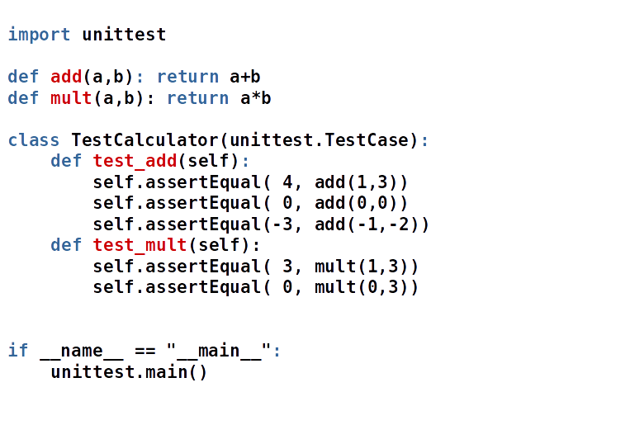
Unit Testing

Slide 10
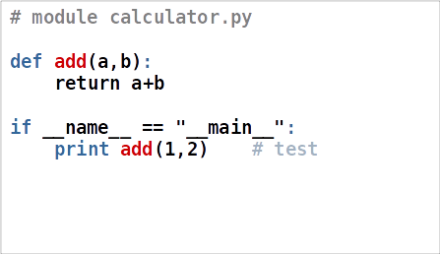
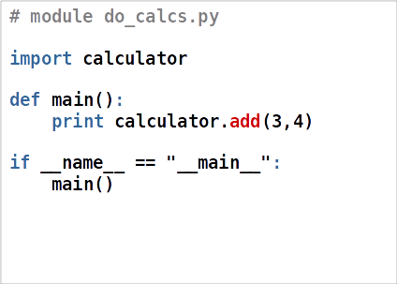
Import Example

Slide 11

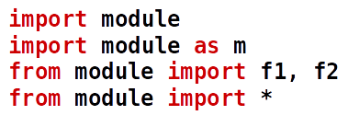

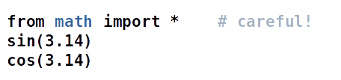
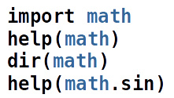


Slide 12
Context Manager
Context managers allow you to allocate and release resources precisely when you want to.
Two related operations which you’d like to execute as a pair, with a block of code in between.
with open("Counter_prac/sample.txt") as f:
for line in f:
print(line)
file = open("Counter_prac/sample2.txt", 'w')
try:
file.write('Hola!')
finally:
file.close()

Slide 13
Questions and Thank you

