Slide 1
XgBoost

Slide 2
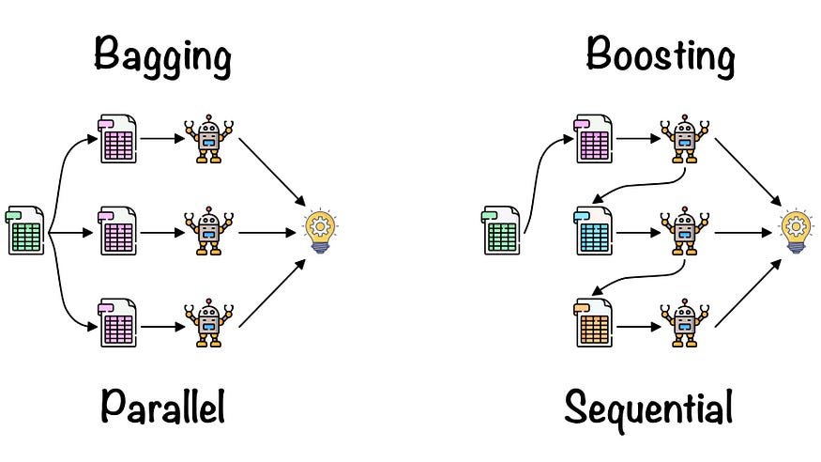
Ensemble Learning Techniques
One of the primary goals of bagging is to reduce overfitting by exposing each base learner to slightly different variations of the training data.
Boosting works best for stable models like linear regression
“Bagging” is derived from the idea of creating multiple subsets or bags of the training data through a process known as bootstrapping. Bootstrapping involves randomly sampling the dataset with replacement to generate multiple subsets of the same size as the original data. Each of these subsets is then used to train a base learner independently. One key advantage of bagging is its ability to handle noisy data and outliers effectively.
Bagging is an ensemble learning technique, but it aims to improve the performance of weak learners by combining them in a sequential manner. The core idea behind boosting is to give more weight to misclassified instances during the training process. Boosting does not rely on bootstrapped subsets of the data. Reduces bias and variance, leading to a more accurate model. It works well with weak learners (models slightly better than random guessing) by turning them into a strong learner.

Slide 3
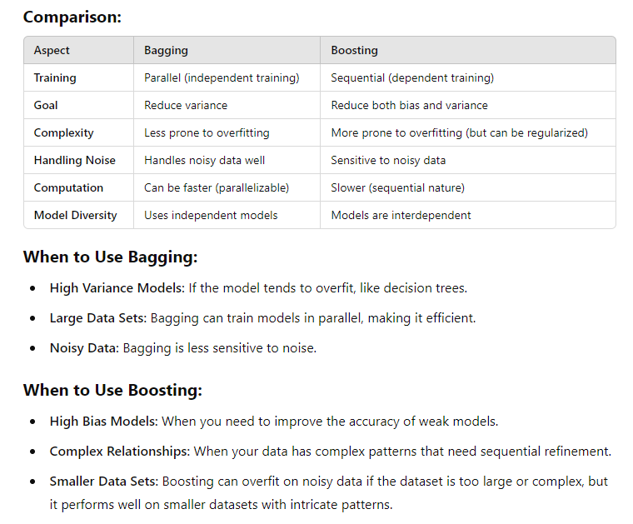

Slide 4
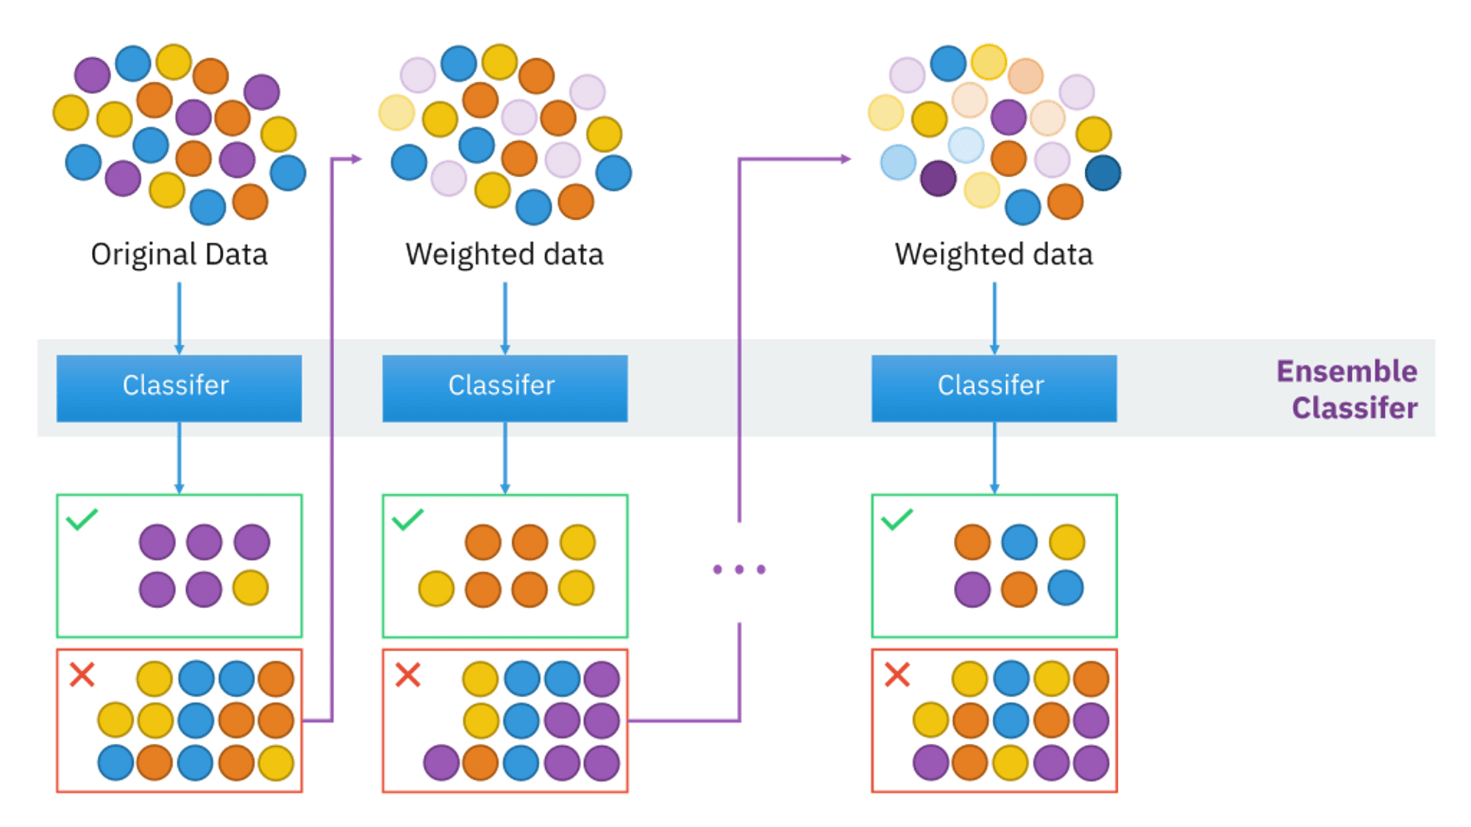
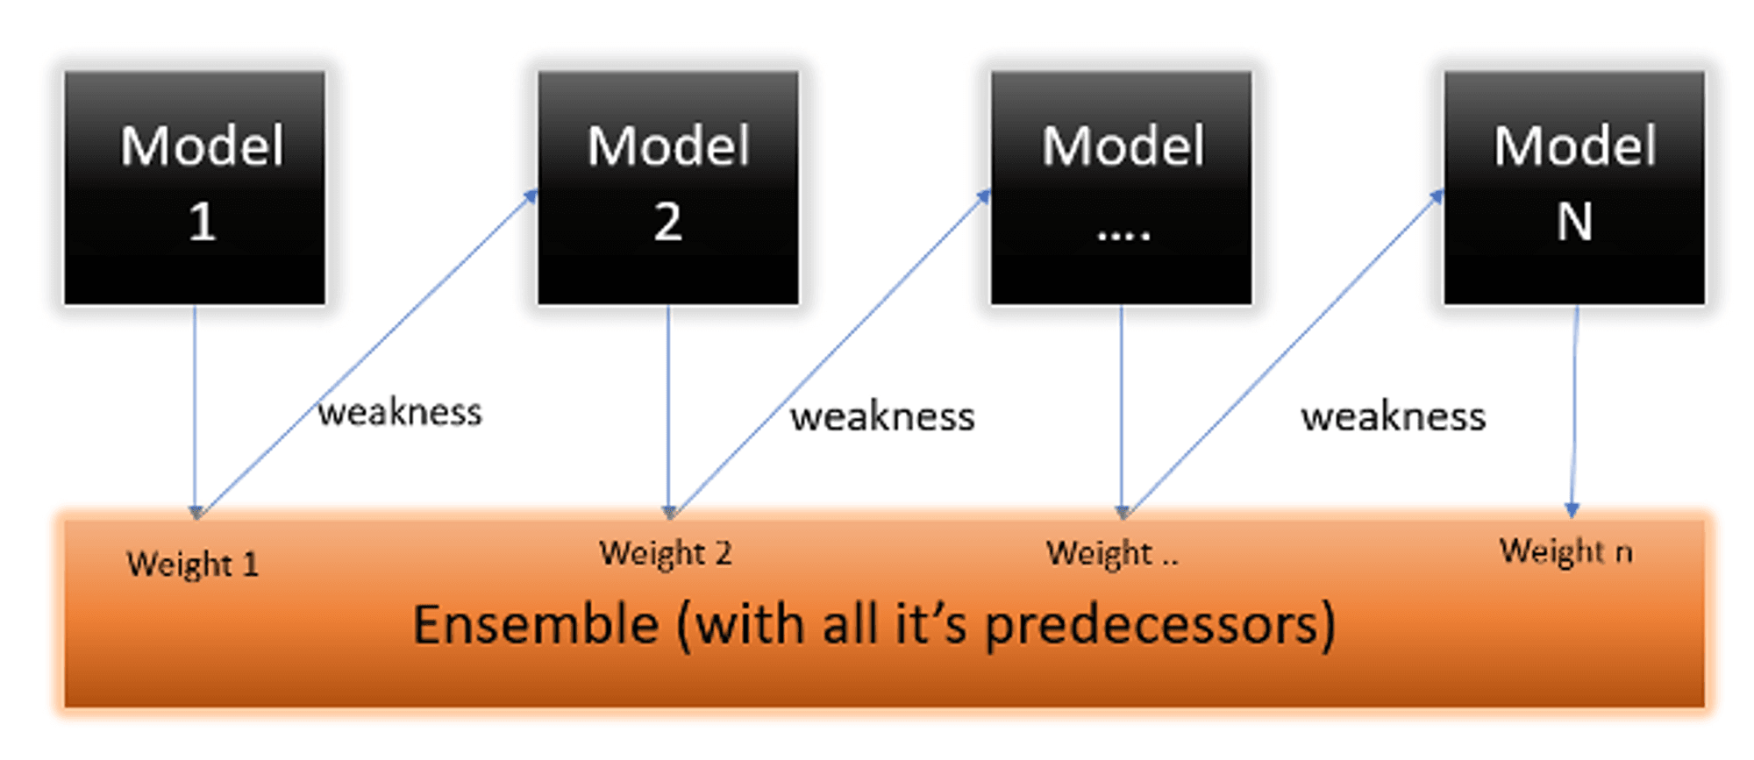
Adaptive Boosting, is an ensemble machine learning algorithm that can be used in a wide variety of classification and regression tasks. It is a supervised learning algorithm that is used to classify data by combining multiple weak or base learners (e.g., decision trees) into a strong learner.
AdaBoost
AdaBoost's most commonly used estimator is decision trees with one level, which is decision trees with just one split. These trees are often referred to as Decision Stumps.

Slide 5
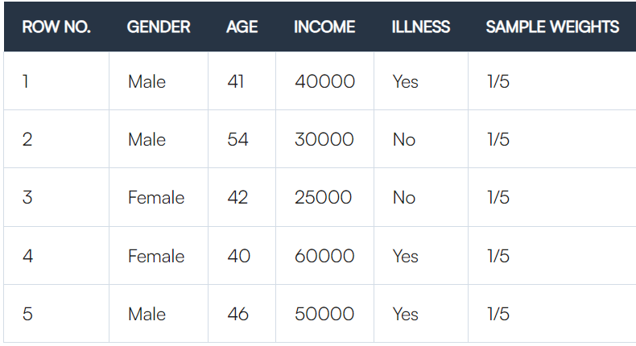
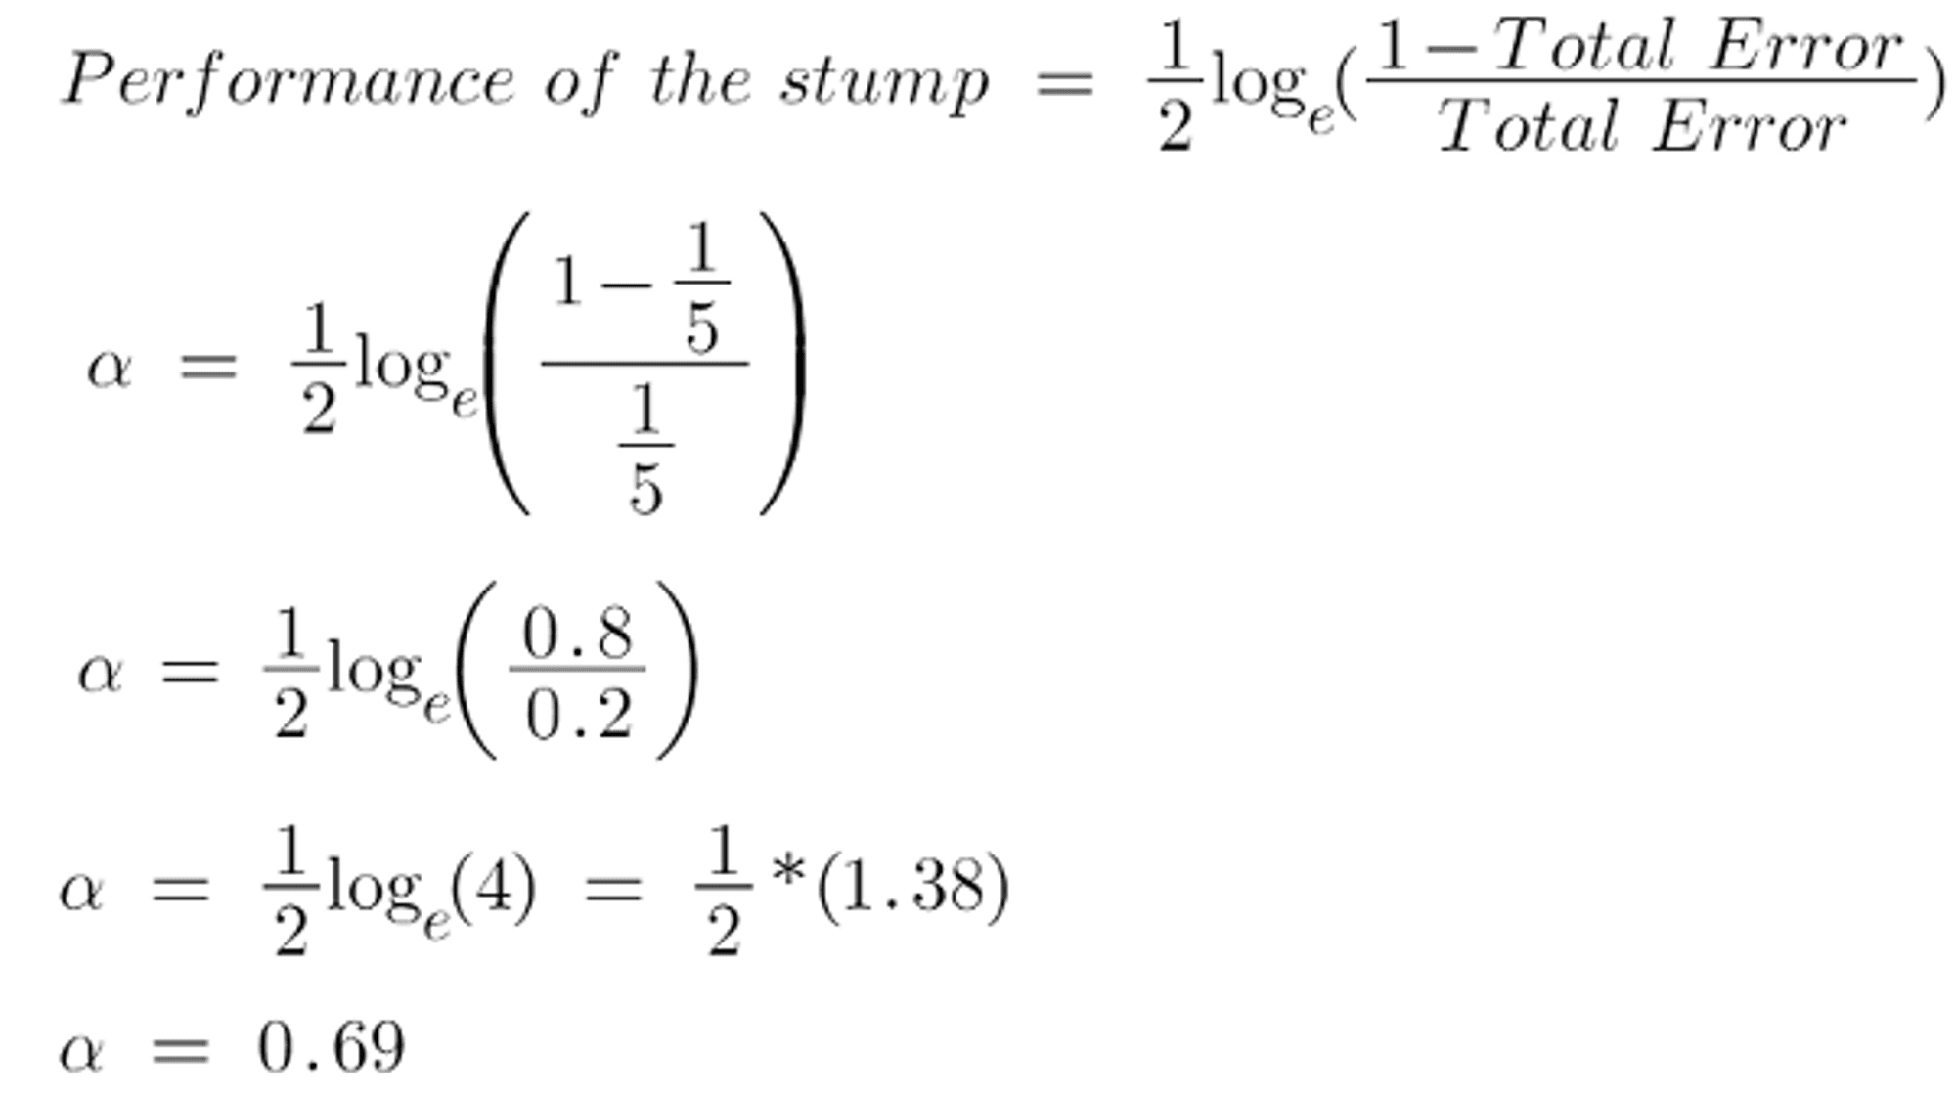
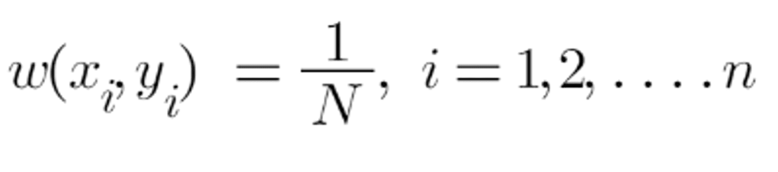
Step 3:
Determine the "Amount of Say" or "Importance" or "Influence" for this classifier in categorising the data points
Step 2:
We will examine how well "Gender" classifies the samples, followed by how the variables (Age and Income) categorise the samples. We'll make a decision stump for each characteristic and then compute each tree's Gini Index. Our first stump will be the tree with the lowest Gini Index.
Let's suppose Gender has the lowest gini index in our dataset, thus it will be our first stump.
The total error is just the sum of all misclassified data points' sample weights.
If there is one incorrect output in our dataset, thus our total error is 1/5, and the alpha (performance of the stump) is:

Slide 6
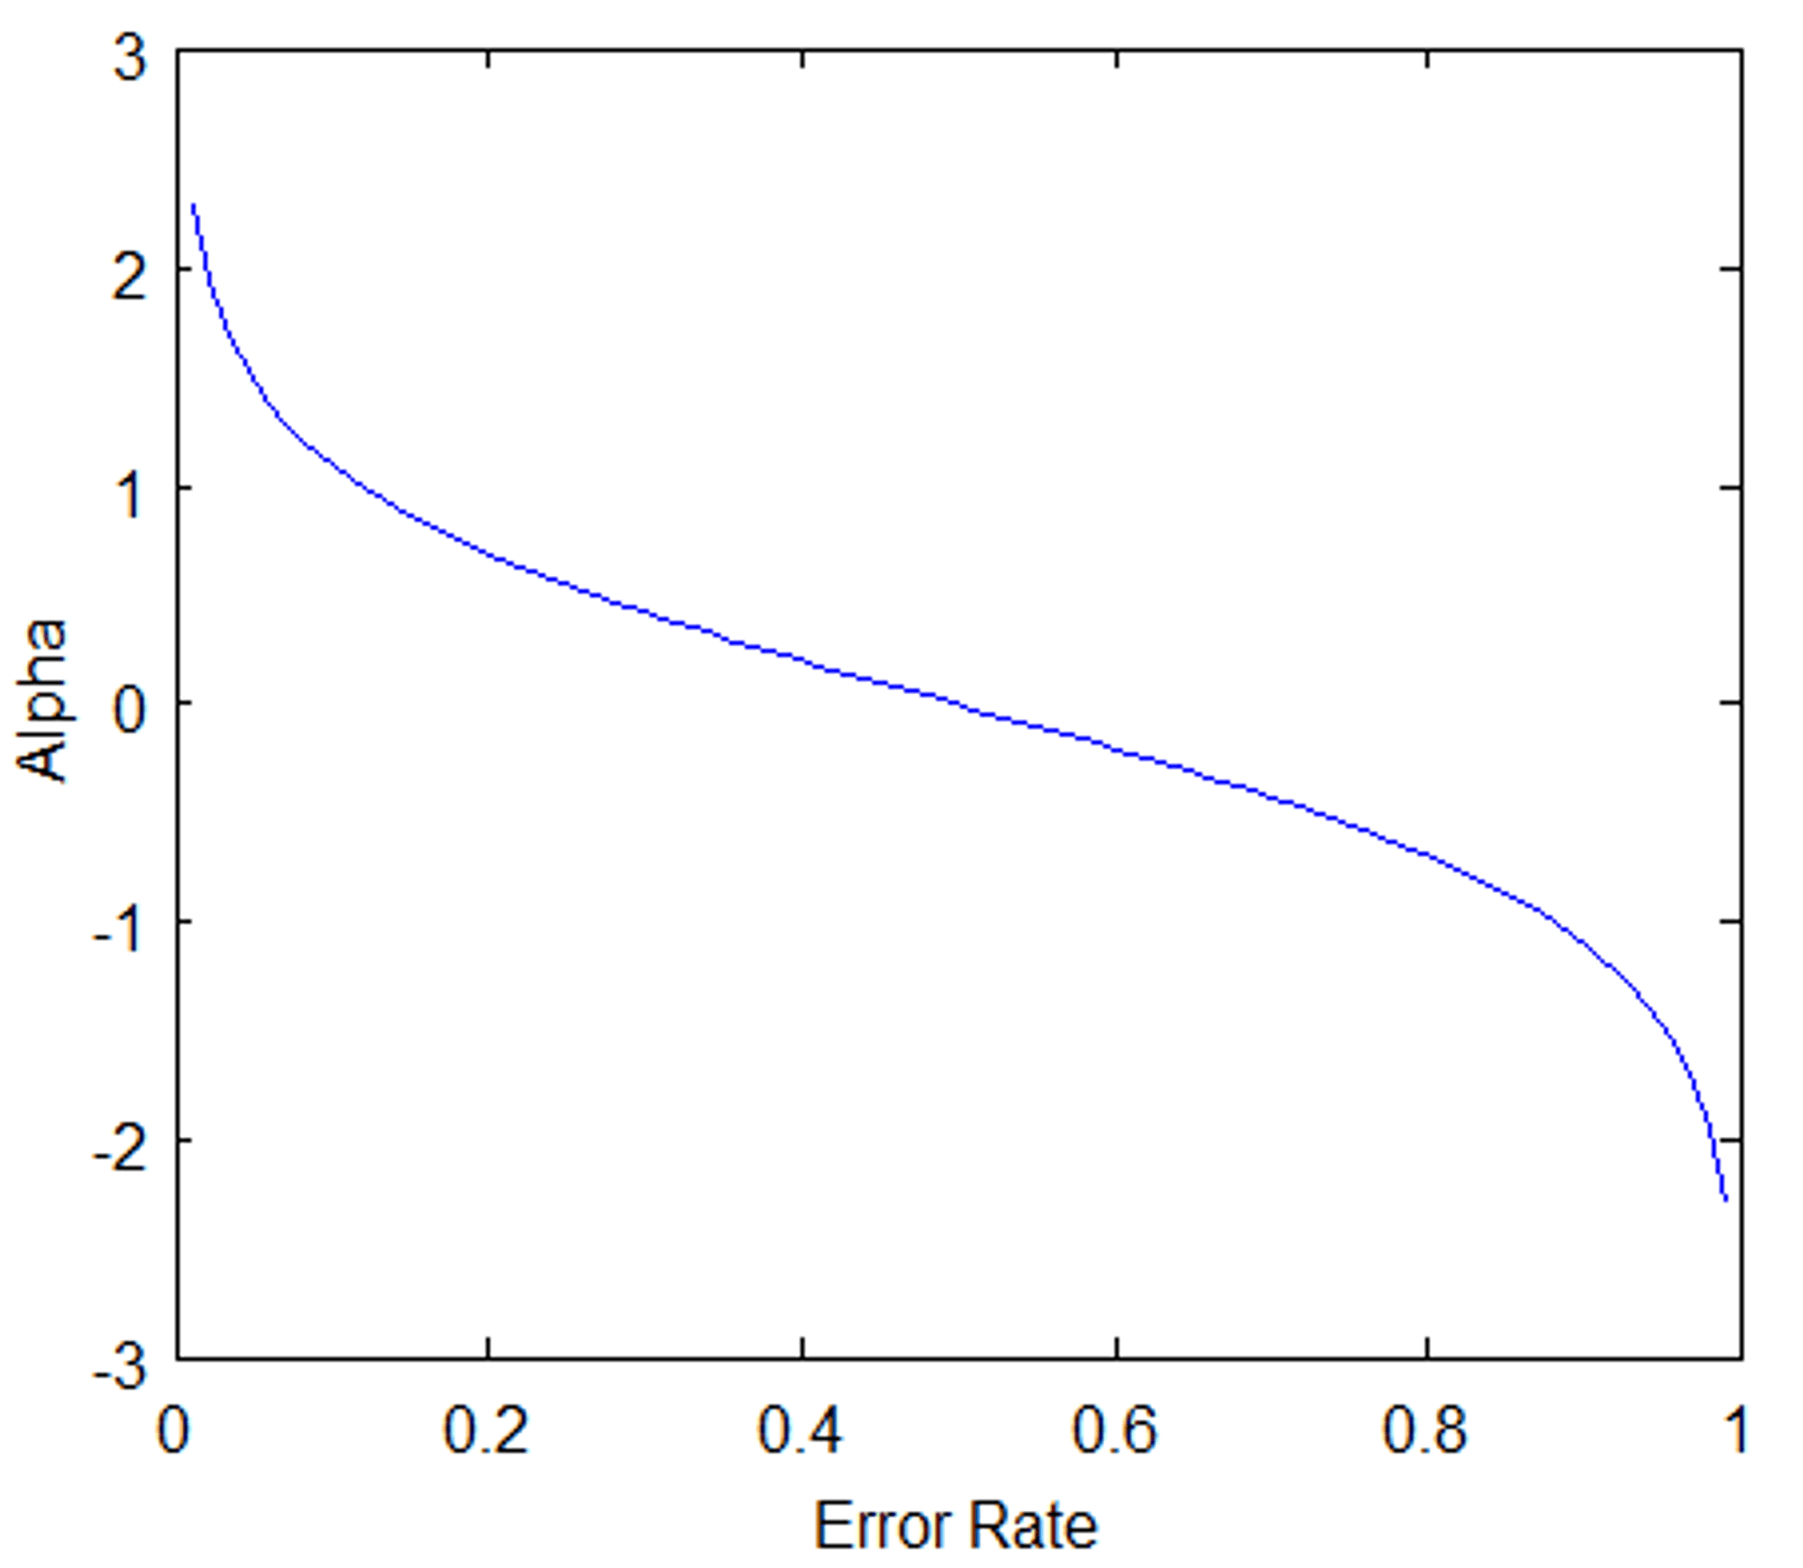
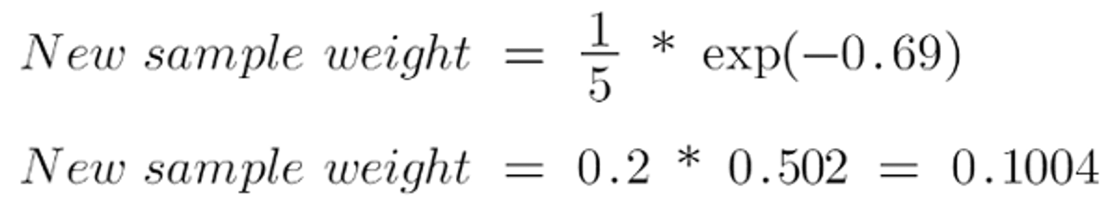
0 represents a flawless stump, while 1 represents a bad stump.
Step 4:
The weights of the incorrect forecasts will be increased, while the weights of the successful predictions will be dropped. When we create our next model after updating the weights, we will assign greater weight to the points with higher weights.
After determining the classifier's significance and total error, we must update the weights using the following formula:
When the sample is successfully identified, the amount of, say, (alpha) will be negative.
When the sample is misclassified, the amount of (alpha) will be positive.
According to the graph above, when there is no misclassification, there is no error (Total Error = 0), hence the "amount of say (alpha)" will be a huge value.
When the classifier predicts half correctly and half incorrect, the Total Error equals 0.5, and the classifier's significance (amount of say) equals 0.
If all of the samples were improperly categorised, the error will be quite large (about to 1), and our alpha value will be a negative integer.

Slide 7
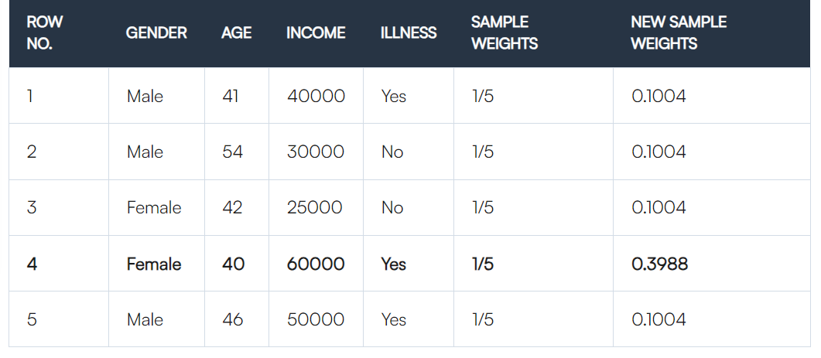
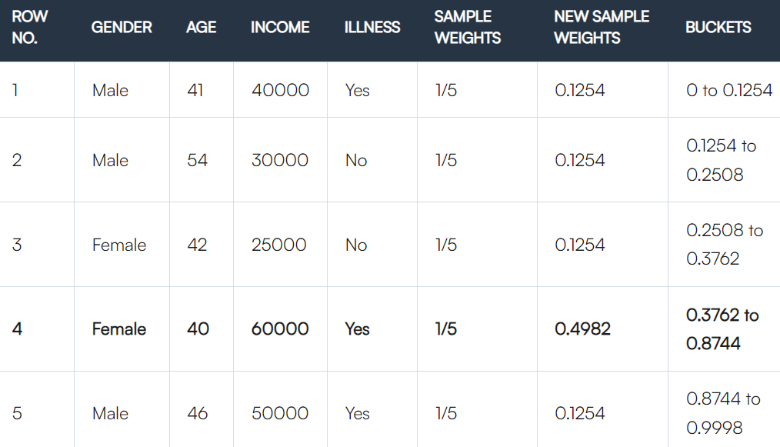
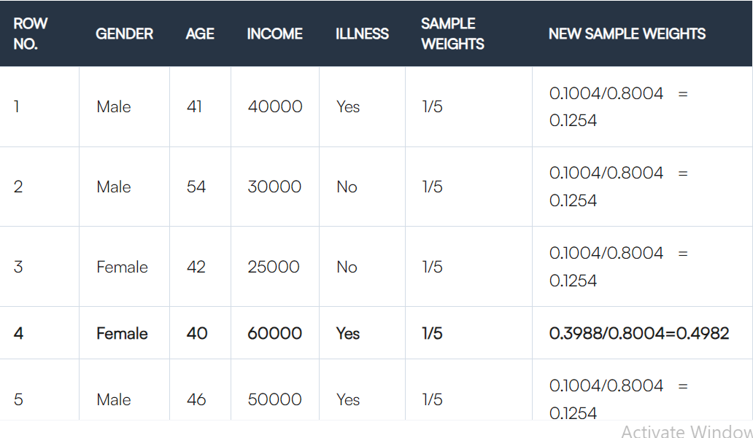
Step 5:
We must now create a fresh dataset to see whether or not the mistakes have decreased. To do this, we will delete the "sample weights" and "new sample weights" columns and then split our data points into buckets based on the "new sample weights.”
Normalization Tech

Slide 8
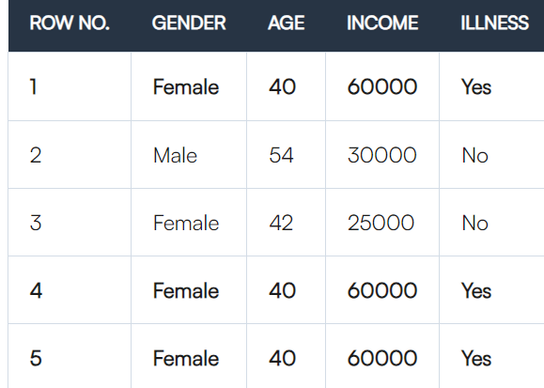
Step 6:
The method now chooses random values ranging from 0 to 1. Because improperly categorised records have greater sample weights, the likelihood of picking them is relatively high.
Assume the five random integers chosen by our algorithm are 0.38,0.26,0.98,0.40,0.55.
Determine the stump that best classifies the new group of samples by calculating their Gini index and picking the one with the lowest Gini index. To update the prior sample weights, compute the "Amount of Say" and "Total error." Normalize the newly calculated sample weights. Iterate through these procedures until a low training error is obtained.
we can see that the data point that was incorrectly categorised has been picked three times since it has a greater weight.

Slide 9
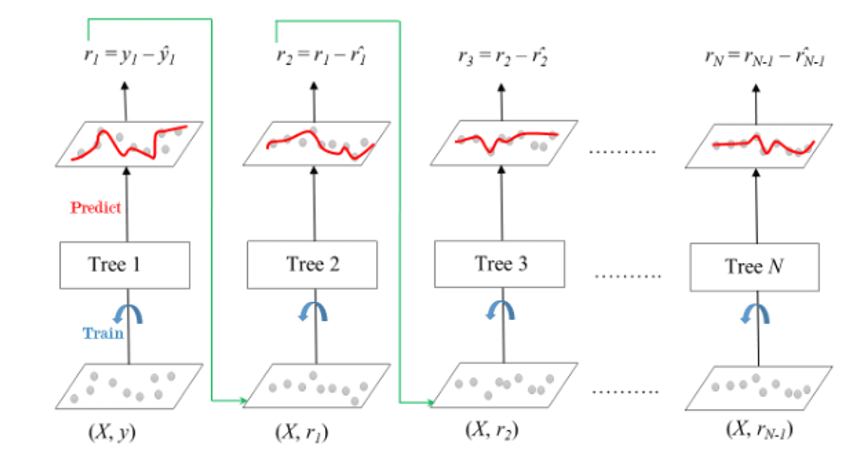
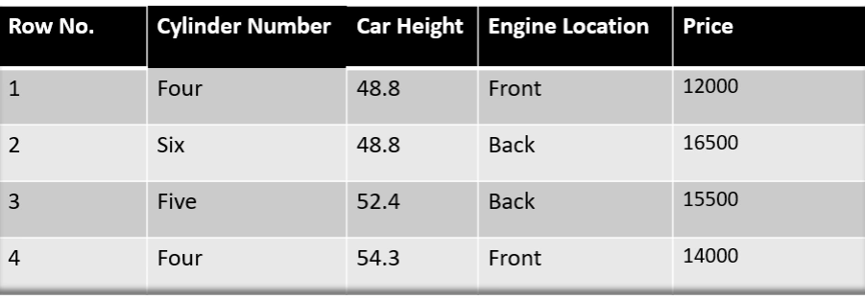
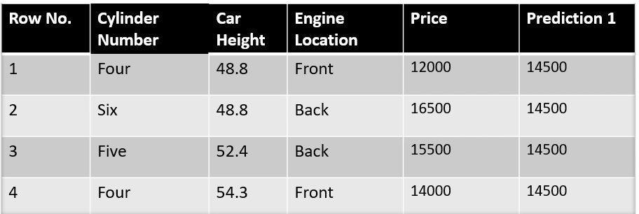
Gradient Boosting
Gradient Boosting is a prominent technique for boosting. In gradient boosting, each prediction corrects the inaccuracy of its previous.
Step 1: Build a Base Model
The first step in gradient boosting is to build a base model to predict the observations in the training dataset.
Gradient Boosted Trees is a method whose basic learner is CART (Classification and Regression Trees).

Slide 10
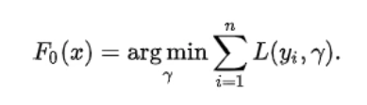
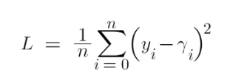
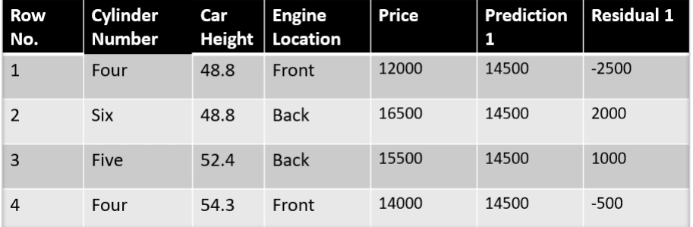

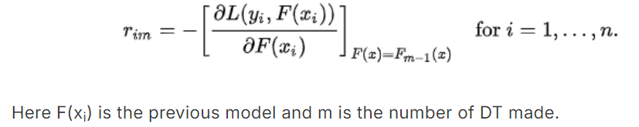
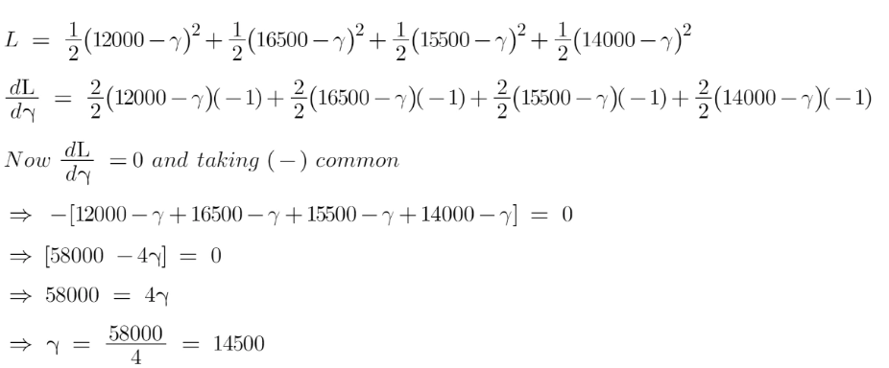
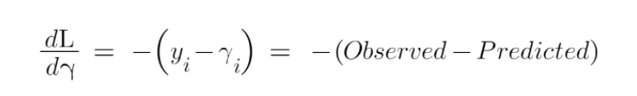
Step 2: Compute Pseudo Residuals
The next step is to calculate the pseudo residuals which are (observed value – predicted value).
Now we need to find a minimum value of gamma such that this loss function is minimum.

Slide 11
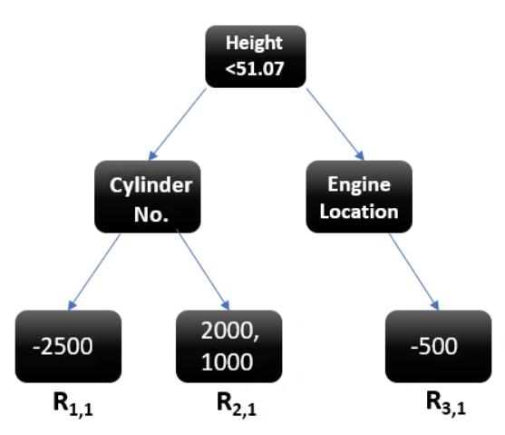

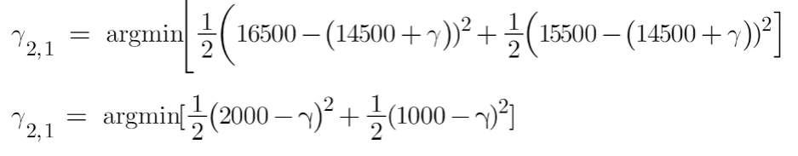
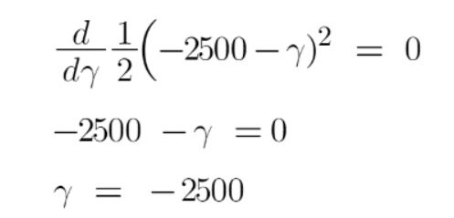
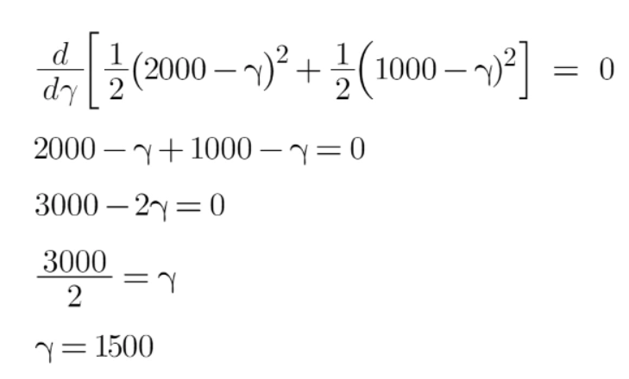
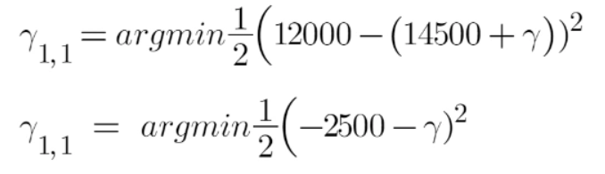
Step 3: Build a Model on Calculated Residuals
Residual as a target and the original feature Cylinder number, cylinder height, and Engine location we will generate new predictions.
Let’s say h_{m}(x) is our DT made on these residuals.
we find the output values for each leaf of our decision tree. That means there might be a case where 1 leaf gets more than 1 residual, hence we need to find the final output of all the leaves. To find the output we can simply take the average of all the numbers in a leaf,

Slide 12
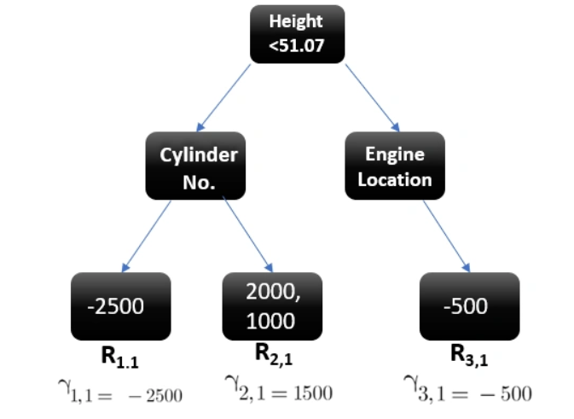
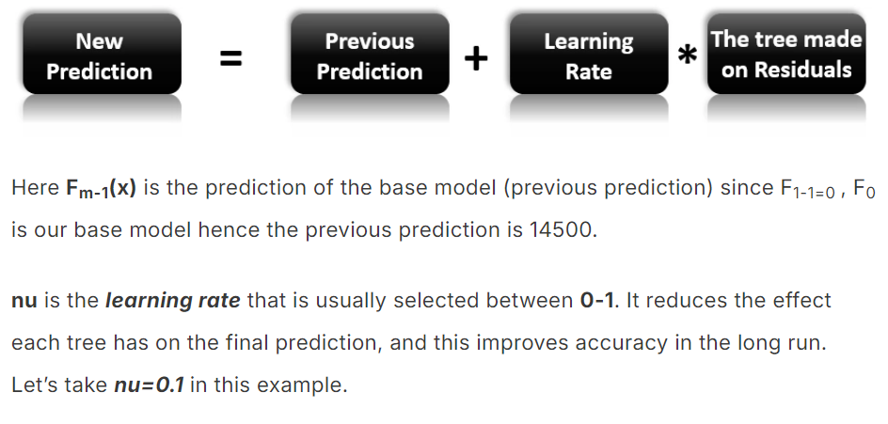
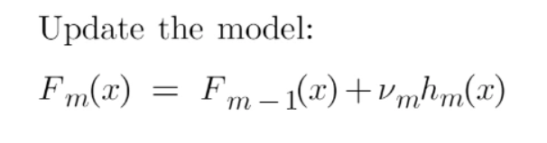
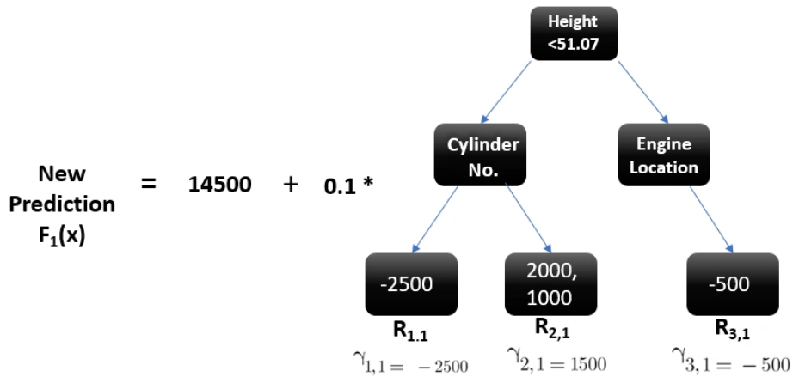

Slide 13
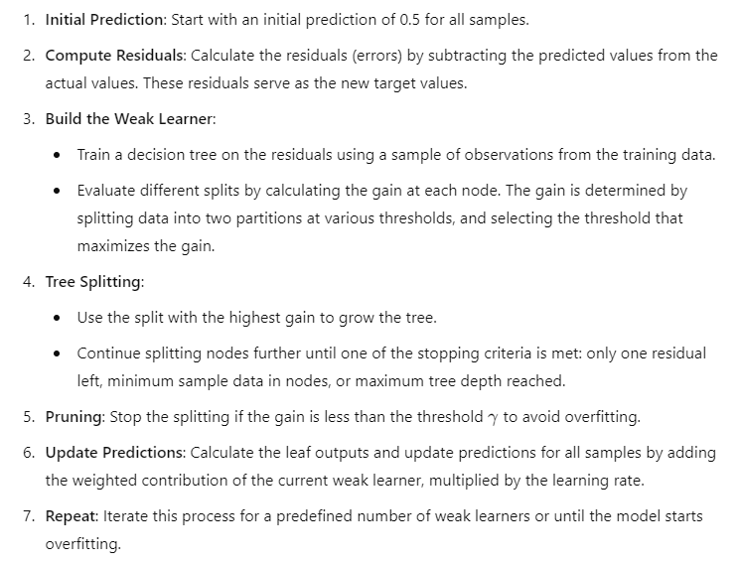
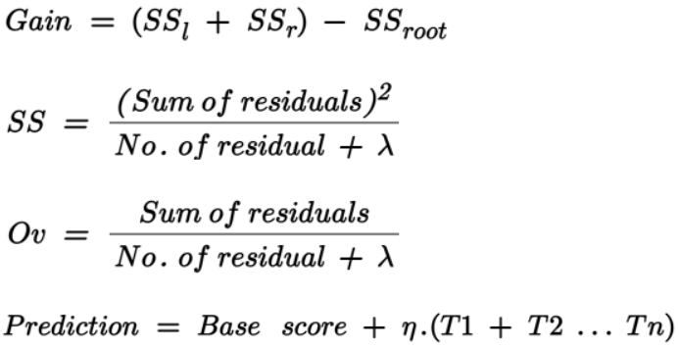

Slide 14
2. Gamma (γ) - Minimum Loss Reduction
Purpose: Gamma specifies the minimum loss reduction required to make a further partition on a leaf node of the tree. In essence, it acts as a threshold for deciding whether a node should split.
Effect: A higher gamma value makes the algorithm more conservative in splitting, as it requires a larger gain to justify the split. This leads to fewer splits, helping control model complexity and overfitting.
Typical Usage: Increasing gamma can help avoid overfitting by ensuring that only the most significant splits are made. If the model is underfitting, decreasing gamma might allow it to capture more patterns.
1. Lambda (λ) - L2 Regularization Term
Purpose: Lambda is the L2 regularization term on the leaf weights. It penalizes large weights in the leaf nodes to reduce model complexity and prevent overfitting.
Effect: Higher values of lambda make the model more conservative, as it discourages overly complex trees by shrinking the weights of the leaves. Conversely, a lower lambda value allows the model to be more flexible.
Typical Usage: If your model is overfitting, you might increase lambda. If underfitting, you may reduce it.
3. Learning Rate (α)
Purpose: The learning rate (also known as eta in XGBoost) controls the contribution of each tree in the model. It scales the predictions of each tree before adding them to the overall model prediction.
Effect: A lower learning rate means that each tree's impact is reduced, requiring more trees to reach the optimal solution. This helps ensure a smoother, more gradual improvement in performance but requires more iterations to converge. A higher learning rate speeds up training but can risk overshooting the optimal solution or overfitting.
Typical Usage: In practice, a low learning rate (e.g., 0.01 to 0.3) is commonly used with a larger number of boosting rounds (trees). It is often a good idea to start with a lower value and increase it if the model is underfitting or reduce it if overfitting occurs.

Slide 15
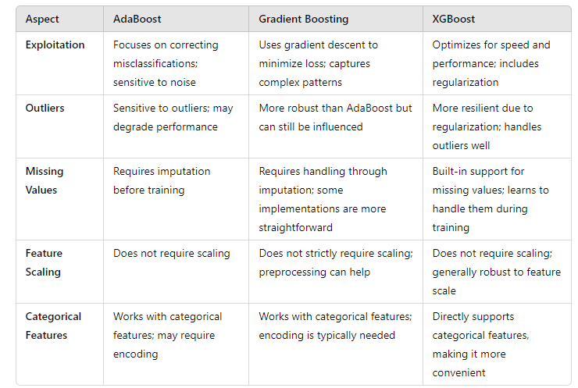

Slide 16
1. AdaBoost (Adaptive Boosting)
When to Use:
  When you have a simple model (like decision stumps) and want to improve its performance.
  When your dataset is small to medium-sized, and you need a quick and interpretable model.
  When you want to reduce bias in the model, as it focuses on misclassified instances by assigning them higher weights.
Strengths:
  Works well with weak classifiers and can improve their performance.
  Robust to overfitting if the base learner is simple enough.
2. Gradient Boosting
When to Use:
  When you want to build a predictive model from a variety of weak learners (often decision trees).
  When you have a larger dataset and can afford the computational cost.
  When you need flexibility in choosing the loss function and can benefit from different objective functions.
Strengths:
  Generally more robust and flexible than AdaBoost.
  Effective for a variety of regression and classification tasks.

Slide 17
3. XGBoost (Extreme Gradient Boosting)
When to Use:
  When you need a high-performance model for large datasets.
  When computational efficiency and speed are crucial, as XGBoost is designed to be faster than traditional gradient boosting.
  When you want to include regularization to prevent overfitting and achieve better generalization.
Strengths:
  Excellent performance in Kaggle competitions and practical applications due to its speed and accuracy.
  Supports parallel processing and tree pruning, making it very efficient.
AdaBoost is suitable for tasks needing quick and interpretable models, like spam detection and face detection.
Gradient Boosting is versatile for various applications, including credit scoring and churn prediction.
XGBoost excels in competitive settings and large-scale applications, such as fraud detection and web ranking.

