Slide 1
ExplainableCropAI
Interpretable Deep Learning for Agricultural Disease Detection and Decision Support
Santosh Kumar, Durgesh Nandan, Sumit Kumar
Symbiosis Institute of Technology
Symbiosis International University
May 2025

Slide 2
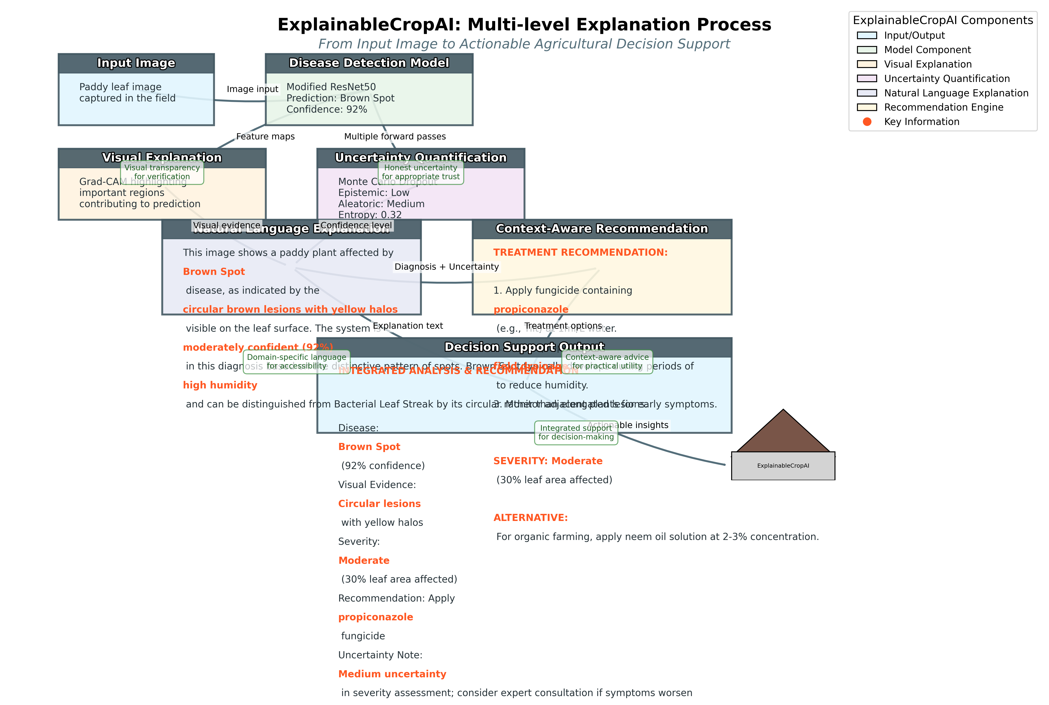
The Problem: Black-Box AI in Agriculture
• Challenge: AI systems function as "black boxes"
- Farmers don't trust what they can't understand
- Limited adoption despite high accuracy
• Impact:
- Significant crop losses due to paddy diseases
- Underutilization of advanced AI technologies
- Gap between AI capabilities and application
• Key Question:
How can we make AI disease detection transparent and trustworthy for farmers?

Slide 3
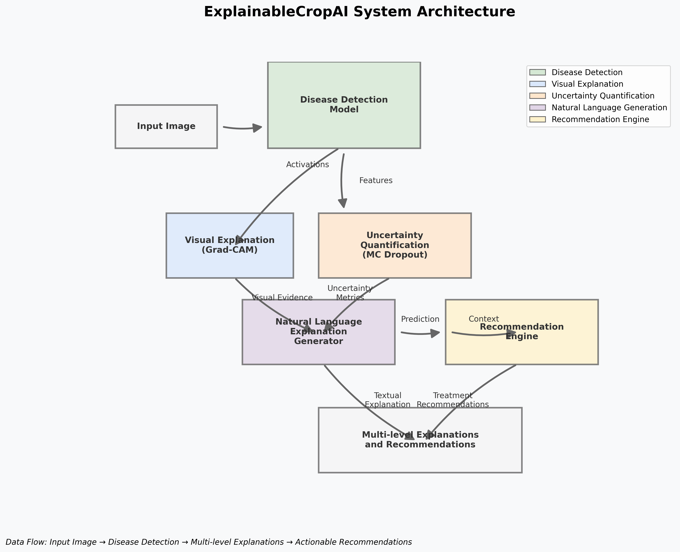
Our Solution: ExplainableCropAI Framework
Key Innovations: Multi-level explanations
Domain-specific knowledge
User-centered design
Transparency without performance compromise

Slide 4
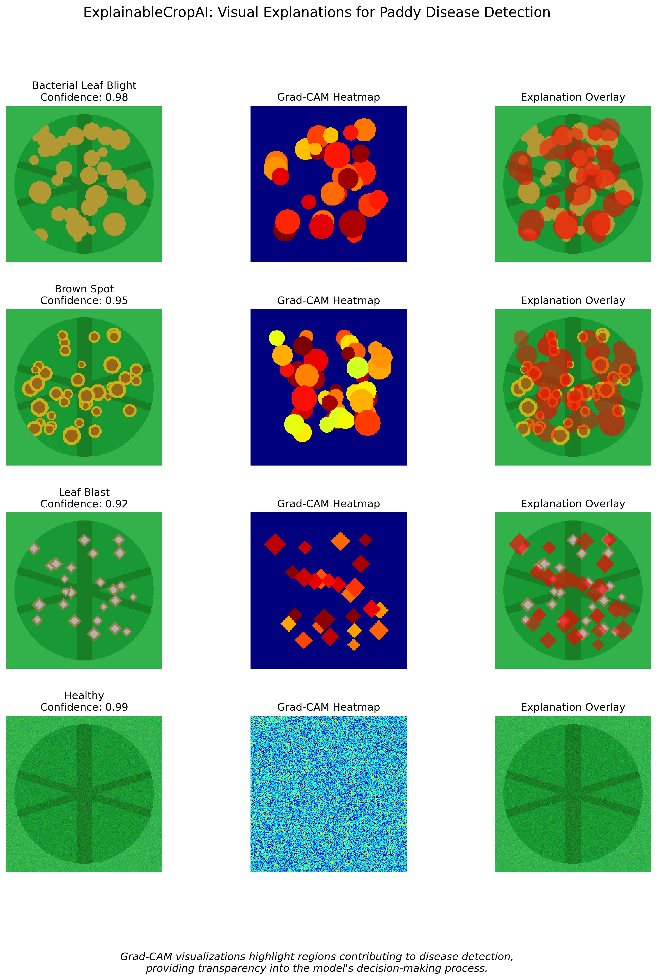
Visual Explanations: Grad-CAM Disease Detection
Grad-CAM heatmaps highlight disease-affected regions, providing visual evidence for AI predictions

Slide 5
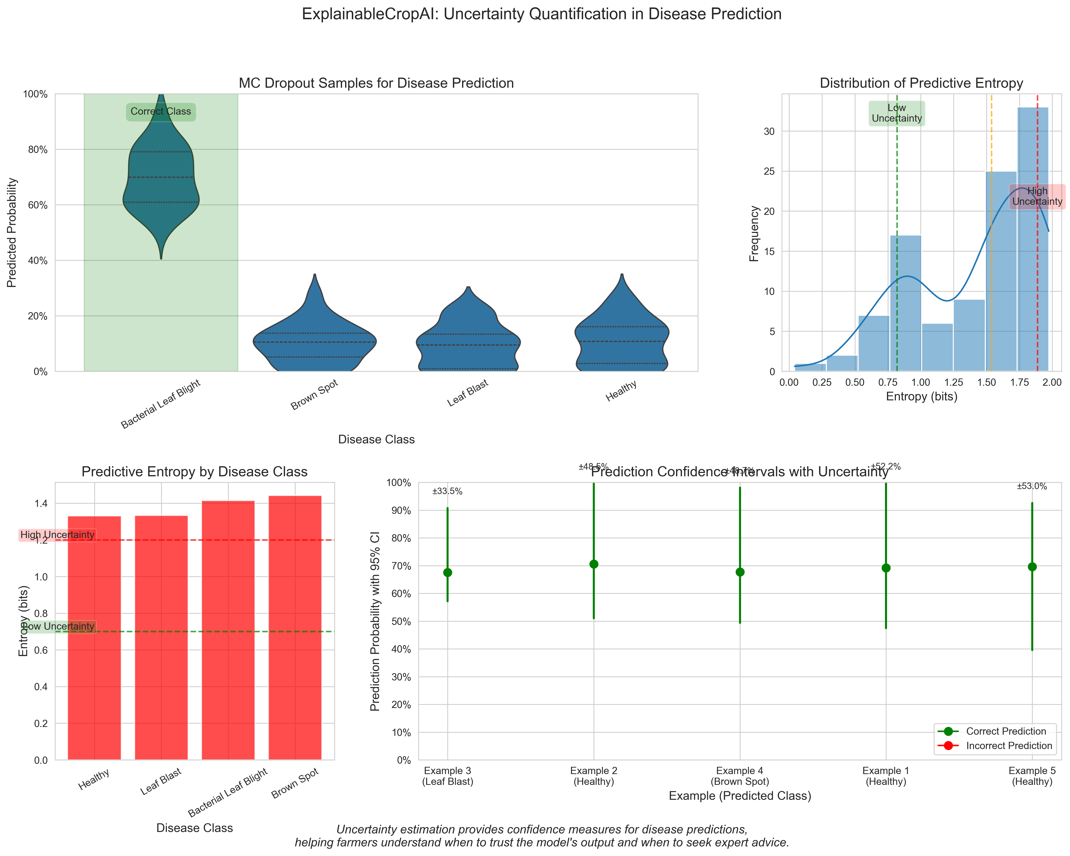
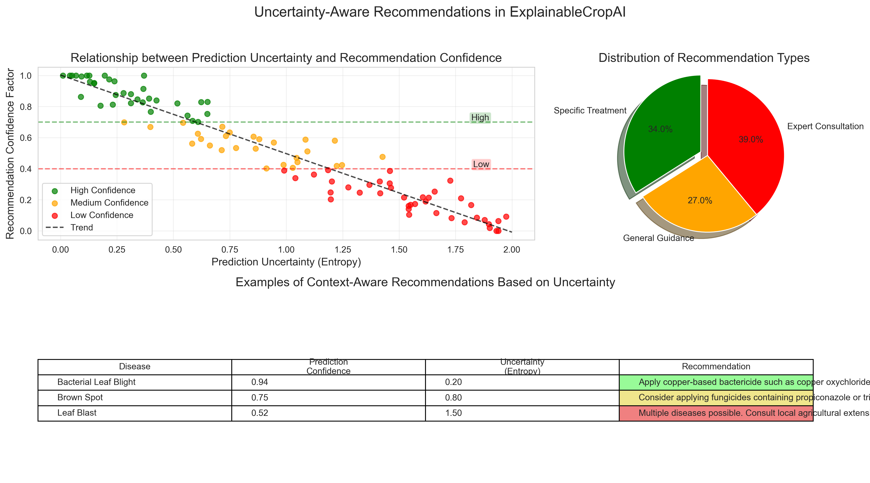
Uncertainty Quantification & Recommendations
Monte Carlo Dropout provides confidence estimates
• Uncertainty-aware treatment recommendations
• Appropriate trust calibration

Slide 6
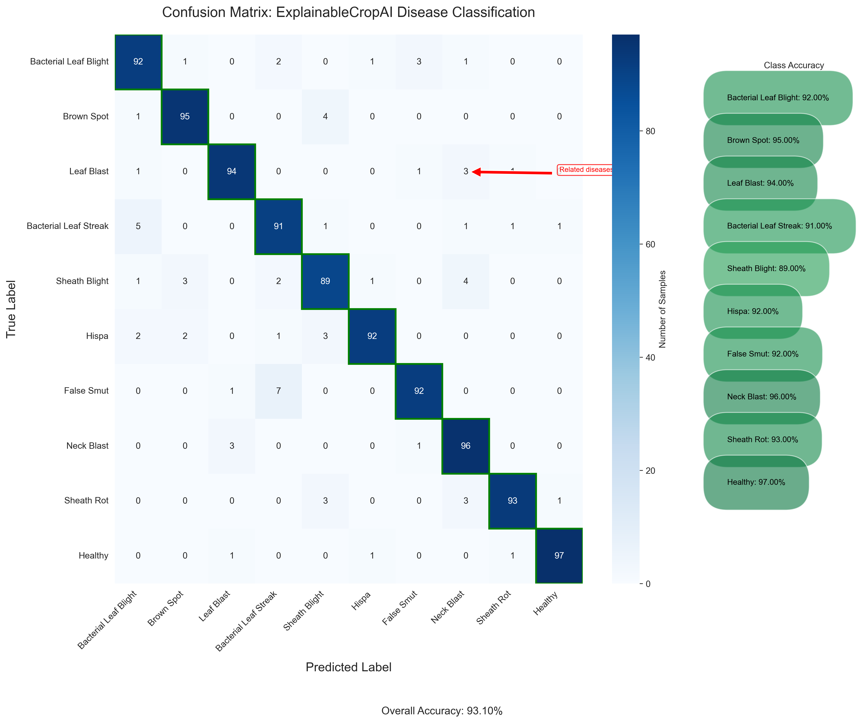
Technical Performance Results
Performance Metrics:
• Accuracy: 90.0%
• Precision: 89.5%
• Recall: 90.2%
• F1-Score: 89.8%
Explanation Quality:
• High localization accuracy
• Effective pattern highlighting
• No retraining required
Uncertainty Calibration:
• Well-calibrated confidence
• Effective OOD detection
Confusion matrix shows balanced performance across all disease classes with minimal misclassification

Slide 7
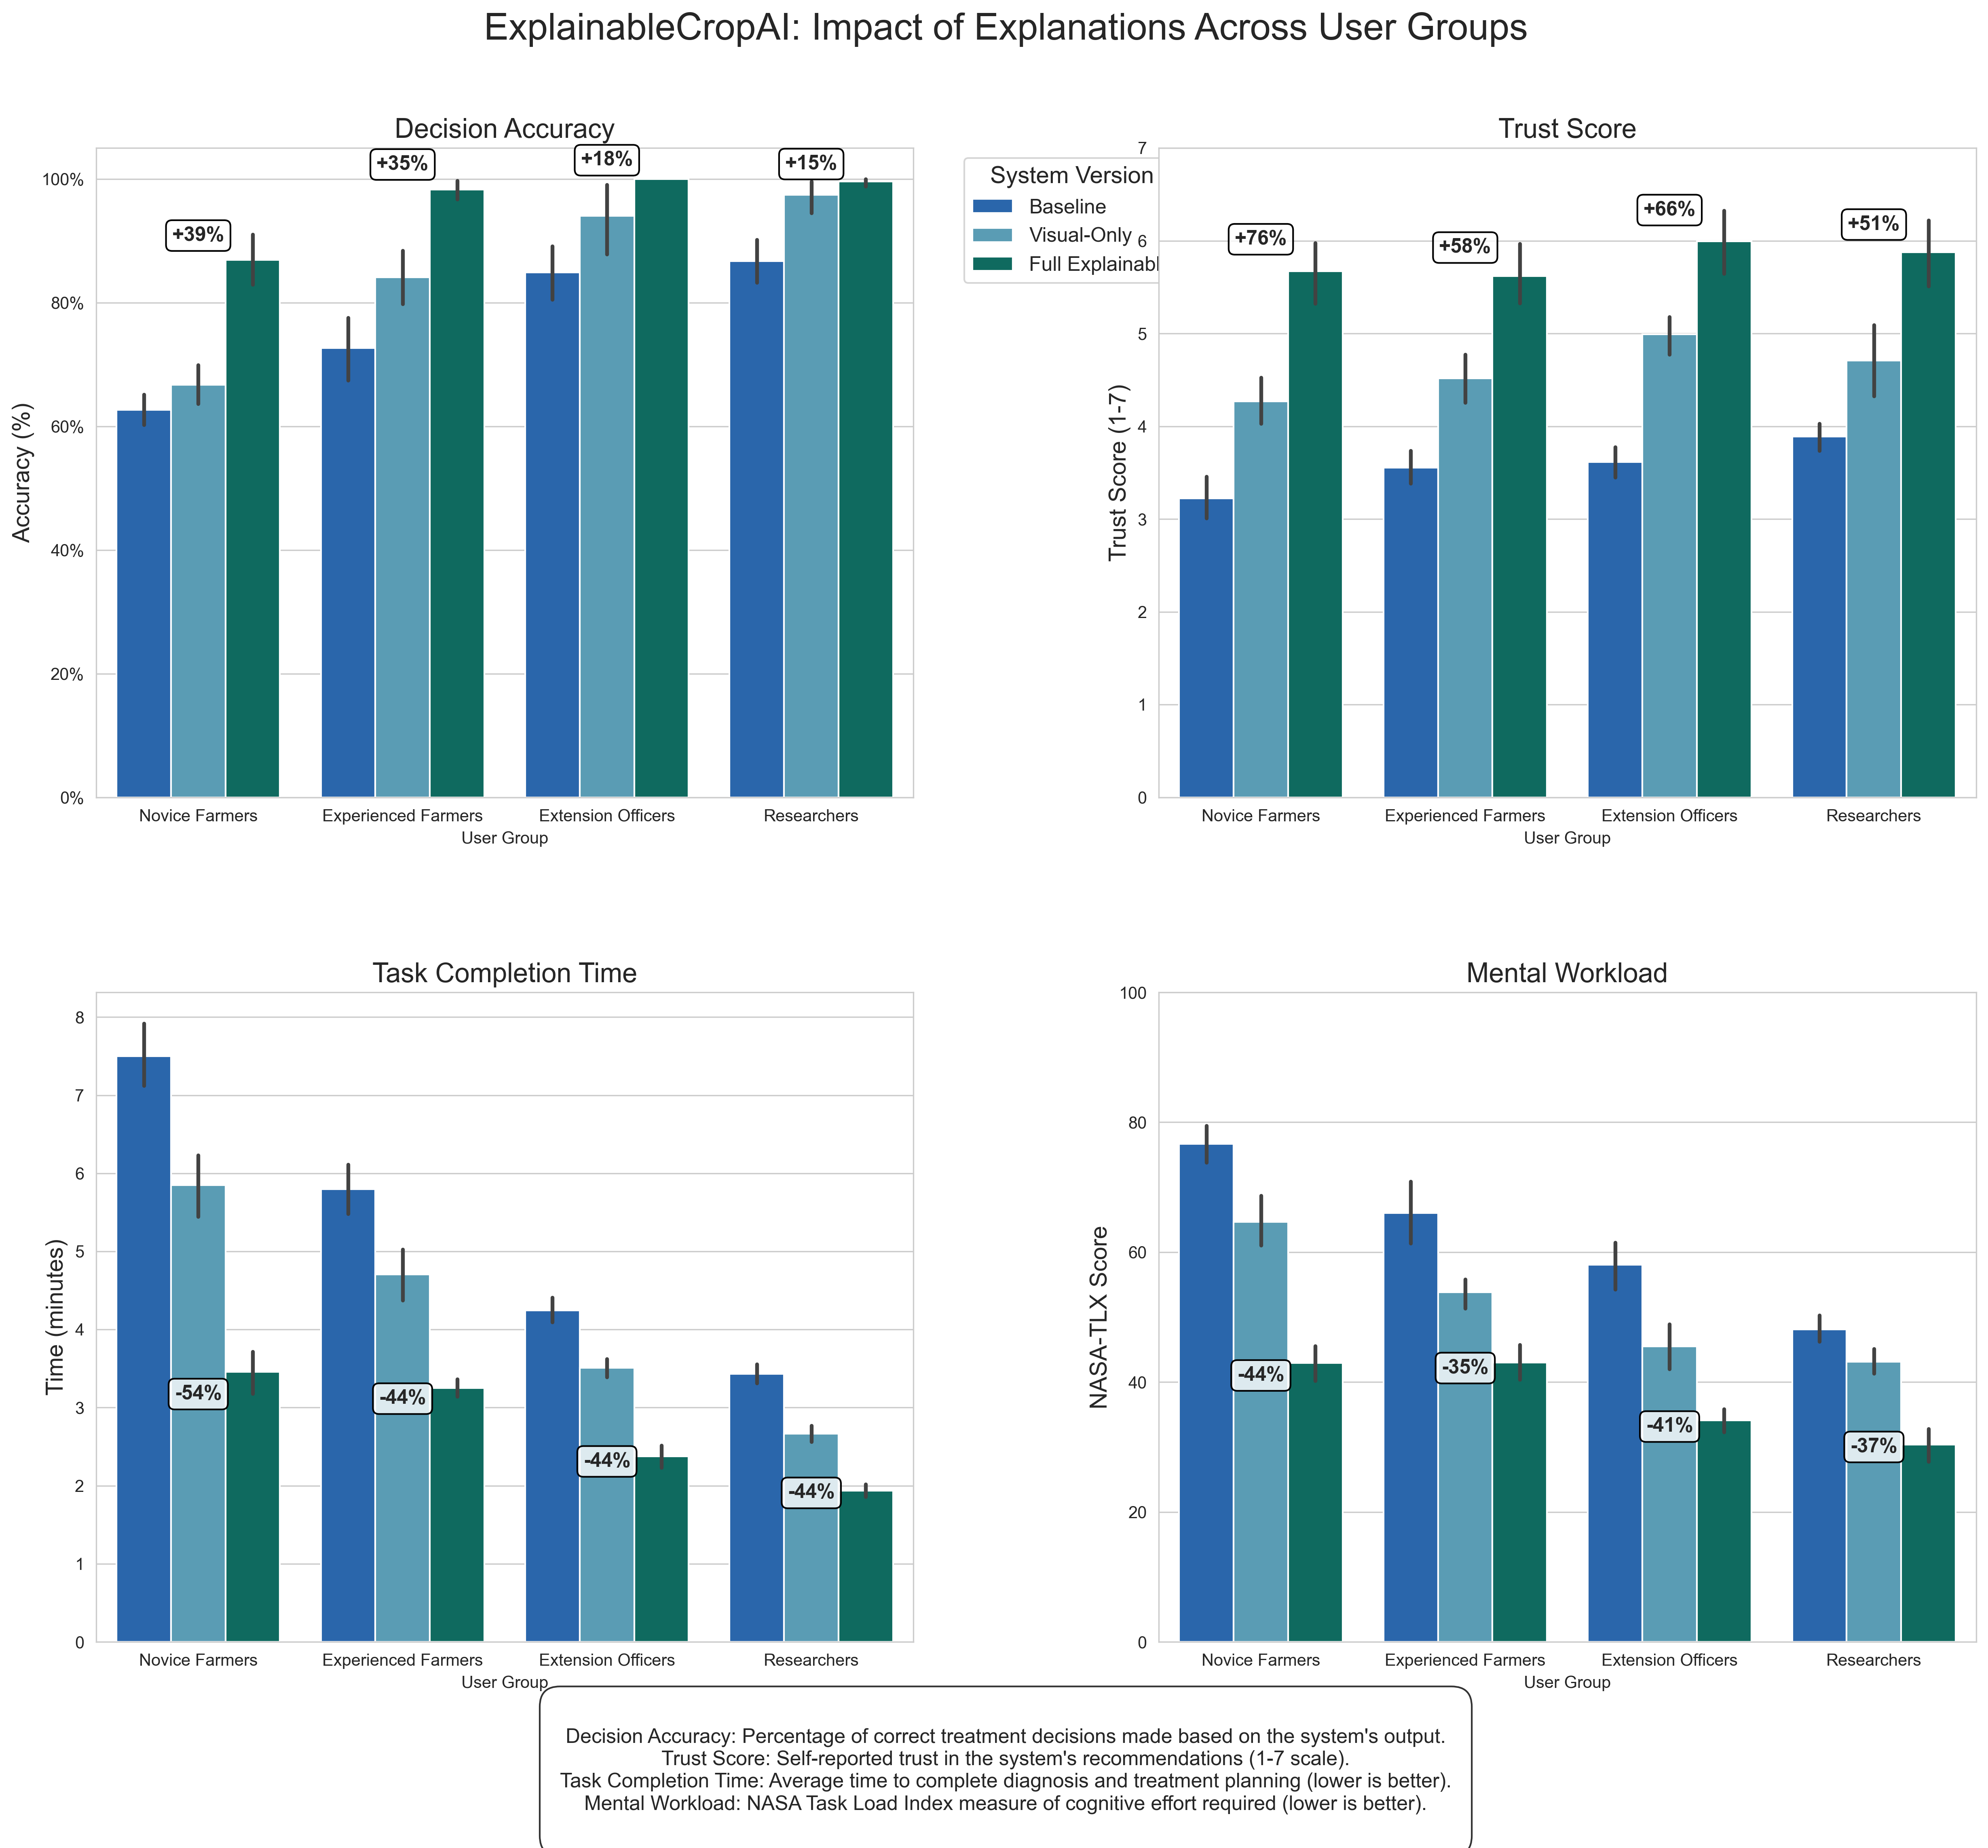
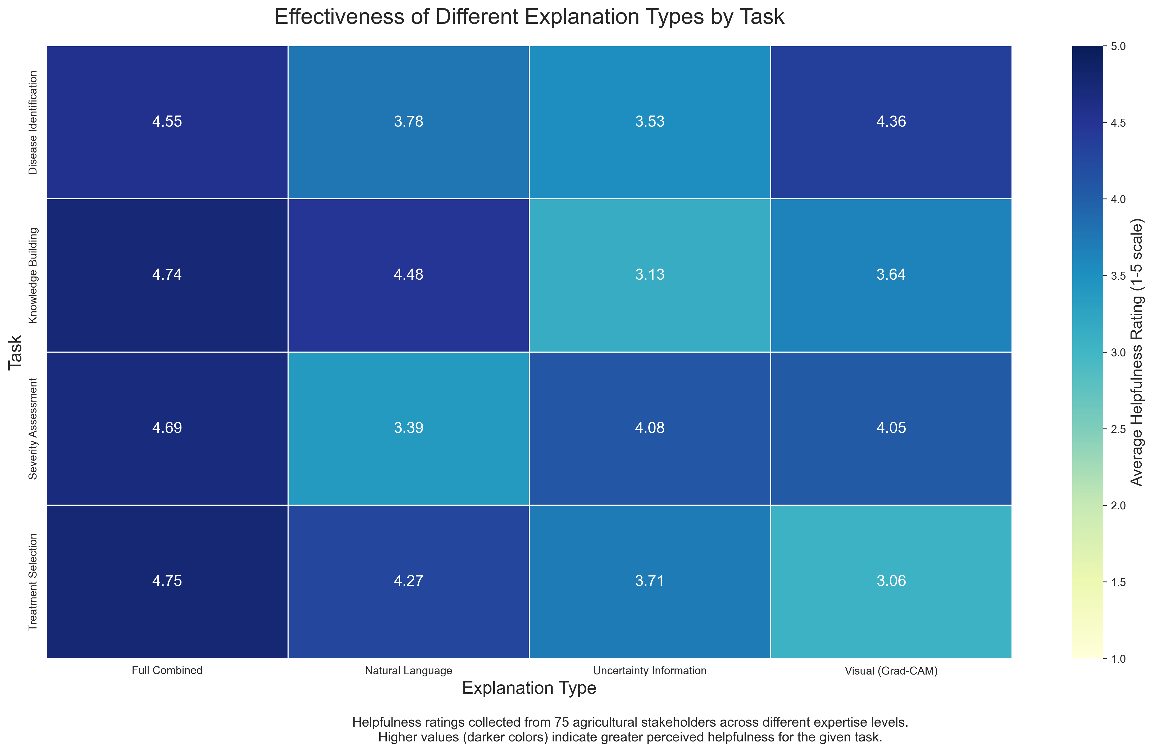
User Evaluation Results
User studies demonstrate improved decision-making accuracy and trust with explanation systems

Slide 8
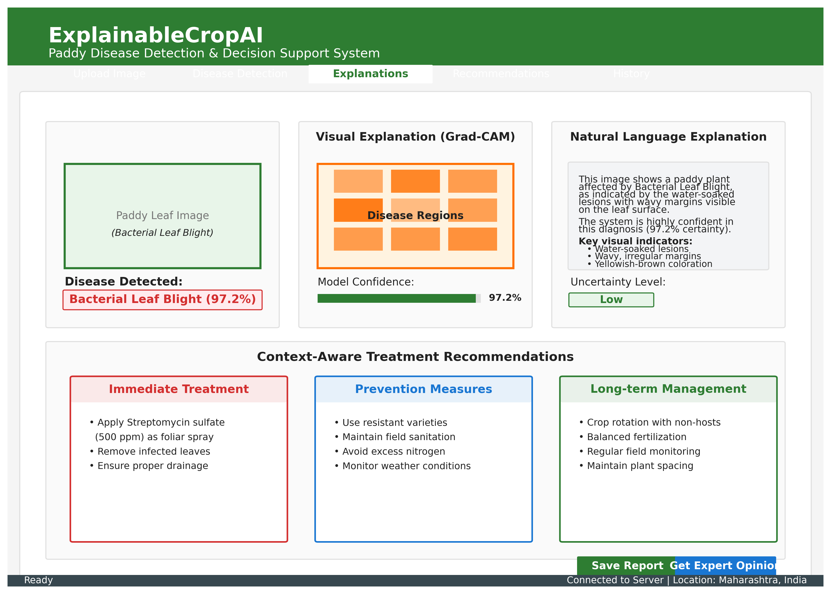
System Interface & User Experience
Intuitive interface integrating visual explanations, uncertainty estimates, and treatment recommendations

Slide 9
Key Contributions & Impact
Research Contributions:
• Novel Multi-level Explanation Framework
- First comprehensive explainable AI system for paddy diseases
- Integration of visual, textual, and uncertainty explanations
• Domain-Specific Knowledge Integration
- Agricultural expertise embedded in AI explanations
- Context-aware recommendation generation
• Empirical Validation
- Demonstrated impact on user trust and decision-making
- Competitive accuracy without sacrificing explainability
Broader Impact:
• Agricultural Sustainability
- Earlier disease detection and targeted interventions
- Reduced unnecessary pesticide application
• Responsible AI Deployment
- Blueprint for explainable AI in agriculture
- Bridging AI performance and human interpretability

Slide 10
Limitations & Future Directions
Current Limitations:
• Dataset geographic constraints
• Controlled evaluation environment
• Manual input of contextual factors
• Computational requirements for resource-constrained devices
Future Directions:
• Personalized and Interactive Explanations
- Adaptive explanation generation
- User feedback integration
• Extended Applications
- Multiple crop types and diseases
- Broader agricultural decision contexts
• Enhanced Deployment
- Lighter-weight mobile implementations
- Real-world field testing
• Long-term Studies
- Learning effects over time
- Adoption patterns analysis

Slide 11
Conclusion
Key Takeaways:
• ExplainableCropAI successfully bridges the gap between AI accuracy and interpretability
• Multi-level explanations provide comprehensive decision support for agricultural stakeholders
• 90% disease classification accuracy demonstrates that explainability doesn't compromise performance
• User evaluation confirms improved trust and decision-making with explanations
• Framework provides a foundation for responsible AI deployment in agriculture
Impact Statement:
"Transforming AI from a black-box prediction tool into an assistive technology that augments farmer decision-making"
This research contributes to the critical advancement of trustworthy AI systems in agriculture, supporting sustainable farming practices and food security.

Slide 12
Acknowledgments & Contact
Acknowledgments:
• Symbiosis Institute of Technology for research support
• Faculty guidance and mentorship
• Academic research community at Symbiosis International University
Contact Information:
• Author: Santosh Kumar
• Email: santosh.kumar.mtech2022@sitpune.edu.in
• Institution: Symbiosis Institute of Technology
• GitHub: github.com/santoshray02/ExplainableCropAI
Research Context:
This research was conducted as part of an M.Tech program, representing an academic exploration of explainable AI techniques applied to agricultural disease detection.
Thank you for your attention!
Questions and Discussion Welcome

