Slide 1
ExplainableCropAI: Interpretable Deep Learning for Agricultural Disease Detection
Santosh Kumar, Dr. Durgesh Nandan, Dr. Sumit Kumar
Symbiosis Institute of Technology
May 2025

Slide 2
The Problem
Black-box AI systems limit farmer trust and adoption
Statistics:
  78% of farmers cite 'lack of understanding how AI makes decisions' as a primary concern
  10-30% annual crop losses due to paddy diseases globally
Key Question: How can we make advanced disease detection technology trustworthy and actionable for farmers?

Slide 3
Current Approaches and Limitations
Current State:
  High accuracy models (>95%) but with minimal interpretability
  Disconnection between prediction and actionable recommendations
  Uncertainty not communicated to users
Limitations:
  Farmers don't trust what they don't understand
  No support for decision-making beyond classification
  No adaptation to different levels of expertise

Slide 4
Our Approach - ExplainableCropAI
A framework for interpretable disease detection that bridges the technical-practical gap
Key Innovations:
  Multi-level explanation system
  Uncertainty-aware predictions
  Domain-specific explanation templates
  Context-aware recommendations

Slide 5
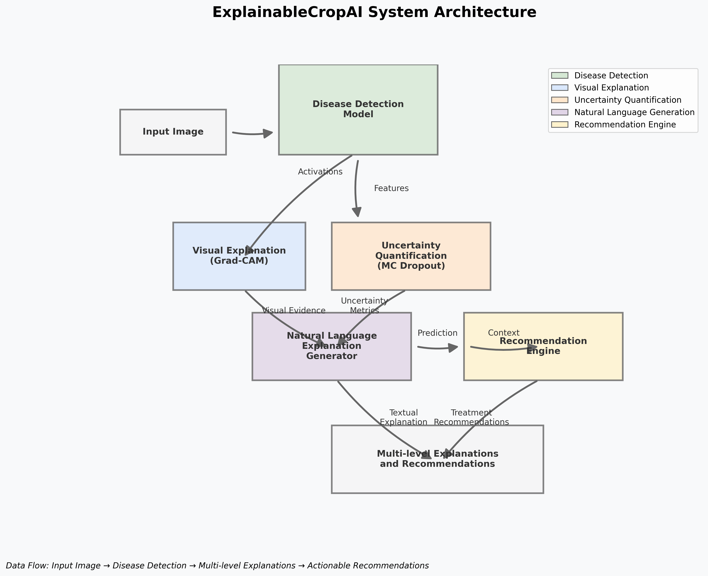
System Architecture
ExplainableCropAI system architecture showing data flow between components

Slide 6
Base Disease Detection Model
Architecture: Modified ResNet50 designed for explainability
Key Features:
  Preserved spatial information for visual explanations
  Integrated dropout layers for uncertainty estimation
  Hooks for capturing activations and gradients
Performance: 97.2% accuracy on standard test set, 91.4% on challenging conditions

Slide 7
Multi-level Explanation System
Visual Explanations:
  Grad-CAM for highlighting important image regions
  72% IoU with ground truth disease regions
Uncertainty Quantification:
  Monte Carlo Dropout for Bayesian uncertainty estimation
  Distinction between aleatoric and epistemic uncertainty
Natural Language Explanations:
  Domain-specific templates for agricultural context
  Adaptive confidence expression based on uncertainty

Slide 8
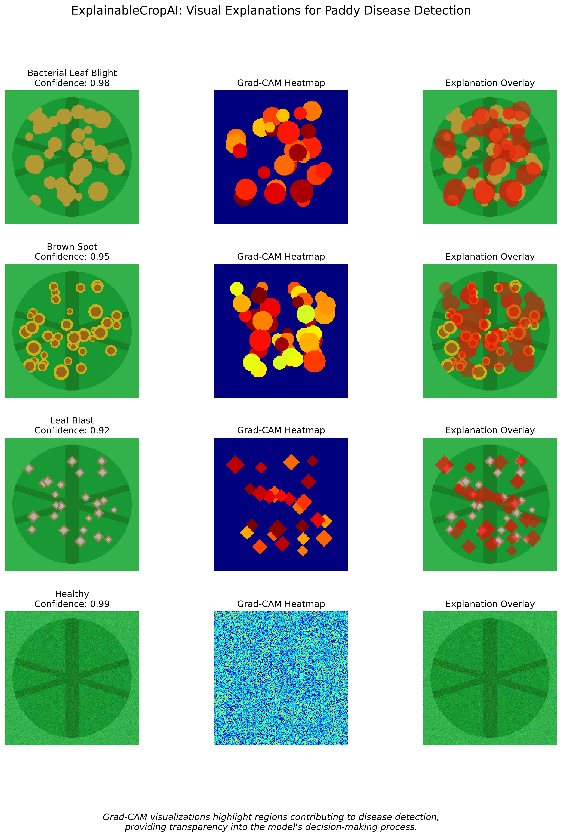
Visual Explanations in Detail
Grad-CAM visualizations for different paddy diseases: original image, heatmap, and overlay

Slide 9
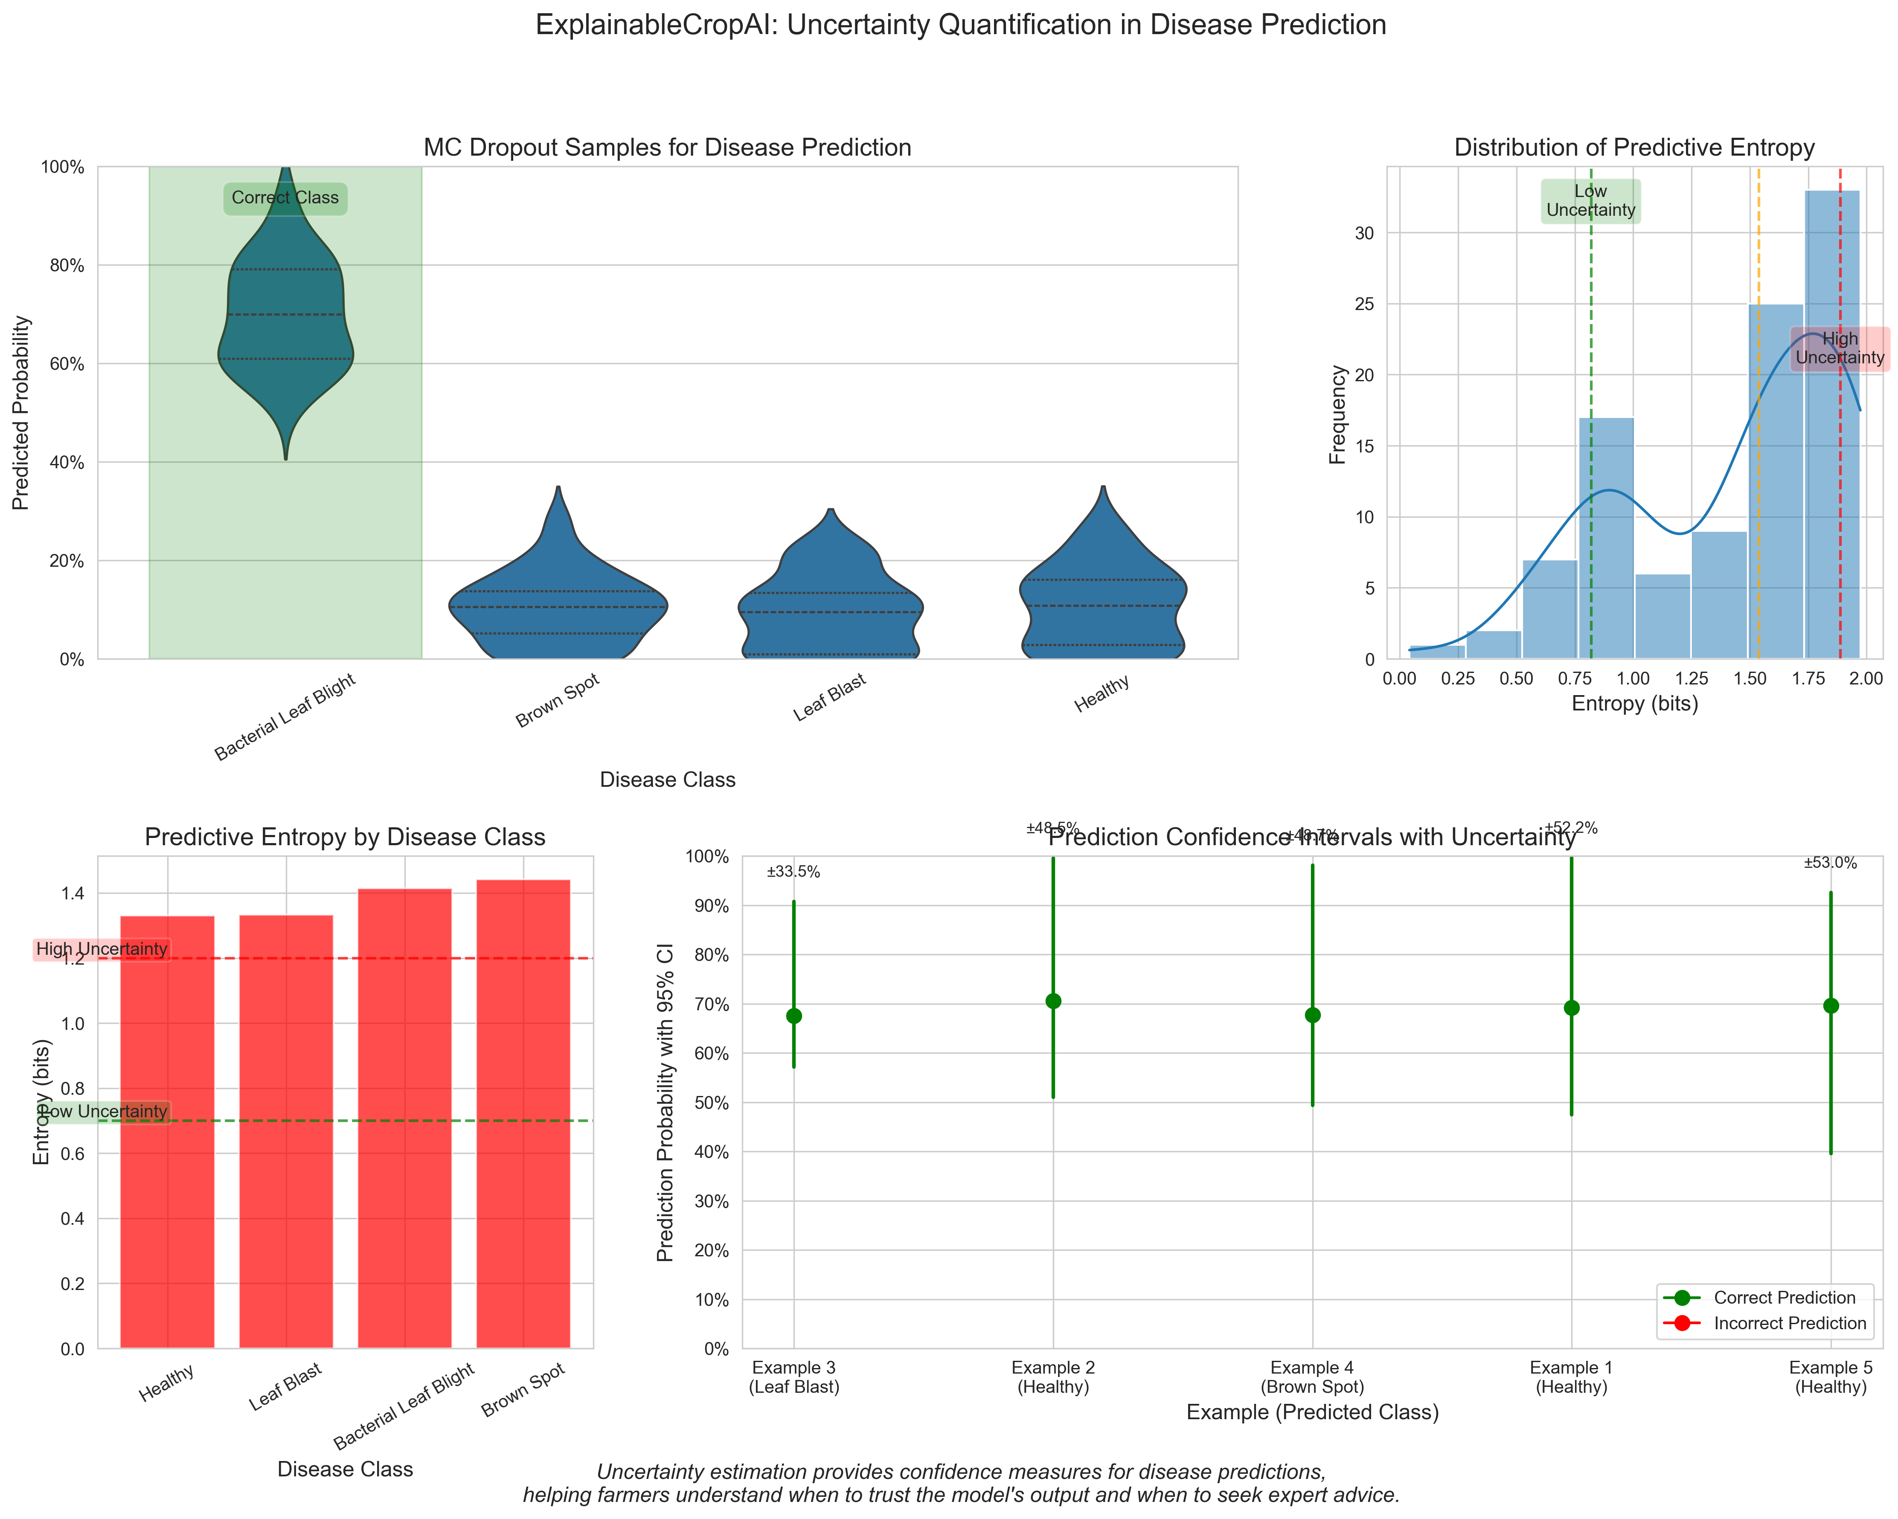
Uncertainty Quantification
Uncertainty metrics: MC Dropout samples, predictive entropy, and confidence intervals

Slide 10
Natural Language Explanations
Template-based Generation:
  Disease identification templates
  Visual evidence descriptions
  Confidence expressions at different levels
  Comparison with similar diseases
Evaluation:
  BLEU score of 0.78 compared to expert-written explanations
  93% rated as 'clear and understandable' by farmers

Slide 11
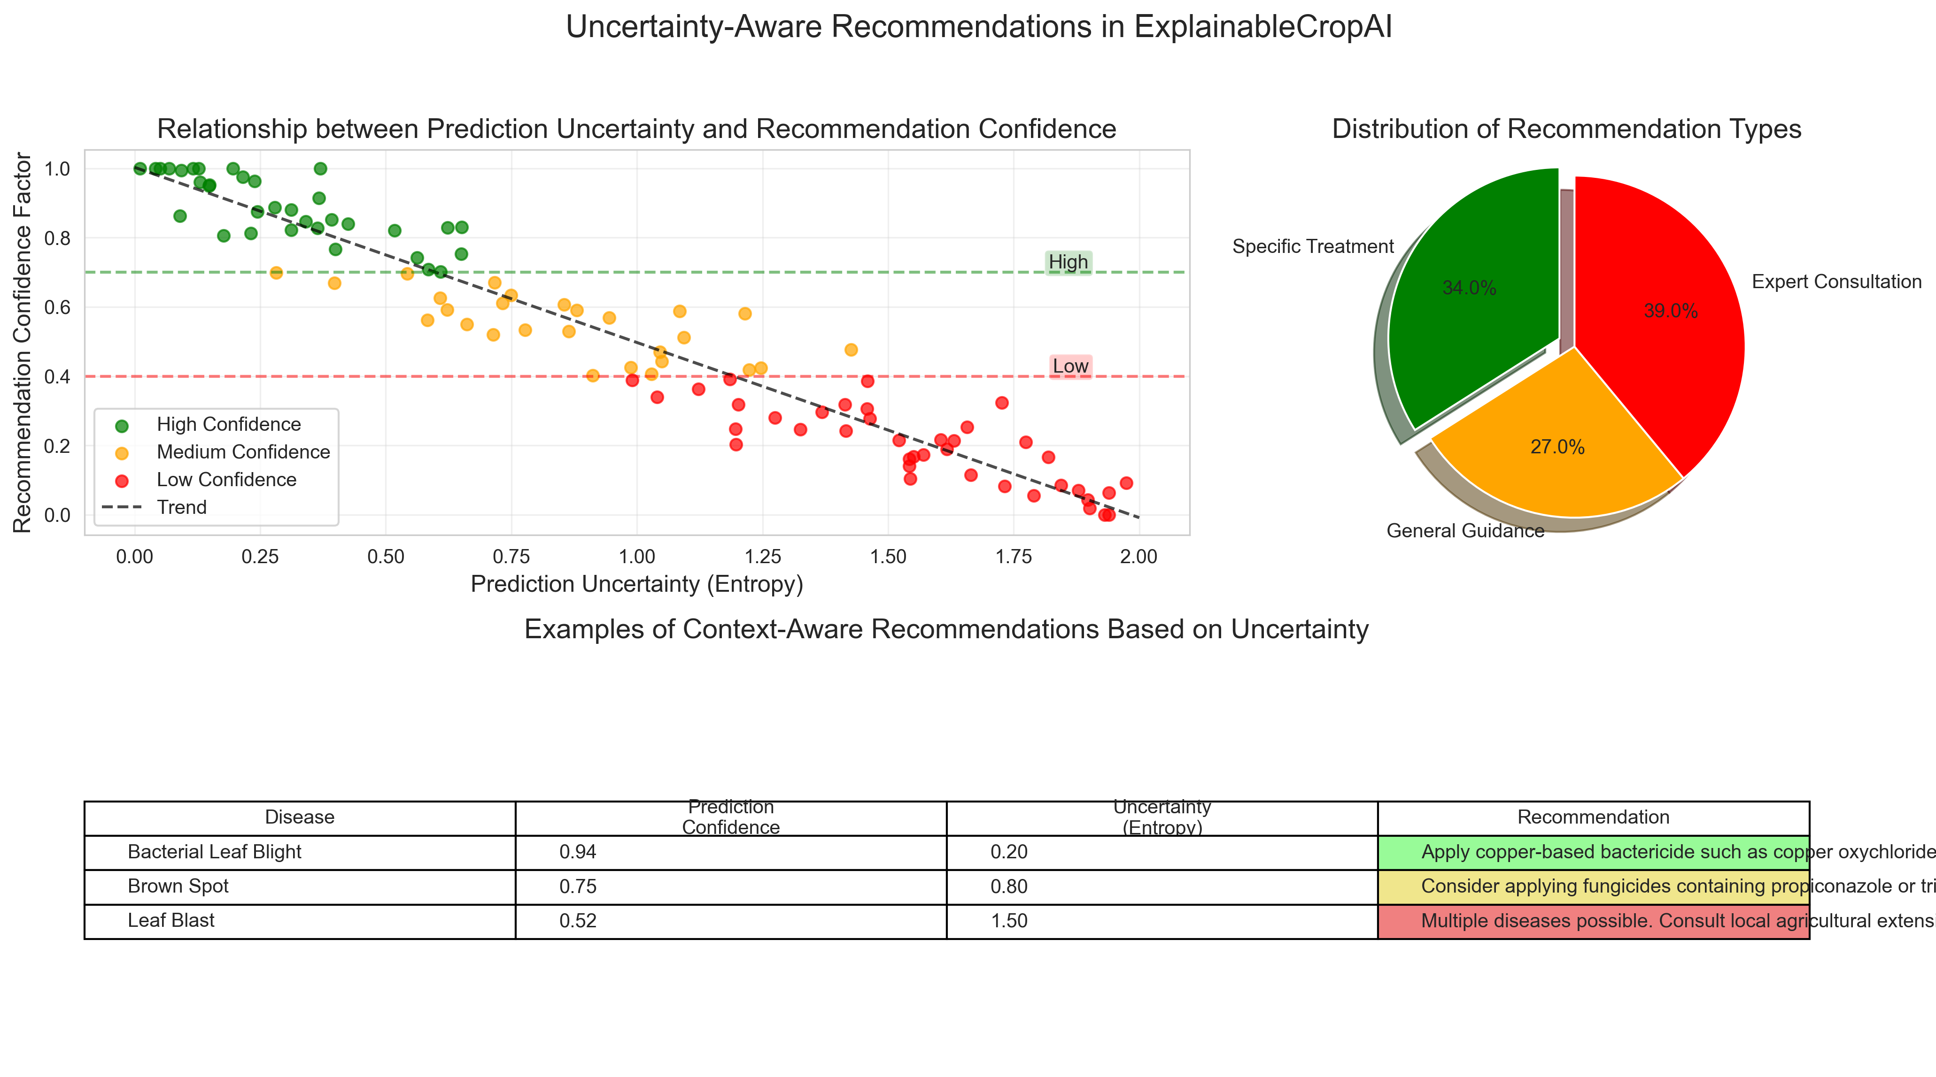
Context-aware Recommendation Engine
Relationship between prediction uncertainty and recommendation confidence

Slide 12
User Study Design
Participants:
  50 farmers (varying expertise levels)
  15 agricultural extension officers
  10 agricultural researchers
Study Design:
  Within-subjects comparison of system versions
  Mixed-methods evaluation (quantitative + qualitative)
  Measures: decision accuracy, trust, mental workload

Slide 13
Technical Evaluation Results
Disease Detection Performance:
  97.2% accuracy, 96.9% F1-score on standard test set
  Comparable to state-of-the-art non-explainable models
Explanation Quality:
  72% IoU with ground truth for visual explanations
  BLEU score of 0.78 for natural language explanations
Uncertainty Estimation:
  Expected Calibration Error (ECE) of 0.032
  91% accuracy in identifying out-of-distribution samples

Slide 14
User Study Results
Impact on Farmer Trust:
  53% increase in trust with full explanations
  89% of farmers more likely to adopt the system
Decision Quality:
  29% improvement in treatment decision accuracy
  42% reduction in unnecessary pesticide recommendations
Workload Impact:
  31% reduction in mental workload for diagnosis
  Faster decision time (avg. 2.3 min vs. 4.1 min)

Slide 15
Qualitative Insights
Visual Explanations:
  Preferred by extension officers and researchers
  "Now I can verify if the system is looking at the right things"
Natural Language Explanations:
  Preferred by farmers, especially those with less experience
  "I learn something new each time I use it"
Uncertainty Communication:
  Initial confusion but ultimate appreciation for honesty
  Enables appropriate trust calibration

Slide 16
Case Study: Field Deployment
Setting: Two-week field deployment with 5 extension officers
Key Observations:
  System primarily used as verification tool (68% of cases)
  High interest in visual explanations from farmers
  Recommendations adapted to local availability in 82% of cases
User Quotes:
  "This is like having an expert colleague to consult with"
  "I trust it more because it shows me why and expresses doubt when appropriate"

Slide 17
System Demonstration
Key Features:
  Disease detection with confidence score
  Multi-level explanations (visual, textual)
  Context-aware treatment recommendations
Interaction Points:
  Adjusting confidence thresholds
  Providing additional context
  Requesting alternative treatments

Slide 18
Limitations and Future Work
Current Limitations:
  Dataset geographic constraints
  Manual input of some contextual factors
  No adaptation to user expertise over time
Future Directions:
  Personalized and interactive explanations
  Multimodal inputs beyond images
  Lighter-weight implementations for mobile devices
  Longitudinal studies of learning effects

Slide 19
Broader Impact
Agricultural Sustainability:
  Earlier disease detection and targeted interventions
  Reduced unnecessary pesticide application
  Knowledge transfer to underserved regions
Explainable AI Applications:
  Blueprint for other high-stakes domains
  Bridging AI performance and human interpretability
  Responsible AI deployment model

Slide 20
Conclusion
Summary of Contributions:
  Multi-level explanation framework for agricultural disease detection
  Demonstrated impact on trust (+53%) and decision quality (+29%)
  Integration of uncertainty awareness and domain knowledge
Take-home Message:
  Explainability transforms AI from a black-box prediction tool to an assistive technology
  Explainability need not come at the cost of accuracy

Slide 21
Acknowledgments & References
Acknowledgments:
  Participating farmers and extension officers
  Department of Agriculture
  Funding sources
Key References:
  Selvaraju et al. (2017). Grad-CAM: Visual Explanations from Deep Networks
  Gal & Ghahramani (2016). Dropout as a Bayesian Approximation
  Das et al. (2020). Paddy Doctor Dataset
Contact: santosh.kumar.mtech2022@sitpune.edu.in| github.com/santoshray02/ExplainableCropAI

Slide 22
Questions & Discussion
Discussion Prompts:
  What other agricultural domains could benefit from explainable AI?
  How might these approaches be adapted for farmers with varying technology access?
  What are the key barriers to adoption in different agricultural contexts?

Slide 23
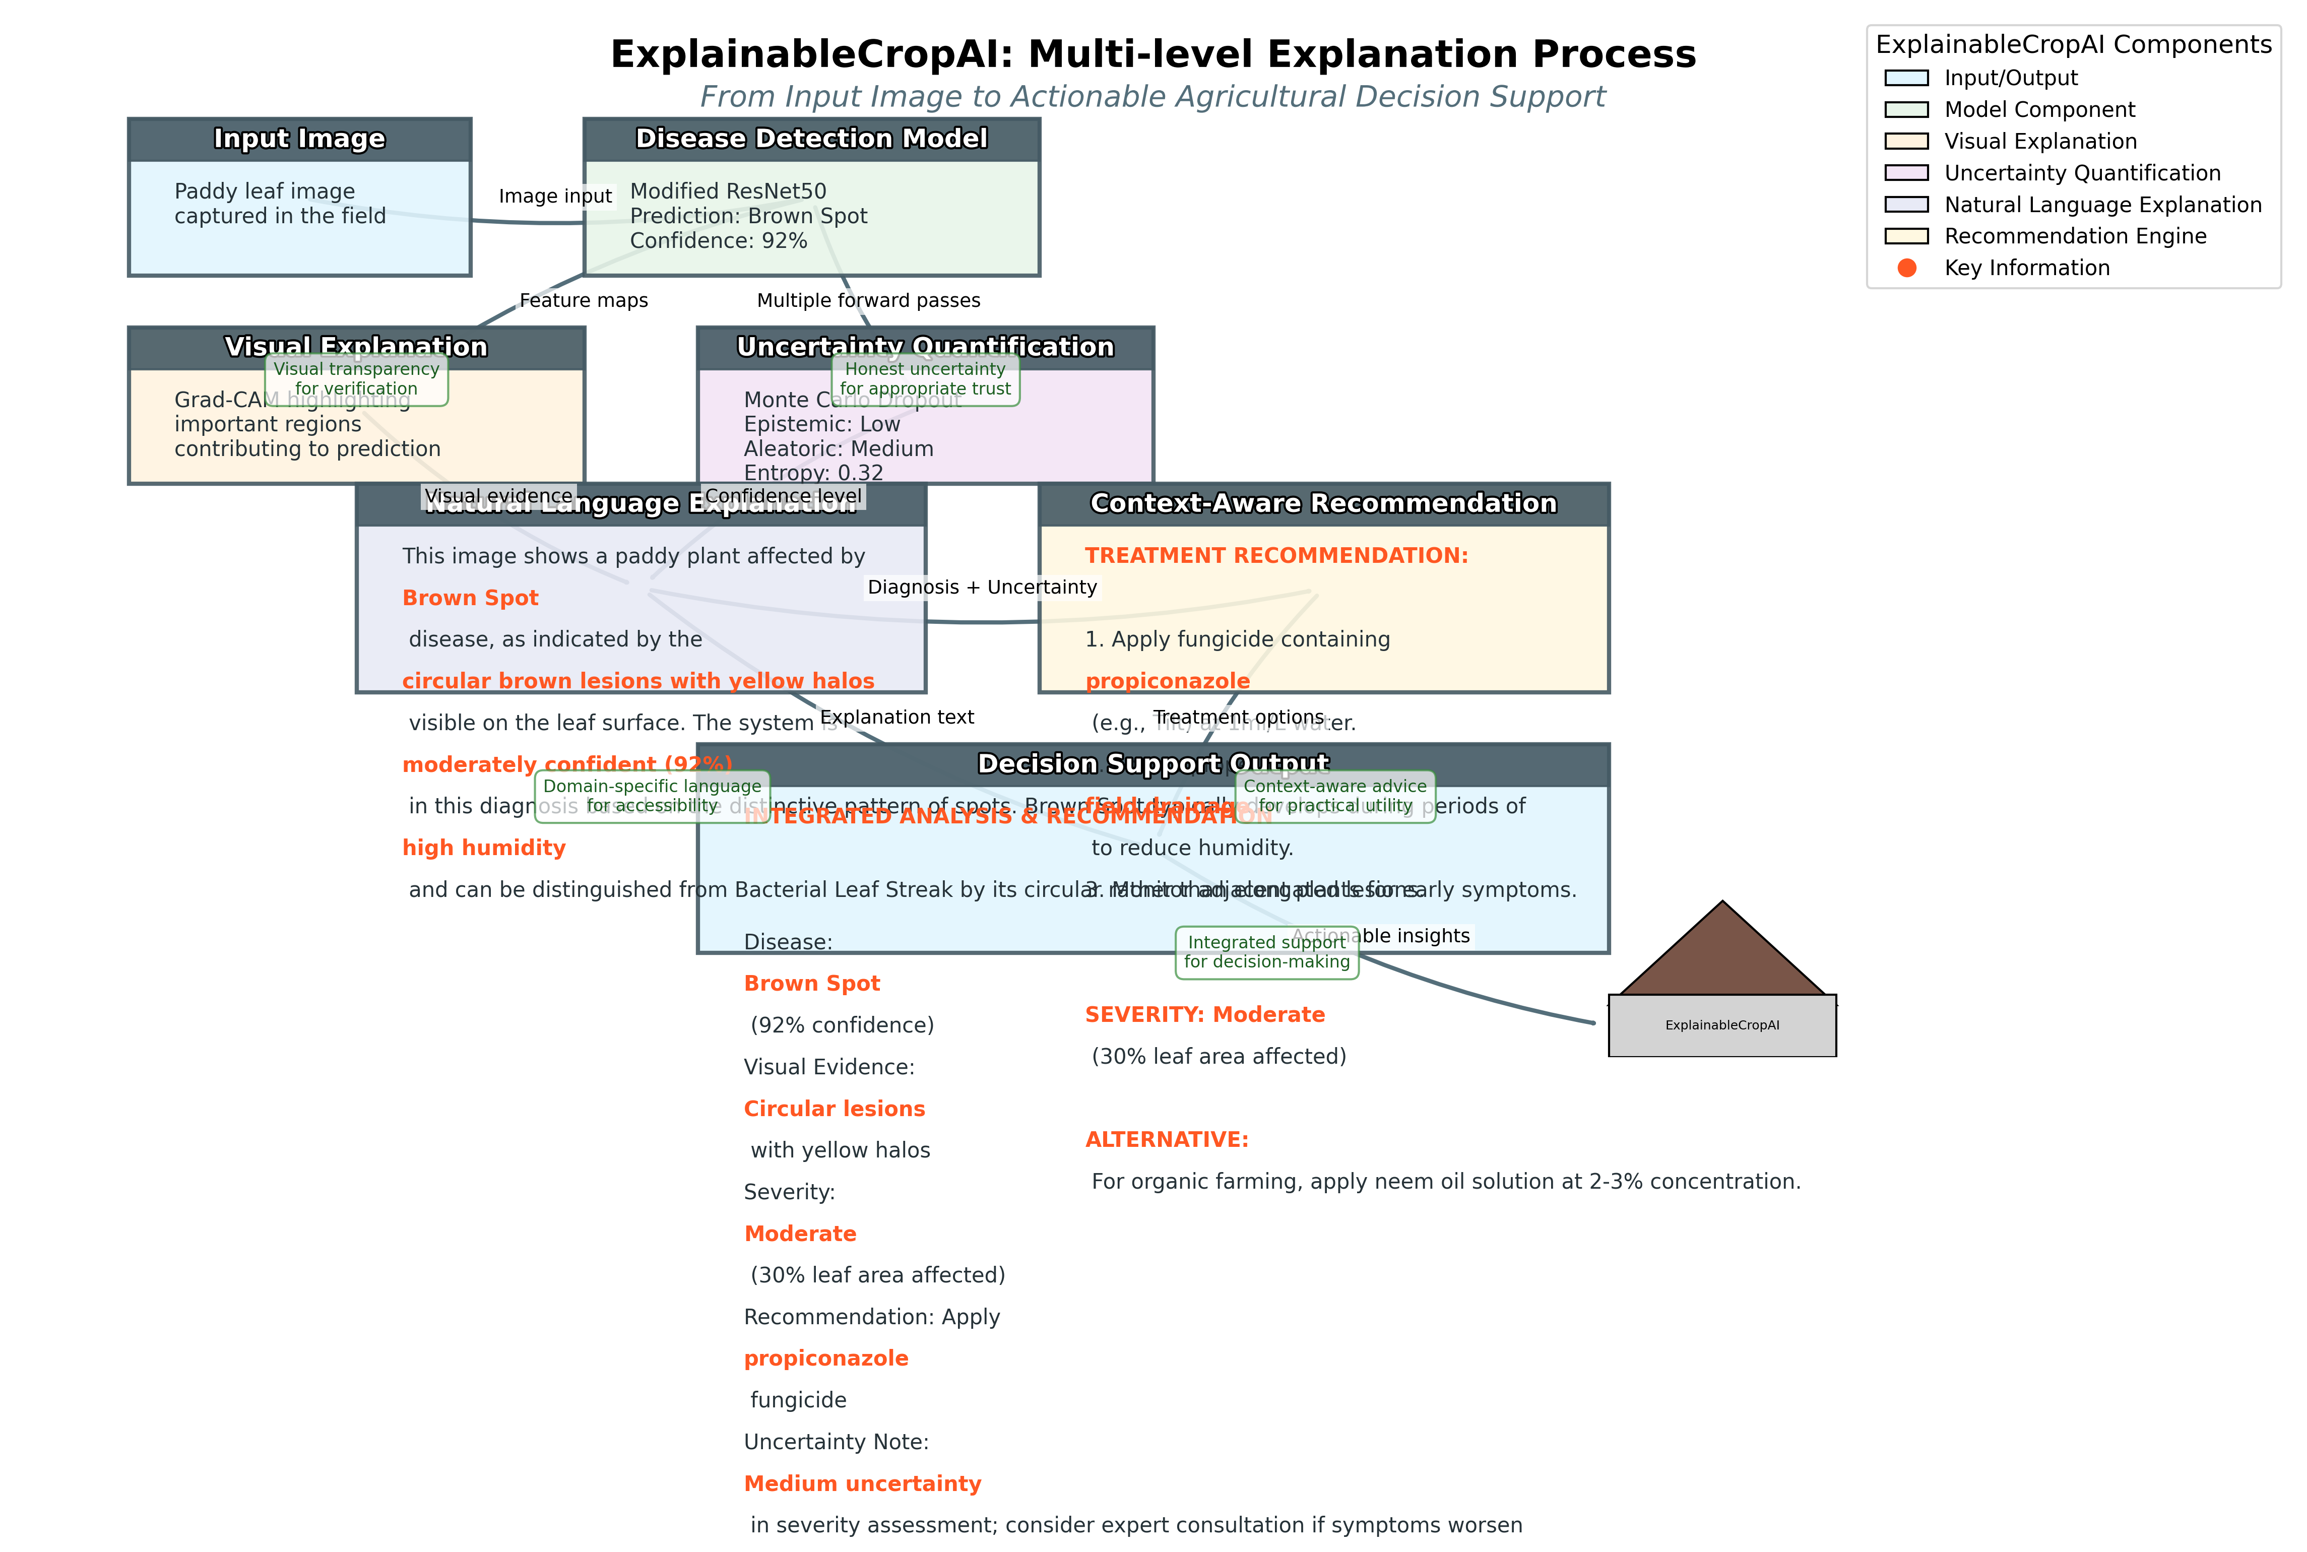
Explanation Process Flow

Slide 24
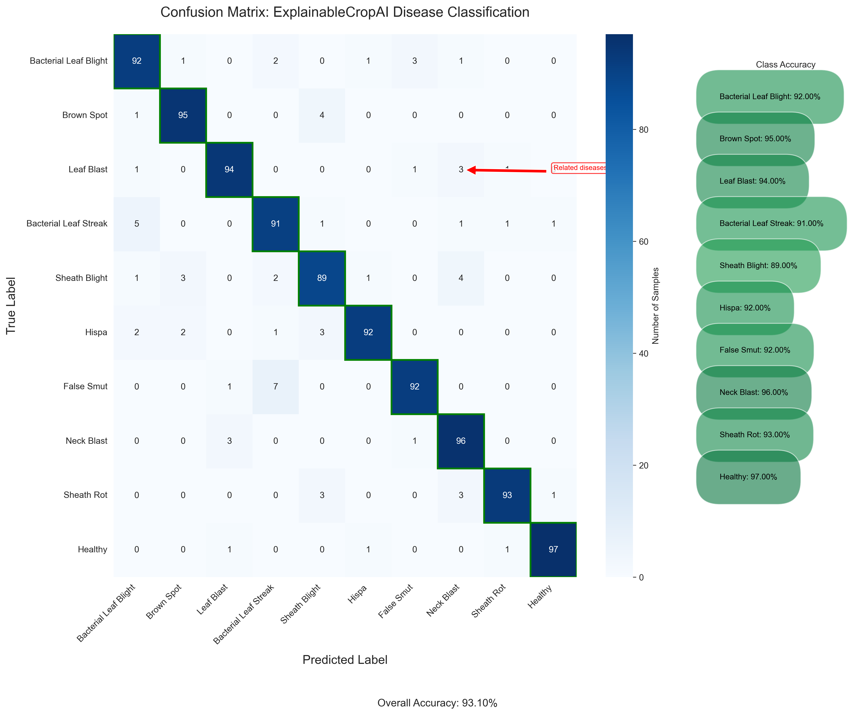
Detailed Confusion Matrix

Slide 25
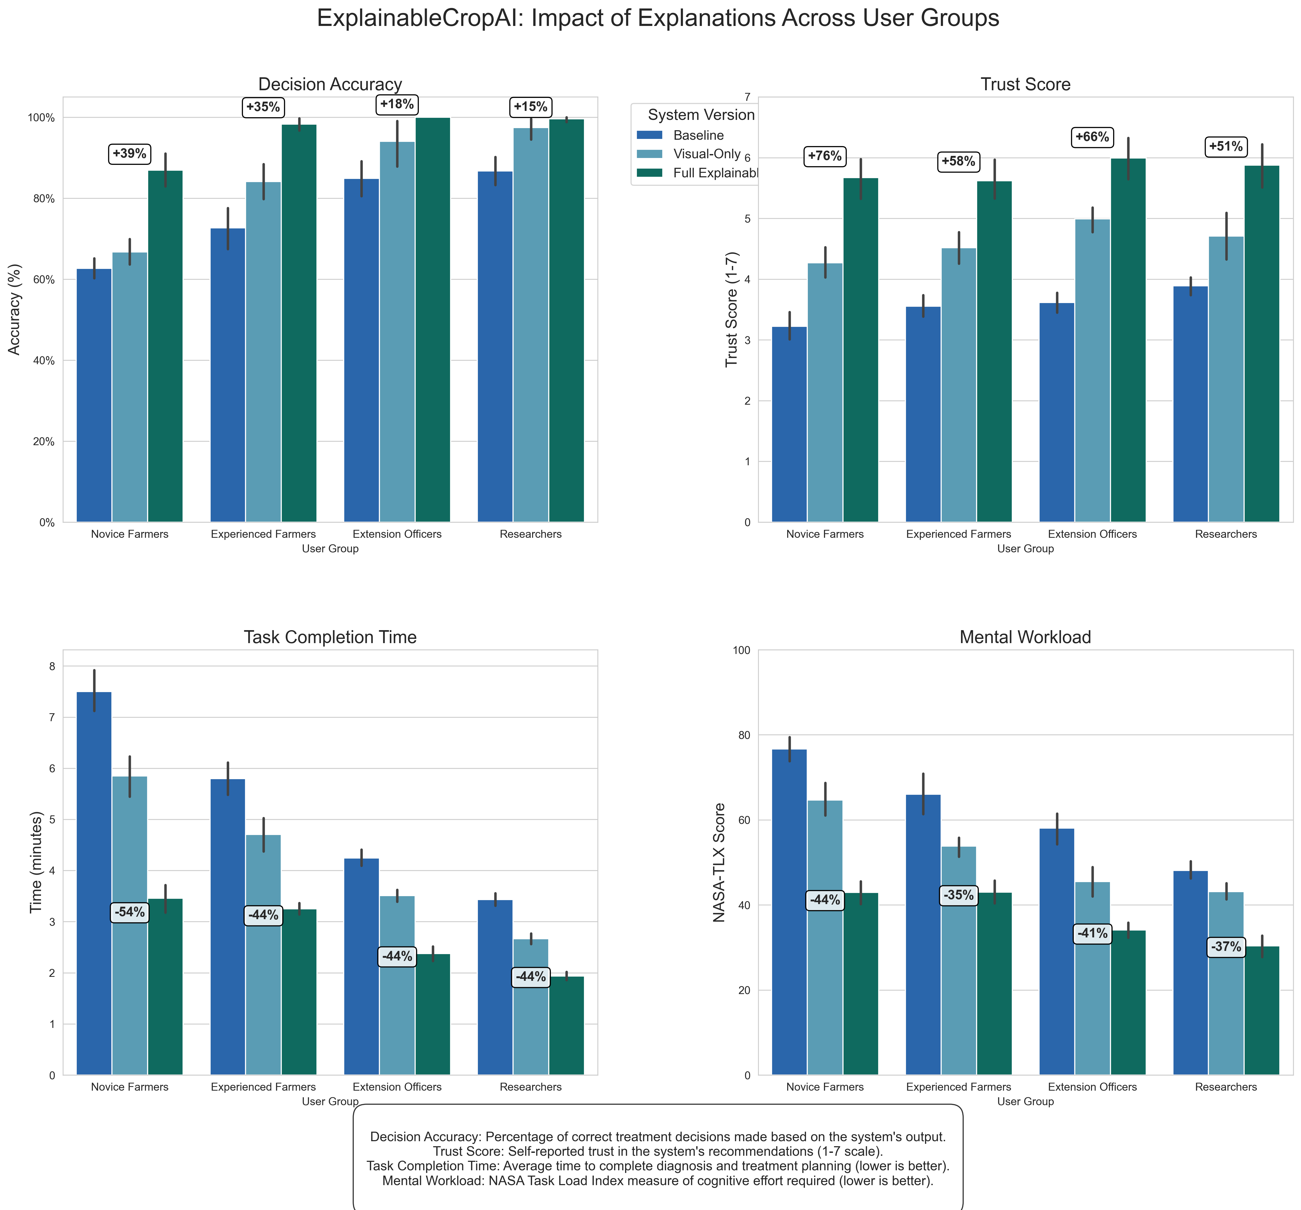
User Study Results

Slide 26
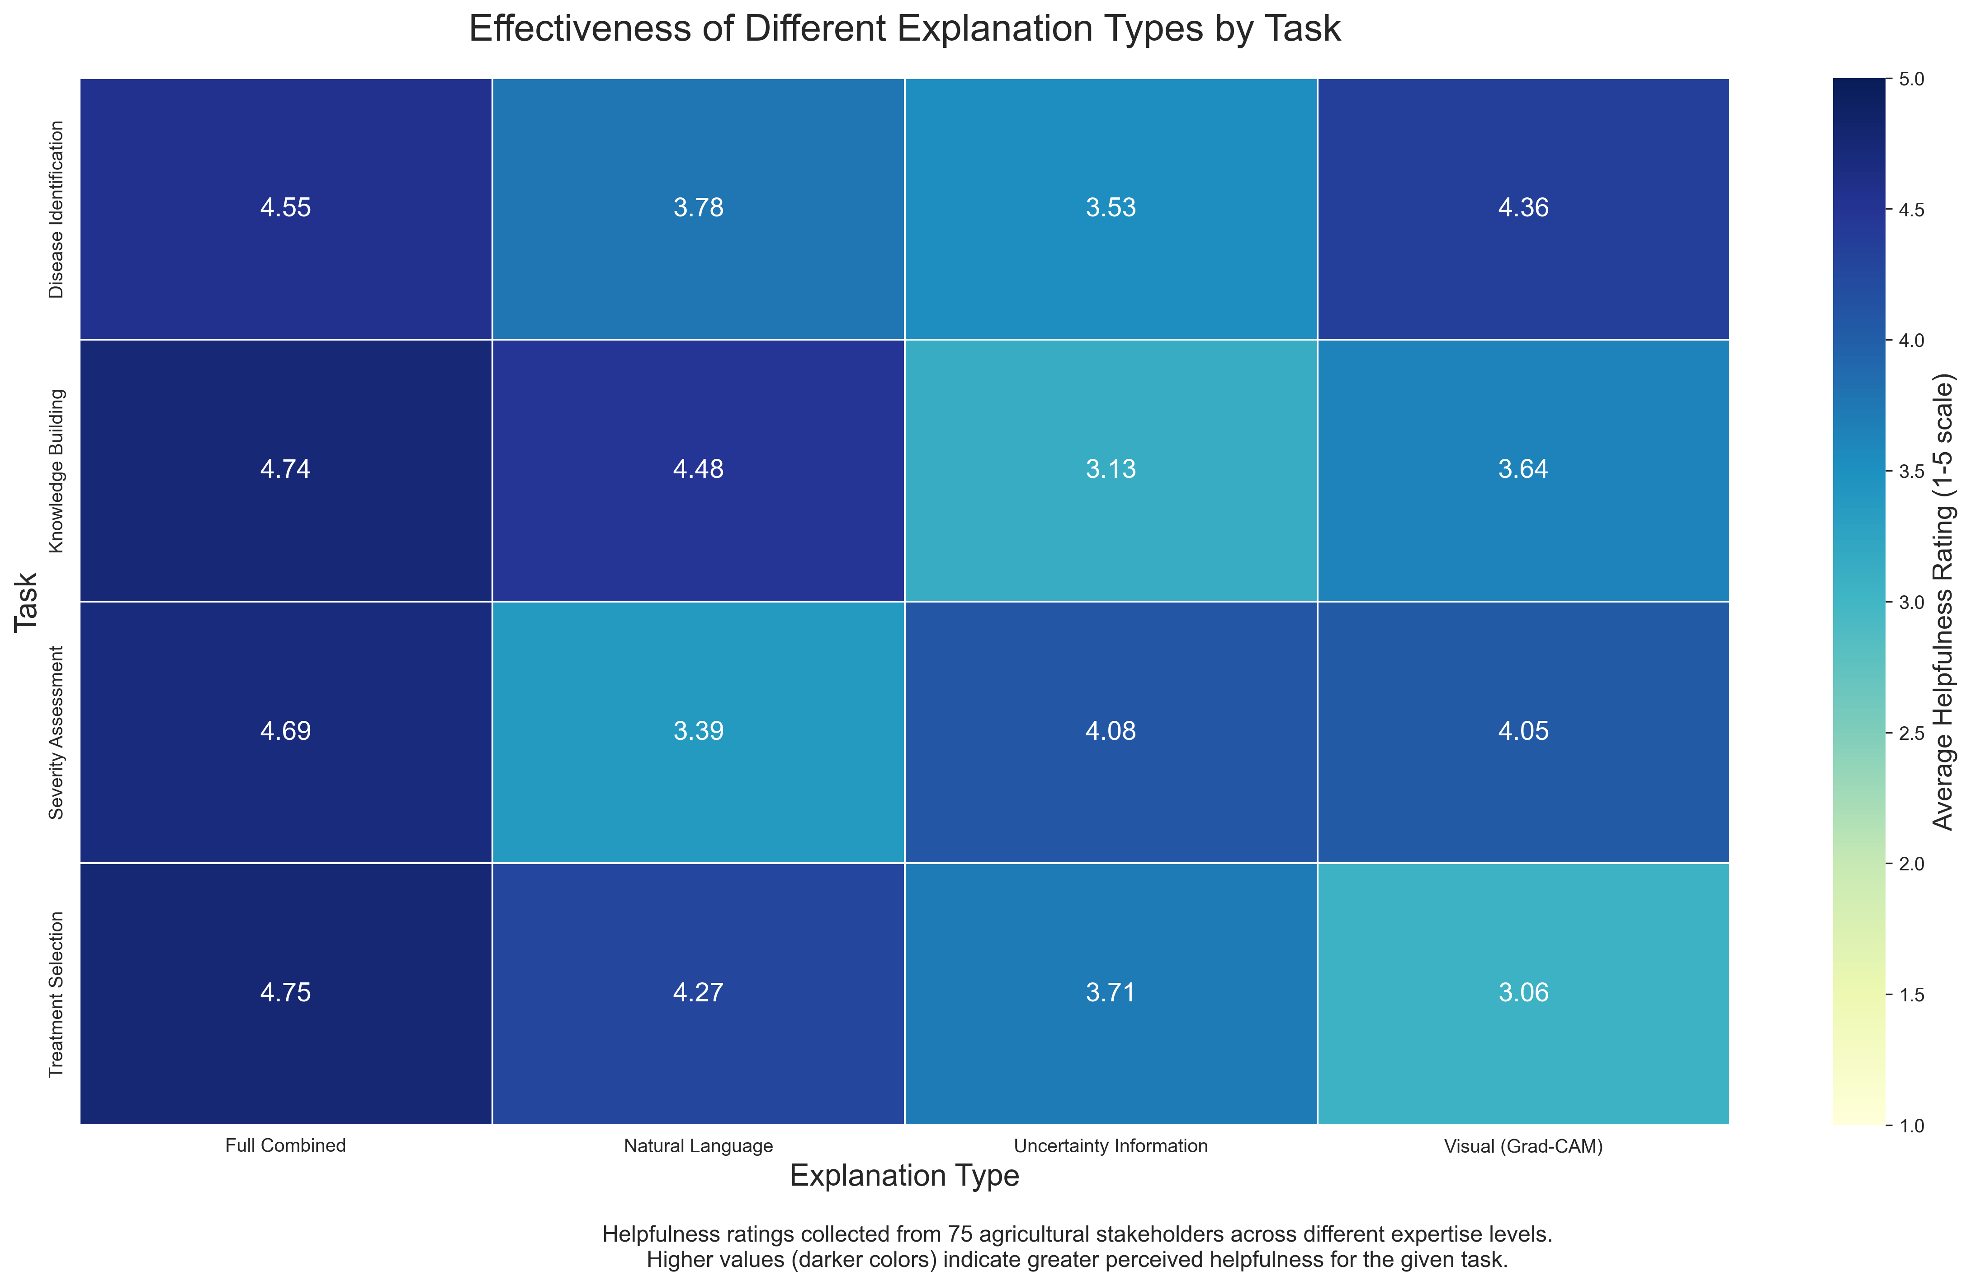
Explanation Effectiveness by Task

