Slide 1


Car Price Prediction Project
By – Santosh Reddy

Slide 2
Problem statement
With the covid 19 impact in the market, we have seen lot of changes in the car market. Now some cars are in demand hence making them costly and some are not in demand hence cheaper. One of our clients works with small traders, who sell used cars. With the change in market due to covid 19 impact, our client is facing problems with their previous car price valuation machine learning models. So, they are looking for new machine learning models from new data. We have to make car price valuation model. This project contains two phase- Data collection phase and Model building phase

Slide 3
You have to scrape at least 5000 used cars data. You can scrape more data as well, it’s up to you.
More the data better the model
In this section You need to scrape the data of used cars from websites (Olx, cardekho, Cars24 etc.)
You need web scraping for this. You have to fetch data for different locations. The number of
columns for data doesn’t have limit, it’s up to you and your creativity. Generally, these columns are Brand, model,
variant, manufacturing year, driven kilometers, fuel, number of owners, location and at last target variable Price of
the car. This data is to give you a hint about important variables in used car model. You can make changes to it,
you can add or you can remove some columns, it completely depends on the website from which you are fetching
the data.
Try to include all types of cars in your data for example- SUV, Sedans, Coupe, minivan, Hatchback. Note – The
data which you are collecting is important to us. Kindly don’t share it on any public
platforms.

Slide 4
After collecting the data, you need to build a machine learning model. Before model building do all data pre-
processing steps. Try different models with different hyper parameters and select the best model.
Follow the complete life cycle of data science. Include all the steps like
1. Data Cleaning
2. Exploratory Data Analysis
3. Data Pre-processing
4. Model Building
5. Model Evaluation
6. Selecting the best model

Slide 5
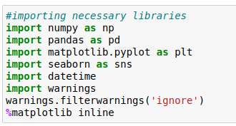
Importing the necessary libraries
We are going to import necessary libraries to use in the project
We imported some of the libraries that are mainly useful for analyze the data set,there are other libraries which will be imported in the flow of project, some are useful for statistical analysis and some are useful for visualization

Slide 6

Importing the data set
Now we have to import the data set in pandas we have read_csv function in the pandas to load the data set
We need to edit both the files as there will be null values in the dataset
We have imported the the data set lets check the shape of the data set and it has any null values

Slide 7
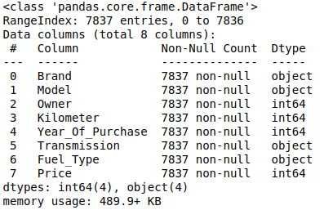
Exploratory Data Analysis
This is the step where we are going to analyze and represent dataset in visual way and we have to see if there is any pattern in the data so we have to use them for feature engineering
Lets stat with shape and
information of data-set in
pandas we have .shape
and .info() methods which
shows us information and
shape of the data

Slide 8
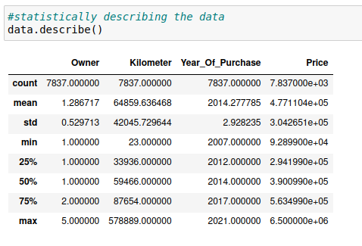
Describe function in pandas helps in the to get details about the statistical data like mean, median, std and percentiles of the data

Slide 9
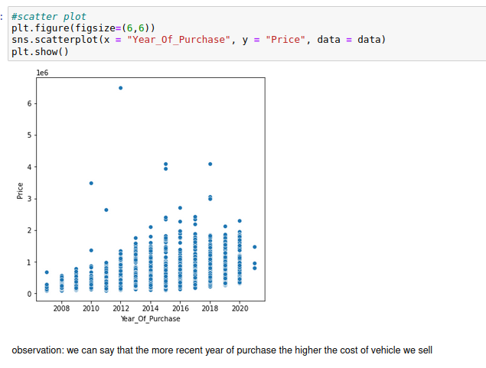

Slide 10
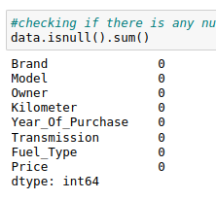
We have to check the null values in the data set, in
pandas we have .isnull() method to see the null values
in this data set we don't have any null values
Lets proceed further
When come to the visualization we have some
visualization libraries we have used in this project are
Matplotlib
Seaborn
yellow brick

Slide 11
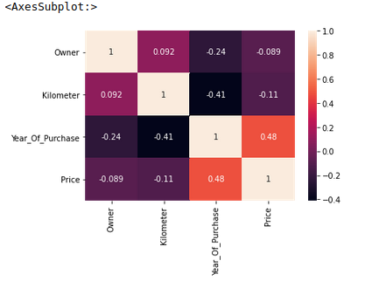
For visualization I have used matplotlib, seaborn, yellow brick , visualization is most important part of machine learning project as it tells us about the
Mainly if want to check the multicolinerarity or correlation and relation with the target variable we will be using visualizations I will display some of them
This is heatmap we will be
using for checking null vals
and correlation between
variables and target variables

Slide 12
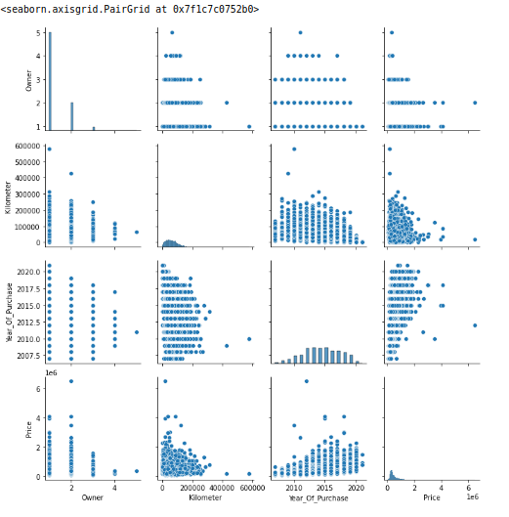
We see the distribution of the dataset weather it is properly distributed or not by the help of the pairplot

Slide 13
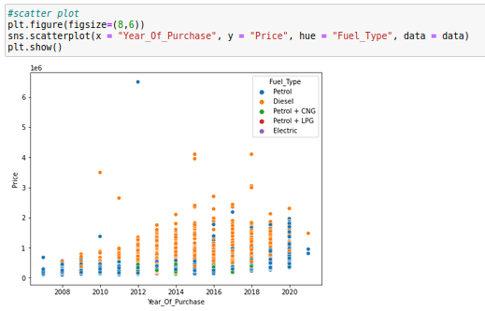
Here we are seeing scatter plots which shows us the data distribution and also the the way the data is distributed and it is most in model building, If data is distributes normally then there is no problem otherwise we have to make it normalize with methods liks log normal distribution

Slide 14
Correlation:
Correlation is defined as relation between two variables on how data is influenced by the change of another variable so lets check that
We will use it to know the relation between the other variables to target variable
Outliers:
we are trying to get cheking the outliers
of the data and we need to fix them

Slide 15
Feature Engineering and Feature Selection
Feature engineering is important step plays a important part of machine learning project,we have to make all the column data , as we can see we have categorical data which we cant feed to the machine learning model and we need no make them into binary data so that w e can feed them to model
Another thing is we have to encode the data , before feeding that to model , encoding the data enables us to categorize the data
Another thing to talk about is scaling the data, it is more essential part as we will have many types of data in a data set by scaling the data we will get all the columns in the same range

Slide 16
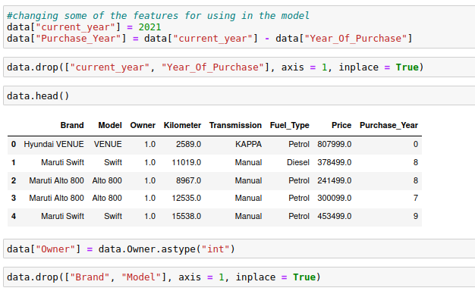
In this we are all converting the data forms in the encoded forms and also converting all the data-types to make the data ready for model creation

Slide 17
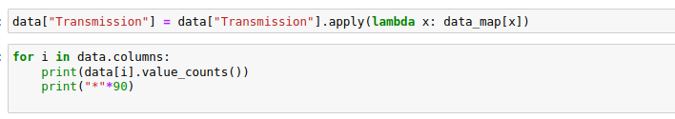
We have to make all the data encoded and we need to make sure that we have to feed simple data machine learning model so that model can learn approximately

Slide 18
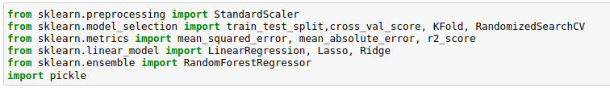
Model creation
Her I am using Linear Regression along with regularization Lasso and Ridge and random forest regressor so that we can predict the car prices
At first we need to import all the metrics and other things to get started

Slide 19
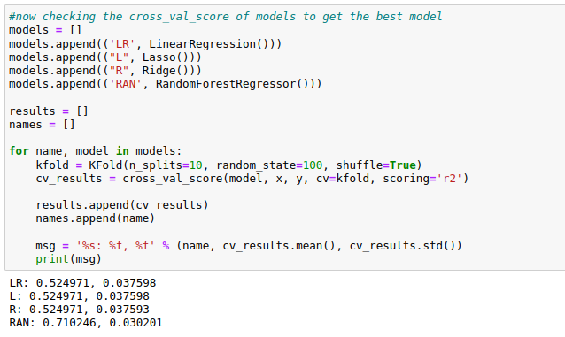
Checking the Cross Val Score
Before creating the model we have to check the cross val score to make sure that
Cross-validation is a technique in which we train our model using the subset of the data-set and then evaluate using the complementary subset of the data-set.

Slide 20
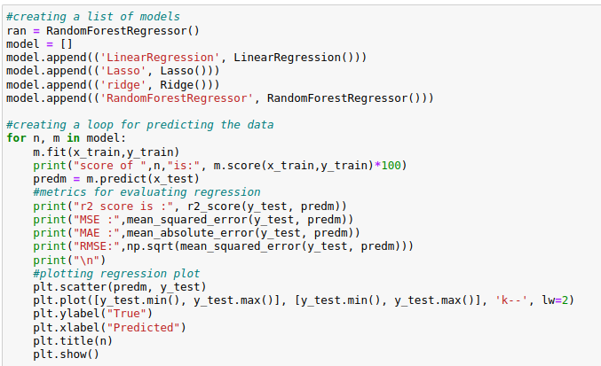
Model Creation
In this step we start using a set of a set of algorithms we need to create the model and them we need to predict the test data
We have used

Slide 21
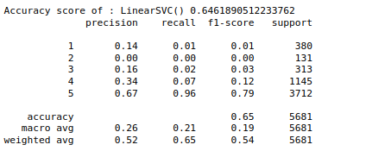
Accuracy
After creation of model we have to hve to check the accuracy of the model
We have to make a note of
r2 score, MSE
and MAE
these are important metrics
that defines the models
accuracy

Slide 22
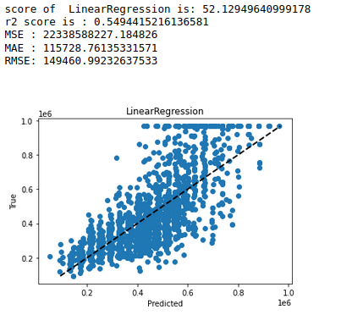
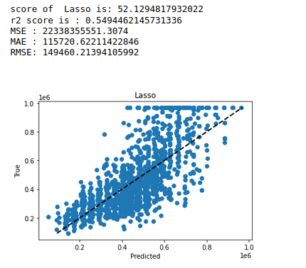

Slide 23

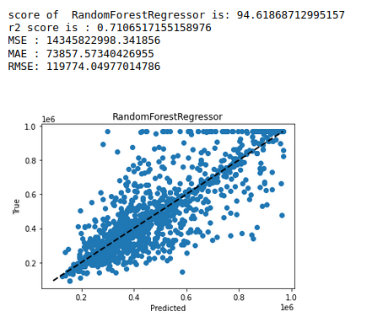

Slide 24
There is a huge difference in the model so we need to pick the best model and we need to performhyperp arameter tuning model to tune the model tuning here I am using hyper parameter tuning for all the models
In hyper parameter tuning we will tune the best model with change of paramters so that we will achieve good results

Slide 25
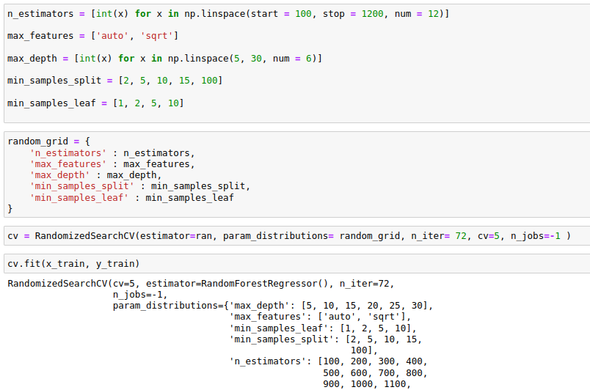

Slide 26
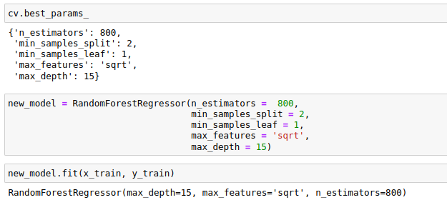

Slide 27
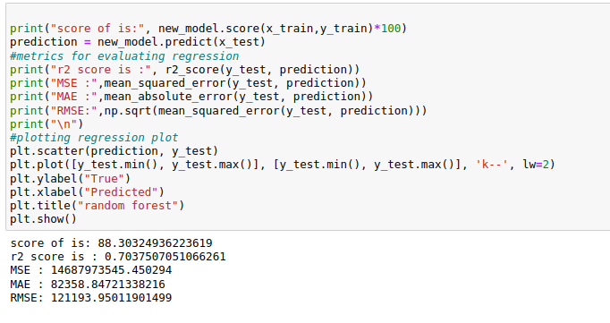
Now fitting the tuned model(Random forest)

Slide 28
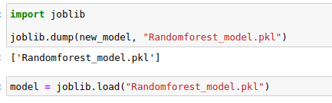
Saving the model
We are going to save the model using a library called joblib with the extension of
.obj or pkl

Slide 29
Conclusion
So after all those steps in the in creating model we have finally achieved an accuracy of percent, and we have saved model for further use, we have tested the model on some metrics like hype parameter tuning etc

