Slide 1
Coursera Capstone Project Opening New Indian Restaurant in Toronto City, Canada
By
Santosh Sawant
06.08.2020

Slide 2

Introduction
Capital city of the Canadian province of Ontario
Most Populous and diverse culture city
Most favored city by immigrants
Major economic activities are executed in Toronto
Higher population from India after China in immigration count

Slide 3
Business Problem
“Using data science methodology and machine learning tools, help investors to select the best locations in the city of Toronto, Canada to open a new Indian Restaurant”

Slide 4
Data and Source of Data
List of neighborhoods in Toronto. This defines the scope of this project which is confined to the city of Toronto in Canada.
Latitude and longitude coordinates of those neighborhoods. This is required in order to plot the map and also to get the venue data.
Venue data, particularly data related to Indian restaurants. We will use this data to perform clustering on the neighborhoods.
Source: Wikipedia page (https://en.wikipedia.org/wiki/List_of_postal_codes_of_Canada:_M)

Slide 5
Methodology
Using web scraping using Python requests and beautifulsoup packages to extract the list of neighborhoods data.
Geographical coordinates in the form of latitude and longitude using Geocoder in order to be able to use Foursquare API.
Populate the data into a pandas Data Frame and then visualize the neighborhoods in a map using Folium package.
Using Foursquare API to get the top 100 venues that are within a radius of 2000 meters.
Analyze each neighborhood by grouping the rows by neighborhood and taking the mean of the frequency of occurrence of each venue category. (Focusing Indian restaurant category)
K-means clustering algorithm to identify cluster based on occurrence of Indian restaurants at neighborhoods.

Slide 6
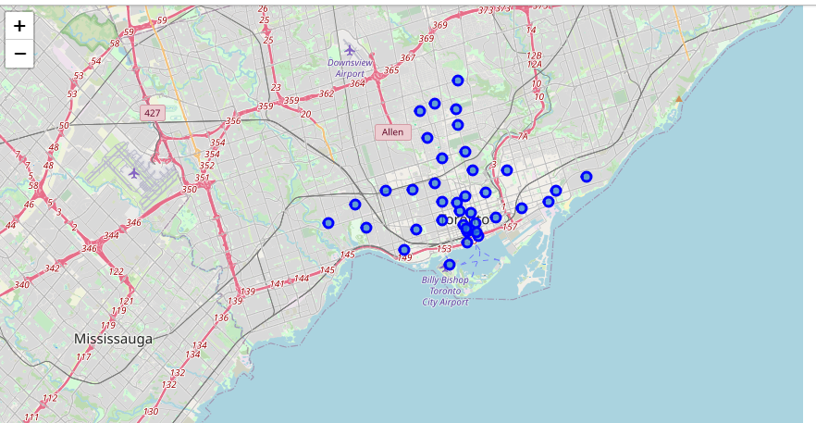
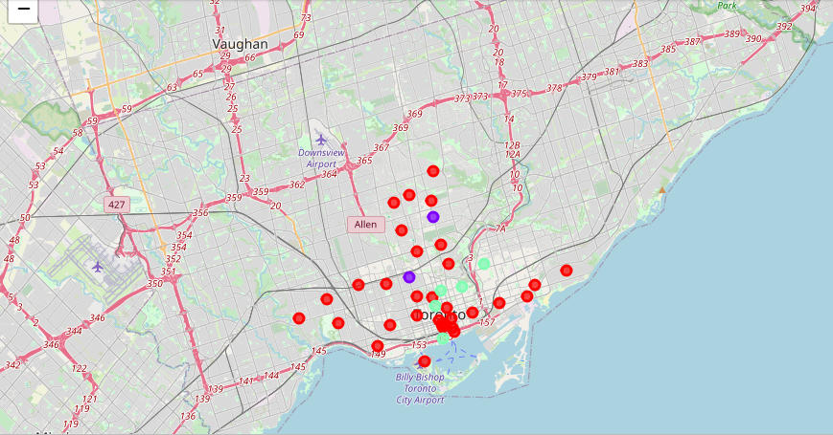
Results
Before Clustering
After Clustering
Cluster 0: Neighborhoods with Zero number of Indian restaurants
Cluster 1: Neighborhoods with moderate number of Indian restaurants
Cluster 2: Neighborhoods with high concentration of Indian restaurants

Slide 7

Conclusion
The neighborhoods in cluster 0 are the most preferred locations to open a new Indian Restaurant. Further decision to identify location in cluster 0 neighborhoods may be based on other factors such as population density of Asian community / income levels of population.
The findings of this project will help the relevant stakeholders to capitalize on the opportunities on high potential locations while avoiding higher competition as in cluster 2.

Slide 8
Thank You

